Slide 1





Create great research posters
Communicating your science message
May 2020

Slide 2


Authors
This slide deck was repurposed from materials originally created for an Infographics training workshop hosted by the UW Water Institute. It was further refined by SWIGS members:
Hillary Quinn-Austin, UW graduate student in Biology & member of the GWF Lake Futures project
Laura Neary, UW PhD student in Biology
Courtney Robichaud, UW PhD student in Biology
Notes:
Start by recognizing Nancy for having provided us with the bulk of the materials for this workshop

Slide 3
Science Poster vs Infographic
Research Impact Poster

Slide 4
Learning Outcomes
Build your ‘research story’
Identify the implications of your research
Identify potential future audiences
Learn how to visualize content and storyboard information
Understand basic design principles of a poster
Become more comfortable using simple software like PowerPoint to create infographics

Slide 5
What are infographics & research posters?
Infographics…
“an infographic is a visualization of data or ideas that conveys complex information in a manner that can be quickly consumed and easily understood”

Slide 6
What are infographics & research posters?
Research impact posters…
Highlight elements of your research most related to its intended impact
Goal: facilitate engagement with end users of your research
Use infographics for quick digestion of the most important points

Slide 7



WHY INFOGRAPHICS & RESEARCH IMPACT POSTERS
Humans process visual content faster than written content
50% of the brain is dedicated to visual processing
65% of the population are visual learners (30% auditory, 5% kinaesthetic)
Readers have limited time to read… need to efficiently share message
Humans process visual content faster than written content
50% of the brain is dedicated to visual processing
65% of the population are visual learners (30% auditory, 5% kinaesthetic)
Readers have limited time to read… need to efficiently share message
Notes:
as opposed to auditory learners ~30% and kinaesthetic learners~5%, therefore the visual nature of infographics caters to a large portion of the population
infographics and research impact posters carefully select content to highlight one or two key messages for a specific audience

Slide 8

CREATING INFOGRAPHICS
DETERMINE YOUR AUDIENCE
DECIPHER KEY MESSAGE
SIMPLIFY THE LANGUAGE
VISUALIZE YOUR KEY MESSAGE
COME UP WITH A LAYOUT
Notes:
Creating infographics
Determine your audience
What do you want viewers to do with your infographic once they view it?
Specifically: is it science or policy, what is their area of expertise within the government?
Decipher your key message
Start by cutting your article down to size. If the abstract doesn't summarise your key points, extract them from the work as short phrases, similar to the bullet lists of “highlights” many journals now ask for. Depending on your research, you may also need to have a phrase you can visualise to summarise the problem you are seeking to solve or the aim of the work, and the methods you used.
What is your audience going to be most interested in knowing?
Is there a provocative fact that can help anchor your infographic to grab their attention?
How will your research help promote change?
Simplify your language
Make sure the words you use are jargon free and instantly understandable
People skim text – remember that
The simpler the language, the more effective the key messaging will be
Visualize your key message
Draw all the images that come to mind as you think about each point, choosing the images that you think communicate the point most powerfully
Put your key words into the Noun Project to get ideas that express your ideas in icons
Talk to someone – Nancy or Allie
Come up with a layout
Draw your layout by hand – decide on the format (landscape vs. portrait)
Make sure you have a flow that the reader can follow
Don’t go crazy with colours – ideally 2-3 should be use (not including font colour) that correlate to your research (ie: blue for water, green for environment, etc.)
Have a call to action
Do you want people to read a paper, visit a website, email you, etc. Add that

Slide 9
YOUR AUDIENCE
Who is going to find your research helpful or valuable?
Be as specific as possible when identifying audience
Which department in the government / company
Think of specific people
RESOURCE TIP
Government staff directories
Federal: http://www.geds.gc.ca
Provincial: http://www.infogo.gov.on.ca
Notes:
Our goal: get our message across which may include changing a behavior (i.e., decisions, processes, attitudes, etc.) because of your research.
To do so, you need to understand your audience, their needs (including WHEN they need info), priorities, preferred language. The more you understand their context, the more you can make your message relevant to them.
What is the mandate of their organization?
What are they currently working on (as it relates to your research)? What challenges and limitations exist that may prevent progress?
Whom do they trust as suppliers of information?
Where do they get information? (their network, media, community, journals, etc.) How do they get information? (word of mouth, printed materials, etc.)
What are their questions for researchers?
How do they perceive that value of your research?

Slide 10
Step 1: IDENTIFY YOUR AUDIENCE
Understand your audience:
What are their current priorities, challenges, research needs, etc.
How does your audience understand and apply information?
Where do they get information? (their network, media, community, journals, etc.)
How do they get information? (word of mouth, printed materials, etc.)
When / timing – when do organizations need info, etc.
What format do they need the info in

Slide 11
Step 2: DECIPHER THE KEY MESSAGE
Step 1 - Outline the goals of your poster
E.g., providing information your target audience wants/needs in a way that is easy for them to understand
Step 2 – Develop content to achieve your goals
The burning problem
The intended impacts of your research
Potential research applications (or anticipated applications)
Notes:
Goals
One of your main goals should be to appeal to your target audience. That means providing information they want/need in a way that is easy for them to understand
Step 2 -Problem
Your audience is trying to gain something from reading your infographic. What is the problem that the audience has in their lives that your infographic is going to solve.
i.e., it is not your theoretical contribution
Frame the problem in their context, not yours. What do they care about?
E.g., “Do fish mercury concentrations in the lake exceed consumption guidelines” as opposed to “What is the level of mercury accumulation in the lake”
Research results. Think about how best to frame the results in a provocative way?
When thinking about your key messages, don’t think of this as a summary of your research.
That might just be one or two key findings that could change the way they are thinking about things
Did your results challenge the status quo? Your poster could describe “Why the Lake Erie phosphorus targets are unlikely to meet the 2025 deadline”. Make sure you offer a solution though!
Create perspective. Example – if you are trying to get people to understand the economic costs of HABs, you might present a list of numbers and facts outlining impact. However, you could compare numbers to the cost of other things we know about to help people digest the true costs and make the information for memorable.
Other notes about content
Research methodology isn’t necessary to include – most stakeholders have minimal interest in how you did your research compared to the results
This is for written communication but it will help you verbally present; translate into your elevator pitch
Not objectives and methodology

Slide 12
THINK ABOUT POTENTIAL RESEARCH APPLICATIONS
Examples:
Policy development (e.g., can your research help policy makers define an appropriate set of targets or actions for the eastern basin of Lake Erie – a goal outline in the Canada-Ontario Action Plan for Lake Erie)
Informing a program (e.g., if you found certain BMPs are more effective, maybe you could point out how the GRCA’s Rural Water Quality Program could be re-evaluated to focus on a different set of BMPs)
A new technology (e.g., did you discover a new process to speed up wastewater treatment)
Inform monitoring (e.g., does your research help improve the way we monitor water quality such as where we should locate monitoring stations)
Communication messages (e.g., do you have information that could help inspire action, such as paying more attention to developing HABs in Lake Ontario?
Discovery (e.g., using drones to detect crop disease)
Notes:
think about how to include information about how your research could apply to the stakeholders coming to the workshop. think about how to include information about how your research could apply to the stakeholders coming to the workshop. For instance, could it be helpful in:
Once you identify the potential research application, this should be a central message in your poster. It should pop out quickly as a key take away for stakeholders

Slide 13
Step 3: SIMPLIFY YOUR LANGUAGE
Use jargon free language
Think about language familiar to your audience
People skim –highlight key messages with headlines and bullets

Slide 14
DESIGNING YOUR POSTER

Slide 15
CREATING INFOGRAPHICS
DETERMINE YOUR AUDIENCE
DECIPHER KEY MESSAGE
SIMPLIFY THE LANGUAGE
VISUALIZE YOUR KEY MESSAGE
COME UP WITH A LAYOUT
Notes:
Creating infographics
Determine your audience
What do you want viewers to do with your infographic once they view it?
Specifically: is it science or policy, what is their area of expertise within the government?
Decipher your key message
Start by cutting your article down to size. If the abstract doesn't summarise your key points, extract them from the work as short phrases, similar to the bullet lists of “highlights” many journals now ask for. Depending on your research, you may also need to have a phrase you can visualise to summarise the problem you are seeking to solve or the aim of the work, and the methods you used.
What is your audience going to be most interested in knowing?
Is there a provocative fact that can help anchor your infographic to grab their attention?
How will your research help promote change?
Simplify your language
Make sure the words you use are jargon free and instantly understandable
People skim text – remember that
The simpler the language, the more effective the key messaging will be
Visualize your key message
Draw all the images that come to mind as you think about each point, choosing the images that you think communicate the point most powerfully
Put your key words into the Noun Project to get ideas that express your ideas in icons
Talk to someone – Nancy or Allie
Come up with a layout
Draw your layout by hand – decide on the format (landscape vs. portrait)
Make sure you have a flow that the reader can follow
Don’t go crazy with colours – ideally 2-3 should be use (not including font colour) that correlate to your research (ie: blue for water, green for environment, etc.)
Have a call to action
Do you want people to read a paper, visit a website, email you, etc. Add that

Slide 16
Eye catching imagery
Limited text with simple language
Colour palette
green, blue, orange and brown
Simple figures
Geographic context

Slide 17








Step 4: Visualize Your Key Message
Key Message
Points
Key Visuals

Slide 18
Visualize Using Icons
PowerPoint has icons
There are free icons online: Noun Project
Make custom icons in PowerPoint
https://www.youtube.com/watch?v=bHSnZ-t4SgY

Slide 19
How to visualize key messages
Statistical
Timeline
Process
Geographic
Comparison
List

Slide 20
Step 5: Come Up With A Layout
Key Components
Title
Burning problem / Current Landscape
Your research outcome
Applications of your research
Avoid:
Methods
Jargon
Lots of references (except images)

Slide 21
Step 5: Come Up With A Layout
Storyboard!
Think about flow for reader
Choose a colour palette – ideally 2-3
Choose fonts
Leave white space, don’t squish

Slide 22
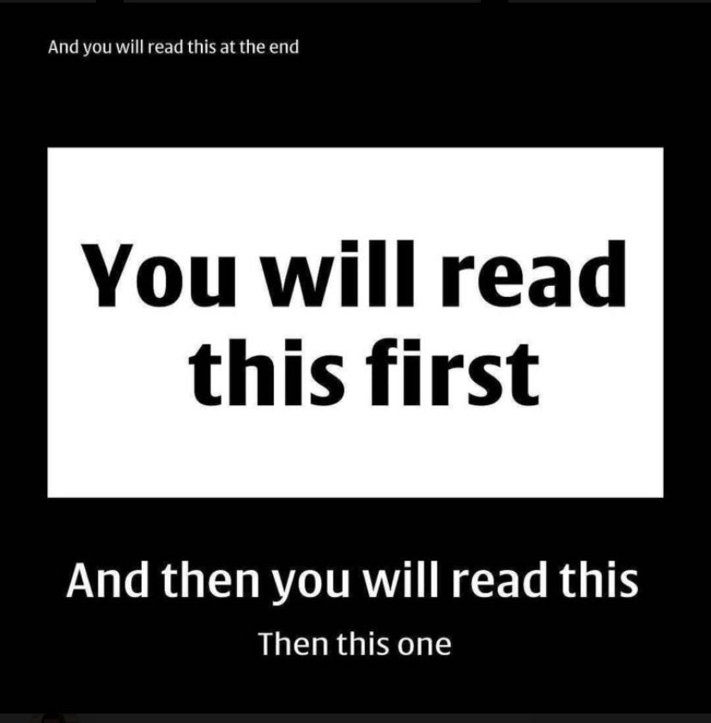

Slide 23
Colour Palettes
Coolors
Color Hunt
PANTONE
60-30-10 Rule

Slide 24
Software
Consider using PowerPoint
You don’t need fancy software like Adobe InDesign
It is easy-to-use and intuitive
Others:
Canva
Figma
BioRender
Visme
Venngage
Easel.ly

Slide 25
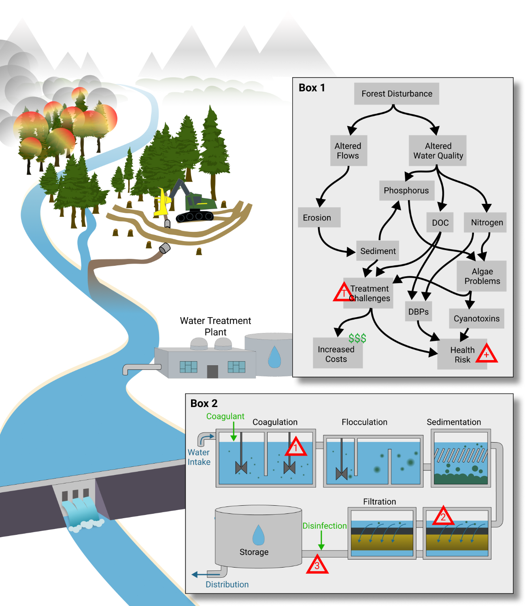
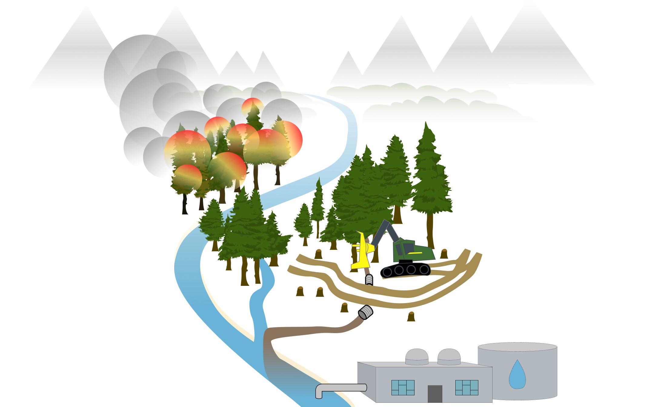
These graphics were made in Figma
Image Credits: Tyler Hampton

Slide 26
Infographic Layouts
Notes:
For some of you who are there, nailed content. Looking for creative presentation
But whats most important is to get the right content out
Here are additional examples
Inspiration not guidelines
Guidelines were above
Also examples – once research is complete, how to tell story.
Dec 5 – likely don’t have time to get this far

Slide 27
TYPES OF INFOGRAPHICS - STATISTICAL

Slide 28
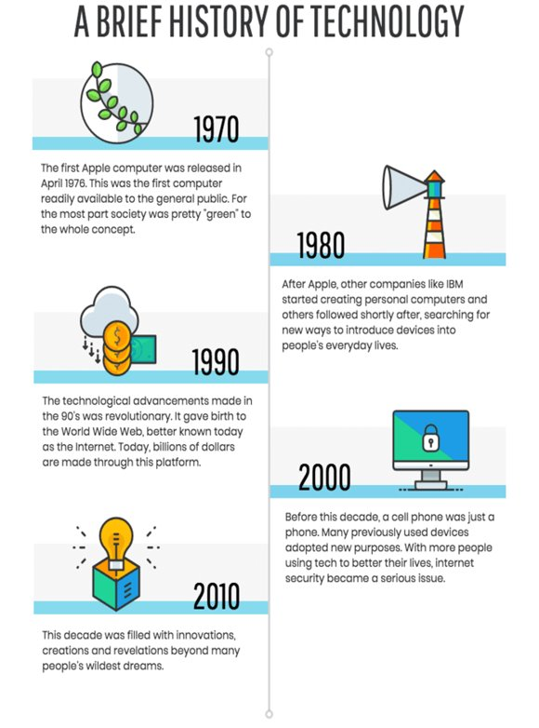
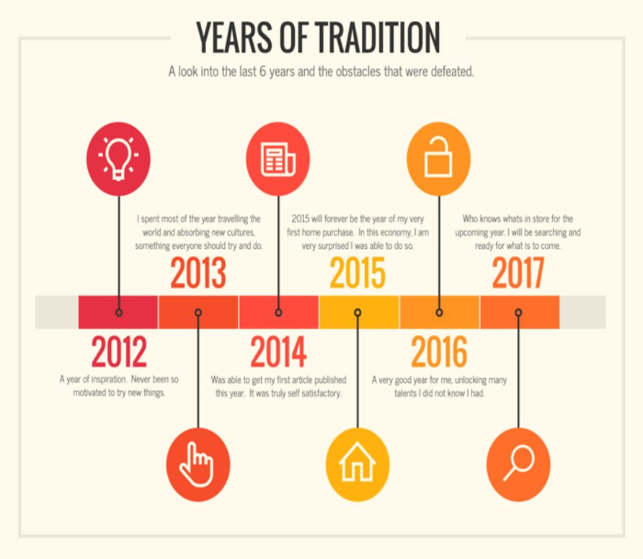
TYPES OF INFOGRAPHICS - TIMELINE

Slide 29
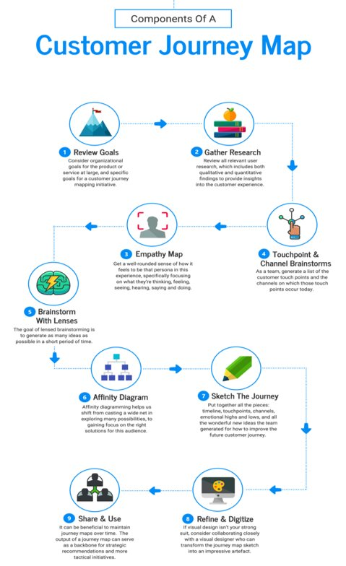
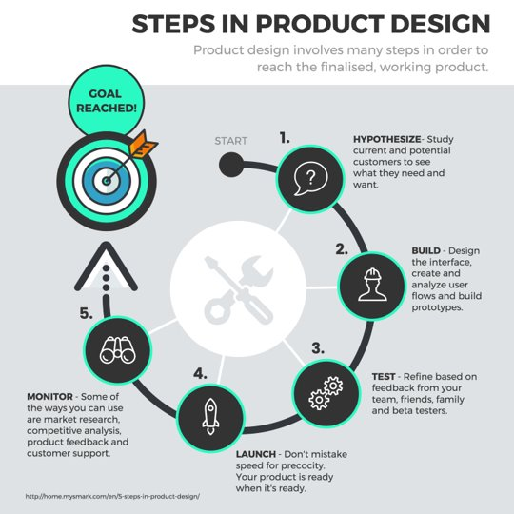
TYPES OF INFOGRAPHICS - PROCESS

Slide 30
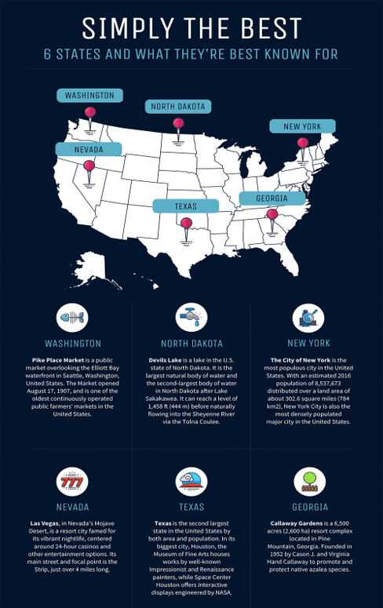
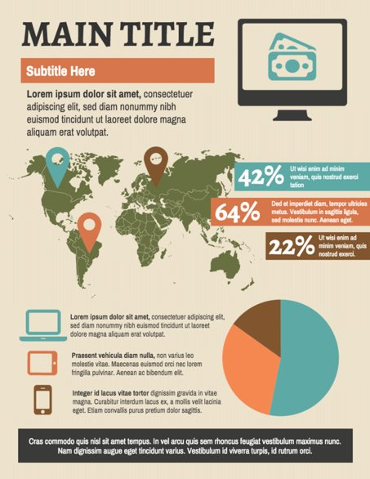
TYPES OF INFOGRAPHICS - GEOGRAPHIC

Slide 31
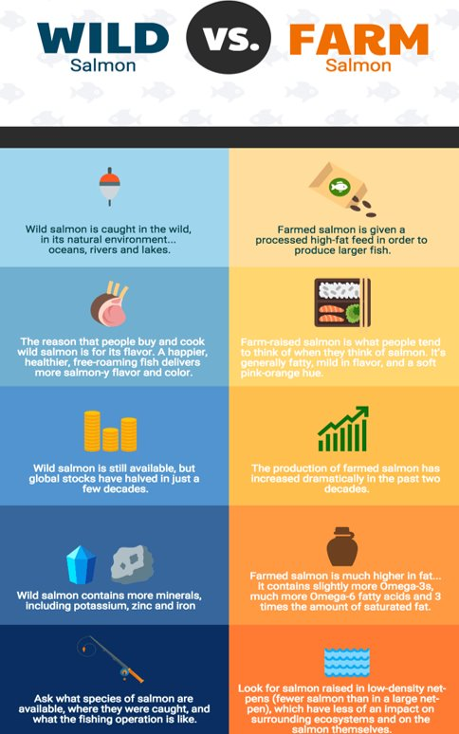
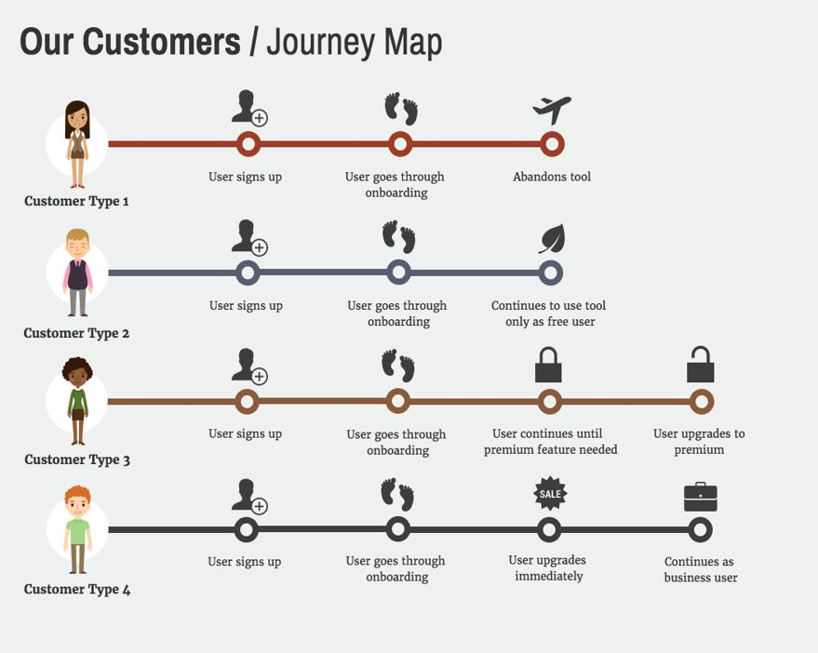
TYPES OF INFOGRAPHICS - COMPARISON

Slide 32
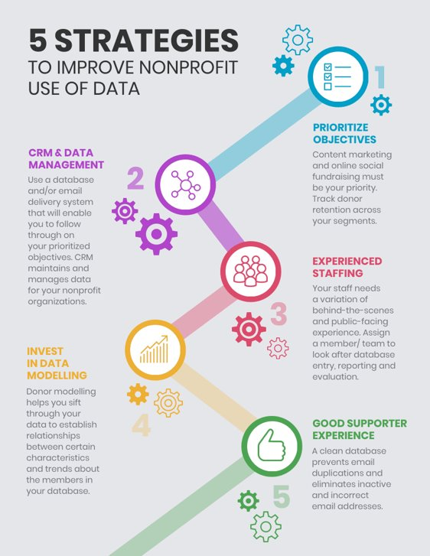
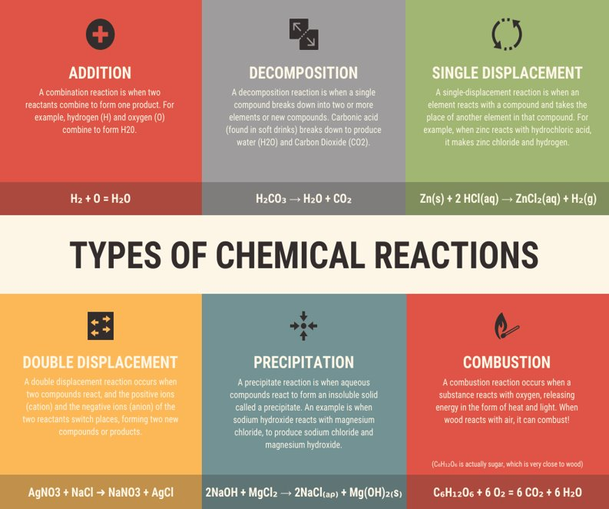
TYPES OF INFOGRAPHICS - LIST

Slide 33


FIND OUT MORE
uwaterloo.ca

