Slide 1
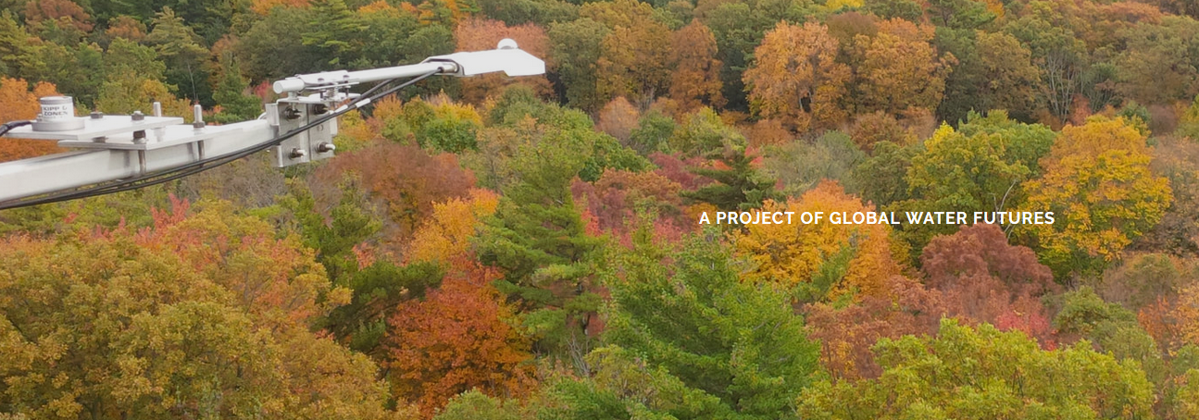
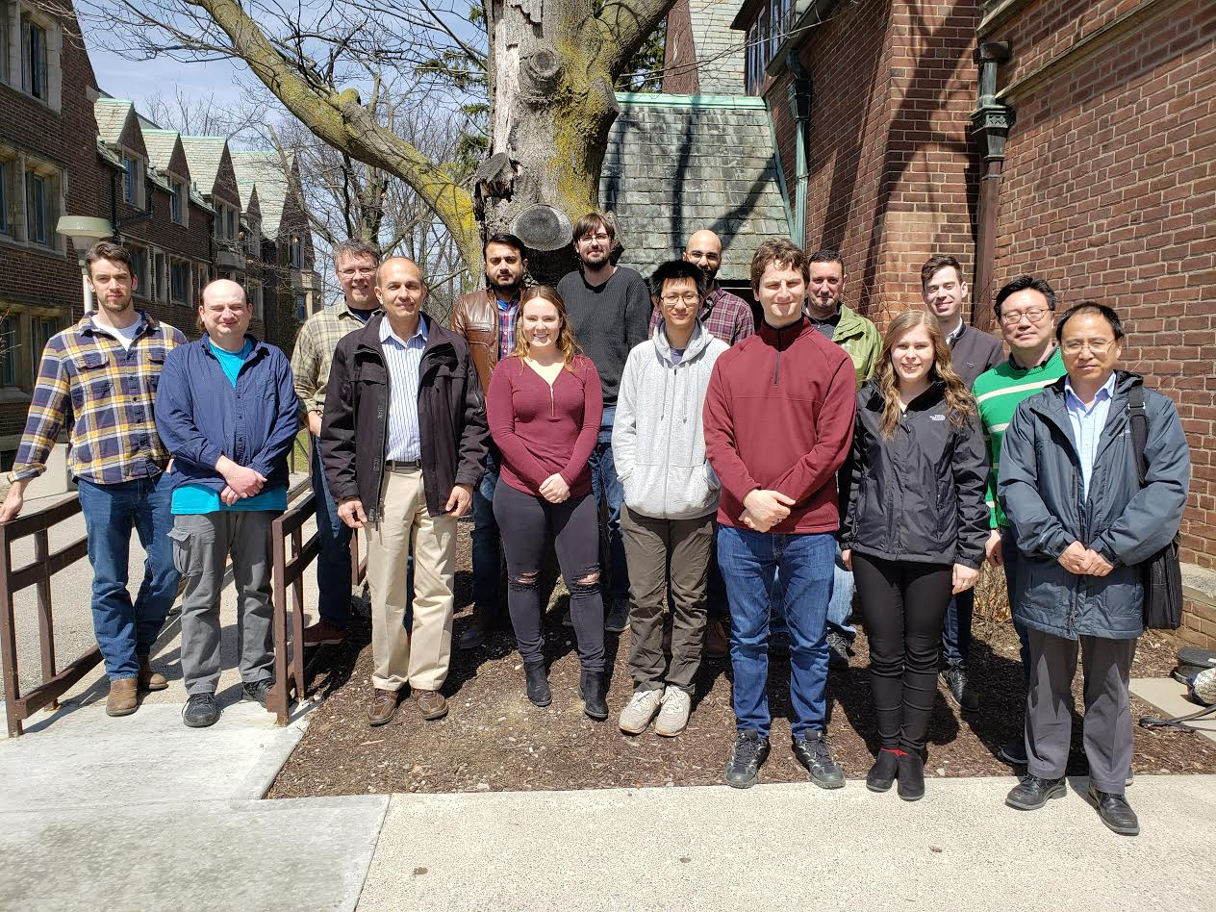
Southern Forests Water Futures
PI: M. Altaf Arain, McMaster University
Email: arainm@mcmaster.ca
Project Introduction:
Project strives to integrate eddy covariance flux, forest inventory, tree ring, stable isotope and ground and airborne remote sensing data to improve our understanding of eco-hydrological processes in southern managed forest ecosystems.
Website: http://www.southernforestswaterfuture.ca/
To explore how the water and carbon budgets of southeastern Canadian forests will respond to future climate change, extreme events and management or disturbance activities.
To develop management strategies that can enhance water use efficiency and sustainable development of water resources in these forests.
Develop the next-generation of processes-based integrated eco-hydrological models to enhance our predictive capabilities in cold regions
GWF-SFWF Team Members
Project coordinates: PI, email, website, etc
GWF Operations Meeting, Hamilton, 19-20 November 2019
Notes:
It can help to frame your main research objective as a question. For example,
How will climate change affect agriculture in Canada?
How can we improve water quality and reduce algal blooms in Canadian lakes?
What are the links between fish health, food safety and food security in the Indigenous North?
What is the significance of groundwater fluxes on surface water flow?

Slide 2
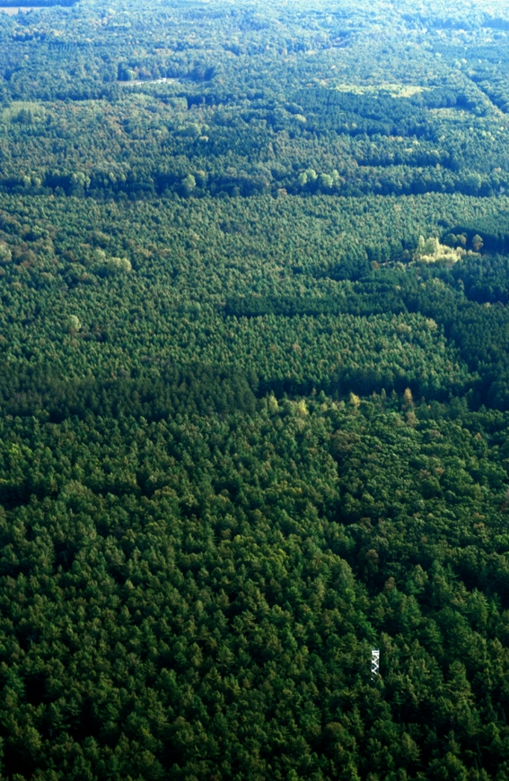
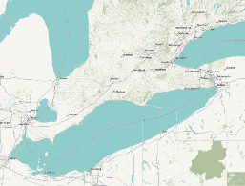
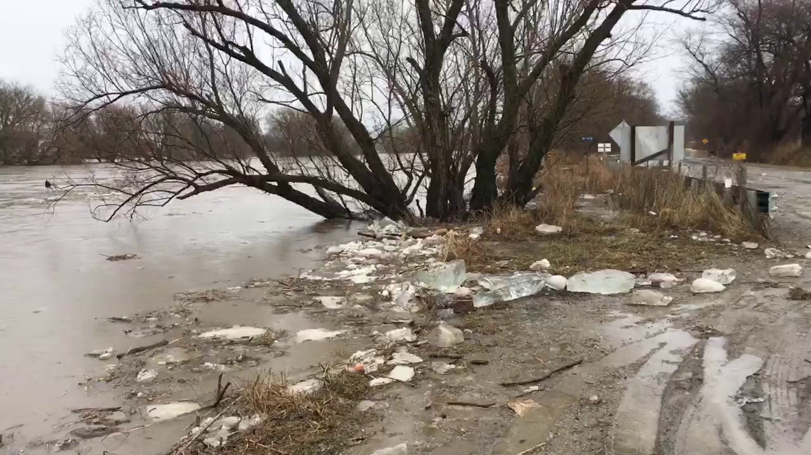
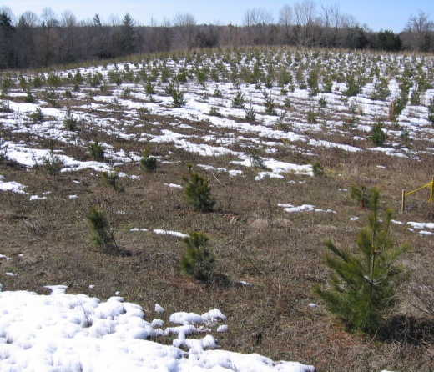
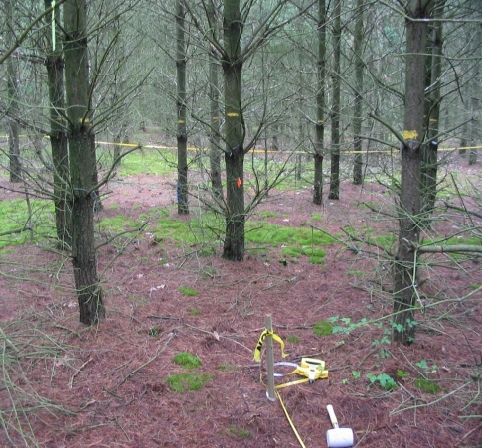
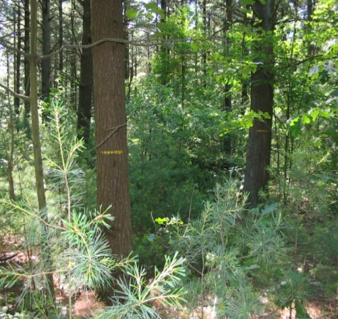
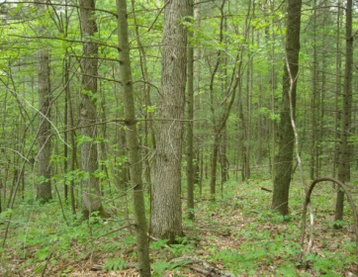
Turkey Point Observatory CA-TP1, CA-TP2, CA-TP3, CA-TP4, CA-TPD Sites
-Turkey Point Flux Station
(42° 42’ 55’’ N, 80° 22’ 20’’ W)
about 20 km southwest of Port Dover,
near Lake Erie in Southern Ontario.
White Pine Plantation Age-sequence
(17, 45, 80 years old);
Carolinian forest, 90 year old
All four sites within 20 km radius
79-yr Pine site tower
Deciduous Forest
CA-TP1
CA-TP3
CA-TP4
CA-TPD
2004 photo
‘17-year-old’ - TP02
‘45-year-old’ – TP74
‘80-year-old’ – TP39
‘90-year-old’ – TPD
Southern Forests Water Futures

Slide 3
Net Ecosystem Productivity (NEP) & Evapotranspiration (ET) at 80-year old site from 2003-2018
Wet in 2006, 2008,
2011, 2013, 2014, 2018
Heat Stress in
2005, 2012, 2016, 2018
Heat and/or Droughts
in 2005, 2007, 2012, 2016
High PPT in 2006, 2008, 2011, 2013, 2014, 2018
Cool in 2003,
2004, 2008, 2009
Summer Drought in
2005, 2007, 2012, 2016
Southern Forests Water Futures

Slide 4
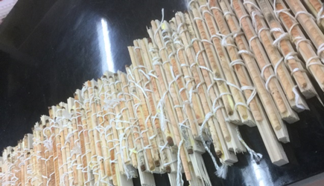
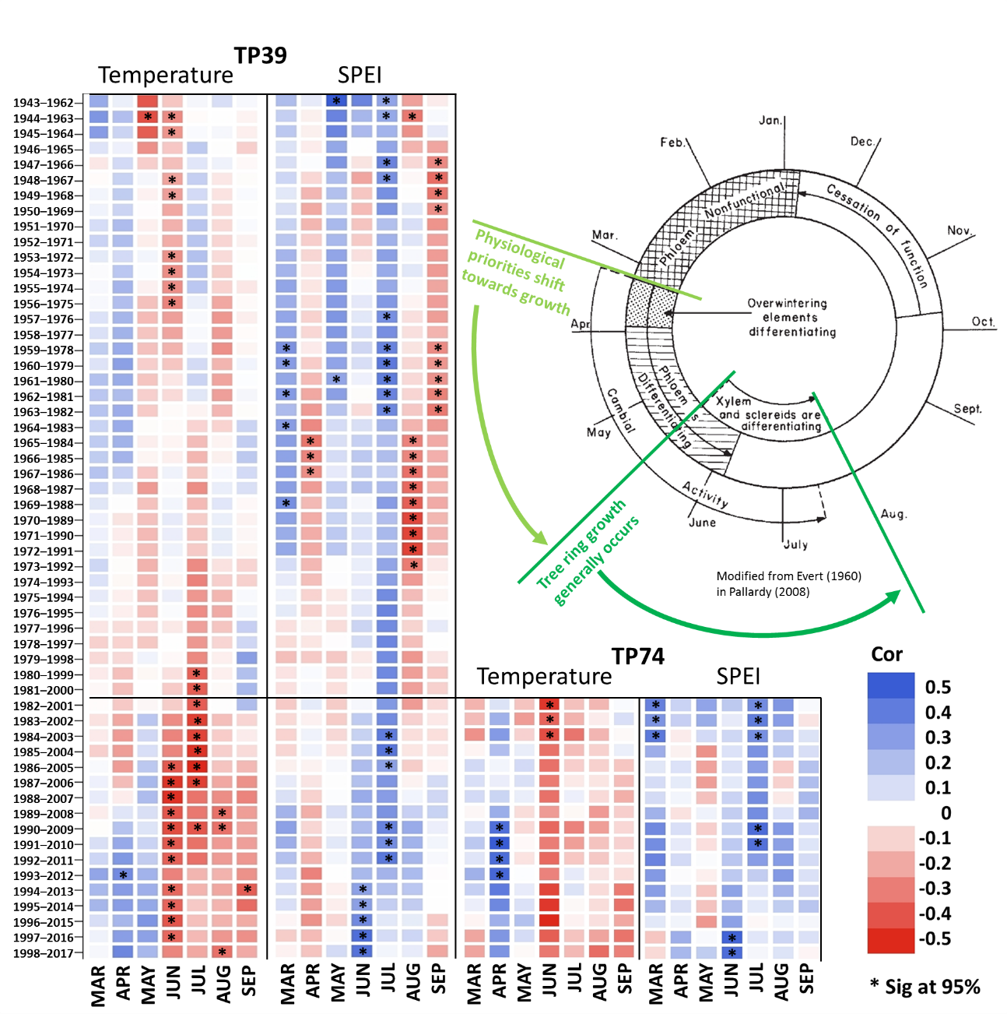
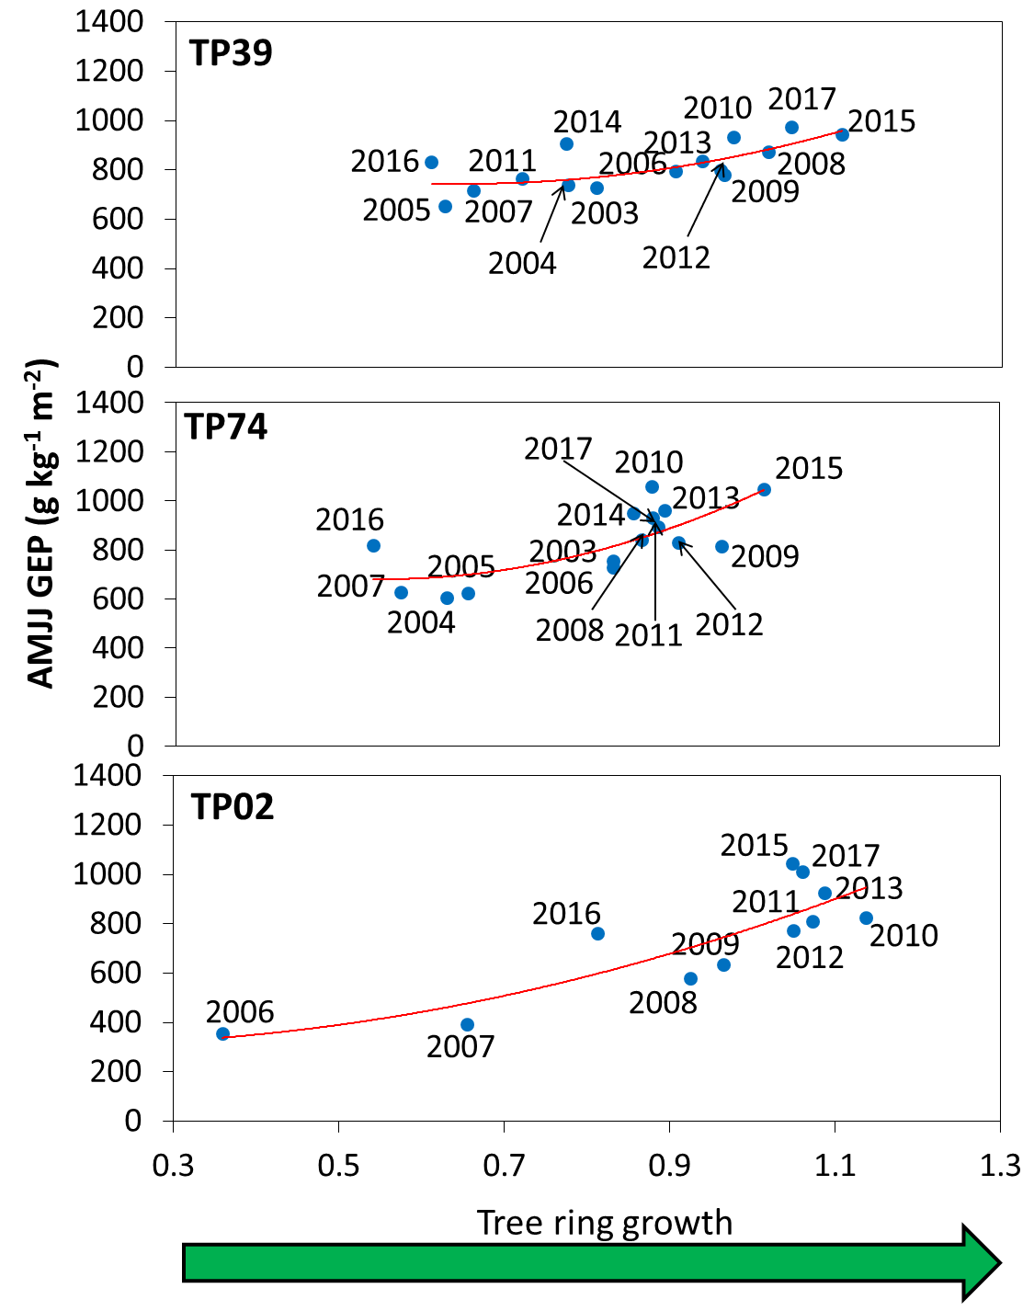
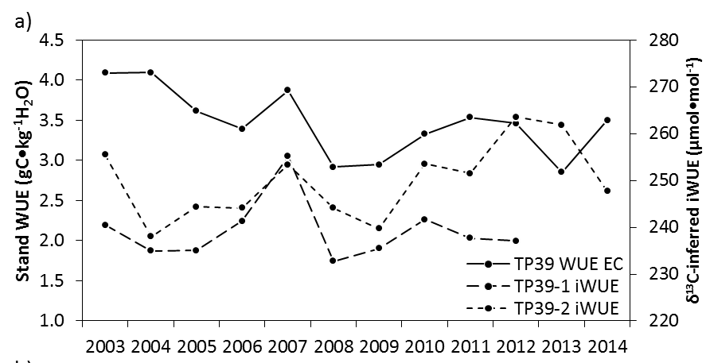
Heat Stress and Growth in Southern Forests EC Fluxes, Dendrochronology and Stable Isotopic Studies
McKenzie S.M., Slater G., Kim S-T., Pisaric M.F.J., Arain M.A., 2018. Influence of seasonal temperature on tree-ring δ13C in different-aged temperate pine forests. Forest Ecology and Management, 419-420: 197–205.
Southern Forests Water Futures

Slide 5
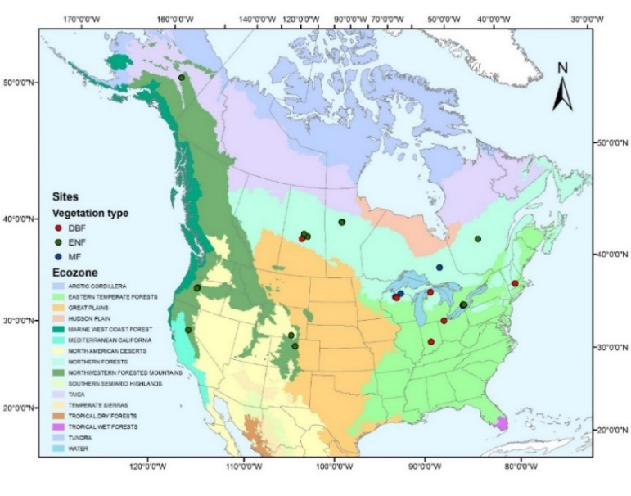
Forest Sensitivity to Heat and Drought Stresses: A Synthesis for North American Forest Ecosystems
29 sites with 301 site years of data
Classification & Regression Tree (CART) analysis
Heat stress – TA (g C m-2 d-1°C-1) sensitivity <0
Drought stress – EF (g C m⁻² d⁻¹) sensitivity >0
Significance at p< 0.01 (solid lines) and 0.01 < p < 0.05 (dashed lines)
High Productivity sites are more sensitive to heat and drought stress.
Managed forests are more sensitive to heat and drought stress.
Xu B., Arain M.A., Black T.A., Law B.E., Pastorello G.Z., Chu H., 2019. Seasonal variability of forest sensitivity to heat and drought stresses: a synthesis based on carbon fluxes from North American forest ecosystems. Global Change Biology, 2019;00:1–18.
Southern Forests Water Futures

Slide 6
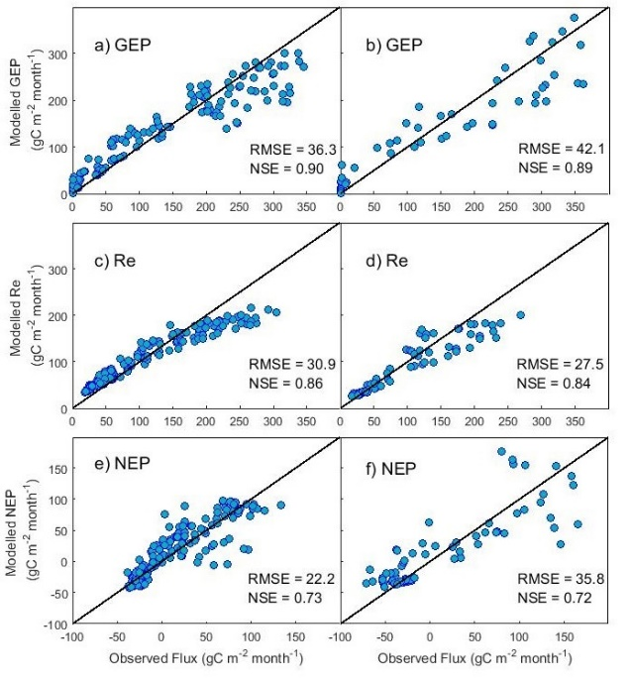
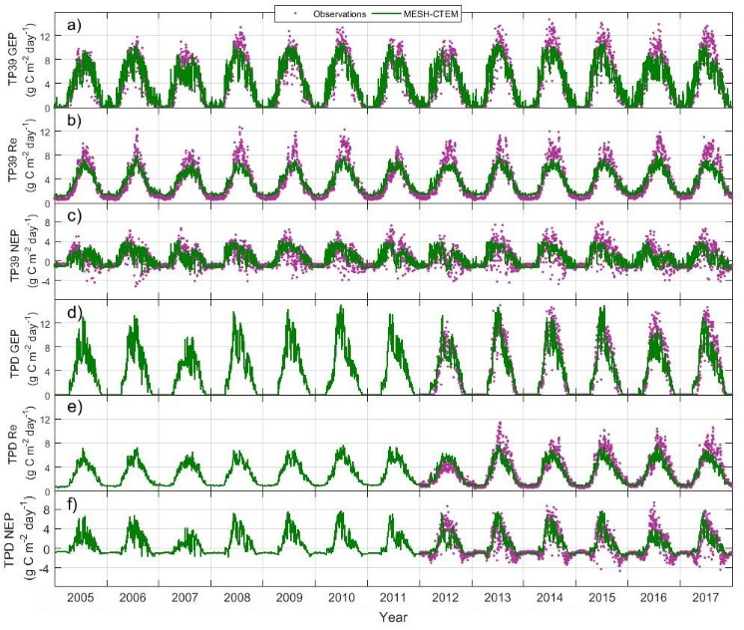
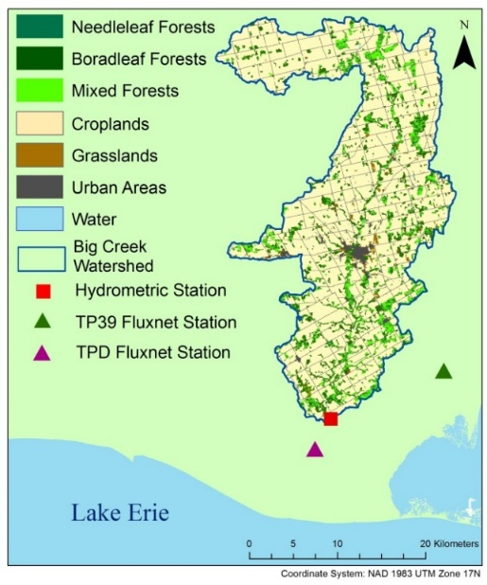
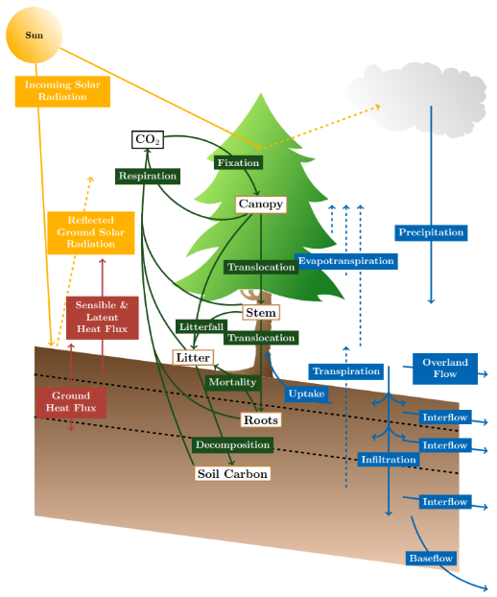
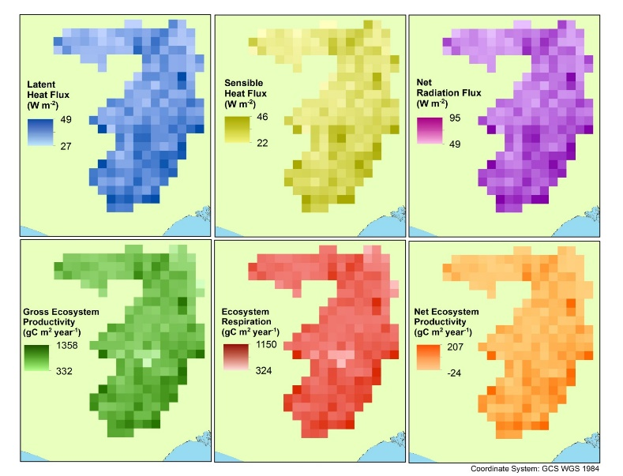
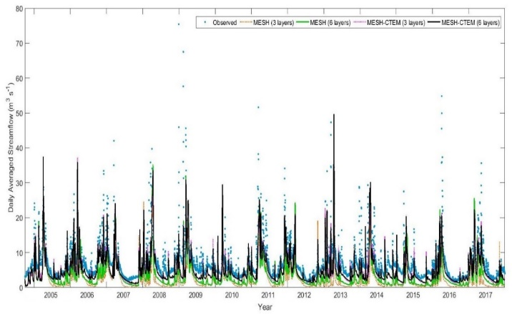
Integrated Eco-hydrological Modelling System (MESH-CTEM) Provides Cross-project Collaboration Opportunities
Integration of MESH and CLASS-CTEM-N⁺ models
Simulations over Big Creek Watershed in Ontario (2004–2017)
Streamflow
Sauer S., Arain M.A., Davison B., Princz D., Bartlett P., Melton J.R., Pietroniro A., 2019. An integrated biogeochemical and hydrological modelling system - MESH-CTEM. Ecological Modelling (in preparation)
Southern Forests Water Futures

Slide 7
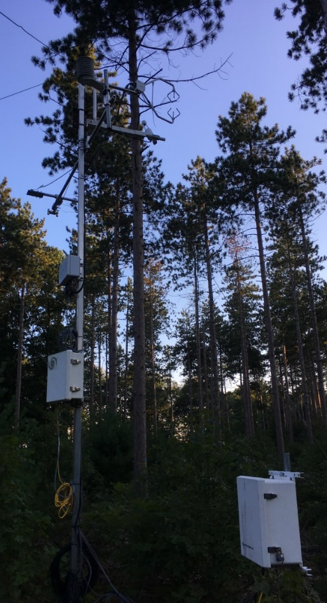
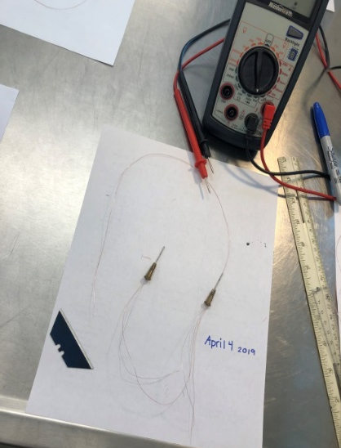
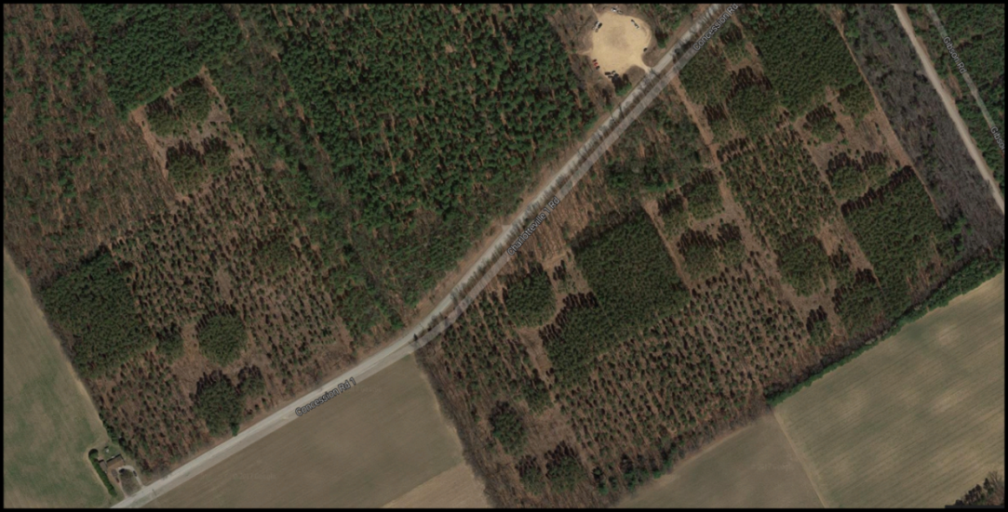
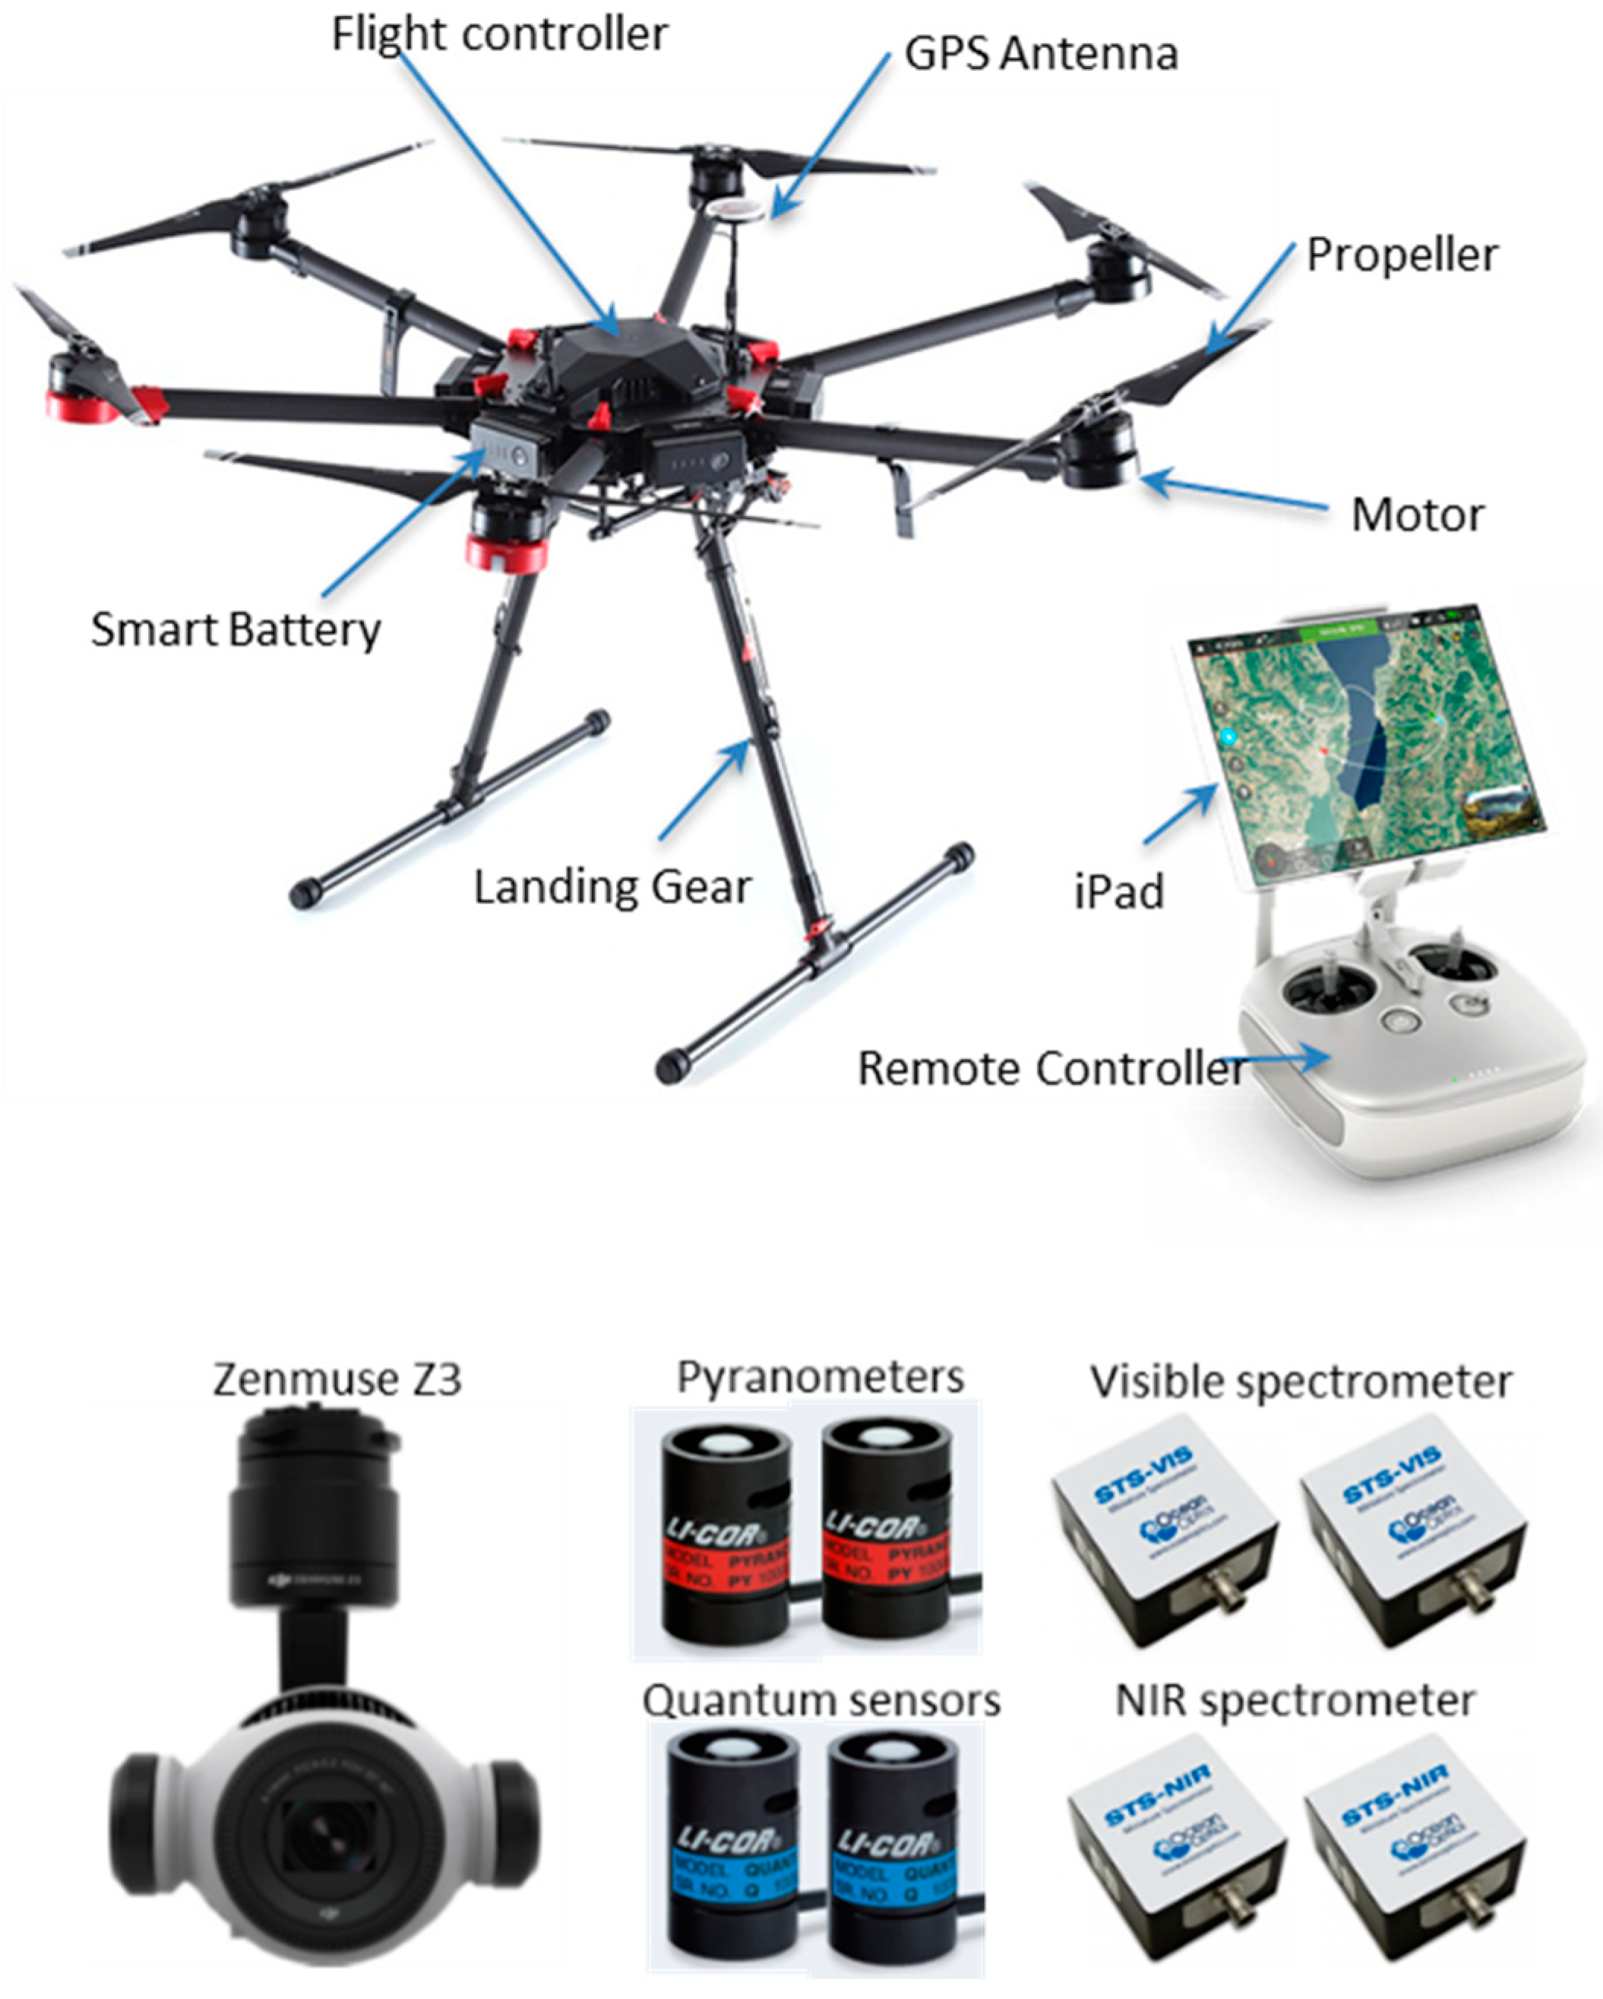
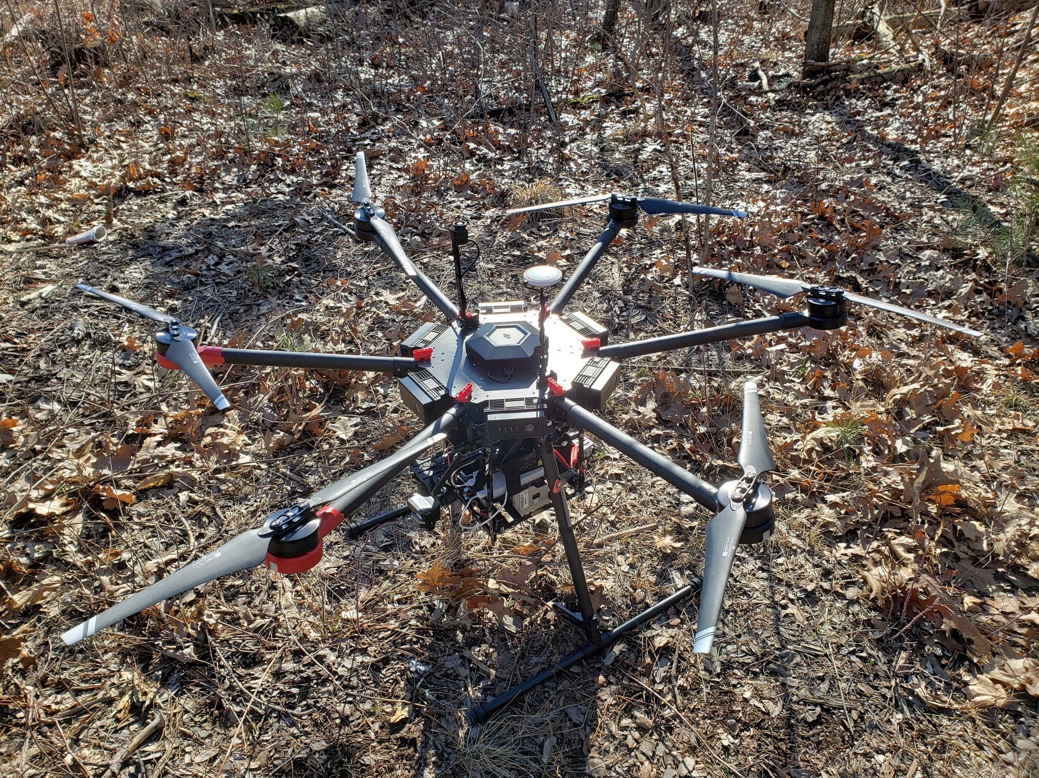
Forest Management Experimental Studies - Aspirations to Provide Solutions?
Moderate thinning (55%) at uniform density promotes the highest sapflux and growth.
(1) Explore controls on timing and magnitude of transpiration including after snow-melt.
(2) Water use between native eastern white pine and non-native red pine plantations.
Remote Sensing Studies in Collaboration with NRCan-CCRS
19 March 2019
(William Parker, Ken Elliott, and Steve Williams, OMNR Researchers)
Southern Forests Water Futures

