Slide 1


Water Futures for the World We Want

Slide 2
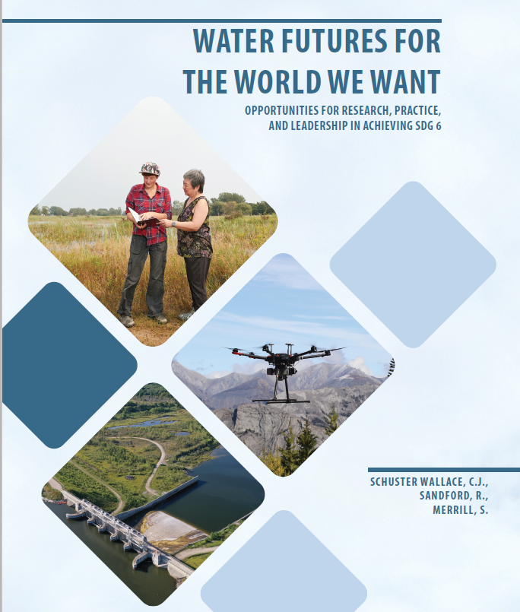
the Report
Water in the World
Water in Canada
Challenges for Achieving Water-related SDGs
Rising to the Challenge
Foundations for a Path forward
Notes:
Hello Everyone,
We are thrilled to be able to present this report at the third annual Global Water Futures Operations meeting. It would not have been possible without all of the research represented by the people in this room. It is a synthesis of Canadian and United Nations documents, a critical appraisal of where Canada is in terms of water sustainability and water research and a pathway forward for research, practice, and leadership. Special thanks to Stephanie, Mark, Morgan, Jesse, and the core data team.

Slide 3
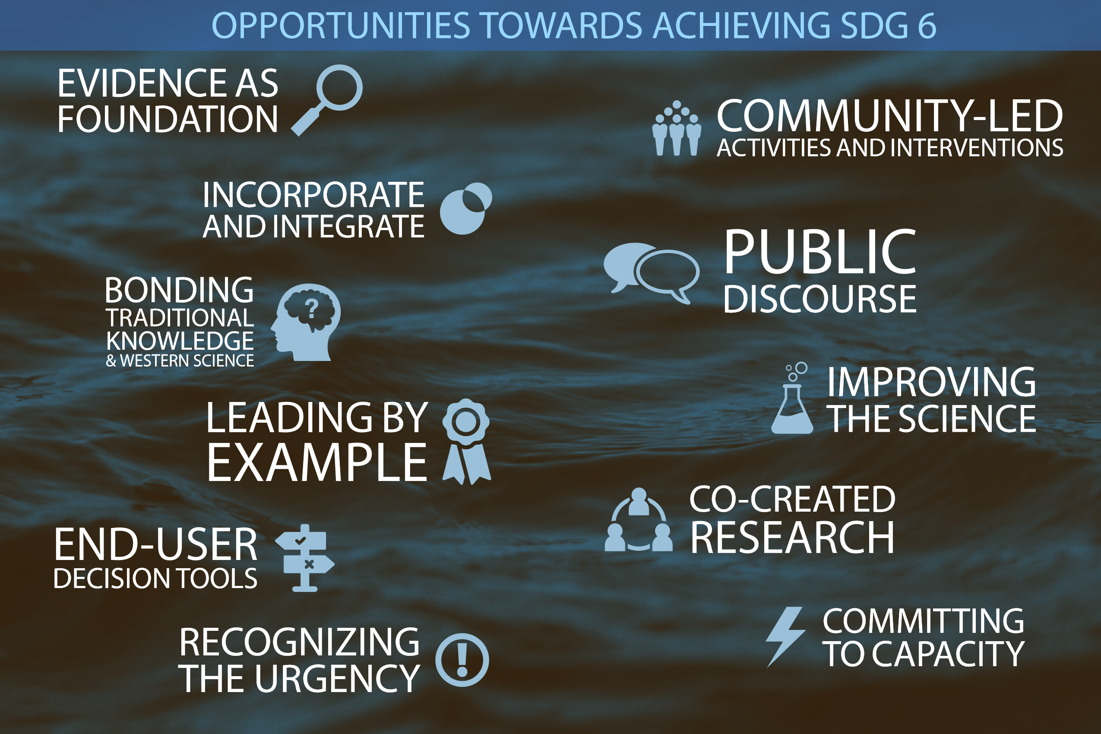
KEY MESSAGES
Notes:
In contrast to recent decisions by the Trump Administration, we strongly believe that evidence must inform decision-making.
We must incorporate and integrate different types of data, from social to environmental, to health, to economic data in order to truly understand risks and tradeoffs
We must find ways to bond or braid traditional knowledge and western science, co-create research with communities, organisations, governments and other stakeholders, and develop tools to support their decision-making processes and identify risks
We need to improve the science, enhance capacity, and commit to public discourse.
Ultimately, we need to lead by example and recognise the urgency of changing what we do and how we do it.
Strengthening Transparency in Regulatory Science: Trump administration significantly limited the scientific and medical research that the government can use to determine public health regulations

Slide 4
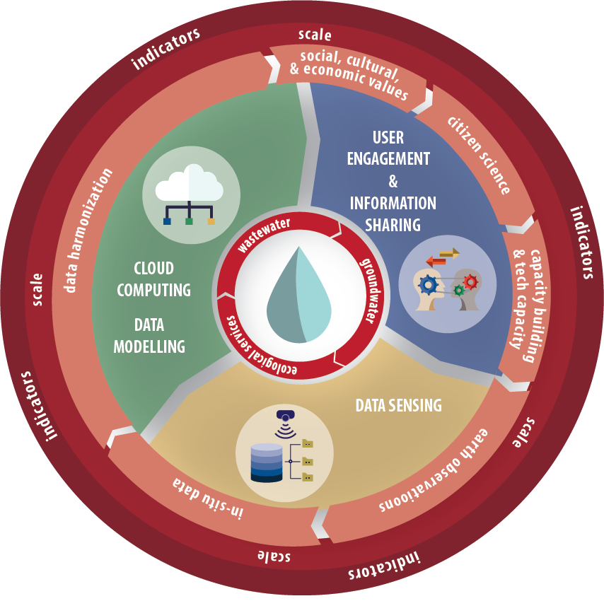
RESEARCH GAPS
Notes:
For researchers, there are clear gaps at national and international levels. These include improving our understanding and tools for assessing and monitoring groundwater, ecosystem services, and wastewater – particularly the emerging contaminants that are difficult to remove.
We need to continue investing in citizen science and earth observation technologies; we need to look at water beyond its physical properties to the social, cultural, economic and health considerations
A critical challenge is data harmonisation, across scales, geographies, and data types.

Slide 5
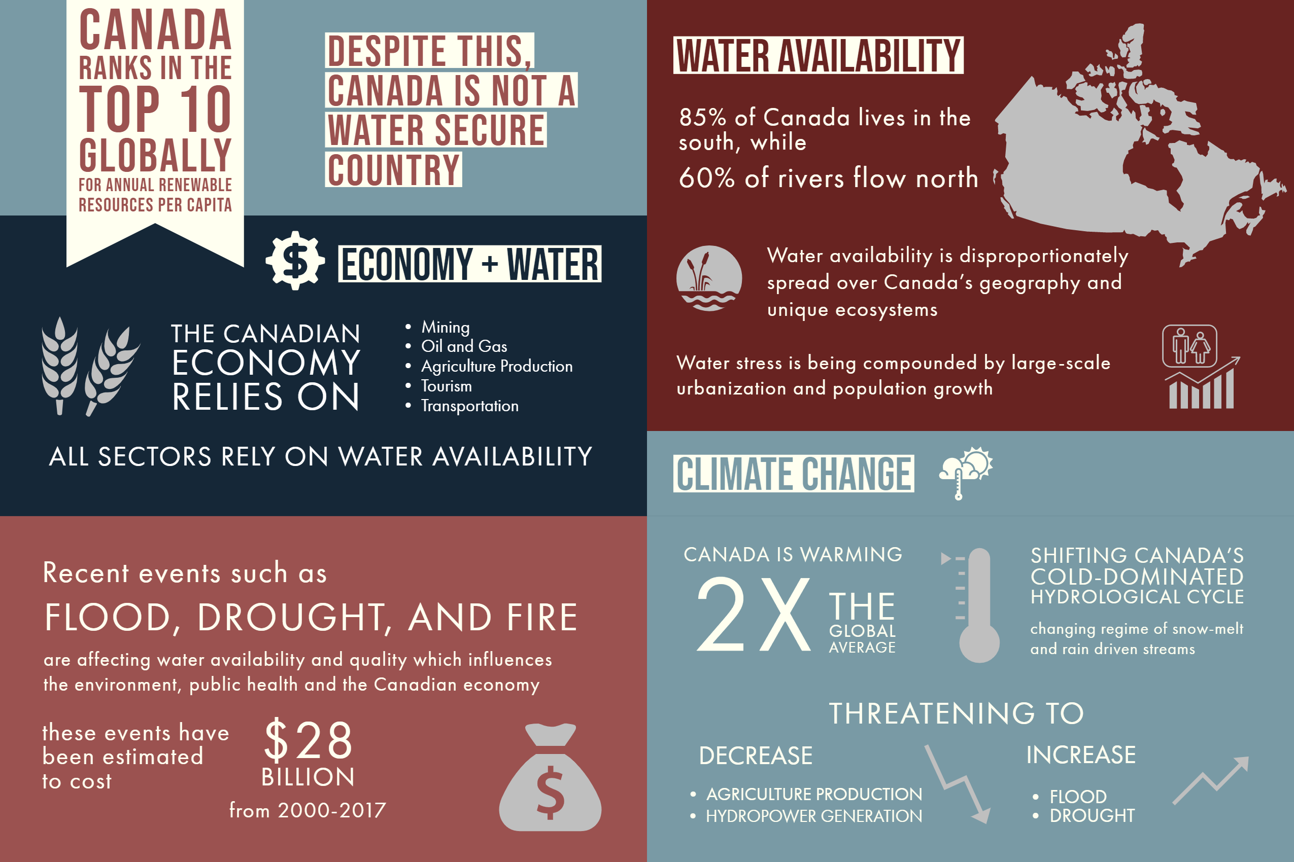
Water in Canada
Notes:
Why is this so important? Despite perceptions of being a water rich country, we face challenges that threaten our water security and our ability to achieve the water goal. Our economy relies on water; water flows away from where the majority of people live; the water quality in some of our lakes, rivers, and streams is degrading over time and some of our river basins are already water stressed, with water demands outstripping supplies in some years in for example the South Saskatchewan.
Climate change is exacerbating some of these problems, ripening conditions for droughts, floods, and wildfires, threatening water dominated economic sectors in some regions, such as agriculture.
How far are we willing to travel down this path?

Slide 6
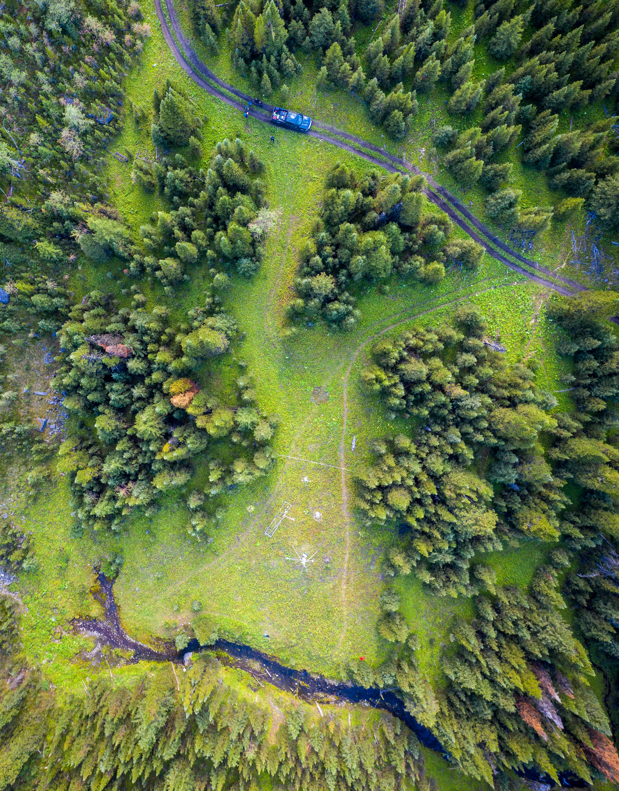
Where Can We Start?
Creating a national water centre
Committing to water sustainability as individuals, communities, institutions & governments
Creating, supporting & sharing strategic research
Finding room for co-created Indigenous leadership
Notes:
The government needs to support and facilitate this. The federal commitment to a national water center is a solid first step, as is the development of a national flood warning system being led by ECCC supported by research from GWF. To say that we cannot afford to is a false economy. How much do we have to pay out as a society before we start proactively reducing costs and damages? How much do Canadians have to lose? We must also focus on reconciliation. Water governance must include Indigenous leadership and we must invest in effective and appropriate water and wastewater solutions, especially on First Nation reserves if we are to truly "leave no one behind" in Canada's achieve to of SDG 6. Eradication drinking water advisories is a great first step, but it must go beyond this. We hope that the recommendations in this report help researchers, academic institutions, communities, and governments focus on what else needs to be done to make Canada's water sustainable.

Slide 7
www.gwf.USASK.Ca/SDGREPORT

