Slide 1
Global Water Citizenship (GWC): Integrating Networked Citizens, Scientists, and Local Decision Makers
A Pillar 2 Project: Developing Big Data and Decision Support Systems
There is wide agreement on the need to engage citizens in environmental monitoring especially in regions of rapid climate change. There is a need to develop new tools, frameworks, and approaches for integrating community-based and citizen approaches with science data, models, and knowledge.
Objectives:
Build a national inventory of citizen science projects for water resources
Develop new tools to reduce barriers to use of citizen science/community-based observation data
Develop approaches to maximize use of GWF information products by vulnerable communities and citizens
Expand participation and improve knowledge of documenting environmental change in Canada’s cold regions
Project contact information: Dr. Colin Robertson (on parental leave this term)
crobertson@wlu.ca
Project coordinates: PI, email, website, etc
Global Water Citizenship (GWC): Integrating Networked Citizens, Scientists, and Local Decision Makers
Notes:
It can help to frame your main research objective as a question. For example,
How will climate change affect agriculture in Canada?
How can we improve water quality and reduce algal blooms in Canadian lakes?
What are the links between fish health, food safety and food security in the Indigenous North?
What is the significance of groundwater fluxes on surface water flow?

Slide 2
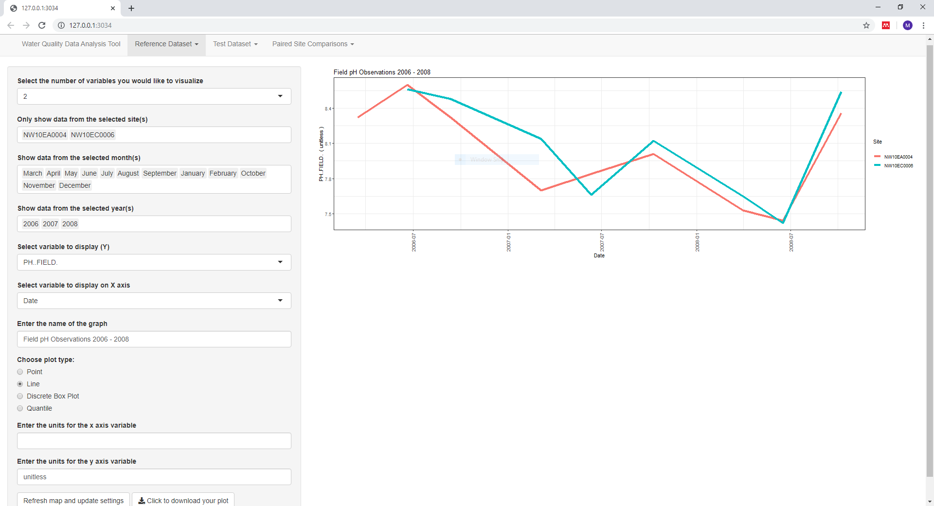
Community-based water quality monitoring (obj. 1)
Problem: Community-based water quality monitoring (CBWQM) initiatives occur across a range of scales. Engagement is needed to identify barriers, to develop best practices, and to support wider participation and initiative sustainability
Approach: Apply the development of a prototype water quality data analysis tool as a research medium to guide discussions with the CBWQM community
Findings: Barriers to CBWQM include a lack of inter- and intra-initiative consistency in data collection and interpretation; heterogeneous priorities and protocols entail robust, dynamic open source analysis tools; the R/Shiny platform can be effectively leveraged to address barriers and bridge gaps; the prototype effectively catalyzed discussions
Outcomes: Prototype well received, meriting ongoing development to further address barriers and to implement survey respondents’ requests
Online data quality assessment tool (beta)
URL: https://annietemp.shinyapps.io/v2_1/
Gray, A. & Robertson, C. In Prep. Investigating Barriers to Community-Based Water Quality Monitoring through the use of a web-based data analysis tool
Project Title
Global Water Citizenship (GWC): Integrating Networked Citizens, Scientists, and Local Decision Makers
Notes:
These accomplishments slides will be also be used to build slide bank for use in GWF presentations
How are these results key to advancing the science
How are these results linked to the needs of your partners/users?

Slide 3
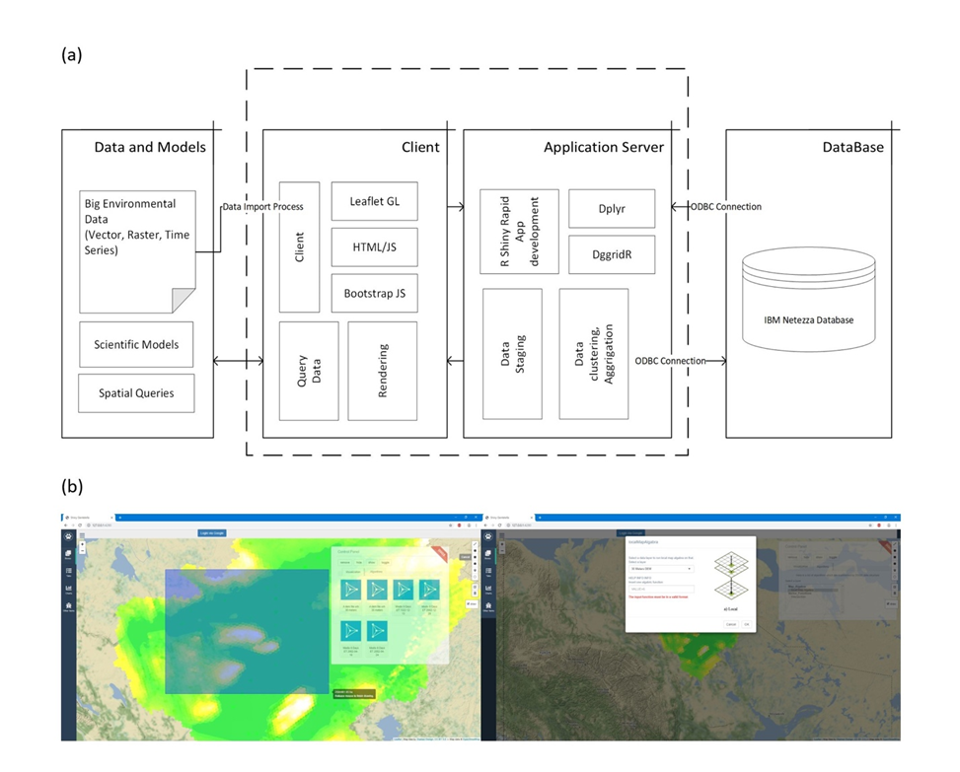
Developing new data models for science-community data fusion (obj.2)
Problem: CBM data rarely integrated with science data; science data not in formats readily useable to many communities. Need for new data models capable of broadscale data fusion.
Approach: Developed a new data model and analytics system to create an operational DGGS-based GIS which is suitable for large scale modelling and analysis
Findings: System outperforms standard geometry data models and can integrate a wide variety of spatial data formats
Outcomes:
New software platform for large-scale spatial data integration and analysis
Robertson C., Chaudhuri C., Hotati M. Roberts S. (Under Review). Big IDEAS: Integrated discrete environmental analytics system (IDEAS), a big data DGGS-based analytics platform for geospatial analysis and modelling.
Bondaruk, Ben, Steven Roberts, and Colin Robertson. “Discrete Global Grid Systems: Operational Capability of the Current State of the Art.” In Proceedings of the Conference on Spatial Knowledge and Information - Canada, 7(6):1. Banff, AB, 2019.
Project Title
Global Water Citizenship (GWC): Integrating Networked Citizens, Scientists, and Local Decision Makers
Notes:
These accomplishments slides will be also be used to build slide bank for use in GWF presentations
How are these results key to advancing the science
How are these results linked to the needs of your partners/users?

Slide 4
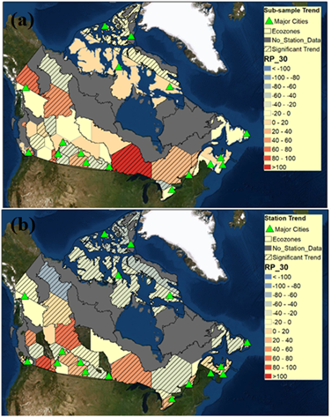
Integrating knowledge on precipitation extremes in Canada (obj. 2)
Problem: Trends in precipitation extremes hard to discern with gridded data in areas of low station density. Spatial correlation is induced through interpolation methods which limit information available for adaptive planning in remote communities.
Approach: Examine trends in annual one-day maximum precipitation using a novel spatial pooling method and within a generalized extreme value theory framework.
Findings: The quantiles of the annual maximum precipitation distribution show significant trends in many regions of western Canada.
Outcomes:
Chaudhuri C., Robertson C.(In prep). Significant trends in tail values of extreme precipitation in Canada.
Project Title
Global Water Citizenship (GWC): Integrating Networked Citizens, Scientists, and Local Decision Makers
Notes:
These accomplishments slides will be also be used to build slide bank for use in GWF presentations
How are these results key to advancing the science
How are these results linked to the needs of your partners/users?

Slide 5
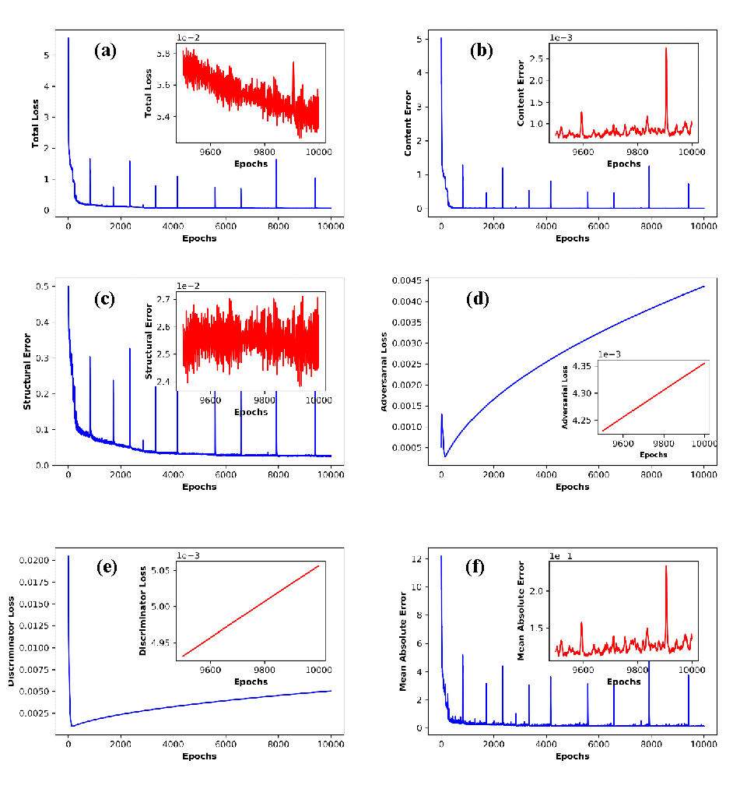
Downscaling climate data using novel machine learning models (obj. 2)
Problem: Northern communities need to adapt and prepare for the climate change with help of the climatic data at hydrologically relevant scales.
Approach: Developed novel downscaling method using Generative Adversarial Network (GAN), CliGAN, which can downscale large-scale annual maximum precipitation given by several AOGCMs to the regional-level gridded annual maximum precipitation.
Findings: GAN method outperformed other models. Integration of structural information of the regional observation in the loss calculation can significantly improve the downscaling performance.
Outcomes:
Chaudhuri C., Robertson C. (In Prep.).CliGAN- A Novel Approach for Statistical Downscaling of Precipitation From multi-model ensemble.
Project Title
Global Water Citizenship (GWC): Integrating Networked Citizens, Scientists, and Local Decision Makers
Notes:
These accomplishments slides will be also be used to build slide bank for use in GWF presentations
How are these results key to advancing the science
How are these results linked to the needs of your partners/users?

Slide 6
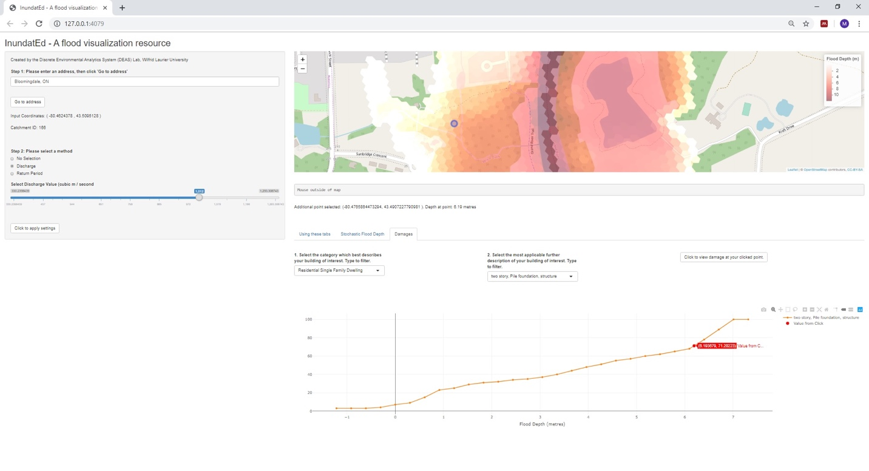
Rapid development of spatial decision support systems (obj 2 & 3)
Problem: Actionable spatial decision support tools required for changing environmental risks.
Approach: We developed two case study applications into wildfire and flood modelling using big data framework (IDEAS).
Findings: The method has produced a simple conceptual flood inundation modeling which is robust, computationally cheap, and produces coherent, physically explainable results. DGGS data model for dynamic CA modelling in a big data platform provides the potential to incorporate constantly updating data streams obtained for key variables, with complex algorithms for learning and updating CA rule sets
Outcomes:
Web applications for 1) large-scale flood risk and flood damage estimation and 2) wildlfire risk modelling and analysis as proof of concept for big data system.
Chaudhuri C., Gray M. A., Robertson C. (In Prep.) InundatEd: Implementation, risk-analytics, and visualization of large-scale flood modeling system on Integrated Discrete Environmental Analytics System
Hojati M., Chaudhuri C., Robertson C. (In Prep.) IDEAS CA: Development of cellular automata wildfire modelling framework based on Integrated Discrete Environmental Analytics System
Project Title
Global Water Citizenship (GWC): Integrating Networked Citizens, Scientists, and Local Decision Makers
Notes:
These accomplishments slides will be also be used to build slide bank for use in GWF presentations
How are these results key to advancing the science
How are these results linked to the needs of your partners/users?

Slide 7
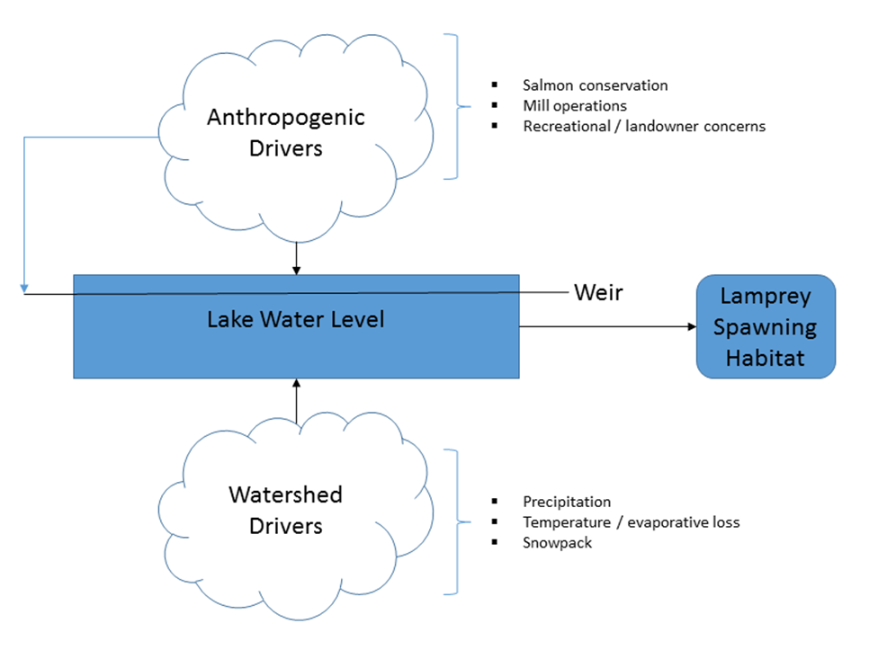
Integration of hydro-climate information for endangered species management (obj 3)
Problem:Suspected declines in population abundance of Cowichan Lake Lamprey in recent decades are thought to be linked to a variety of threats including water use from recreational and economic water licenses, climate change, and management actions for competing species.
Approach: Critical Cowichan Lamprey habitat areas were imaged using an unmanned aerial vehicles. Meteorological and anthropogenic controls on habitat area were investigated through automatic relevance detection regression models.
Findings: The water level should remain above the 1m mark which equates to 67% coverage of water nearshore habitat areas. Increasing the height of the weir to increase storage season capacity is one way to achieve this.
Outcomes:
Chaudhuri C., Wade J., Robertson (Under Review). Critical habitat mapping and change analysis using heterogeneous information sources: The case of the Cowichan Lake Lamprey.
Project Title
Global Water Citizenship (GWC): Integrating Networked Citizens, Scientists, and Local Decision Makers
Notes:
These accomplishments slides will be also be used to build slide bank for use in GWF presentations
How are these results key to advancing the science
How are these results linked to the needs of your partners/users?

Slide 8
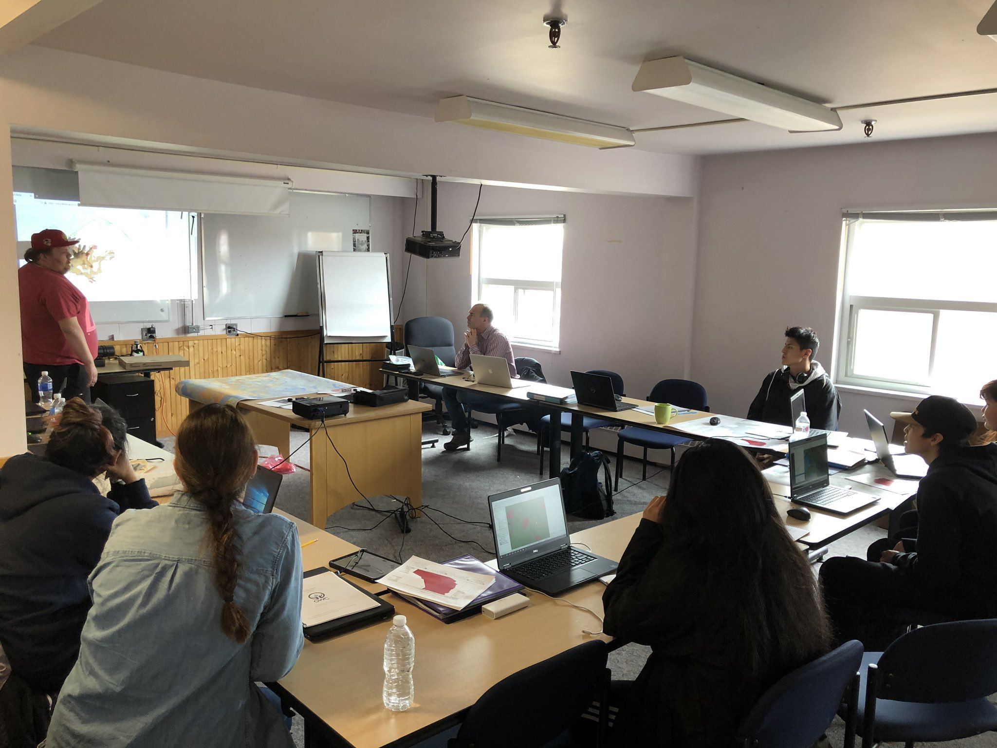
Capacity building for contributing to community-based monitoring (obj 4)
Problem: In many remote and northern communities that can benefit greatest from commmunity participation in monitoring, capacity and skills are needed to facilitate participation with digital tools and frameworks.
Approach: Development of tailored workshop training materials using open source software for youth that involve GPS data collection, mapping, and basic GIS analysis with desktop software.
Findings: Geographically-relevant geomatics training can engage high school youth in a workshop setting. Students were interested and we received support and substantive contributions from Chief Jimmy Bruneau School staff, teachers and partners in the Lands Protection Branch of the Tłı̨chǫ government.
Outcomes:
Two-day workshop delivered at Chief Jimmy Bruneau School in Behchokǫ̀ with 10 Indigenous youth; May 2019.
Robertson, C., Feick, R. and Kuzma, M. Global water citizenship tutorial series, Beginner Level Training manual; 15 copies left with students at Chief Jimmy Bruneau School
Project Title
Global Water Citizenship (GWC): Integrating Networked Citizens, Scientists, and Local Decision Makers
Notes:
These accomplishments slides will be also be used to build slide bank for use in GWF presentations
How are these results key to advancing the science
How are these results linked to the needs of your partners/users?

Slide 9
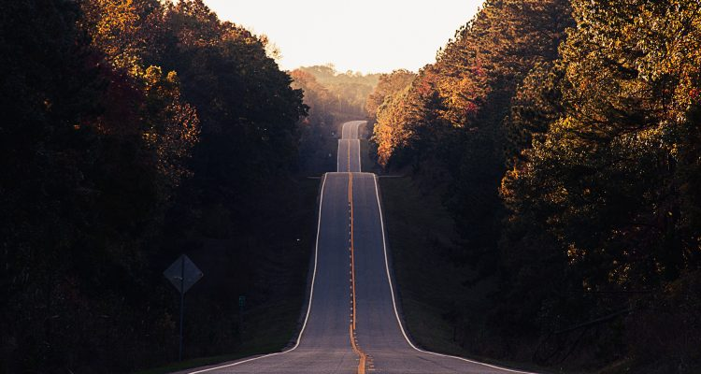
Project Impact and Aspirations
Results of our work now being seen through development of web applications depending on a wide variety of spatial datasets; clear opportunity to link our results/tools with outputs from other GWF projects
Working with communities and the wider community-based monitoring groups across Canada to identify new partnerships and linkages that will further drive impact of integration with remotely sensed and model data from GWF
Working with community of Délı̨nę (NT) on data management and analysis planning in support of Tsá Tué Biosphere Reserve research and monitoring strategy
Deliver on our 7-year planned project deliverables and objectives through other funding mechanisms and partnerships
Project Title
Global Water Citizenship (GWC): Integrating Networked Citizens, Scientists, and Local Decision Makers

Slide 10
Challenges and Cross-project Collaboration Opportunities
Many of our projects and ideas used existing datasets that were available because data products not available from GWF projects at the time project started. We developed tools with idea to incorporate GWF model and observation data eventually. Will work on this aspect of the project in our final year.
Please engage with our project if any of the ideas presented here might connect with your project or GWF work
Project Title
Global Water Citizenship (GWC): Integrating Networked Citizens, Scientists, and Local Decision Makers

