Slide 1

An Update on the
Matawa Water Futures (MWF) Project
Developing an Indigenous-Informed Framework for Watershed Monitoring and Stewardship
Global Water Futures Operations Meeting, Hamilton, Ontario, November 19-20, 2019

Slide 2
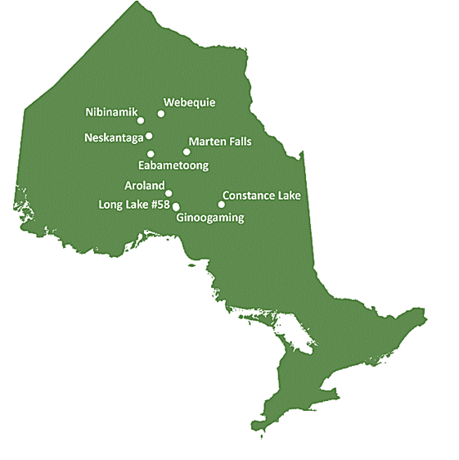
Matawa Water Futures: Developing an Indigenous-informed Framework for Watershed Stewardship & Monitoring
The Matawa member First Nations (MFN) Homelands & Traditional Territories lie within the Treaty 9 area (1905-06, adhesions 1929-30), the ancestral home of Anishinaabe (Ojibway), Mushkegowuk (Cree) and Oji-Cree Nations.
The combination of changing climate with forecasted Ring of Fire development in northern Ontario means that watersheds within the MFN territories will be subject to change.
There is an urgent need for Indigenous values and traditional knowledge (ITK) to be linked with Western science to respond effectively to contemporary challenges and opportunities in water governance both regionally and nationally.
Matawa Water Futures will advance Indigenous-informed water science to address the need for a more robust and effective water monitoring and governance system that will support Indigenous decision making and water stewardship.
Co-PI: Dr. Terry Mitchell, School of International Policy and Governance, Balsillie School of International Affairs, Wilfrid Laurier University, Waterloo, Ontario. tmitchell@wlu.ca.
Co-PI: Sarah Cockerton, Matawa First Nations Management, Thunder Bay, Ontario. scockerton@matawa.on.ca
      Project website:
Project coordinates: PI, email, website, etc
Matawa Water Futures: Developing an Indigenous-informed Framework for Watershed Stewardship & Monitoring
Notes:
It can help to frame your main research objective as a question. For example,
How will climate change affect agriculture in Canada?
How can we improve water quality and reduce algal blooms in Canadian lakes?
What are the links between fish health, food safety and food security in the Indigenous North?
What is the significance of groundwater fluxes on surface water flow?

Slide 3
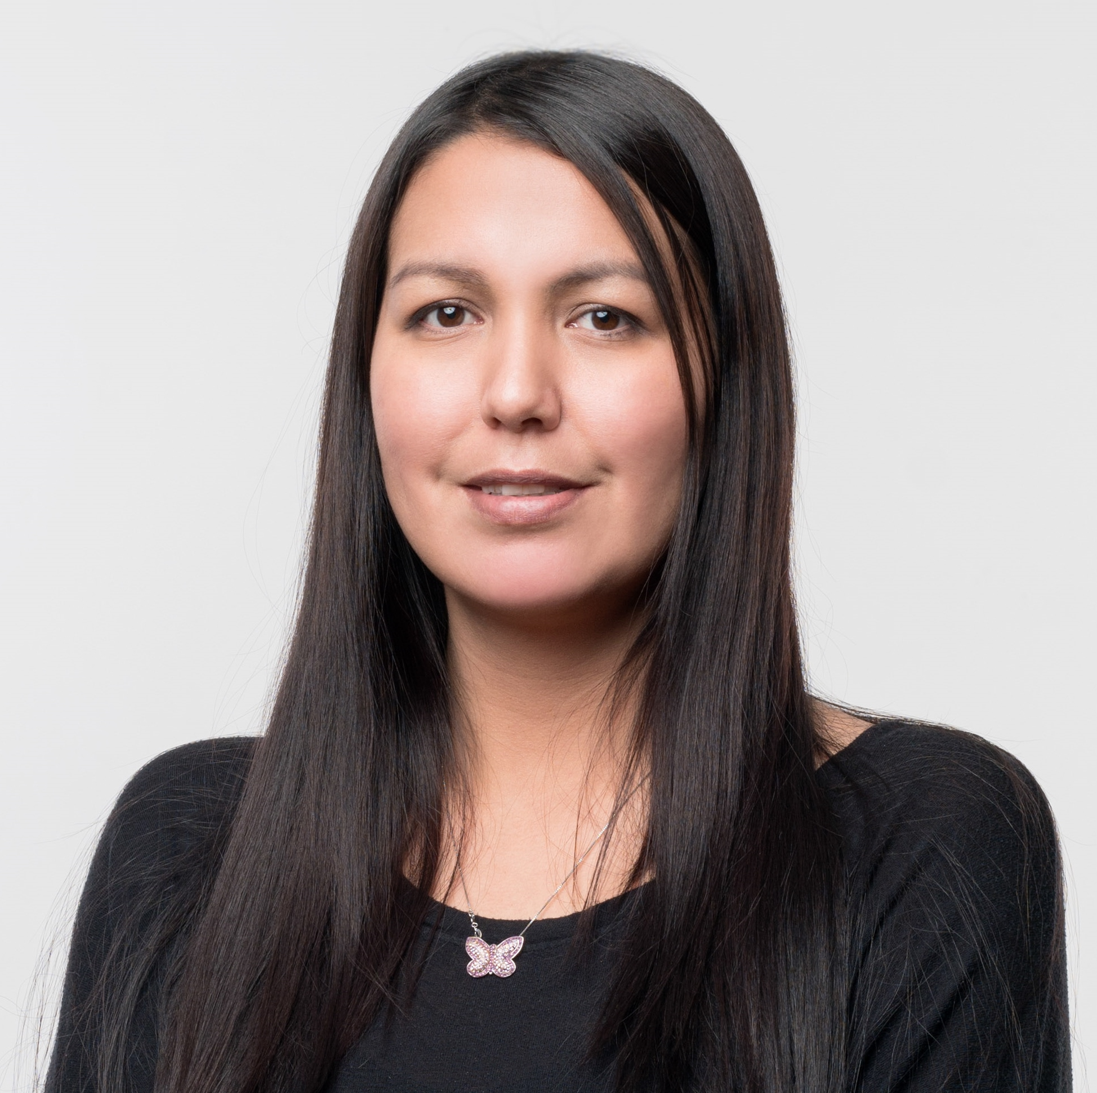
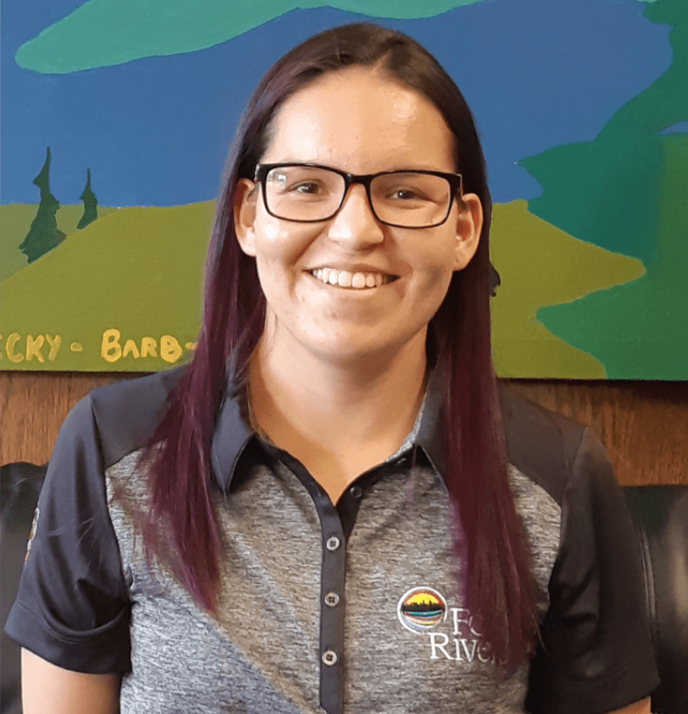
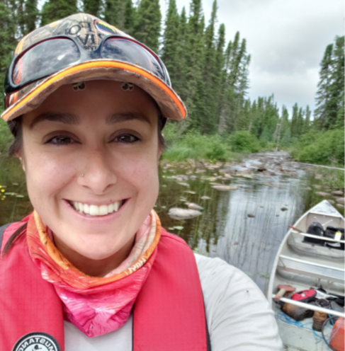
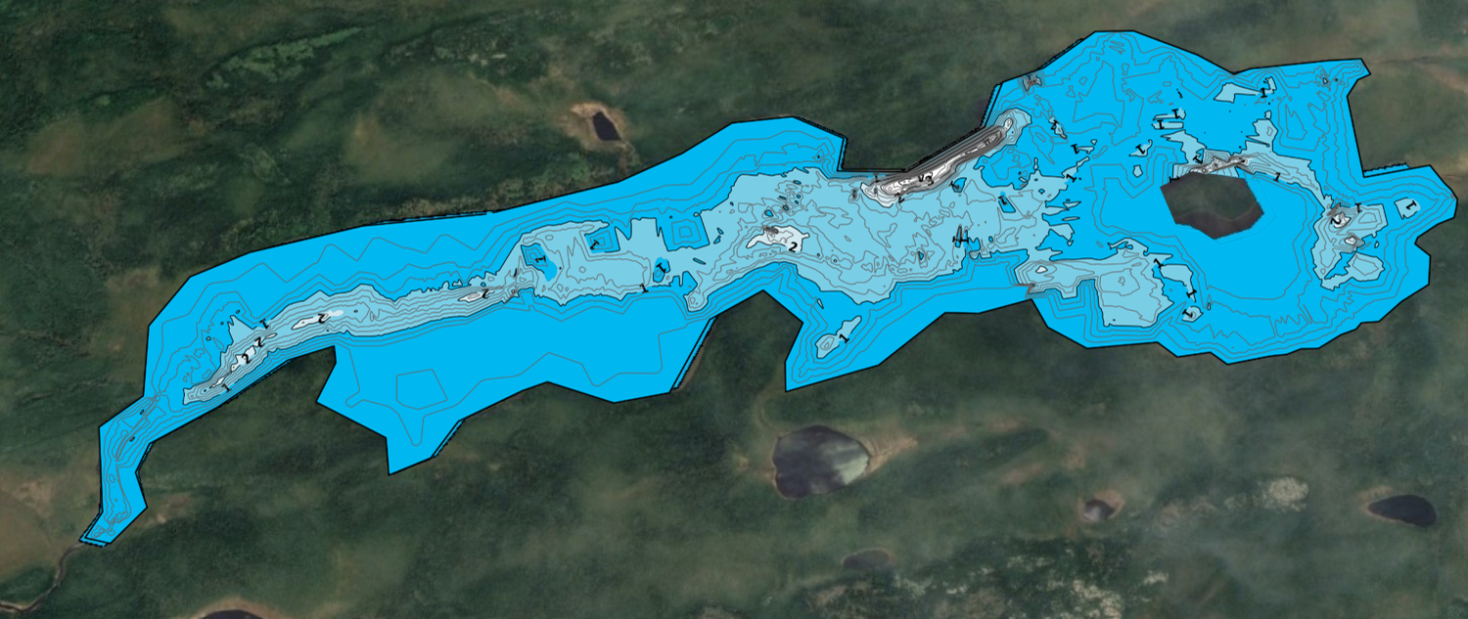
Preliminary Project Sucesses & Initative Highlights
Investigations at Eabametoong First Nation’s Tidy Lake
Investigations at Constance Lake
Water Photo Engagement Event with over 50 Matawa member submissions
IK Water Story Interviews
December/18 First Nation Gathering with over 40 participants
Formation of adhoc Matawa environment technical working group
Jan/19 Community Based Monitoring Workshop with Matawa environmental technical working group
June/19 Co-Training Event with Matawa environment technical working group
July/19 Nibinamik Youth Retreat with over 50 youth
July/19 First Nation Gathering with over 100 participants
Creation of new student/internship program and recruitement of 3 Matawa members
Training and support to 5 other Matawa member First Nation environment champions
http://fourrivers.group/mwfvideo
Project Title
Matawa Water Futures: Developing an Indigenous-informed Framework for Watershed Stewardship & Monitoring
Notes:
These accomplishments slides will be also be used to build slide bank for use in GWF presentations
How are these results key to advancing the science
How are these results linked to the needs of your partners/users?

