Slide 1

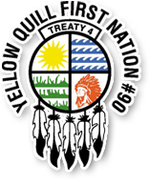


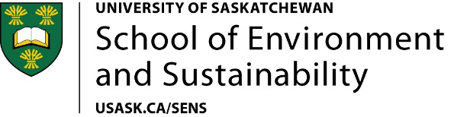
Special thanks to Myron Neapetung and Bill Marion
Notes:
Land/treaty acknowledgment: the traditional territories of the Erie, Neutral, Huron-Wendat, Haudenosaunee and Mississaugas - covered by the Dish With One Spoon Wampum Belt Covenant, and covered by the Between the Lakes Purchase, 1792.
This work is a co-created project that emerged from collaboration with Yellow Quill First Nation on Treaty 4 Territory and James Smith Cree Nation in Treaty 6 Territory. It is also a cross-campus collaboration of the Schools of Public Health and Environment and Sustainability, the Department of Computer Science, and GWF’s core modeling group with specific support of Dr. Kevin Shook with the WDPM modeling.

Slide 2
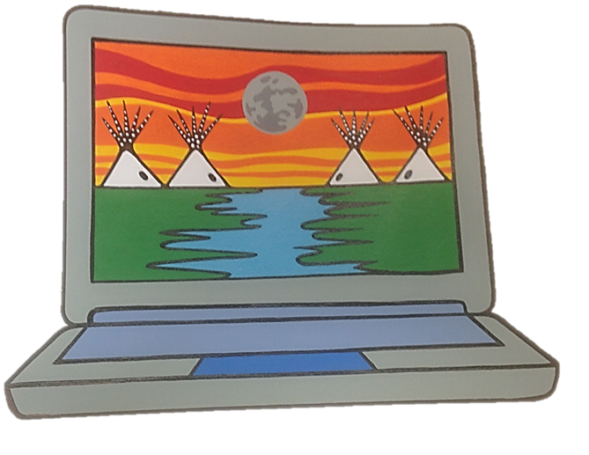
Agent Based Modeling as a Tool to Investigate Comprehensive Health Impacts of Flooding in Indigenous communities
How can we make model outputs more useful for Indigenous communities experiencing flooding and health effects?
We approach this work in the spirit of
ê-miciminitômakahki –
interconnectedness and togetherness
We used a participatory modeling approach based on co-decision and joint action to co-create agent-based models of potential health effects of flooding in two communities – YQFN (Treaty 4) and JSCN (Treaty 6)
We completed this work alongside an ISC-funded First Nations Adapt Program grant. We combined LiDAR, WDPM-based modeling of floods and verification of flood extent maps by community members with: 1° and 2° health information, vulnerability assessment findings, and community social dynamics into agent-based models designed around community-requested scenarios
ABMS and health effects of flooding – proof of concept
Project coordinates: PI, email, website, etc
Notes:
This project was created as a proof-of-concept that we could co-create agent-based models for examining potential holistic health effects of flooding on reserves. We are guided by the principles of participatory modeling put out by Basco-Carrera et al 2017.
AY-mi-TSI-min-NIT-toe-MUK-Kuhn-Ki

Slide 3
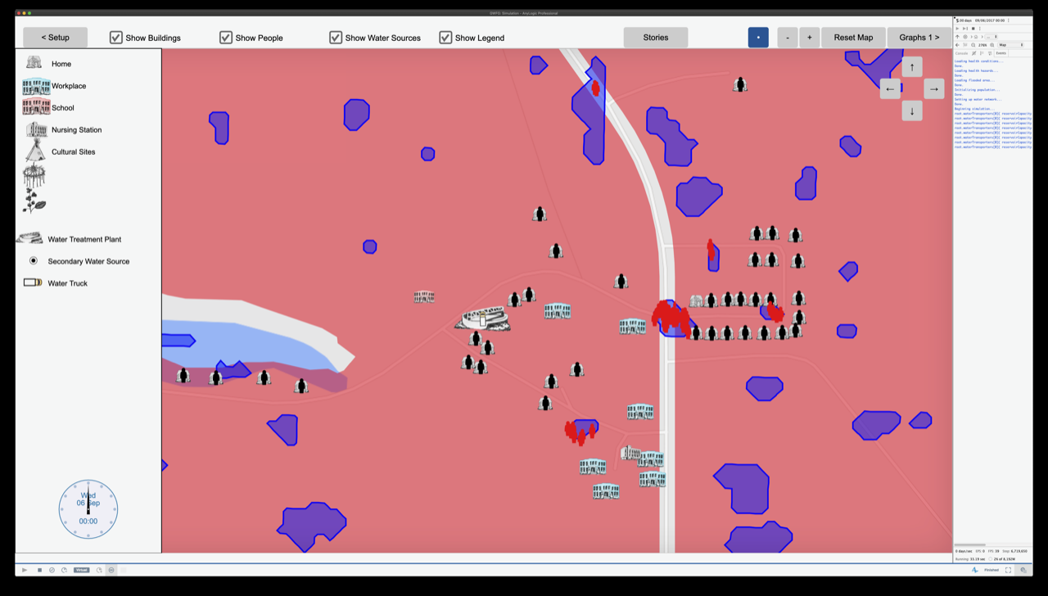
Transformational Science Highlights
We made GIS, DEM, WDPM, FN-PIEVC, and ABMs ‘talk’ to each other
Outputs include infrastructural, health, social, and cultural effects
First use of StoryTeller output from ABMs in Indigenous communities
Provides communities with potential outcomes to discuss for emergency management
ABMS and health effects of flooding – proof of concept
Project Title

Slide 4
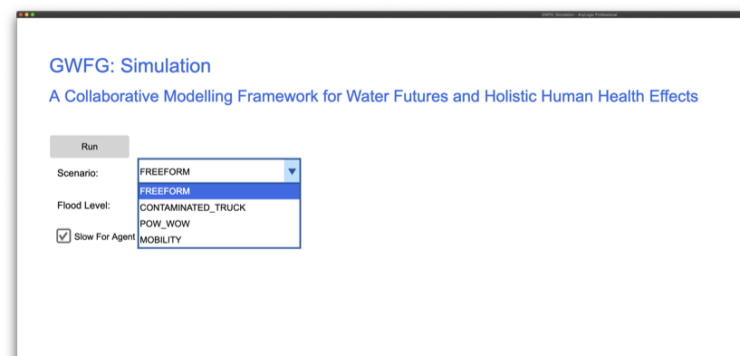
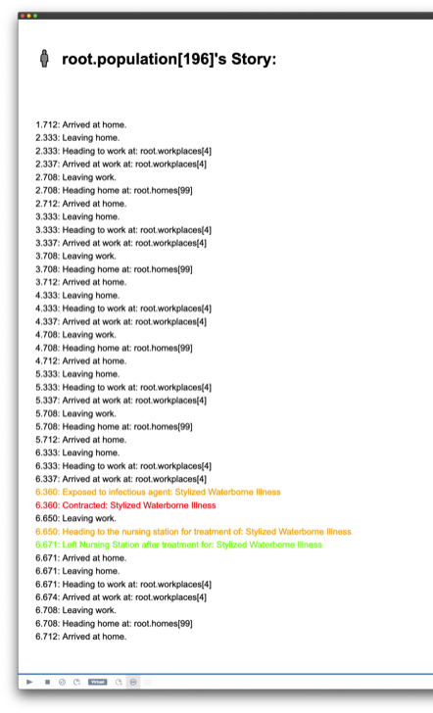
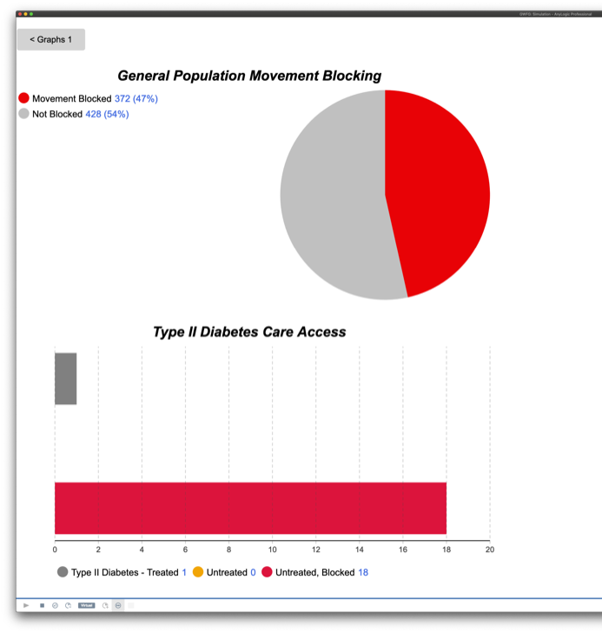
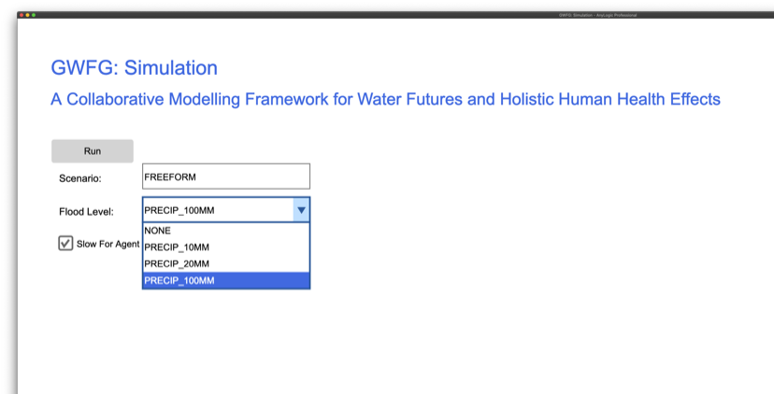
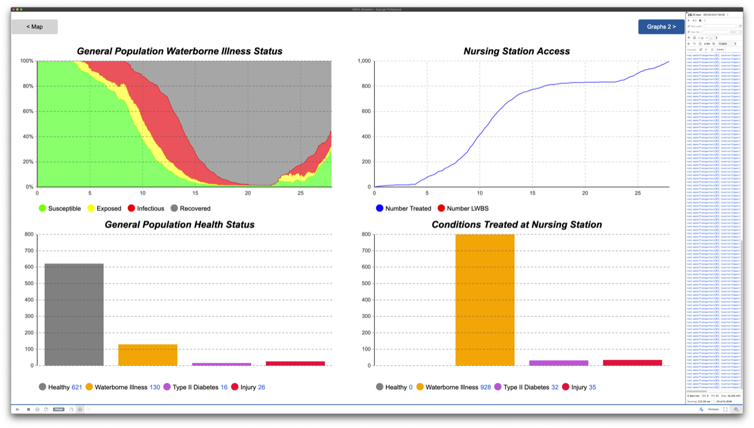
Notes:
These are screen shots from the model itself – community co-learners can select the kind of scenario they want to run, then select the water-related issue (rainfall, contamination event, drought etc…). Outputs are determined by community interest or need for reporting, for example – will the health center be able to cope with those seeking care during or after a flood, will community mobility be impacted (i.e., people not being able to access diabetes care due to roads washed out).
The storyteller piece allows each agent-person to have a record of their daily activities and how these were affected by a water event. Co-learners informed the rules for the person agents – and can look at each agent to see if their ‘story’ was realistic and if patterns emerged in the social dynamics of the community

Slide 5
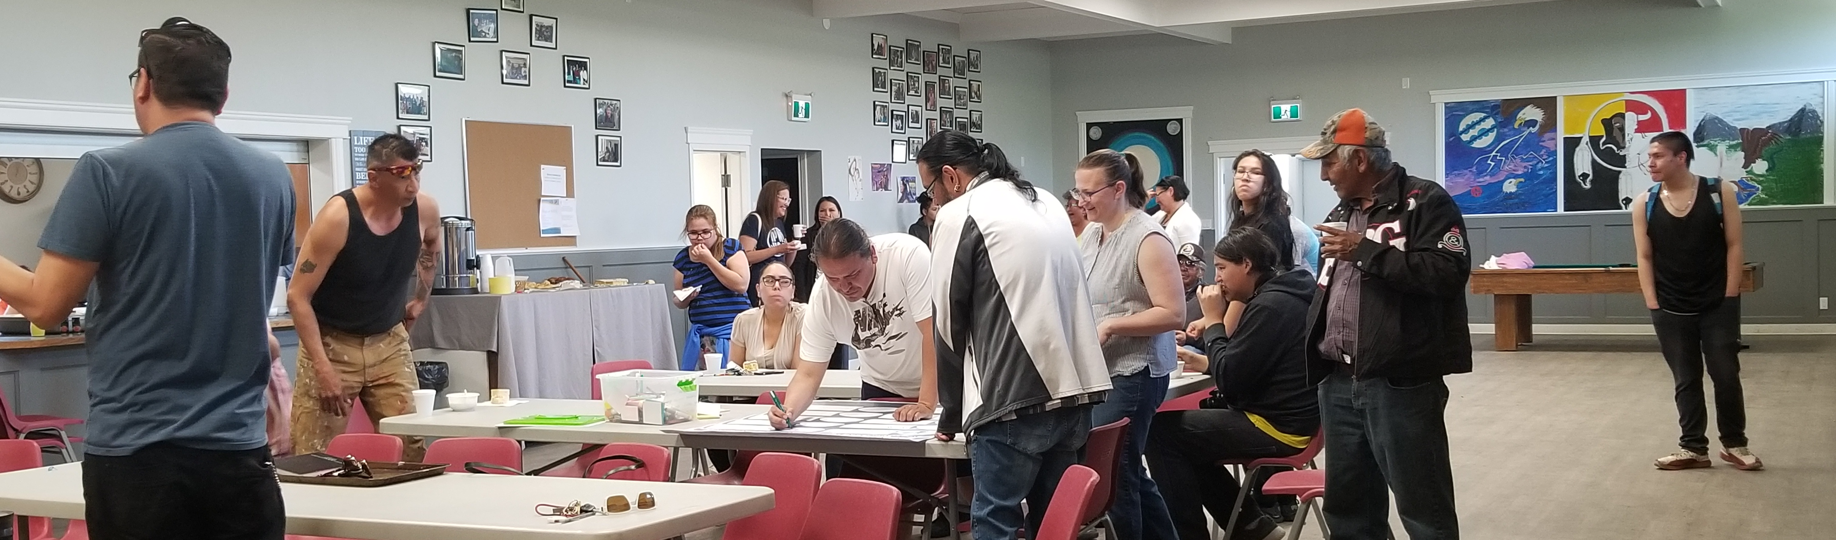
Project Impact and Aspirations
Data gathering is complete – OCAP principles in place for management
1st working ABM being used to examine community-specified scenarios
2nd model configured – awaiting community input on desired scenarios
Communities are working with model outputs to support applications to ISC for operational, infrastructural, and service-related enhancements and improve emergency management planning
Photo: Anuja Thapa
ABMS and health effects of flooding – proof of concept
Project Title

Slide 6
Challenges and Cross-project Collaboration Opportunities
Much of the work emerged from miyo-wicêhtowin (good relationships)
We would like to collaborate with others to include other water challenges (i.e., nutrients, groundwater) and we would like to share results with other Indigenous communities
GWF Core modeling group and agent based modelers have been supportive of this work and have been appreciative of community feedback on outputs
Participatory modeling can promote nisitohtamowin (understanding) among researchers and Indigenous communities and contribute to reconciliation
ABMS and health effects of flooding – proof of concept
Project Title
Notes:
miyo-wicêhtowin – mi-YOH-wee-TSAY-too-win – possessing good relations with one another
Nisitohtamowin – ni-SI-toe-TA-noe-win – ability to develop understanding

