Slide 1
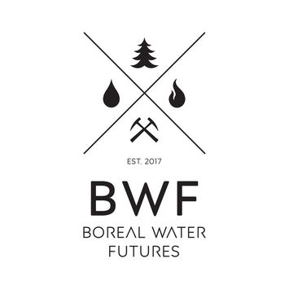
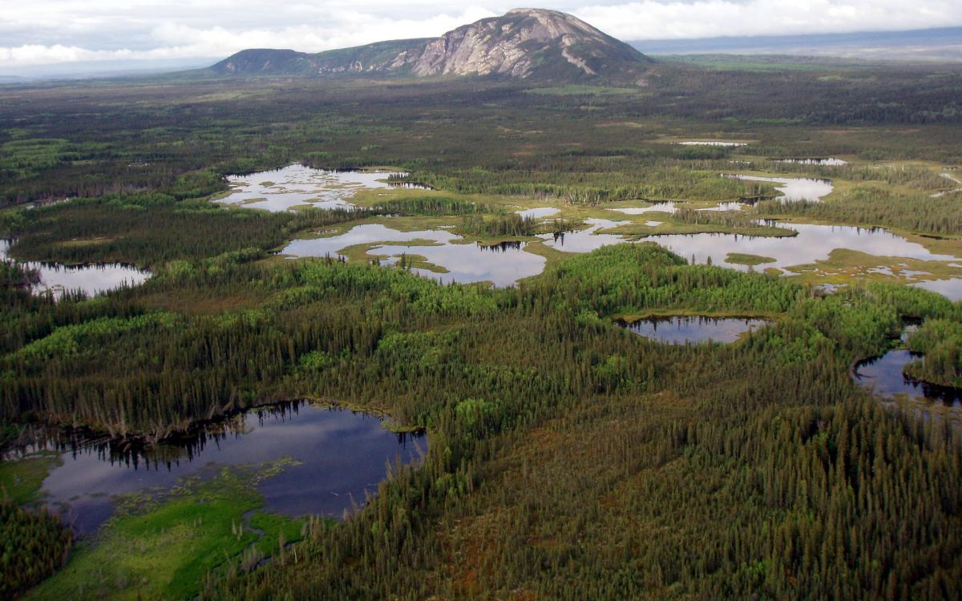
PI: Mike Waddington, Geography/Earth Sciences, McMaster
Charles de Lannoy, Chemical Engineering, McMaster
Pat Chow Fraser, Biology, McMaster
Sean Carey, Geography/Earth Sciences, McMaster
Brent McKnight, Strategic Management, McMaster
Nancy Doubleday, Philosophy, McMaster
John Pomeroy, Geography and Planning, USask
Rich Petrone, Geography and Environmental Management, Waterloo
Jon Price, Geography and Environmental Management, Waterloo
Mike Flannigan, Renewable Resources and Wildland Fire, UofA
Sylvain Jutras, Sciences du bois et de la forêt, Laval
Project coordinates: PI, email, website, etc
Boreal Water Futures

Slide 2
Boreal Water Futures
Canada’s Boreal:
The largest contiguous forest
National economic significance, ~$95B value
Home to many different residents
Objectives:
To assess and ensure the resilience of boreal Canada's primary hydrological systems
To propose strategies to mitigate water risks to this region's ecosystems, associated industries and infrastructure, and growing urban population
To develop an effective water futures risk assessment (WFRA) framework for the boreal region.
A transdisciplinary team of academic and government researchers, industry users, NGOs, and key provincial and national stakeholders conducting process-based science.
Project coordinates: PI, email, website, etc
Boreal Water Futures

Slide 3
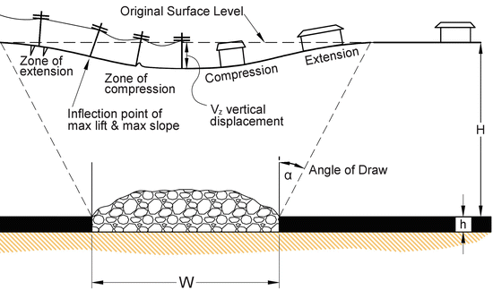
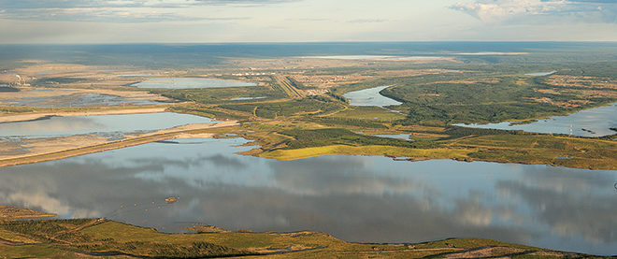
Transformational Science Highlights
UoW, Ecohydrology: Ground level subsidence of up to 0.6m, controlled by the thickness of underling marine sediment, rather than distance to mining pit (Ontario)
Victor Mine, James Bay Lowlands
McMaster, hydrology: First measurement of water fluxes for oil sands end pit lakes. First documented eddy flux work within white spruce boreal forest stand (Yukon)
Project Title
Boreal Water Futures
Notes:
Lot of great work being done with a few key/new findings and their impact on the science and operations summarized here.
De Beers Victor Mine (Diamond mine) now not operational but the peatlands surrounding it were dewatered (drained) for > 10 years. Looking at the ecohydrological implications of that. Subsidence is key to quantify for infrastructure, and for impacts on the hydrology of the surrounding systems.
Oil sands is such a larger areal disturbance in the boreal, first time measurements are key to advance the understanding of the impacts on hydrology and associated ecosystem services. Closure plans for oil sands mines are being based on this work, with millions of dollars in impact. Water resource managers in Yukon interested in impact of vegetation change on territory-wide hydrology.
These accomplishments slides will be also be used to build slide bank for use in GWF presentations
How are these results key to advancing the science
How are these results linked to the needs of your partners/users?

Slide 4
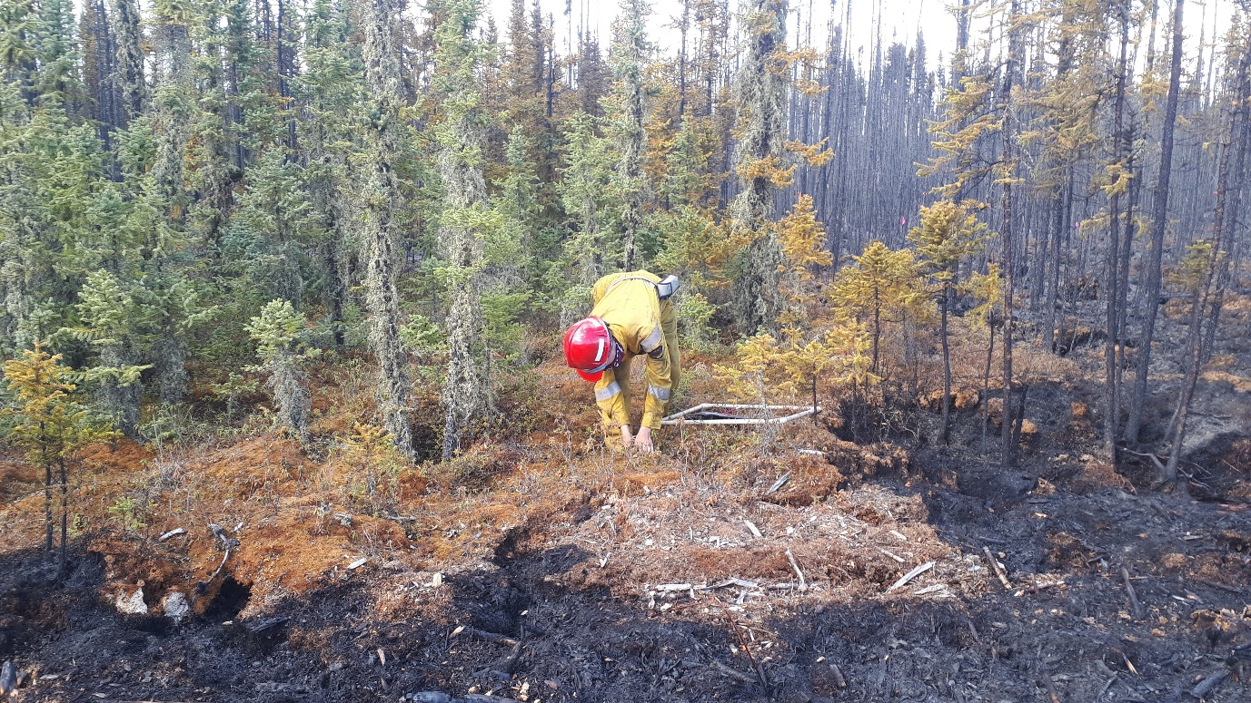
Transformational Science Highlights
McMaster, ChemEng: Determined chemical signatures that lead to peat hydrophobicity/hydrophilicity. Quantified structural/chemical peat soil changes as a function of fire temp (Alberta)
Burned and unburned moss/peat. Source: Ecohydrology Lab
McMaster, Biology: Examined how tree species composition and proximity to water affect burn severity and forest recovery Produced fire severity map for Parry Sound Fire 2019 (Ontario, Alberta)
New flux tower in NOBEL region. Source: Ecohydrology Lab
Project Title
Boreal Water Futures
Notes:
Your work. Has implications for post-fire(eco)hydrology, such as reduced evaporative losses (increased water conservation) in post-fire peatlands, and therefore the boreal water budget.
Remote sensing (Sentinel 3) fire severity mapping and linking to landscape features, to help assess fire impacts and predict fire impact based on landscape features that can be detected from remote sensing. Advancing science on restoration policies and risk management.

Slide 5
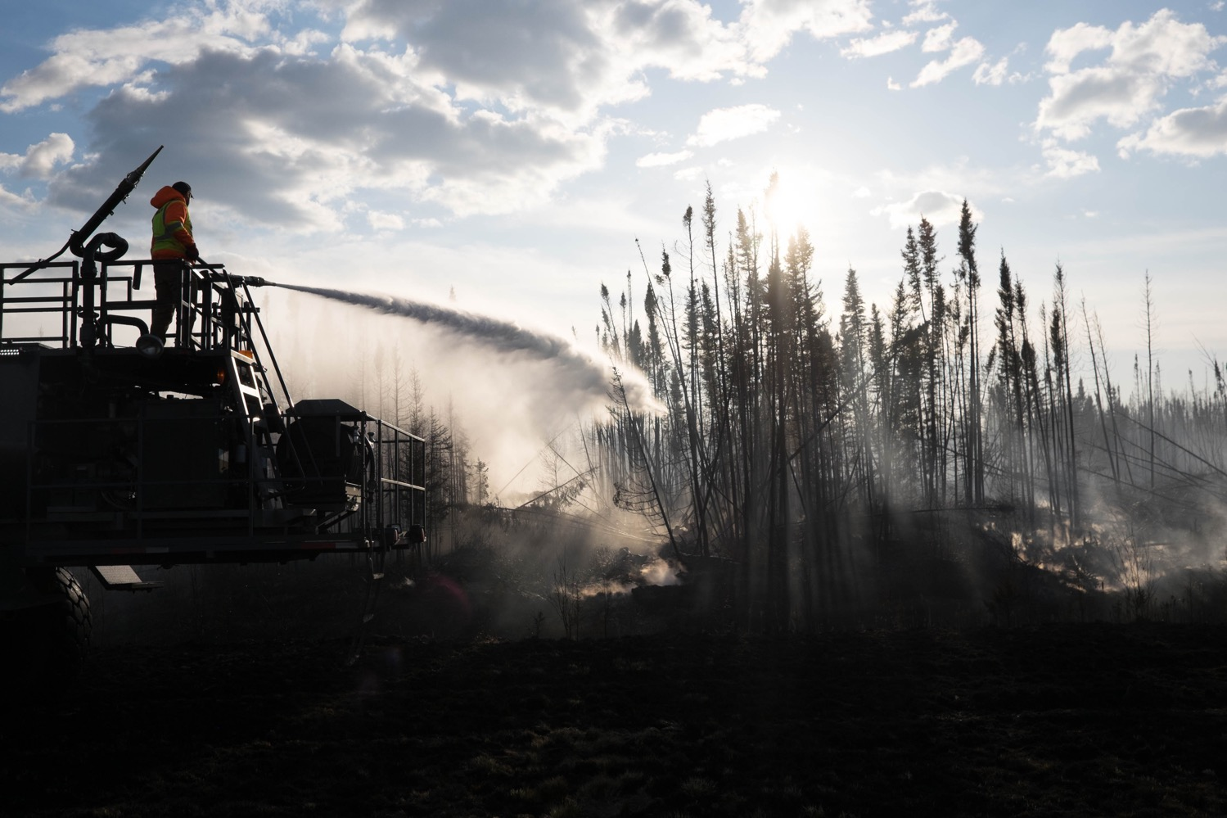
Project Impact and Aspirations
Science impact: Advances have been made to modelling work e.g. CRHM results for Saskatchewan basin found that hydrology responded non-linearly to the precipitation and temperature changes.
Societal impact: Direct application to society e.g. source water protection from wildfire in Alberta and efforts to extend this work to Canada as a whole.
Knowledge mobilization and feedback is being, and will be, conducted through presentations at Canadian Geological Union, Wildland Fire Canada and other conferences.
Results are also communicated with partners on an ongoing basis through reports.
Wildfire fighters working to suppress the Fort McMurray wildfire (2016). Source: Leyland Cecco
Project Title
Boreal Water Futures
Notes:
Modelling Impact: advances in modelling carve the way for future field research and help predict the water challenges in the light of climatic changes.
Impact to Society
There is a vested interest in the global north and conserving the world’s carbon stores. Understanding the response of these systems to the pressure of resource extraction and changes in weather patterns will be important in establishing socially and environmentally responsible mining practices, conservation efforts and risk management plans.
Wildfire is becoming an increasingly pressing issue, especially in Canada’s boreal, research rooted in hydrology, chemistry, ecology and the social sciences gives way to a greater understanding of the cross-disciplinary impacts and challenges of this large scale disturbance.

Slide 6
Challenges and Cross-project Collaboration Opportunities
A better understanding of data sharing within the network would be helpful.
Coordinated KM opportunities would be useful in such a transdisciplinary team.
Seeking further collaborations to:
Incorporate chemistry with hydrology modelling
Link empirical burn indicators to predictive models
Connect sensing with soil and forest fire monitoring
Technologies for lower impact mining
Anthropogenic (logging) and natural disturbances (wildfire) on the Boreal. Source: CFS (2019)
Project Title
Boreal Water Futures

