Slide 1





GWF Project:
Next generation solutions to ensure healthy water resources for future generations
John P. Giesy, Ph.D., FRSC, FSETAC
GWF Operations Committee Meeting
November 19, 2019
Hamilton, Ontario
Global Water Futures: Solutions to Water Threats in an Era of Global Change

Slide 2
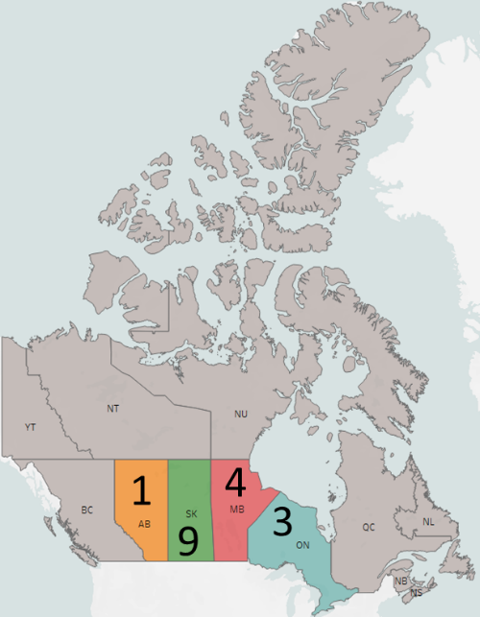
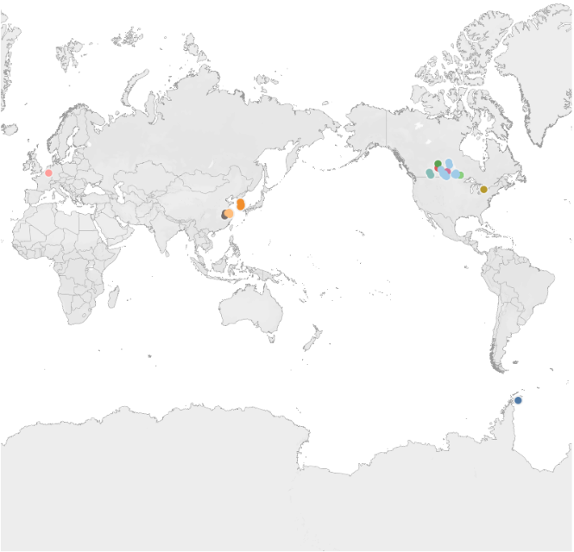
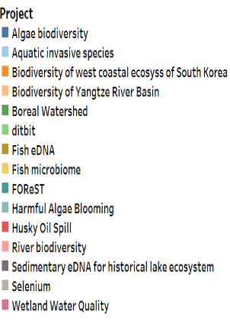
Objective and research focus
  How can we apply eDNA in biomonitoring to meet needs of end-users to protect and manage aquatic ecosystems in a rapidly changing world?
  eDNA based solutions for both targeted (endangered and invasive speceis) and non-targeted multiple community monitoring
  eDNA based assessment of ecosystem health under natural and anthropogenic stressors
  Study regions
Project contact information: https://gwf.usask.ca/edna/index.php
  John P. Giesy, Ph.D., FRSC, FSETAC
  Tel: 306-966-2096; Email: john.giesy@usask.ca
Next generation solutions to ensure healthy water resources for future generations
Project coordinates: PI, email, website, etc
Notes:
How can we improve the capability and efficiency of biomonitoring to meet end-users’ mandate to protect aquatic ecosystems, predict future trajectories for these ecosystems, and foster sustainable development in a rapidly changing world?
Appily eDNA based approaches to:
Assess changes in aquatic communities of northern and urbanized Canadian watersheds
Characterize aquatic communities as indicators of ecosystem health under varying degrees of natural and anthropogenic stressors
It can help to frame your main research objective as a question. For example,
How will climate change affect agriculture in Canada?
How can we improve water quality and reduce algal blooms in Canadian lakes?
What are the links between fish health, food safety and food security in the Indigenous North?
What is the significance of groundwater fluxes on surface water flow?

Slide 3
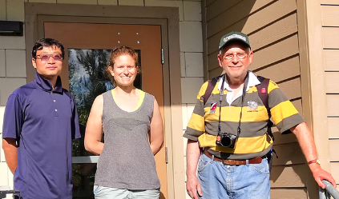
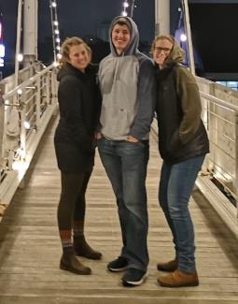
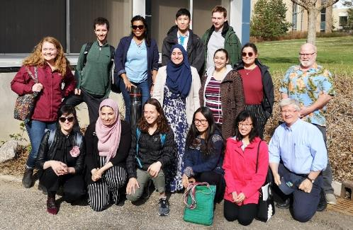
Personnel
11 staffs
7 Undergraduate Students
6 Masters Students
2 Doctoral Students
2 Postdoctoral Fellows
2 Technicians
Project Title
Next generation solutions to ensure healthy water resources for future generations

Slide 4
Major accomplishments: Output
Platform
  44 sharable SOPs posted on eDNA website
  eDNA field and lab gears
Publication
  11 papers one 1 report published
  1 paper under review
  15 drafts under preparation
  44 Conference Presentations
  2 Graduate and Undergraduate Theses
  Won 6 student awards
Project Title
Next generation solutions to ensure healthy water resources for future generations

Slide 5
Transformational Science Highlights
Fish metabarcoding
North Saskatchewan River
Global
equivalency
~ 85%
Next generation solutions to ensure healthy water resources for future generations
Project Title
Notes:
Tell us about some new and exciting transformational results you have or that are emerging that are key to advancing the science
You may use one or two visual results (e.g., graphs or charts) that are easily interpreted and reused for a broad audience
These accomplishments slides will be also be used to build slide bank for use in GWF presentations
How are these results key to advancing the science
How are these results linked to the needs of your partners/users?

Slide 6
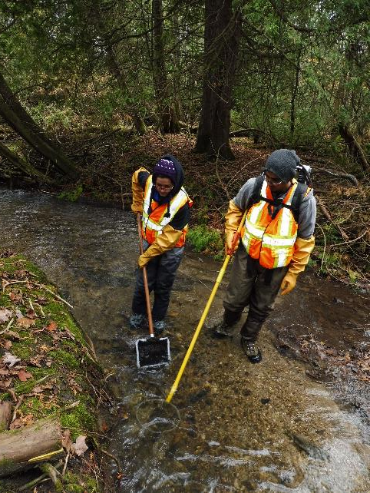
Project Impact and Aspirations: Outcomes-1
Developed metabarcoding platform for multiple community biomonitoring
  For bacteria, algae, protozoa, zooplankton, benthos and fish
Developed reference libraries for Canadian freshwater fishes and zooplankton
Validation eDNA metabarcoding of fish, zooplankton and benthos against traditional methods – ongoing
Project Title
Next generation solutions to ensure healthy water resources for future generations
Notes:
This slide should communicate the applications of your results. This could include:
How have the results so far been, or will be, of interest to your partners and other potential users?
What opportunities have you identified to put these results into action that you will be taking up in the coming year?
What do you foresee will be the impact of this research to society?

Slide 7
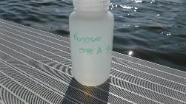
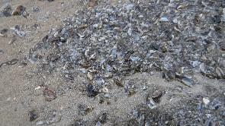
Project Impact and Aspirations: Outcomes-2
Saskatchewan Aquatic Invasive Species Science Group
  Direct contribution to technology development for targeted detection of invasive mussels-Ongoing
In partnership with Saskatchewan Environment
  Applied eDNA to identify habitats where tree frogs were present
  Applied eDNA to monitor for both invasive fishes and threatened and endangered fishes-Ongoing
Project Title
Next generation solutions to ensure healthy water resources for future generations
Notes:
Invasive Species
Prussian carp; Water milfoil; Spiny waterflee; Rusty crayfish
Endangered/rare species
Lake sturgeon; Bigmouth buffalo; Bull trout; West slope cutthroat trout; Chestnut lamprey; Northern leopard frog

Slide 8
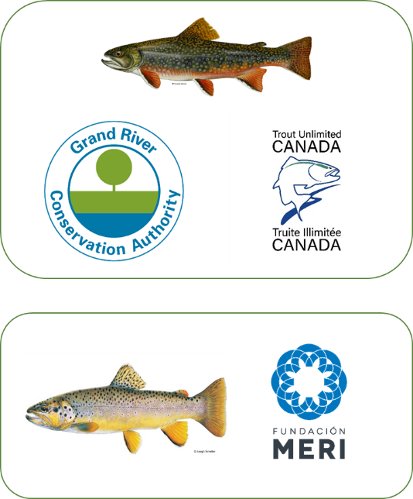
Project Impact and Aspirations: Outcomes-3
Application of eDNA barcoding:
  Seasonally monitoring of brook trout in threatened cold water habitats on the Waterloo Moraine-Ongoing
  Detect invasive brown trout in remote Patagonian rivers at the Melemoyu Nature Reserve-Ongoing
Project Title
Next generation solutions to ensure healthy water resources for future generations

Slide 9









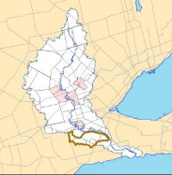

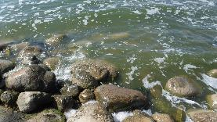
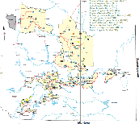


Project Impact and Aspirations: Outcomes-4
Application of eDNA metabarcoding:
  Validation against traditional methods and detection of aquatic species (fish and amphibians) in streams undergoing remediation-Ongoing
  Assess fish movement and biodiversity in streams –Ongoing
  Monitoring of plankton communities of surface and irrigation waters in Alberta - Ongoing
McKenzie Creek
Project Title
Next generation solutions to ensure healthy water resources for future generations
Notes:
Invasive Species
Prussian carp; Water milfoil; Spiny waterflee; Rusty crayfish
Endangered/rare species
Lake sturgeon; Bigmouth buffalo; Bull trout; West slope cutthroat trout; Chestnut lamprey; Northern leopard frog

Slide 10

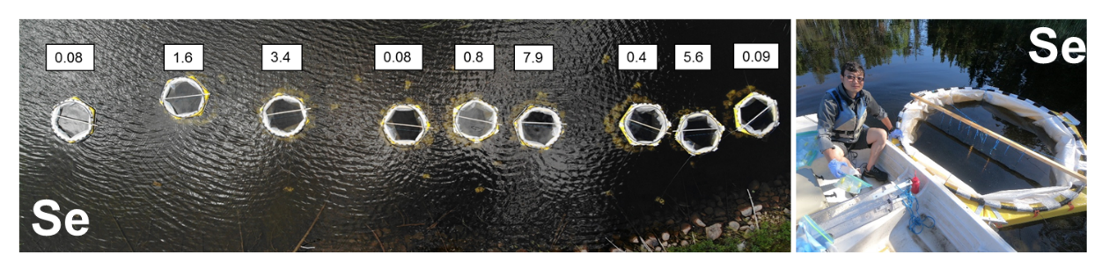
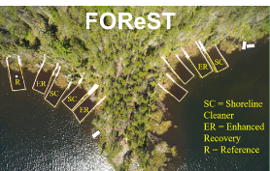


Project Impact and Aspirations: Outcomes-5
Applied eDNA for risk assessments
  Effects of “dilbit” on zooplankton – Finished (BOREAL study )
  Determine best methods of cleaning up spills of dilbit in Canadian boreal lakes - Finished
  Effects of Selenium (Se) on aquatic ecosystems in boreal lakes of Canada-Finished
  Monitoring program of lakes mine effluent-ongoing
Project Title
Next generation solutions to ensure healthy water resources for future generations

Slide 11
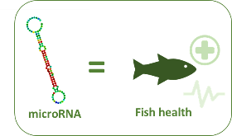

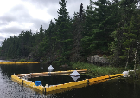
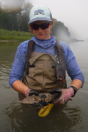
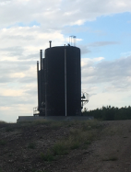
Project Impact and Aspirations: Outcomes-6
Grand River
Test e-miRNA as an indicator of stress in fish at sites downstream of wastewater treatment plants in the Region of Waterloo – Ongoing
Developing eRNA as an indicator to tell who is active - Ongoing
Applied eDNA to fish microbiomes
  Assessment of the Husky oil spill to the N. Saskatchewan River-Finished
eDNA
eRNA
Project Title
Next generation solutions to ensure healthy water resources for future generations
Notes:
Invasive Species
Prussian carp; Water milfoil; Spiny waterflee; Rusty crayfish
Endangered/rare species
Lake sturgeon; Bigmouth buffalo; Bull trout; West slope cutthroat trout; Chestnut lamprey; Northern leopard frog

Slide 12
Challenges and Cross-project Collaboration Opportunities
Operational challenges that you want to highlight to the network
Are there opportunities to collaborate with other GWF projects that can help solve those challenges and/or leverage opportunities to have impact (i.e. shared data or coordinated KM activities)?
Do you need something from the collective Operations Team help you solve these challenges?
Challenges: data management and KM activities
    Yes. eDNA platform is open and shareable
We do need help to solve the issues of data management and KM activities.
Next generation solutions to ensure healthy water resources for future generations
Project Title

