Slide 1


GWF Project:
‘Omic’ and chemical fingerprinting methodologies using ultrahigh-resolution mass spectrometry for geochemistry and healthy waters.
Paul D. Jones, Ph.D., and John P. Giesy, Ph.D., FRSC, FSETAC
GWF Operations Committee Meeting
November 19, 2019
Hamilton, Ontario
‘Omic’ and chemical fingerprinting methodologies for geochemistry and healthy waters

Slide 2
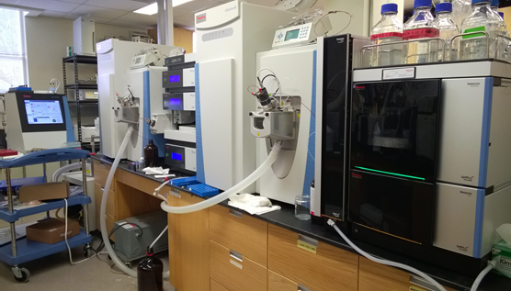
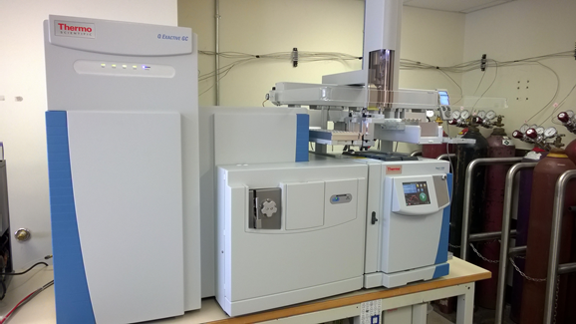
Personnel:
2 faculty
1 Undergraduate Student
2 Masters Students
2 Postdoctoral Fellows:
Banting Fellow
Marie Curie Fellow
‘Omic’ and chemical fingerprinting methodologies for geochemistry and healthy waters
Project coordinates: PI, email, website, etc
Project Title
‘Omic’ and chemical fingerprinting methodologies for geochemistry and healthy waters
Notes:
How can we improve the capability and efficiency of biomonitoring to meet end-users’ mandate to protect aquatic ecosystems, predict future trajectories for these ecosystems, and foster sustainable development in a rapidly changing world?
Appily eDNA based approaches to:
Assess changes in aquatic communities of northern and urbanized Canadian watersheds
Characterize aquatic communities as indicators of ecosystem health under varying degrees of natural and anthropogenic stressors
It can help to frame your main research objective as a question. For example,
How will climate change affect agriculture in Canada?
How can we improve water quality and reduce algal blooms in Canadian lakes?
What are the links between fish health, food safety and food security in the Indigenous North?
What is the significance of groundwater fluxes on surface water flow?

Slide 3
Major accomplishments: Output
Infrastructure established
Platforms/Workflows Established
Proteomics - Completed
Lipidomics - Completed
Metabolomics - ongoing
Chemoinformatics - ongoing
Publications
1 paper published (3 under review)
3 drafts under preparation
11 Conference Presentations
2 Graduate Theses Completed
4 Invited Plenary Presentations
‘Omic’ and chemical fingerprinting methodologies for geochemistry and healthy waters
Project Title

Slide 4
Collaborations:
GWF Researchers:
Morrissey – GWF fatty acids in food chain
Jardine – DFO Husky Oil Spill
Brinkman – PAHs – effects on fish
Other Funding:
SWA – PAHs, Husky Oil Spill
BCRC – Hormones and growth stimulants, fate in cattle feed lots
GNWT – Transboundary fish health and contaminant monitoring
U. Lethbridge – Effects of TBCO on fish
DFO – Classic and Modern PFCs – effects on valued fisheries
Lorne Doig – Paleolimnology, pigments, Humic & fulvic acids
‘Omic’ and chemical fingerprinting methodologies for geochemistry and healthy waters
Project Title

Slide 5
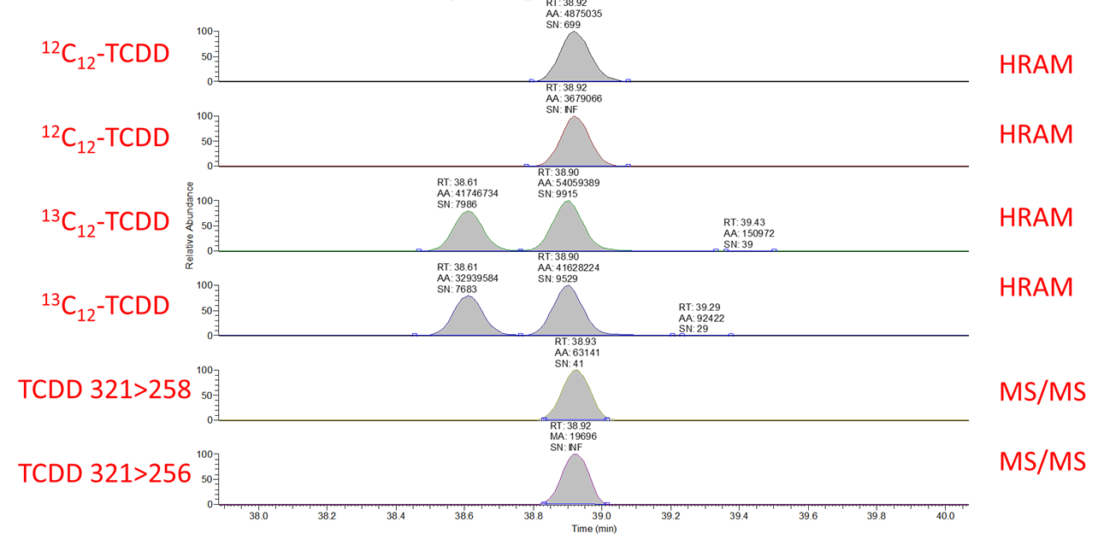
New Technologies for the Worlds most Toxic Contaminants
New technologies for PCDD/DF
Computing technology reduced information bottleneck
New data acquisition capabilities
New standardized data
Proposed New QA Criteria for PCDD/F MS
Resolution – 40,000 (FWHM) minimum @ 500 m/z
Scan rate >5 Hz
Full profile 300-550 m/z
100 fg 2,3,7,8-TCDD gives S/N >100
Mass Resolution check – every peak
Mass accuracy <1 mmu
Lock mass – reference gas or column bleed peaks

Slide 6
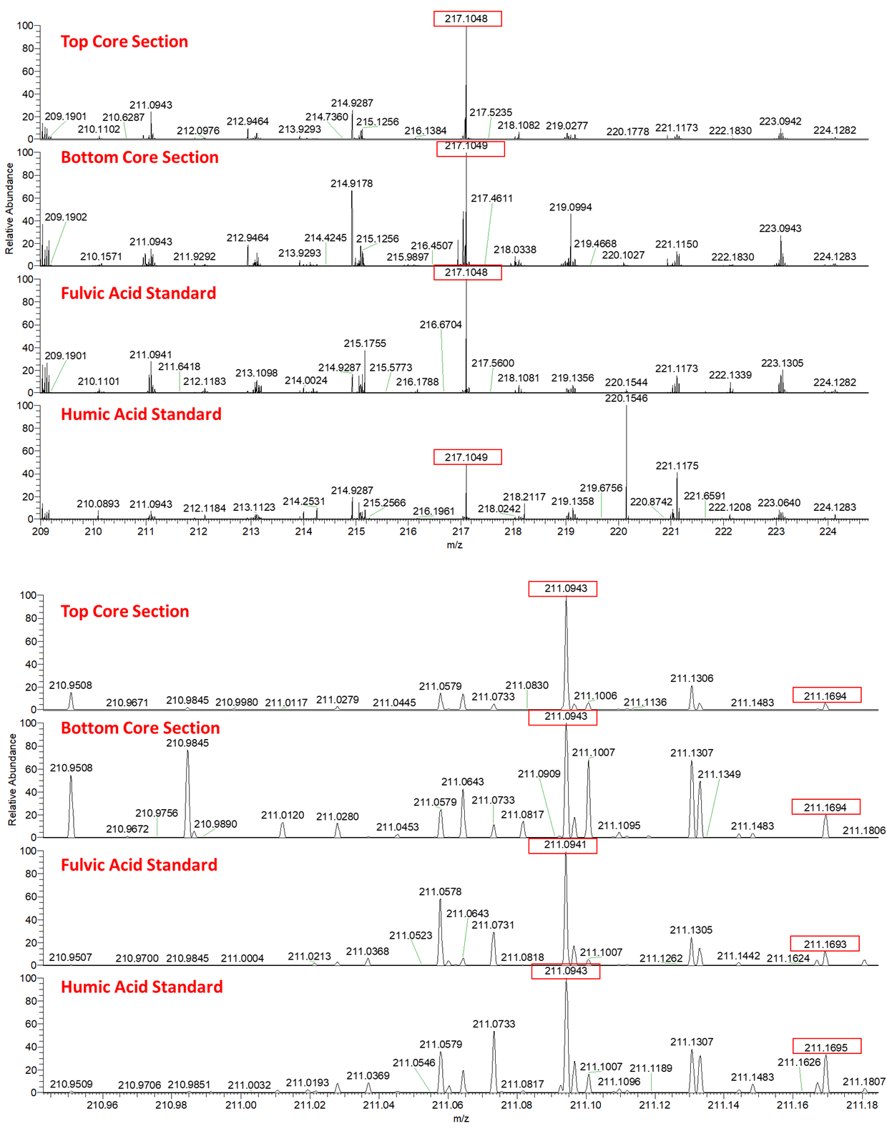
Prehistoric Chemical ‘Features’
Present Day
Sediment core from a small lake in northern Saskatchewan
Deepest segments dated to almost 9,000 YBP
Dissolved Organic carbon (DOC) extracted from sediment
Mass spectra acquired at 250,000 mass resolution by direct infusion
Fulvic, humic acid standards for comparison
> 5,000 unique ‘features’ identified per sample
Some ‘features’ persist for >8,000 years
Some of these ‘prehistoric’ features are also present in contemporary water samples
8,400 YBP
Present Day
8,400 YBP

Slide 7
Challenges and Cross-project Collaboration Opportunities
Operational challenges that you want to highlight to the network
Are there opportunities to collaborate with other GWF projects that can help solve those challenges and/or leverage opportunities to have impact (i.e. shared data or coordinated KM activities)?
Do you need something from the collective Operations Team help you solve these challenges?
Ongoing data processing, data management and KM activities
Yes. Infrastructure is installed, stable and available to all with experienced operators available to assist. Limited capacity for training or analyzing samples
We need additional and continued assistance with data processing and management and KM activities. Now archiving data.
‘Omic’ and chemical fingerprinting methodologies for geochemistry and healthy waters
Project Title

