Slide 1
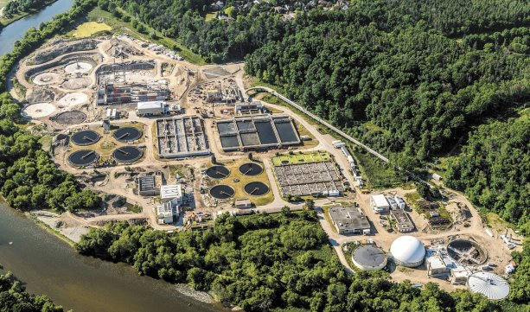
Linking multiple stressors to adverse ecological responses across watersheds
Mark Servos, Wayne Parker, Paul Craig
University of Waterloo
Objective: To reduce the cumulative impact of contaminants on water resources.
Approach: Development and validation of integrated models for predicting the exposure and response of sentiel species to mixtures and multiple stressors.
Location: Grand River watershed as a case study with emphasis on wastewater treatment plant upgrades; building on a decade of detailed ongoing (bio)monitoring in the watershed.
mservos@uwaterloo.ca
https://uwaterloo.ca/servos-group/
Project coordinates: PI, email, website, etc
Global Water Futures: Solutions to Water Threats in an Era of Global Change
Notes:
It can help to frame your main research objective as a question. For example,
How will climate change affect agriculture in Canada?
How can we improve water quality and reduce algal blooms in Canadian lakes?
What are the links between fish health, food safety and food security in the Indigenous North?
What is the significance of groundwater fluxes on surface water flow?

Slide 2




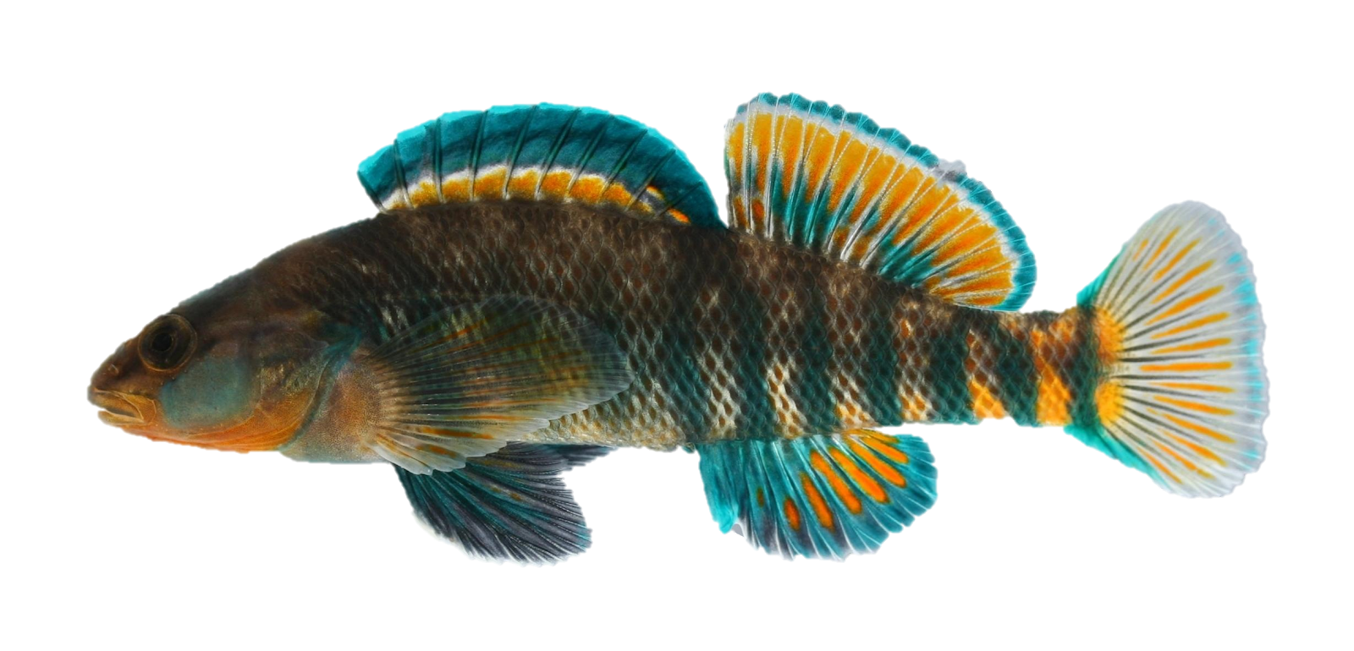
Transformational Science Highlights
Influent
Effluent
River
Fish
Linked model development and application supporting local and national policy.
Incorporation of relevant chemicals (including chirality), fate processes and biological endpoints (estrogenic, metabolism, growth, etc.).
HQP Training: 4 MSc, 2 PhD students, 1 PDF have been involved in interdisciplinary projects.
Project Title
Linking multiple stressors

Slide 3
Transformational Science Highlights
a) Pre-upgrade
b) Post-upgrade
Testing scenarios:
infrastructure upgrades, emerging contaminants, population growth, climate change
Supporting assessment of remedial actions:
Prediction of changes in effluent quality on ecological impacts relative to specific effects thresholds (e.g. estrogens, metabolism).
GWF Project directly linked to
NSERC-CRD with Region of Waterloo
Project Title
Linking multiple stressors
Notes:
These accomplishments slides will be also be used to build slide bank for use in GWF presentations
How are these results key to advancing the science
How are these results linked to the needs of your partners/users?

Slide 4
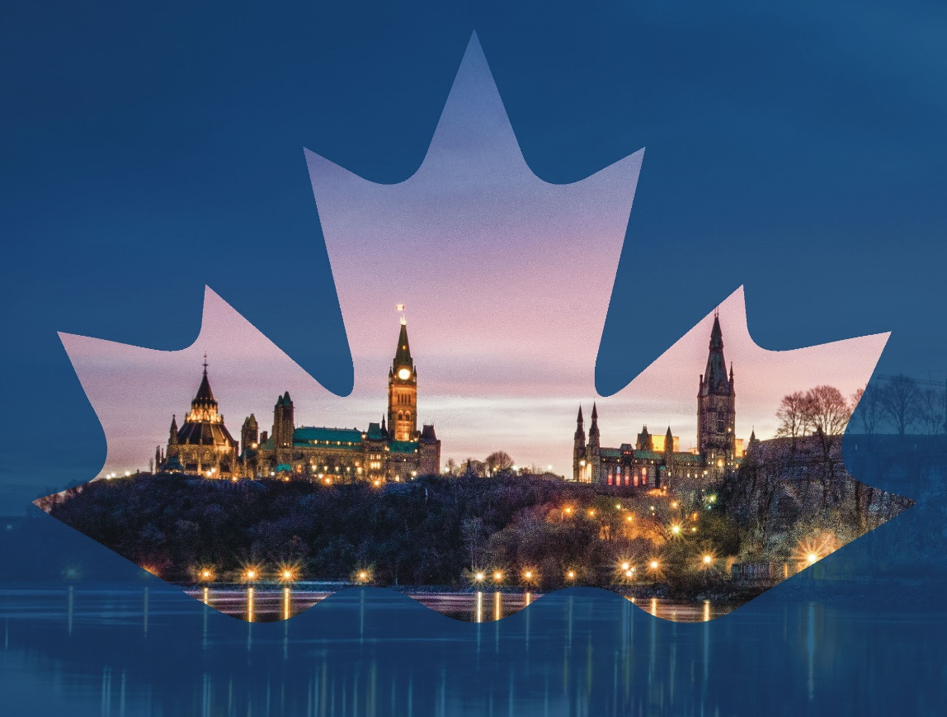
Project Impact and Aspirations
Direct collaboration with municipalities, federal government and watershed agency (GRCA).
Supporting national assessment and policy related to wastewater infrastructure and challenges of emerging contaminant assessment and remediation.
Advancing approaches to assess and predict cumulative effects at watershed scales.
Strengthening linkages to (inter)national projects, reviews and policy development (e.g. Eawag Visiting Fellow, National Wastewater Panel)
Canada’s Challenges and Opportunities to Address Contaminants in Wastewater (National Panel Report)
Project Title
Linking multiple stressors
CANADA’S CHALLENGES AND OPPORTUNITIES TO ADDRESS CONTAMINANTS IN WASTEWATER
National Expert Panel
Notes:
Eawag is the highest ranked water institute in world
National Panel reported directly to ECCC.

Slide 5
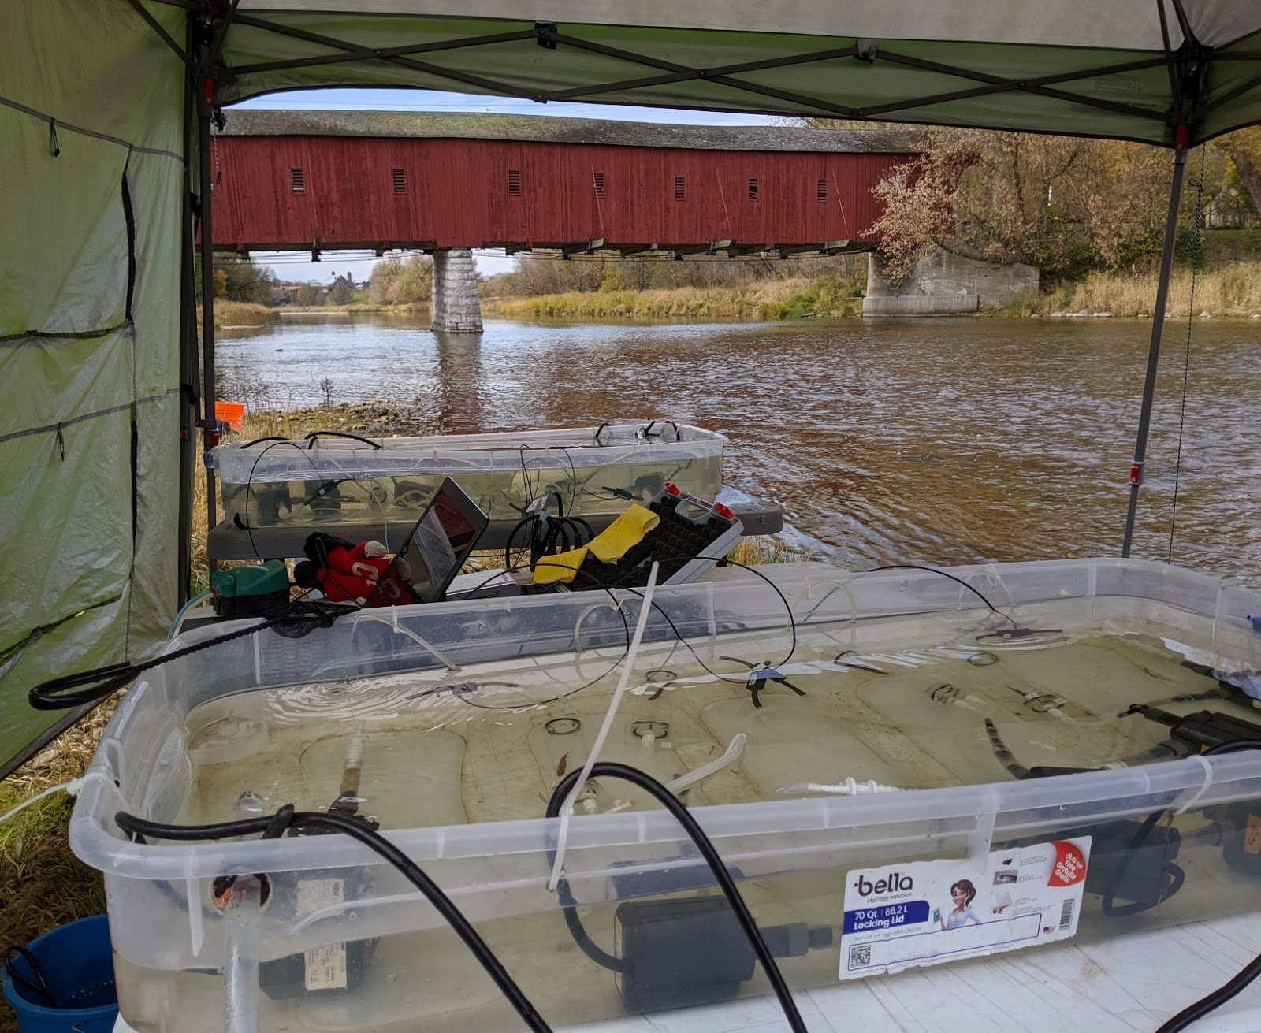
Challenges and Cross-project Collaboration Opportunities
Strong collaboration and support already but potential for additional linkages to the modelling group and other projects working in other watersheds (especially Grand River).
Extending models downstream to Six Nations of the Grand River.
Potential to extend model to other chemicals, hydrologic conditions and (sub)watersheds.
Opportunity to further engage students with GWF HQP activities.
Validating effects endpoints in the Grand River watershed
Linking multiple stressors
Project Title
Notes:
Biological responses (e.g. metabolism, intersex, growth) and stressors (wastewater, agricultural runoff, temperature)
Intake of Six Nation Drinking Water Plant.

