Slide 1
Indigenous Community Water Research Projects
CCIWQT
Sensors and Data
(Ravi, 3:33pm)
Ohneganos
Field Testing Sensors
Indigenous Training
and
Capacity Development
CEA Team
WG Team
Sensors Networks and Data Systems
TEK Training and Water Governance
CHA Team
MW Team
Human and Ecological Health Assessment Information
IK Team
IK Team
Water Quality and Ecological Health Information
Co-Created Holistic Water and Health Wellness Tools
Project Title
9
Putting it all together: A Holistic Vision for Community
🔎: Dawn Martin-Hill | ✉️: dawnm@mcmaster.ca | 🌐: https://cciwqt.squarespace.com/

Slide 2
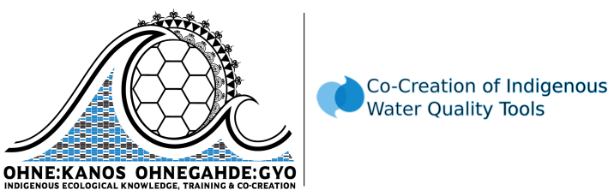
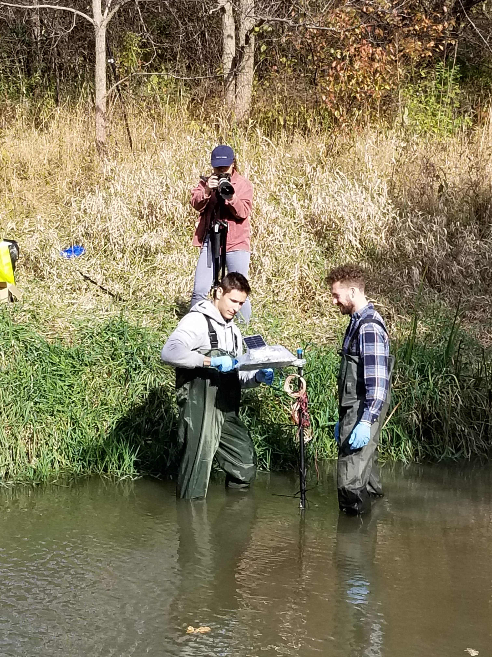
Co-Creation of Indigenous Water Quality Tools
BACKGROUND
Access to clean, safe, and plentiful water in Indigenous communities is often difficult and environmental degradation is severe.
          Environmental health is fundamental to culture and community.
          PROJECT INFORMATION
            Led by Indigenous knowledge & community
          Main objective: characterizing ecological health and community health by investigating environmental water quality and water quality in built systems.
          Methodology: Employs an innovative approach to knowledge creation and epistemology reconciliation – co-constructing knowledge by corroborating Western Science and Indigenous Knowledge.
          Community Partners: Six Nations and Lubicon Lake Nation
Figure 1: Installing sensors in Mackenzie Creek (Personal, 2019)
Project coordinates: PI, email, website, etc
Co-Creation of Indigenous Water Quality Tools
1
🔎: Dawn Martin-Hill | ✉️: dawnm@mcmaster.ca | 🌐: https://cciwqt.squarespace.com/

Slide 3
Transformational Science Highlights
Indigenous Knowledge | Community Health Assessment | Community Ecological Assessment
Climate summit event and report Water governance – Water Council and Grandmother’s Council protect/directed by treaties IK direction to CHA and CEA, culture, ceremony, ecology Hunter monitoring Youth training programs Ohneganos Ohnegahdę:Gyo | 55 surveys completed (health and water use) 22 interviews discussing health and water completed Data analysis for surveys will start at the end of Nov 2019 Data analysis for interviews has already begun Aiming to share findings March 2020 Summaries will be presented to community according to their preference (e.g. digital story or video) | Investigating the impact of climate change and extreme weather events on reserve. Analyzed water samples taken from taps, wells, cisterns of 75 households. Contamination detected exceeding guidelines (e.g. mercury) Investigating water quality in the Grand River and tributaries (Mackenzie and Boston Creek). High levels of P and E.Coli contamination found in certain areas. Sensor installations begun.
Project Title
Co-Creation of Indigenous Water Quality Tools
2
🔎: Dawn Martin-Hill | ✉️: dawnm@mcmaster.ca | 🌐: https://cciwqt.squarespace.com/

Slide 4
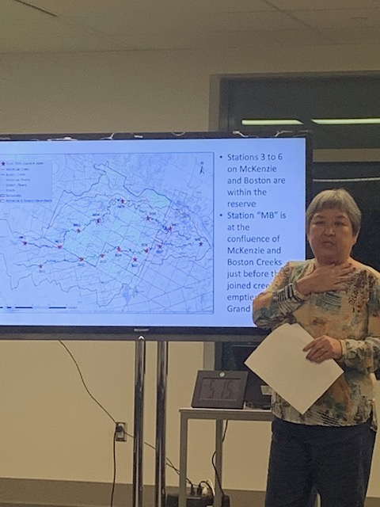
Transformational Science Highlights
Dr. Pat Chow-Fraser, McMaster University
Monthly survey of water quality (E.coli)
Extreme weather events, climate change, and flooding – impact on water quality
Comparing water quality along the Grand River with water quality found in Six Nations
Project Title
Co-Creation of Indigenous Water Quality Tools
2
🔎: Dawn Martin-Hill | ✉️: dawnm@mcmaster.ca | 🌐: https://cciwqt.squarespace.com/

Slide 5
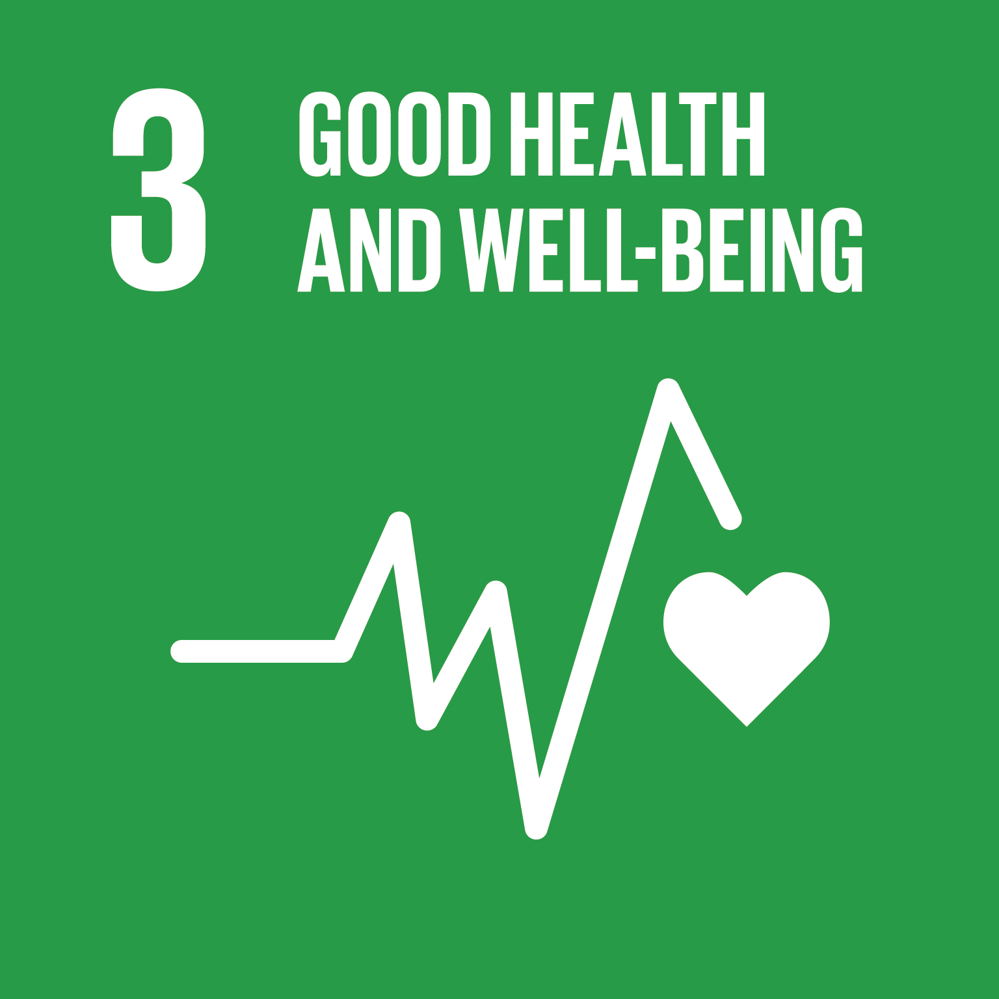
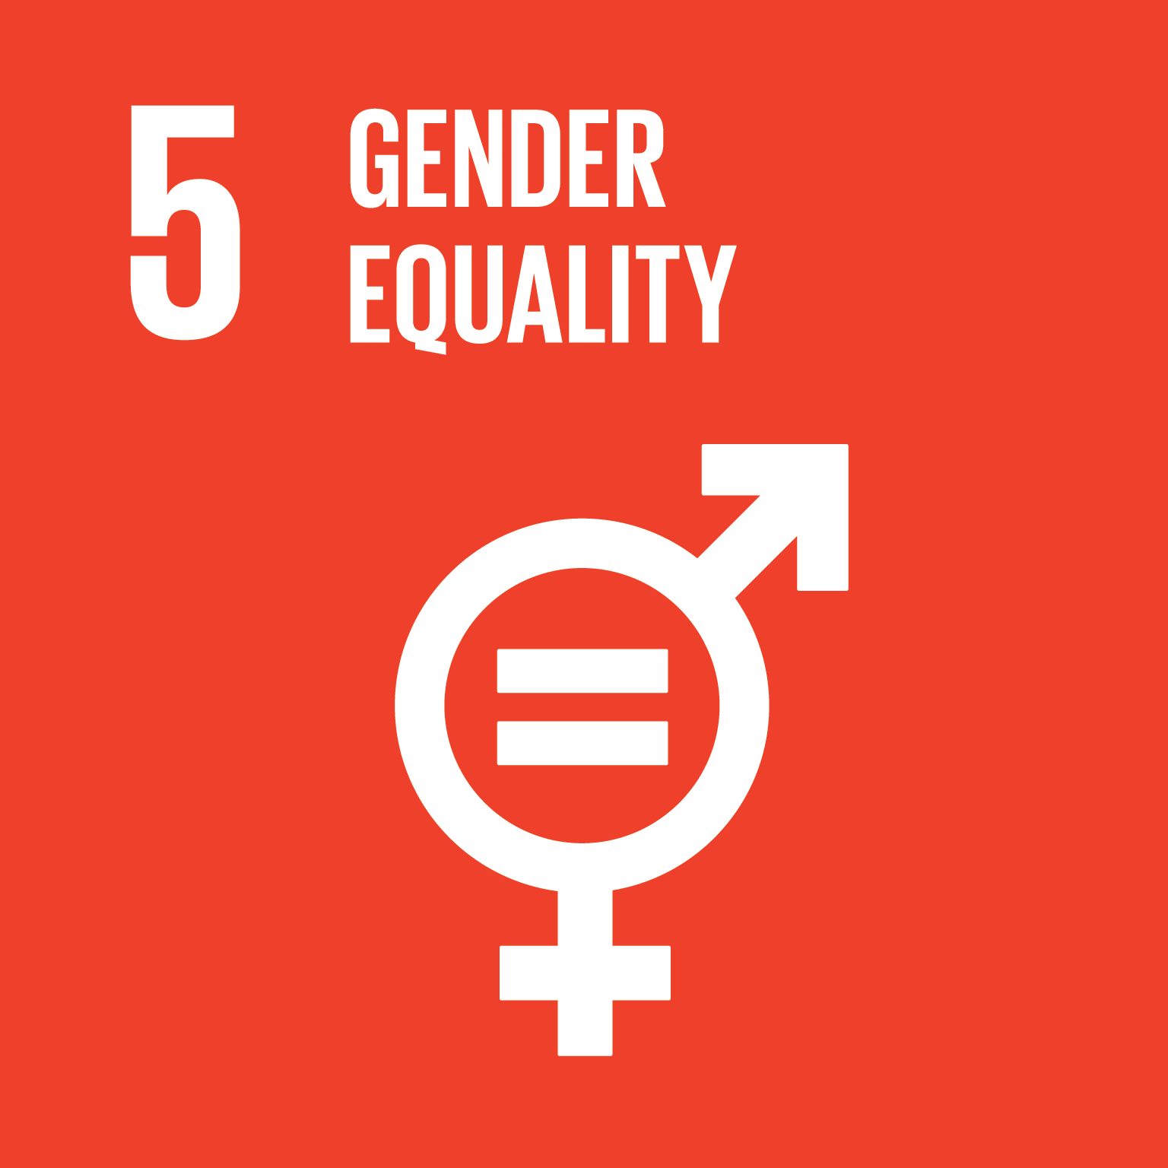
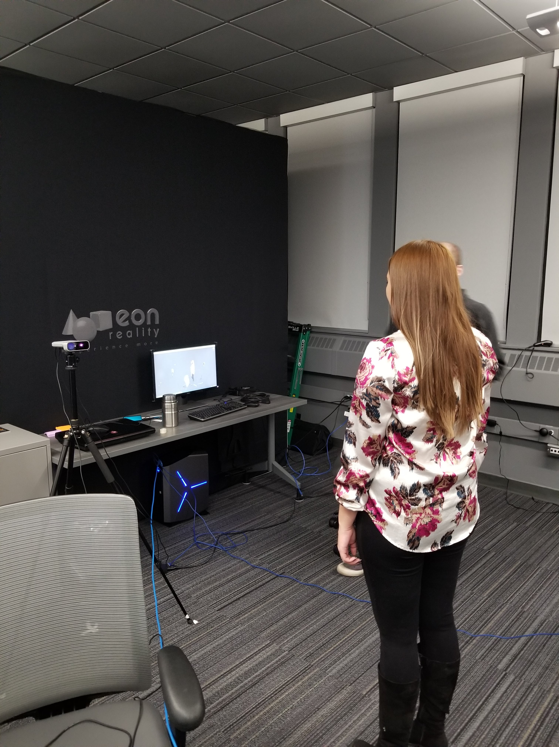
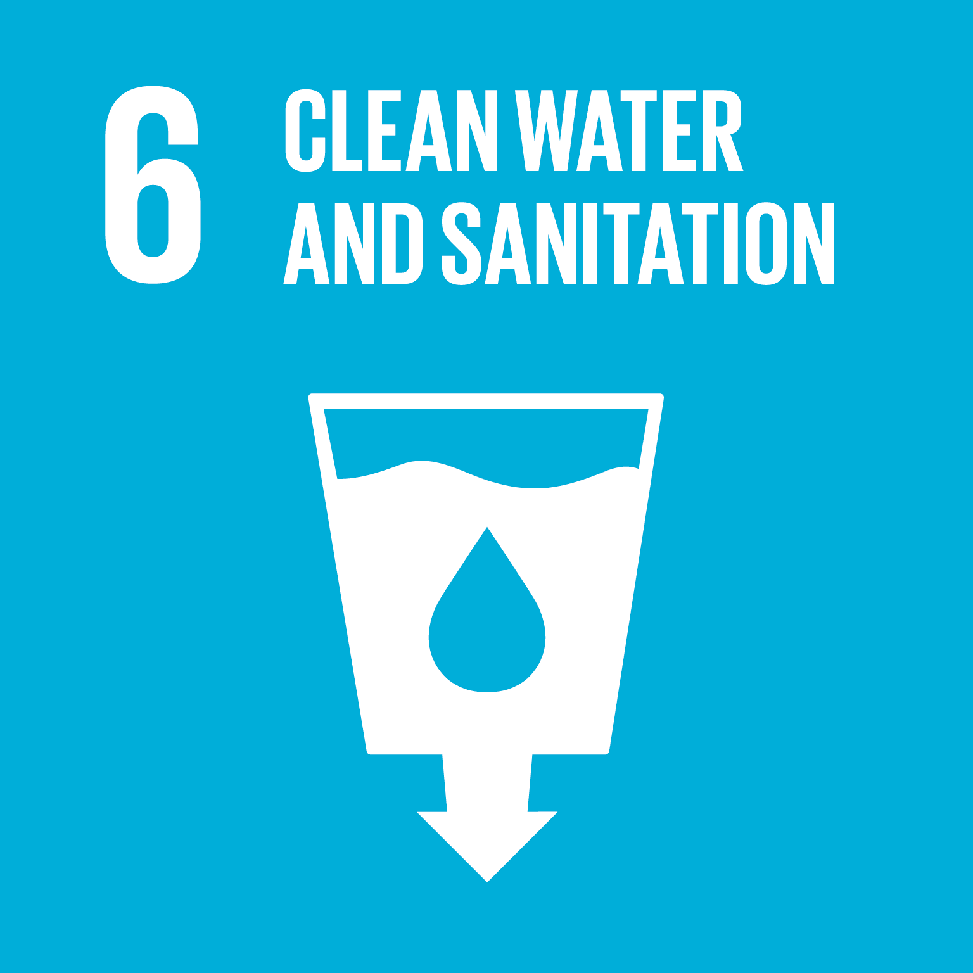
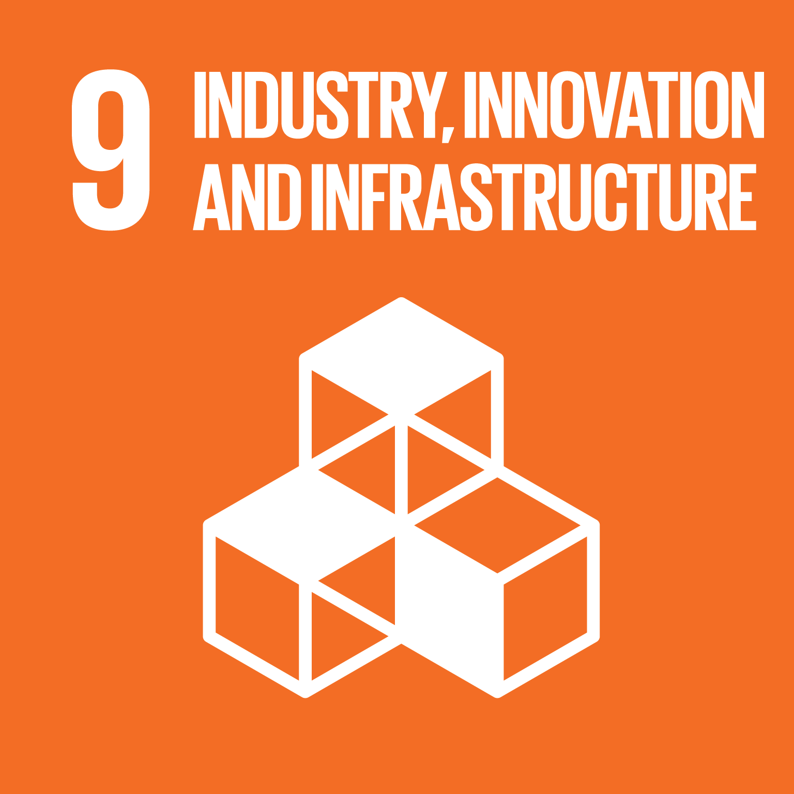
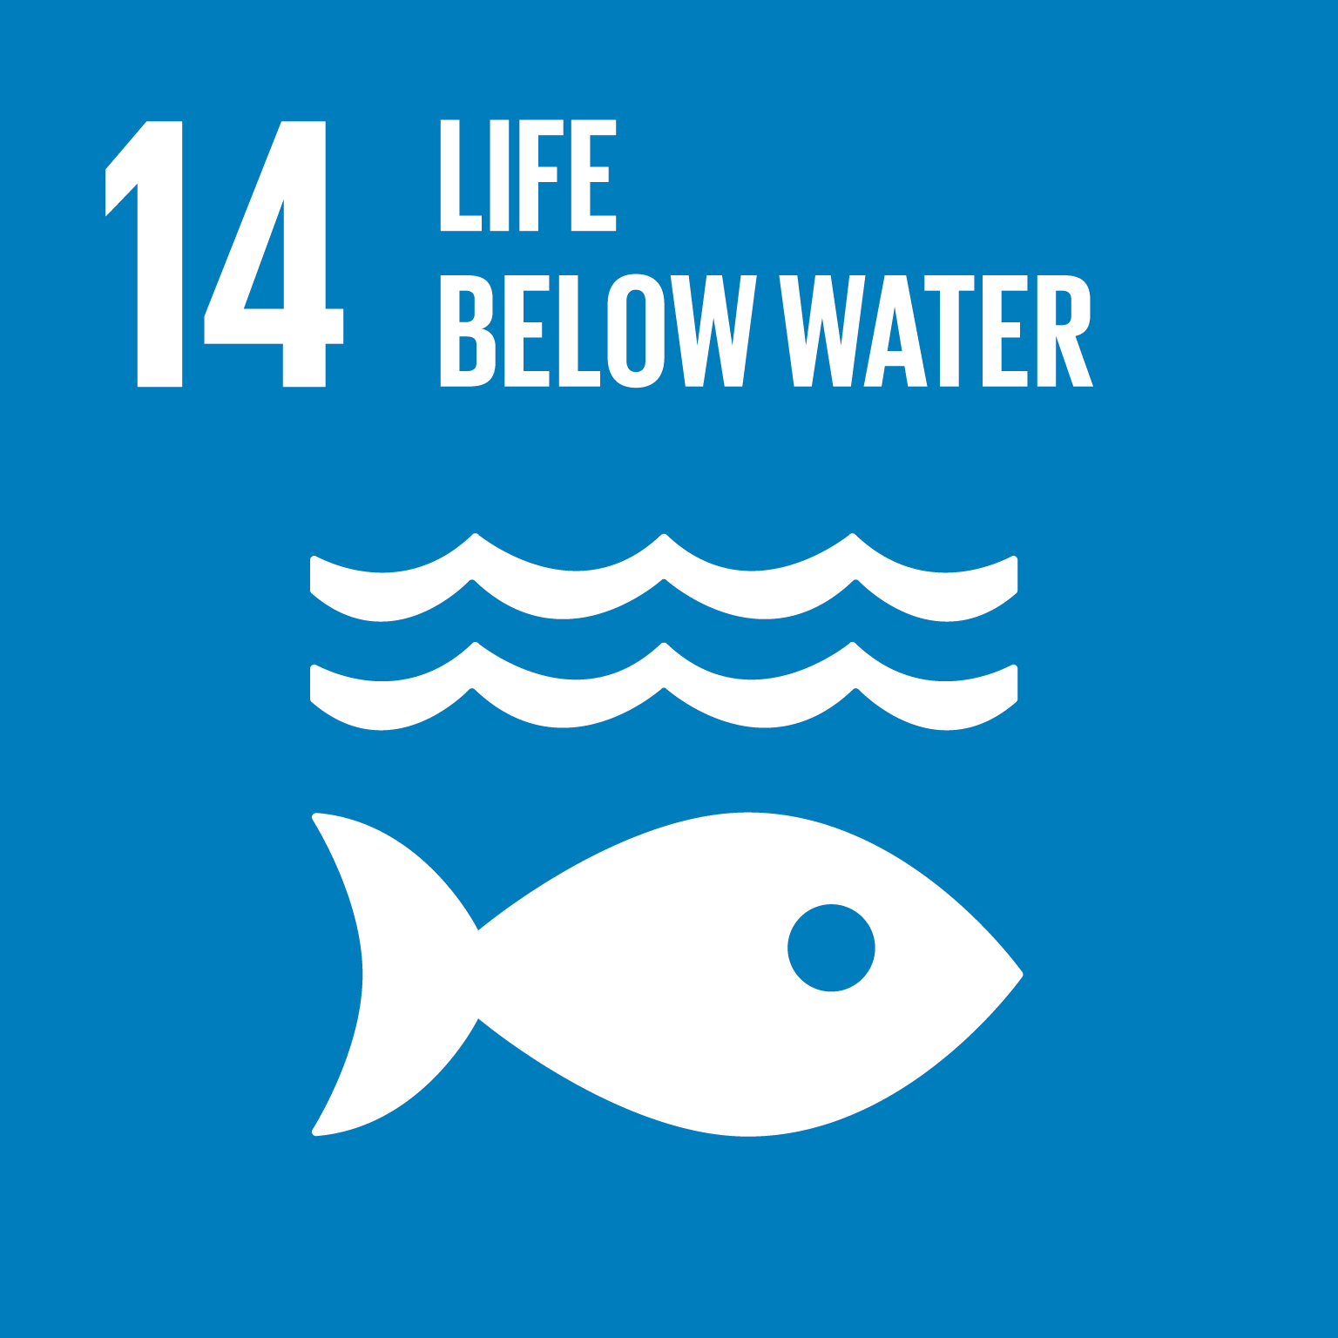
Project Impact and Aspirations
LEGACY EXAMPLE: TOUR OF THE GRAND RIVER
Traditional Ecological Knowledge and data from Western Science studies used to document past, present health of the Grand River and project future health.
Interactive experience employing indigenous pedagogies (digital storytelling, experiential learning) and cutting-edge technologies.
Culture embedded in experience – language - art, music, spirituality
Female youth – Voice of the River data presented in this format with traditional knowledge
Virtual reality, 3D modelling, volumetric capture and holographic imagine.
Figure 1: Volumetric capture to create a hologram for storytelling at Mohawk College (Personal, 2019).
Keep an eye out for our demo tomorrow!
Project Title
Co-Creation of Indigenous Water Quality Tools
3
🔎: Dawn Martin-Hill | ✉️: dawnm@mcmaster.ca | 🌐: https://cciwqt.squarespace.com/
Notes:
while implementing water security underscored by UNDRIP, TRC, UNESCO and several SDG through our water monitoring, women, Indigenous knowledge and capacity building. We do meet the UNESCO Resolution XXIII-8, IHP support sustainable goal indicator 6.a.2 water education affirms intergovernmental programme devoted to fostering water research, water resources management, education and women/youth capacity building, all female leads with Six Nations community, observing the UNESCO target, Agenda 2030 “aims to achieve gender equality and empowerment of women and girls” and (SDG 5) “developing technology” to disseminate western/Indigenous technology through science storytelling - bilingual, virtual and augmented reality with Mohawk College
- developing Indigenous language waterscaping maps with traditional stories, resiliency outcomes and scholarly theoretical and applied Indigenous governance tools developed to assist Indigenous people's achieve SDG 5 and XXIII-8., highlight the SDG 5 women and girls as the AFN has a history of not embracing gender equity as you may notice.

Slide 6
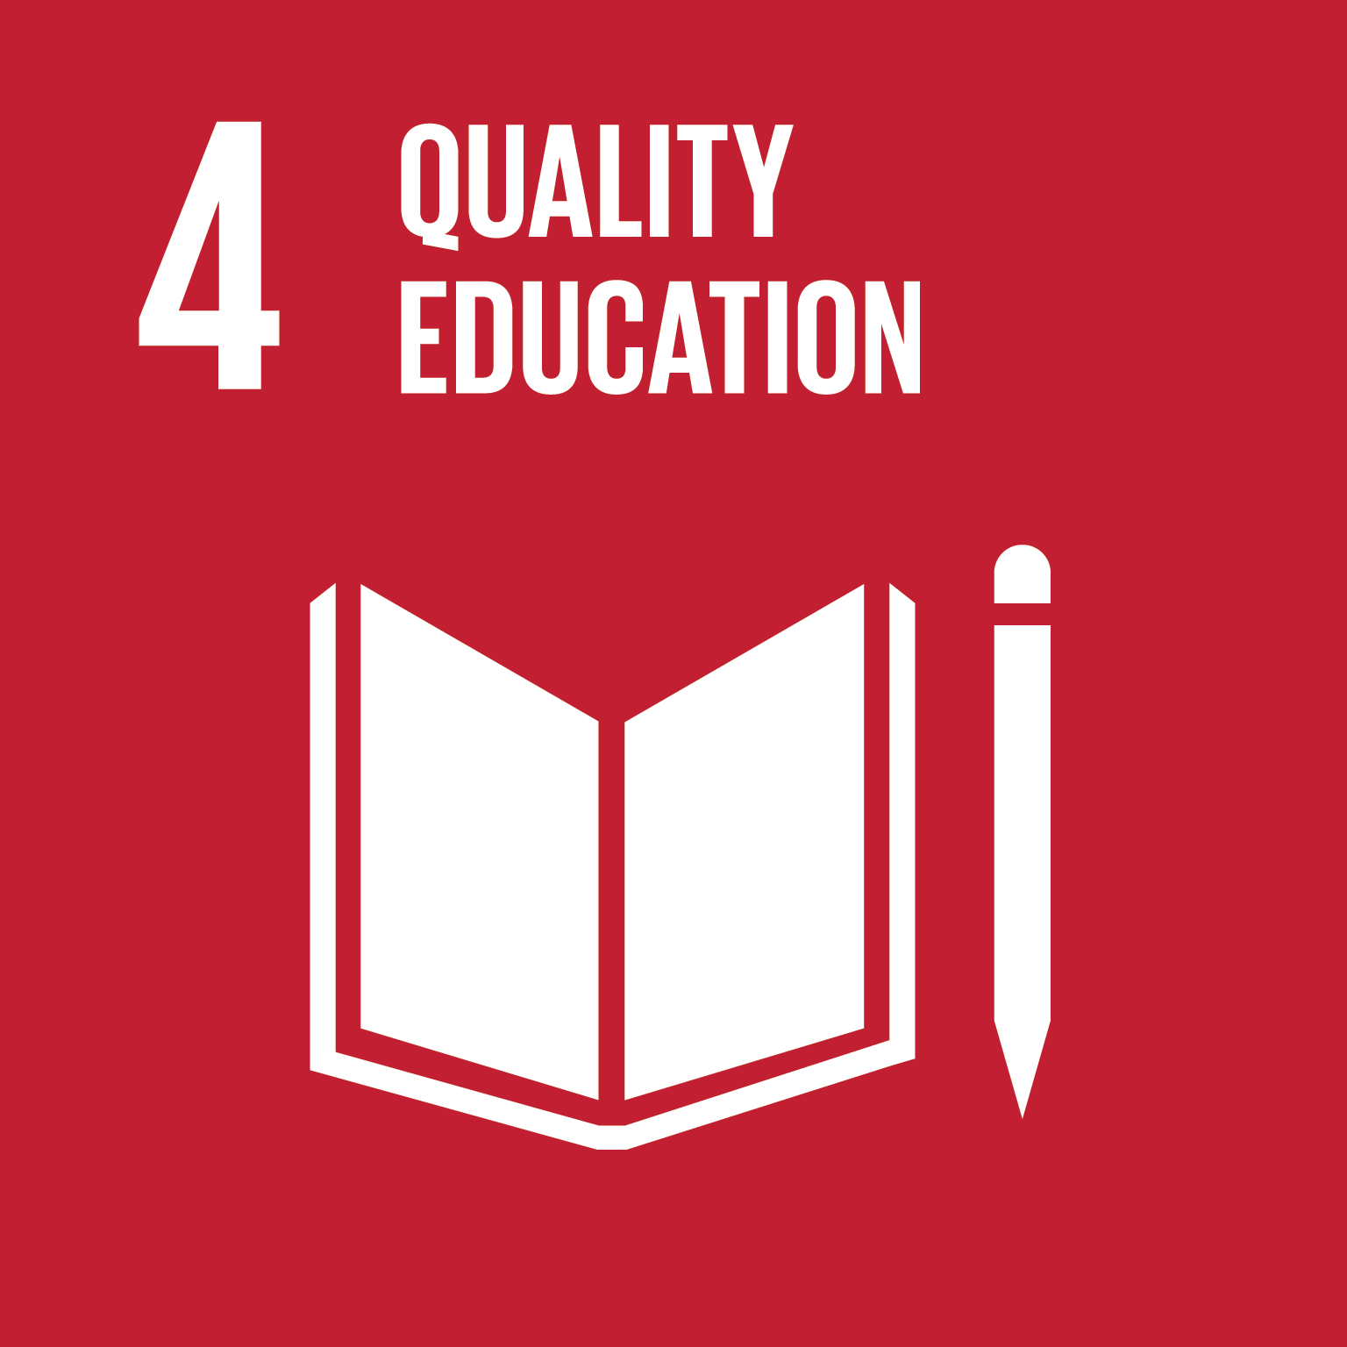
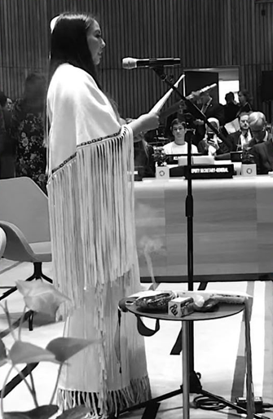
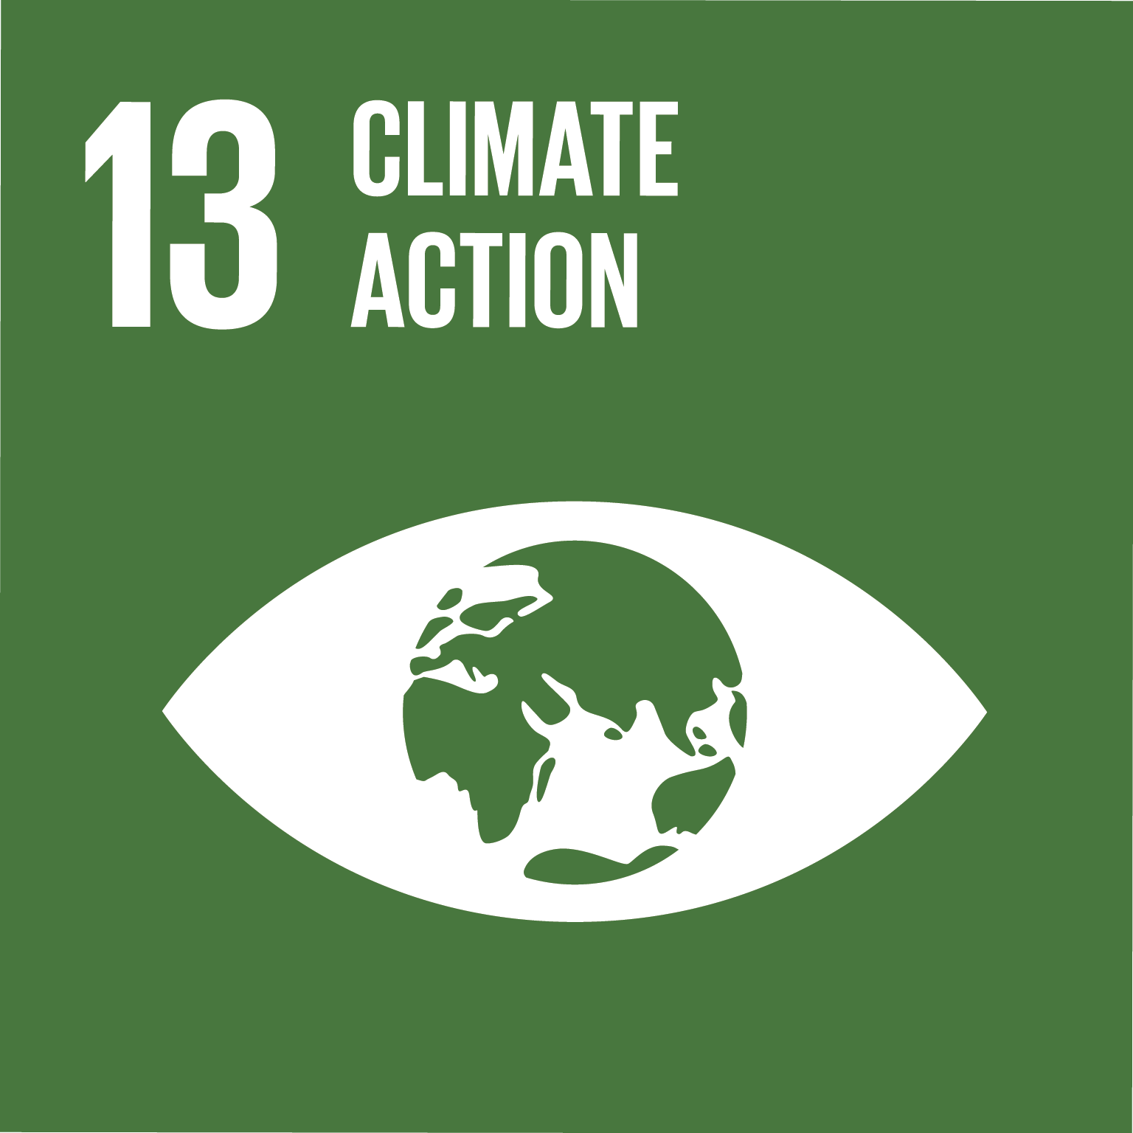
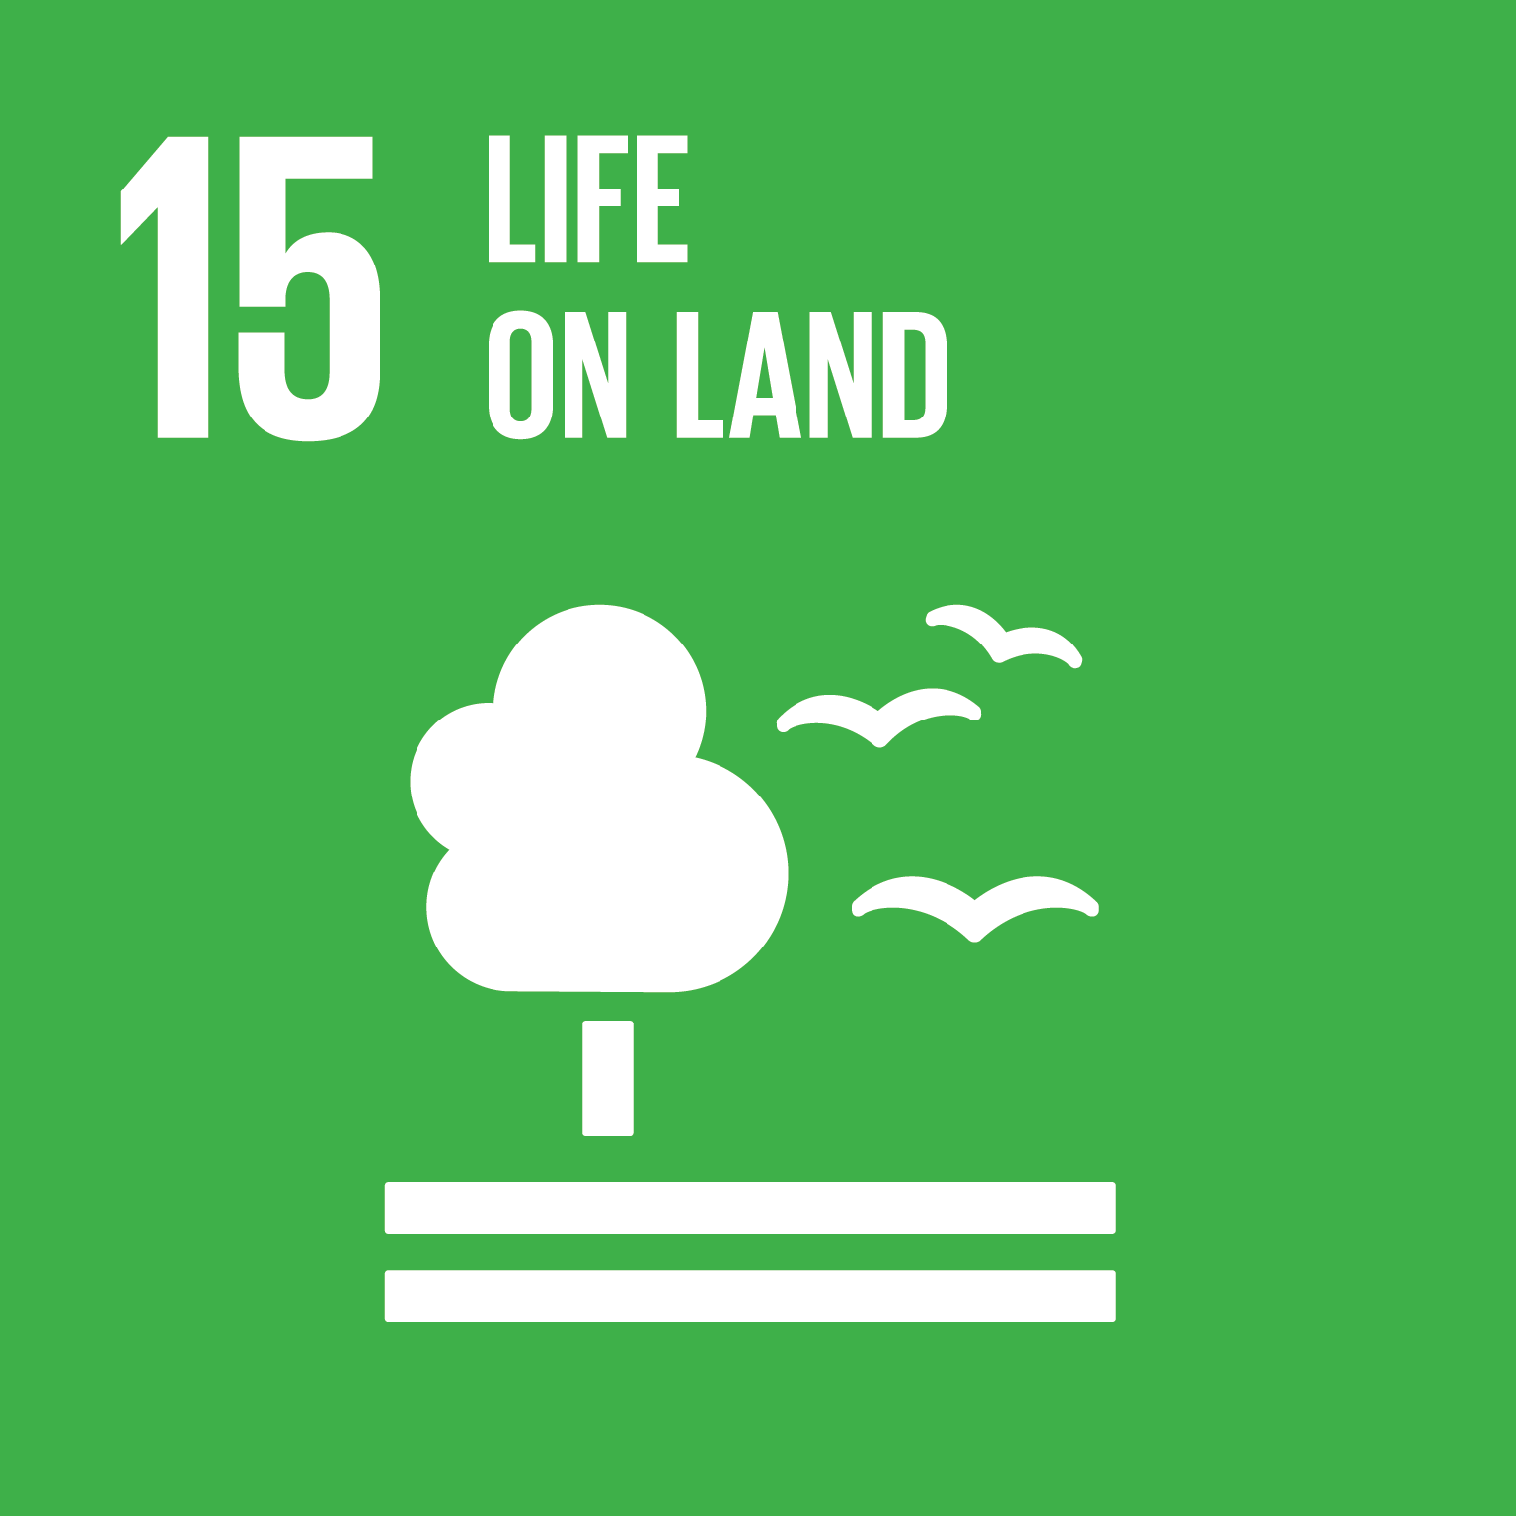
Ohneganos Ohnegahdę:Gyo
Indigenous Ecological Knowledge, Training & Co-creation of Mixed-Methods Tools
BACKGROUND
Barriers in the education pipeline exist, preventing indigenous students from pursuing science.
Climate change and environmental degradation is impacting the mental health and wellbeing of indigenous youth.
Scientific resources need to be created to reflect indigenous culture, language, methodologies and pedagogies.
PROJECT INFORMATION
          Main objective: to develop educational and wellness tools (e.g. bilingual mapping waterscapes, turtle tagging, mental health app, bilingual science textbooks) and educational pathways (e.g. TEK diploma, water operator certification, experiential learning initiatives) for indigenous youth.
          Methodology: Innovative approach to knowledge creation/epistemology reconciliation – co-constructing knowledge by corroborating Western Science and Indigenous Knowledge.
          Community Partners: Six Nations and Lubicon Lake Nation
Figure 2: Youth leadership – opening at the UN Youth Climate Summit.
Project coordinates: PI, email, website, etc
Ohneganos Ohnegahdę:Gyo - Indigenous Ecological Knowledge, Training & Co-creation
5
🔎: Dawn Martin-Hill | ✉️: dawnm@mcmaster.ca | 🌐: https://cciwqt.squarespace.com/
Notes:
Ohneganous is developing capacity to strengthen legal and political stewardship over aquifer and developing tools for community to respond to:
2) U.N. assessment, compiled by 145 experts from 50 countries over three years Summary for policymakers of the global assessment report on biodiversity and ecosystem services -, "While humans have "significantly altered" environments, these trends have been less severe or avoided altogether in areas held or managed by Indigenous peoples. Indigenous people could contribute to global sustainability efforts if provided legal and political rights to use and steward the lands they know so well."
(Sandra Díaz, (Co-Chair, Argentina), Josef Settele (Co-Chair, Germany), Eduardo Brondízio (Co-Chair, Brazil/United States of America)
Supporting Haudenosaunee women - students present at UN IPPF – (use poster attached) leading to their invitations to Geneva, Youth Water Summit, Rapid City SD, UN Youth Climate Change Summit, NY (Makasa’s photos) creation of traditional governments Water Committee to assist in advising GWF youth (list names of Chiefs)

Slide 7
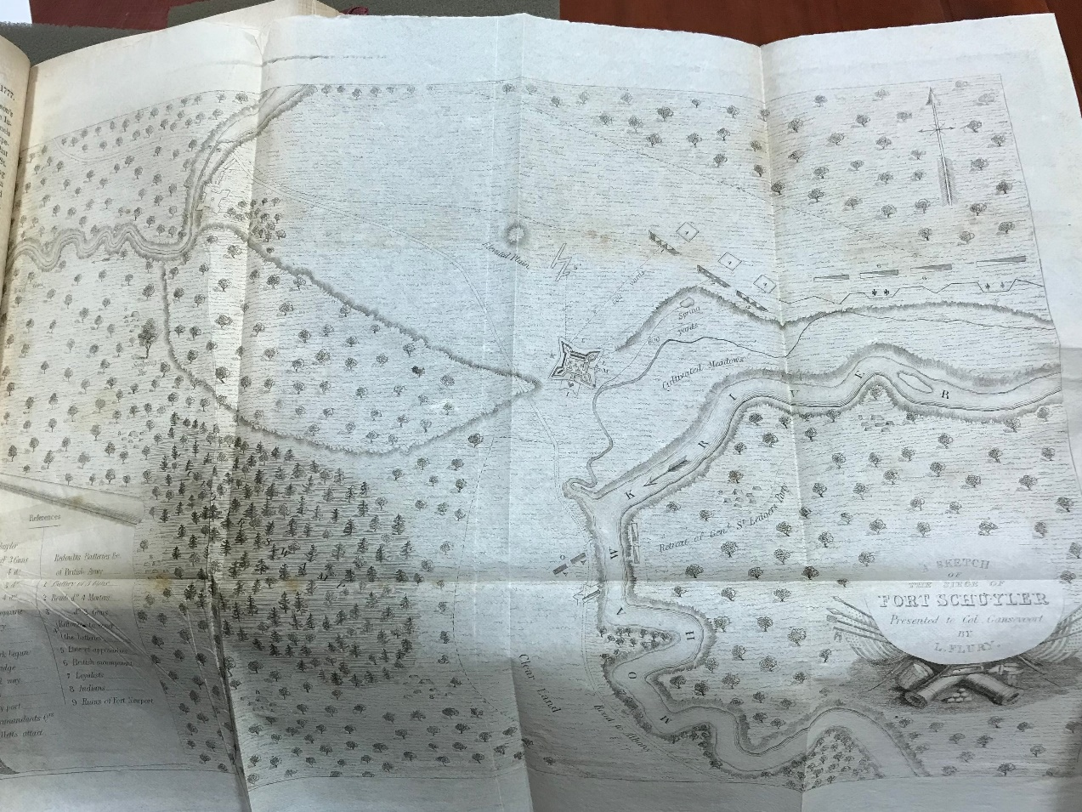
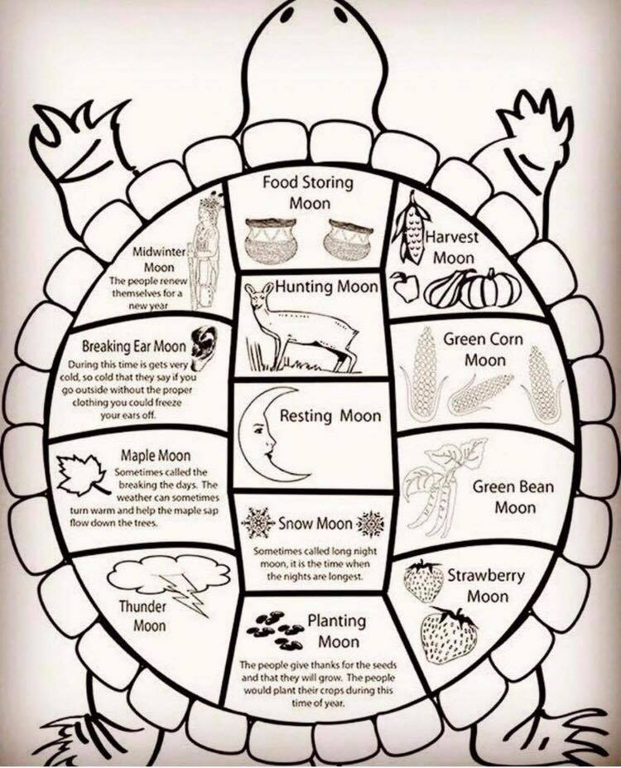
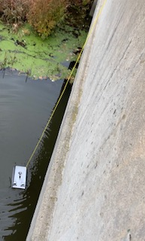
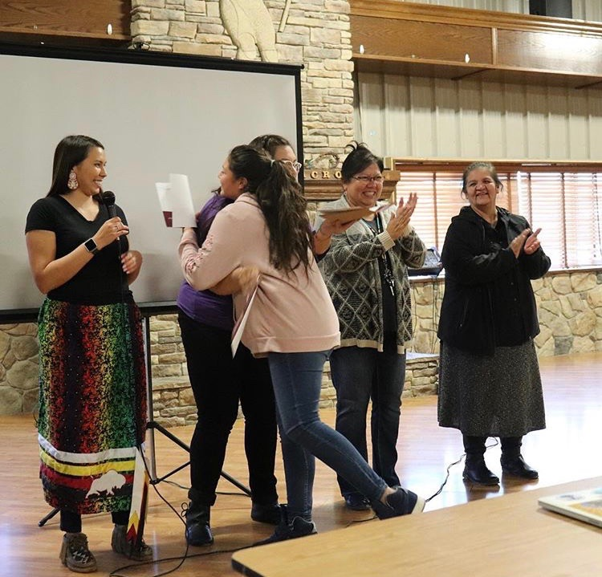
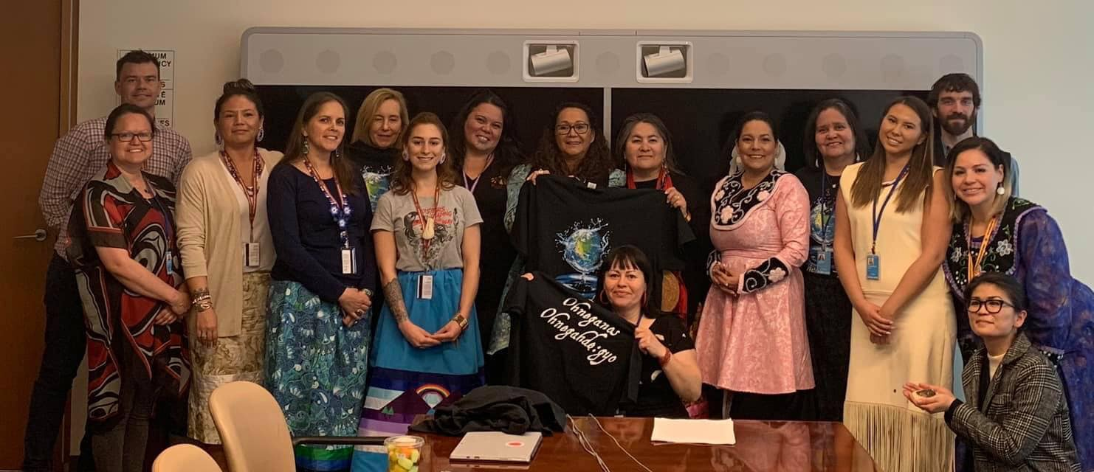
Transformational Science Highlights
Indigenous Knowledge Training | Mental Wellness | Water Governance
2. Story’ing our land and water.
4.a Turtle Tagging.
1. Students receiving certificates.
3. Digital storytelling.
4.B Underwater Drone.
Project Title
Ohneganos Ohnegahdę:Gyo - Indigenous Ecological Knowledge, Training & Co-creation
6
🔎: Dawn Martin-Hill | ✉️: dawnm@mcmaster.ca | 🌐: https://cciwqt.squarespace.com/
Notes:
Kawenni:yo/Gaweni:yo Students Receiving Certificates
2. Story’ing our land, colonial maps present ‘empty wilderness’- we populate them with ancient heritage to modern day. Rebekah update: I've created the naming database and it has been populated with the archival information. I've produced a number of stripped-down maps (i.e., physical features only, no markings at all)
3. Digital stories demonstrating how water quality shapes and informs emotional-mental wellbeing; developing pathways to empower and manage control over their water, facilitate mechanisms to achieve self-determination; and in the 2019 UN Indigenous Forum.
4. Turtle tagging to monitor populations. Use underwater drones for identification and educational purposes.

Slide 8
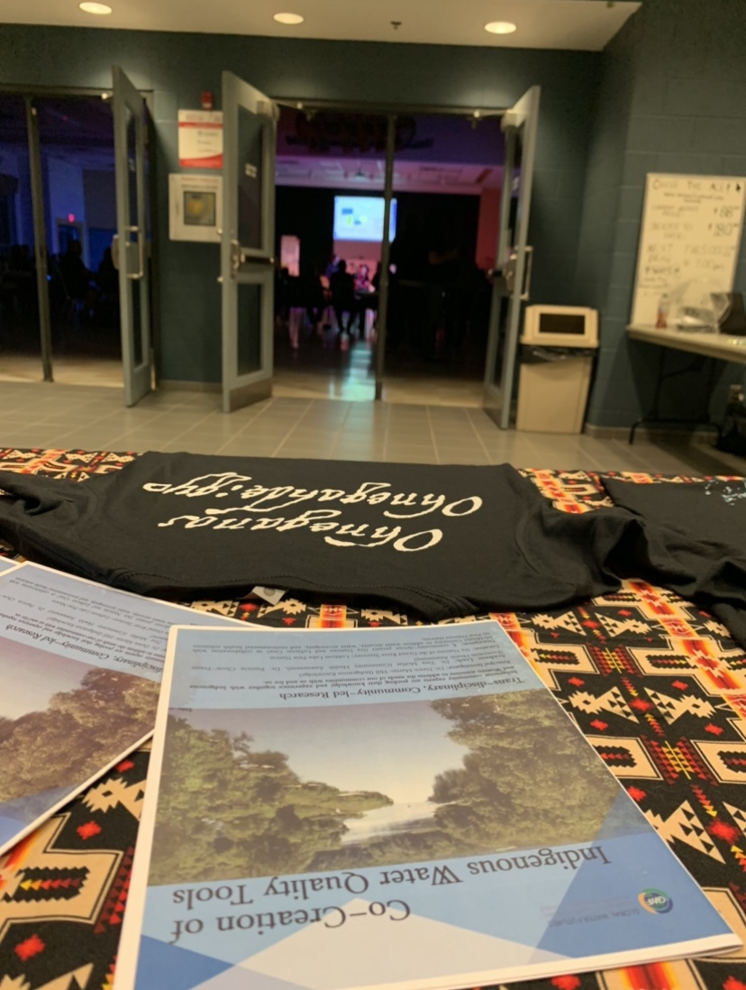
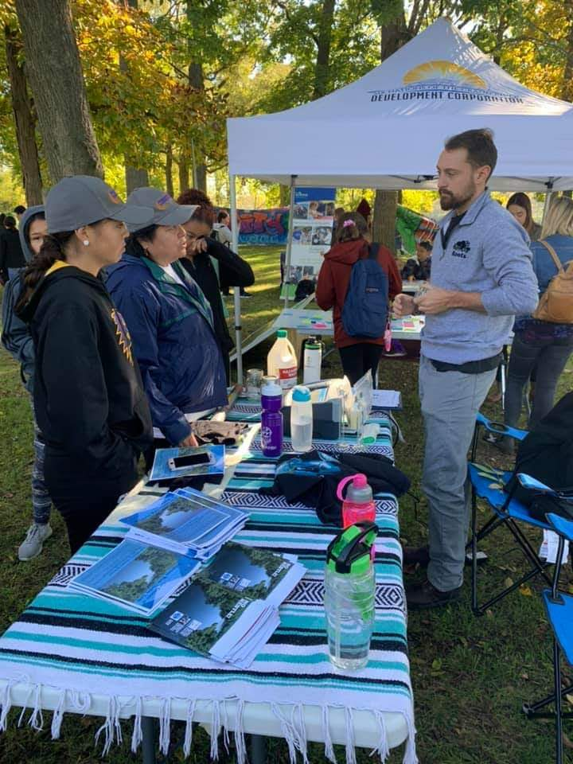
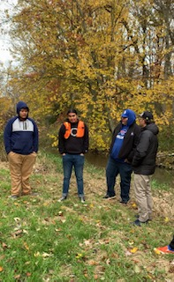
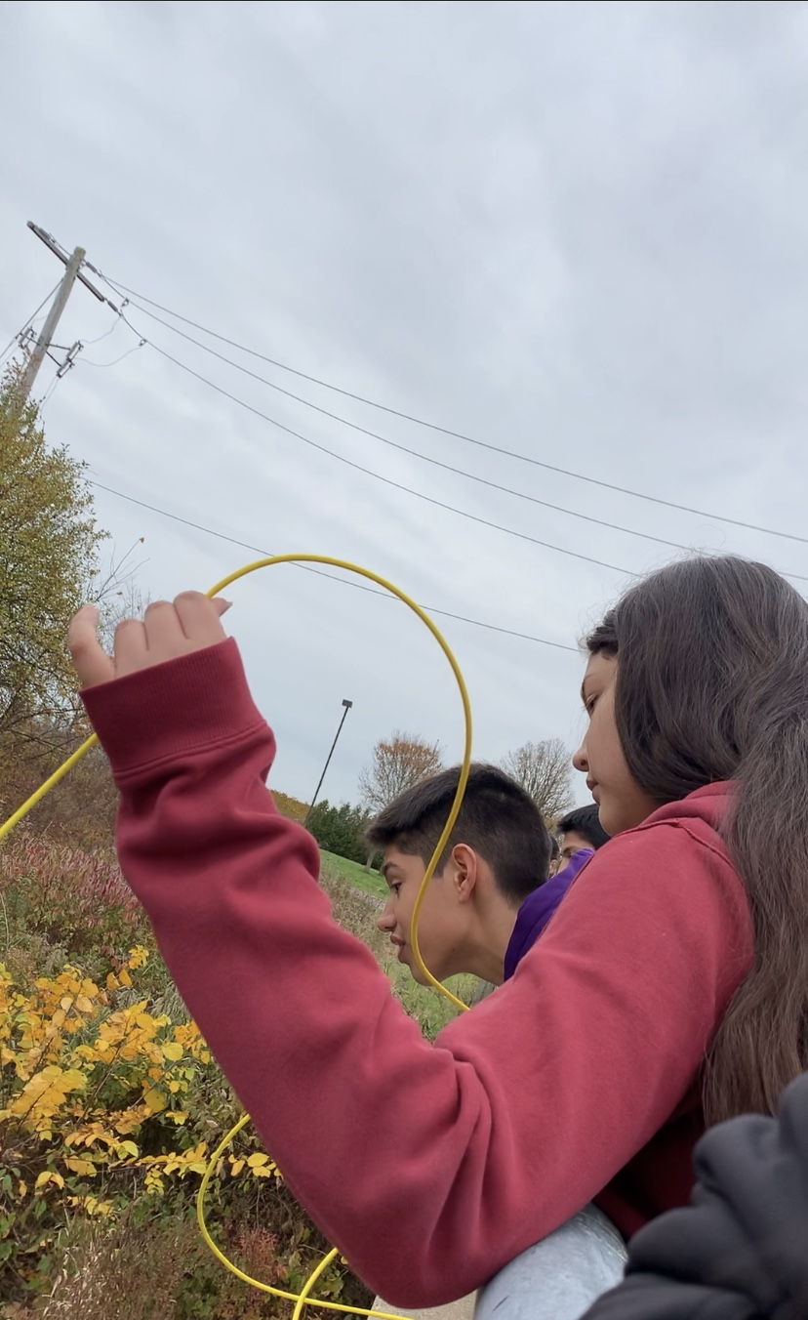
Transformational Science Highlights
Indigenous Knowledge Training | Mental Wellness | Water Governance
Project outreach – Youth-led Climate Event
Land-based learning – collaborations with Dartmouth University
Project Title
Ohneganos Ohnegahdę:Gyo - Indigenous Ecological Knowledge, Training & Co-creation
6
🔎: Dawn Martin-Hill | ✉️: dawnm@mcmaster.ca | 🌐: https://cciwqt.squarespace.com/

Slide 9
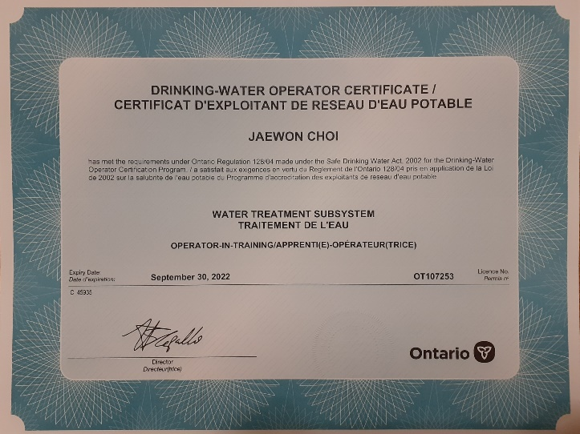
Project Impact and Aspirations
LEGACY EXAMPLE: INDIGENOUS WATER TREATMENT OPERATOR CURRICULUM
Step 1
Highschool modules for water treatment plant training to prepare for provincial exam
Provincial exam completion awards operator-in-training certificate
Permits working in water treatment plants
Double as a university/college credit
Step 2
Develop a curriculum to deliver in water treatment plant
Model Six Nations water treatment plant for remote training
Pass this course, second credit for university/college
Train to be class 1, 2, 3, 4 (depending on number of hours)
Continuing Education Committee:
Amy Kelaidis
Lorraine Vanderzwet-Servos
Johanne McCarthy
Project Title
Ohneganos Ohnegahdę:Gyo - Indigenous Ecological Knowledge, Training & Co-creation
7
🔎: Dawn Martin-Hill | ✉️: dawnm@mcmaster.ca | 🌐: https://cciwqt.squarespace.com/

Slide 10
Challenges and Collaboration Opportunities
Project Administration
Research Grant Model – need holistic model to avoid community confusion;
Graduate Students in Indigenous & Studies community hires full time
Coordination with community and scheduling;
Accommodating research timelines and understanding community context;
Maintaining lead from community;
Administrative support and community liaisons;
Ethics;
Project Title
Co-Creation of Indigenous Water Quality Tools
4
🔎: Dawn Martin-Hill | ✉️: dawnm@mcmaster.ca | 🌐: https://cciwqt.squarespace.com/

Slide 11
Meet the Team Leads
Co-Creation of Indigenous Water Quality Tools
Ohneganos Ohnegahdę:Gyo
Principal Investigator | Dawn Martin-Hill
IK Team | Dawn Martin-Hill
CHA Team | Tina Moffat
CEA Team | Patricia Chow-Fraser
Principal Investigator | Dawn Martin-Hill
IK Training Team | Dawn Martin-Hill
Mental Wellness Team | Christine Wekerle
Water Governance Team | Beverly Jacobs
IK = Indigenous Knowledge
CHA = Community Health Assessment
CEA = Community Ecological Assessment
Indigenous Community Co-Lead: Lori Davis-Hill
Project Title
9
Putting it all together: A Holistic Vision for Community
🔎: Dawn Martin-Hill | ✉️: dawnm@mcmaster.ca | 🌐: https://cciwqt.squarespace.com/

