Slide 1
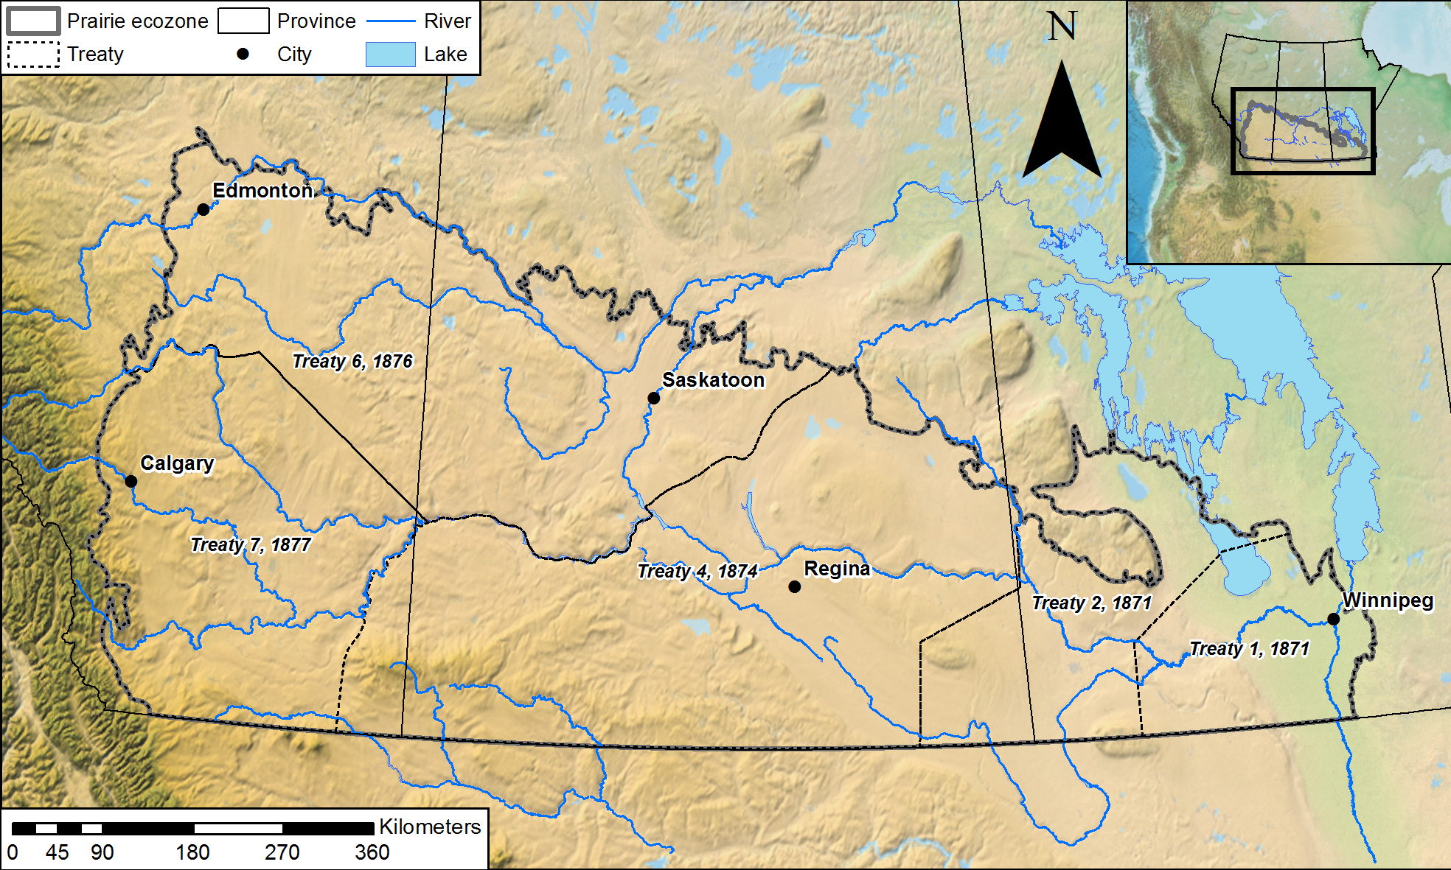
Prairie Water
How can we enhance the resilience of Prairie communities to climate and water resource related impacts?
Our research methods include, but are not limited to, improving biogeochemical process understanding,
classifying catchments, mapping groundwater recharge and aquifer use, developing holistic hydrology-
chemical-ecological-economic models to evaluate sensitivity to climate and land use change, and
implementing experimental laboratories to explore importance of evidence in decision making
Contacts:
Christopher Spence (chris.spence@canada.ca)
Colin Whitfield (colin.whitfield@usask.ca)
Jared Wolfe (jared.wolfe@usask.ca)
https://gwf.usask.ca/prairiewater/
https://twitter.com/Prairie_Water
Project coordinates: PI, email, website, etc
Prairie Water
Notes:
It can help to frame your main research objective as a question. For example,
How will climate change affect agriculture in Canada?
How can we improve water quality and reduce algal blooms in Canadian lakes?
What are the links between fish health, food safety and food security in the Indigenous North?
What is the significance of groundwater fluxes on surface water flow?

Slide 2
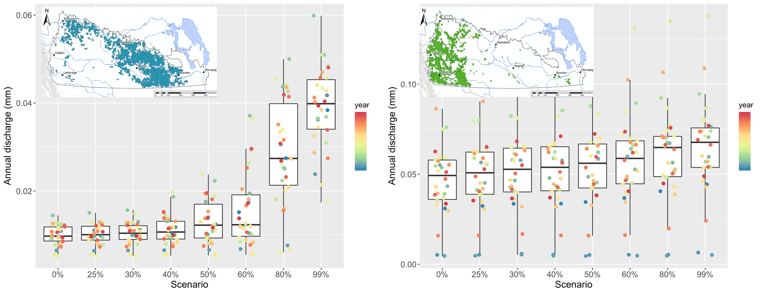
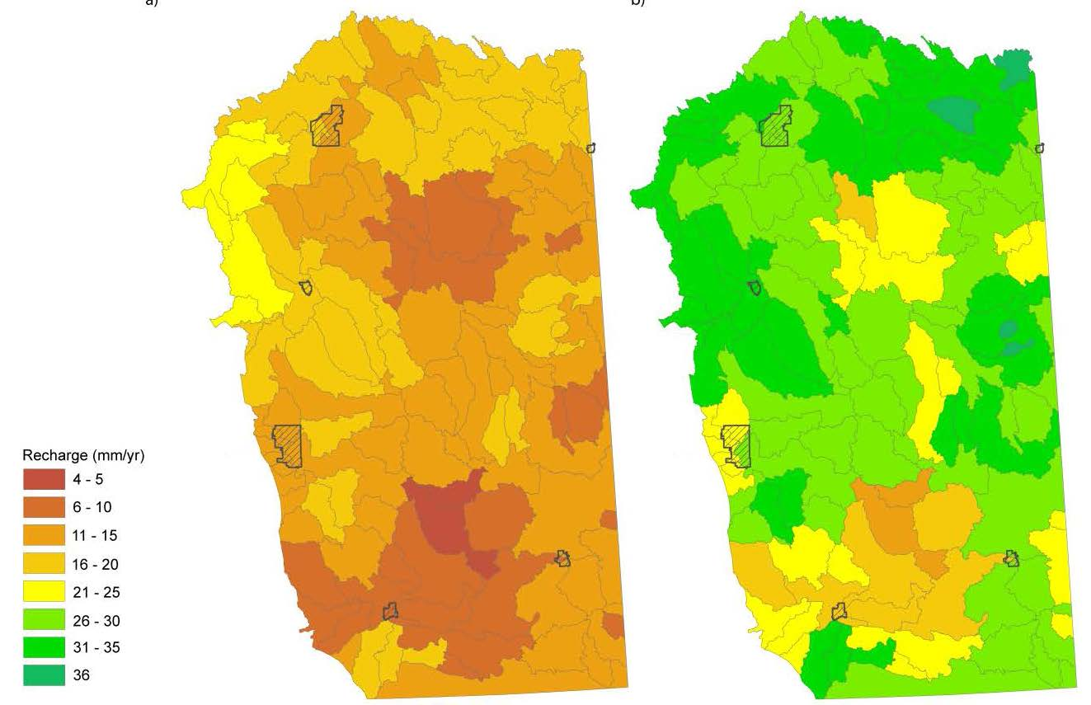
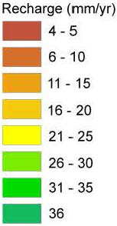
Transformational Science Highlights
Found that hydrological response to wetland loss differs among Prairie watershed types.
Assembled maps on groundwater vulnerability, oil spills, and water production and use by the oil industry in Saskatchewan.
Mapped groundwater recharge rates in Alberta
Conducted four wetland surveys (n > 150), which represent the first extensive sampling of biogeochemical and pesticide conditions in the region.
Developed a model to estimate which wetlands are most at risk of being removed by land owners based solely on private costs.
Evaluated the interactive effects of climate and land cover/use on wetland biodiversity.
Klassen et al., 2018
Project Title
Prairie Water
Notes:
These accomplishments slides will be also be used to build slide bank for use in GWF presentations
How are these results key to advancing the science
How are these results linked to the needs of your partners/users?

Slide 3
Project Impact and Aspirations
Results have been used to inform:
The dissemination of wetland drainage policies in Saskatchewan;
Emergency response plans in a partner First Nation;
Groundwater risk in Alberta.
Opportunities to put these results into action include:
Providing curriculum to the Saskatchewan Water Security Agency’s Drainage 101 program;
Co-development of a water governance framework with a partner First Nation;
A scientific concensus statement on the effects of wetland drainage;
Modelling frameworks adopted by partners.
The impact Prairie Water will have on society will be through:
The development of predictive frameworks and risk maps with which partners can assess their choices;
Prairie-wide accessible wetland water chemistry data;
An assessment of the usefulness and effectiveness of this new information for shaping long and short term decisions.
Project Title
Prairie Water

Slide 4
Challenges and Cross-project Collaboration Opportunities
Operational challenges include:
Access to core services
Ability to properly engage a geographically distributed partner network
Opportunities to collaborate with other GWF projects to help solve challenges and/or leverage opportunities include:
Continue to partner with AWF and IMPC on knowledge mobilization and tool development
Work with Pillar 1 & 2 projects to link objectives are leverage outreach opportunites
What we need from the Operations Team help you solve these challenges includes:
Data management
Core modelling
Communications and Knowledge Mobilisation support and expertise
App development (e.g., visualizations)
Project Title
Prairie Water

