Slide 1
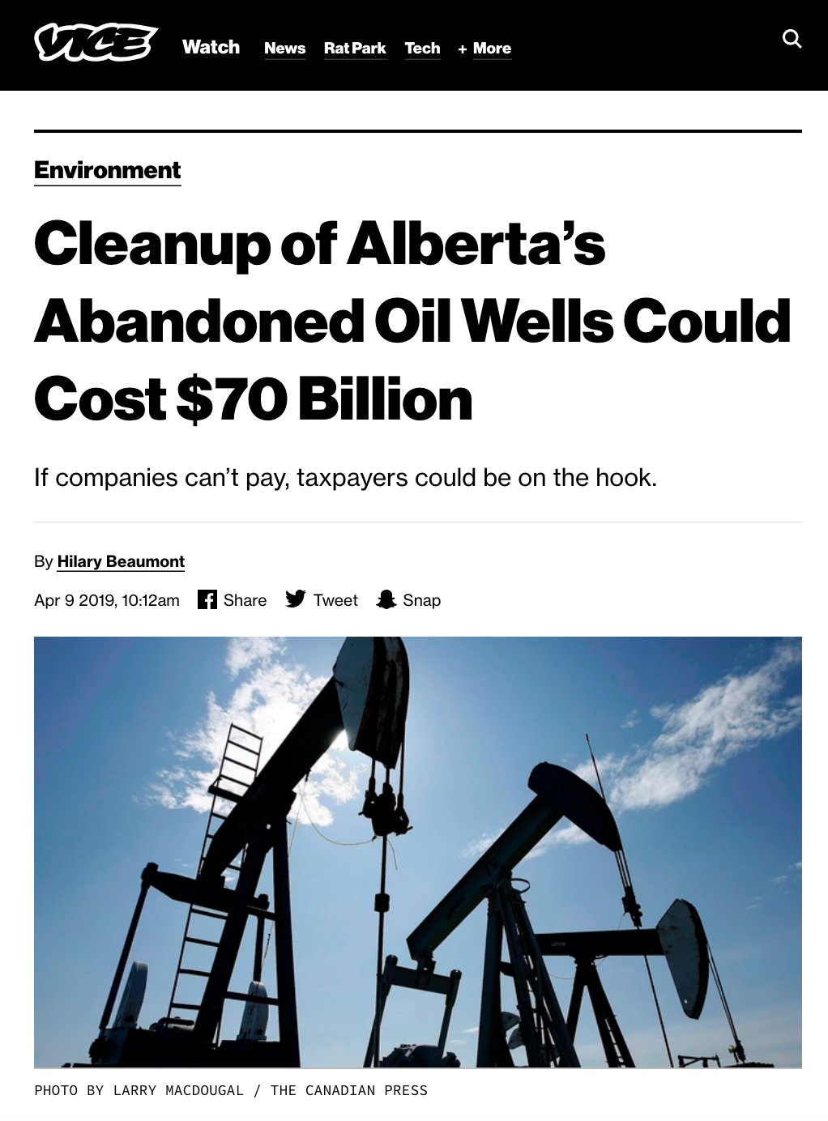
Old Meets New: Subsurface Connectivity and Groundwater Protection
Deep groundwaters are saline, often contain hydrocarbons and other contaminants
Interactions between deep and shallow groundwaters in the subsurface due to both natural and anthropogenic connections are a threat to groundwater resources and are largely uncharacterized
Data from proprietary oil and gas industry datasets and provincial groundwater monitoring have not been analyzed in this context at regional scales in the Canadian Prairies
Targeted sampling through other collaborations with industrial partners is being conducted to provide additional insights
Grant Ferguson, email: grant.ferguson@usask.ca, website: https://water.usask.ca/about/profiles/people/grant-ferguson.php
Project coordinates: PI, email, website, etc
Old Meets New: Subsurface Connectivity and Groundwater Protection
Notes:
The Old Meets New project addresses issues around groundwater quality. We have typically thought about threats to groundwater as coming from the surface but we are seeing more and more evidence of groundwater quality issues at depth, either due to poor natural groundwater quality or due to impacts from the oil and gas industry or other anthropogenic uses of the subsurface.
Due to the extreme costs of drilling to the depths involved (100s of m), this project is relying on proprietary databases from the oil and gas industry and provincial groundwater monitoring data to assess water chemistry, construct maps and create models. We have been able to collect additional samples for analysis of major ions, trace element and isotope through other projects with industrial partners, notably Nutrien.

Slide 2
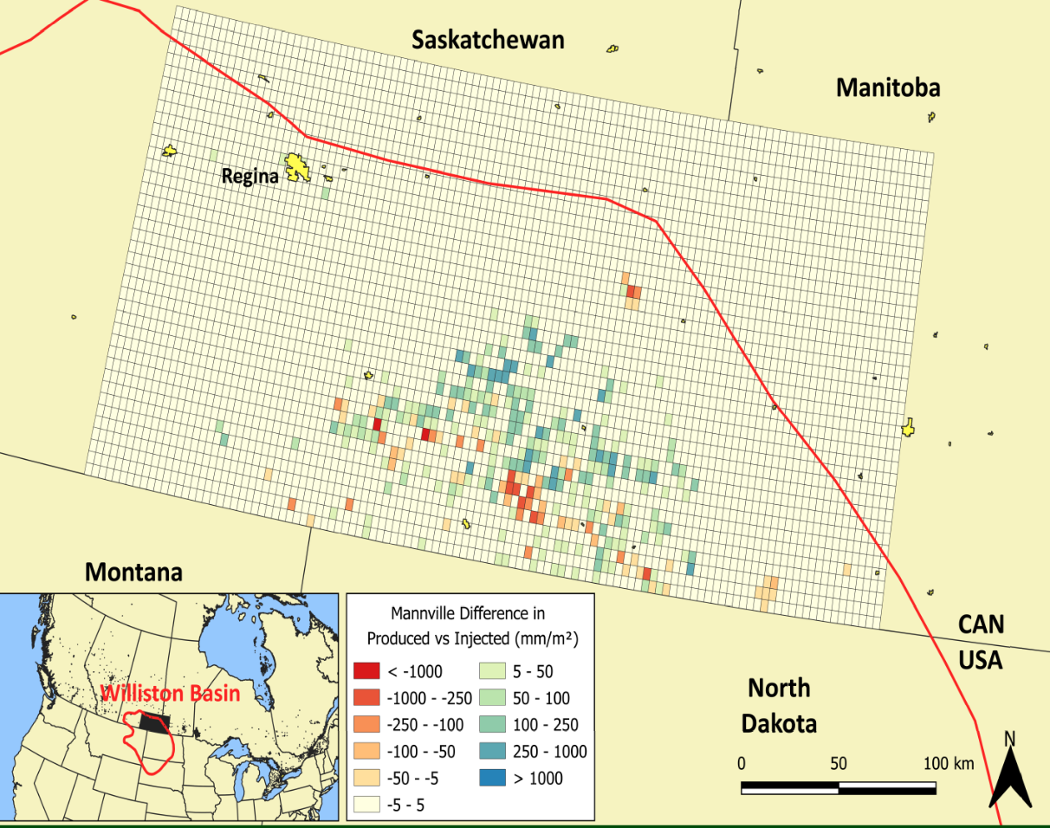
Transformational Science Highlights
Demonstrated that hydraulic fracturing is a small piece of the puzzle when it comes to oil and gas production and water resources
Determination of the extent of fresh and brackish groundwaters and their relationship with oil and gas production in Canada and the USA
Preliminary results provide insight into prioritizing sites for remediation in Canada’s multibillion dollar well abandonment problem
New insights into interpretation into tracers in deep groundwater systems (complications with interpreting Cl, Br, Sr isotopes, potential noble gas applications)
From McIntosh & Ferguson, 2019
From Jellicoe, McIntosh & Ferguson, 2019
Project Title
Project name
Notes:
Our biggest finding to has been that the threat that hydraulic fracturing poses to groundwater resources is small compared to the fossil fuel industry as a whole. This should not be interpreted as a lack of risk from unconventional oil and gas production. What we found is that most documented impacts from unconventional oil and gas production are shared with the conventional oil and gas industry, which has a much longer history.
We have also done work to help prioritize abandonment of old oil and gas wells. This is a critical issue for western Canada, where the liability has been estimated to be ~$100 billion.
We have also made some progress in understanding the use of different tracers to track interactions between deep and shallow groundwaters.

Slide 3

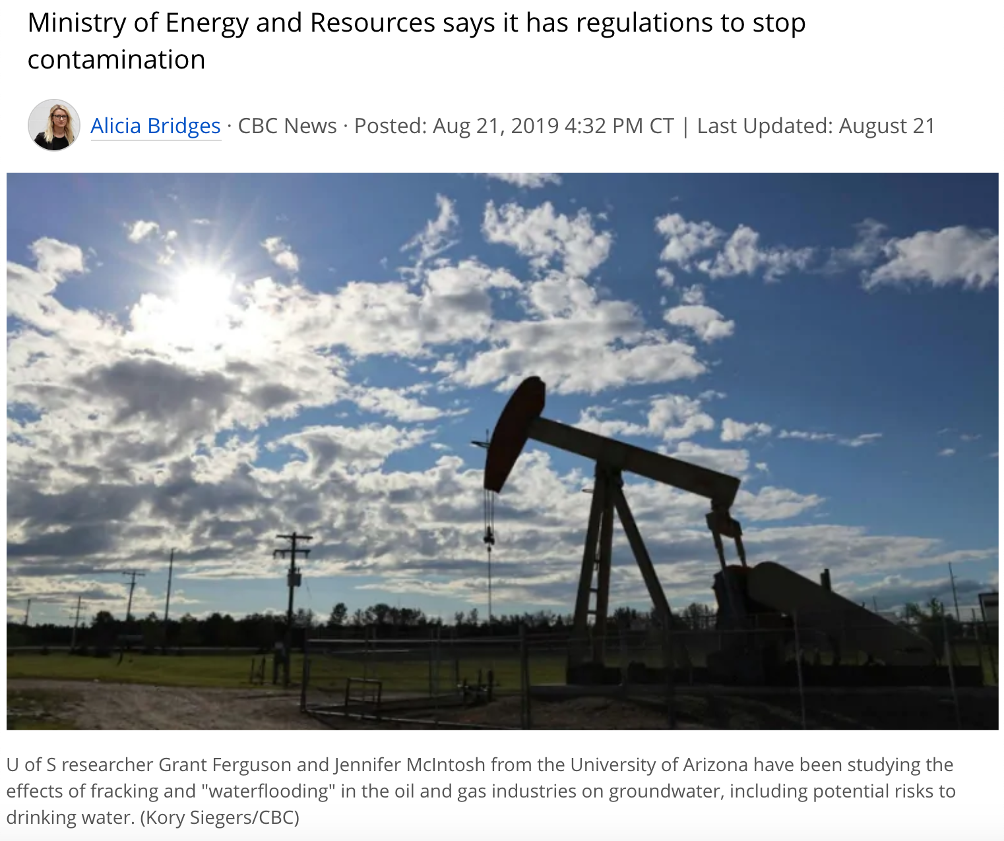
Project Impact and Aspirations
Recent work on deficiencies in regulations has attracted attention from the press in Canada and the US and response from Sask Ministry of Energy & Resources
Provided advice to British Geological Survey on unconventional gas development in England
Continued work with the Alberta Energy Regulator
Upcoming Water Resources Research commentary on ”deep groundwater’
Global review of energy production & groundwater with B. Scanlon & W. Timms
            NFRF LOI with B. Sherwood Lollar invited for full proposal
          Involvement with EARTH4D CIFAR Project
Project Title
Project name
Notes:
Recent impacts have included press coverage on the potential impacts of conventional oil and gas development on groundwater resources. This work was covered by CBC News and NPR among other outlets.
We have worked with both the Alberta Energy Regulator and the British Geological Survey to on groundwater protection issues related to oil and gas production. Work with AER is ongoing
Upcoming WRR commentary with Laura Condon, Christa Kelleher, Jen McIntosh and Grant Ferguson on how deep to go when considering groundwater in catchment hydrology and critical zone science.
New initiatives include an International Association of Hydrogeologists project to review impacts to groundwater from energy development globall with Bridget Scanlon (Univerity of Texas Austin) and Wendy Timms (Deacon University, Australia) and an NFRF LOI on deep groundwater and geomicrobiology, which was recently invited to the proposal stage. We are also involved with the CIFAR Earth4D project that Barbara Sherwood Lollar is leading.

Slide 4
Challenges and Cross-project Collaboration Opportunities
A challenge to branching out and collaborating with other projects has been the lack of a groundwater component or capacity within some other projects.
There has been little support for groundwater modeling within the core modelling group. While there is some aspiration to better integrate groundwater and surface water models, it is not clear whether some of these deeper hydrogeological systems require an integrated approach.
Project Title
Project name

