Slide 1
Project Introduction and Information
General introduction to our project and research focus:
Our main focus is to develop capability for high resolution simulations of Great Lakes that include lake ice.
We are using the MIT gcm as the primary simulation tool. In the next year, we will contrast this approach with an approach based on ROMS-CICE
Lake Erie (whole basin), the Grand River Plume
PI: Kevin Lamb kglamb@uwaterloo.ca, Presenter and co-investigator Marek Stastna, mmstastn@uwaterloo.ca, co-investigator Andrea Scott ka3scott@uwaterloo.ca
Project coordinates: PI, email, website, etc
Evaluation of Ice Models in Large Lakes using Three-dimensional Coupled Hydrodynamic-Ice Models
Notes:
It can help to frame your main research objective as a question. For example,
How will climate change affect agriculture in Canada?
How can we improve water quality and reduce algal blooms in Canadian lakes?
What are the links between fish health, food safety and food security in the Indigenous North?
What is the significance of groundwater fluxes on surface water flow?

Slide 2
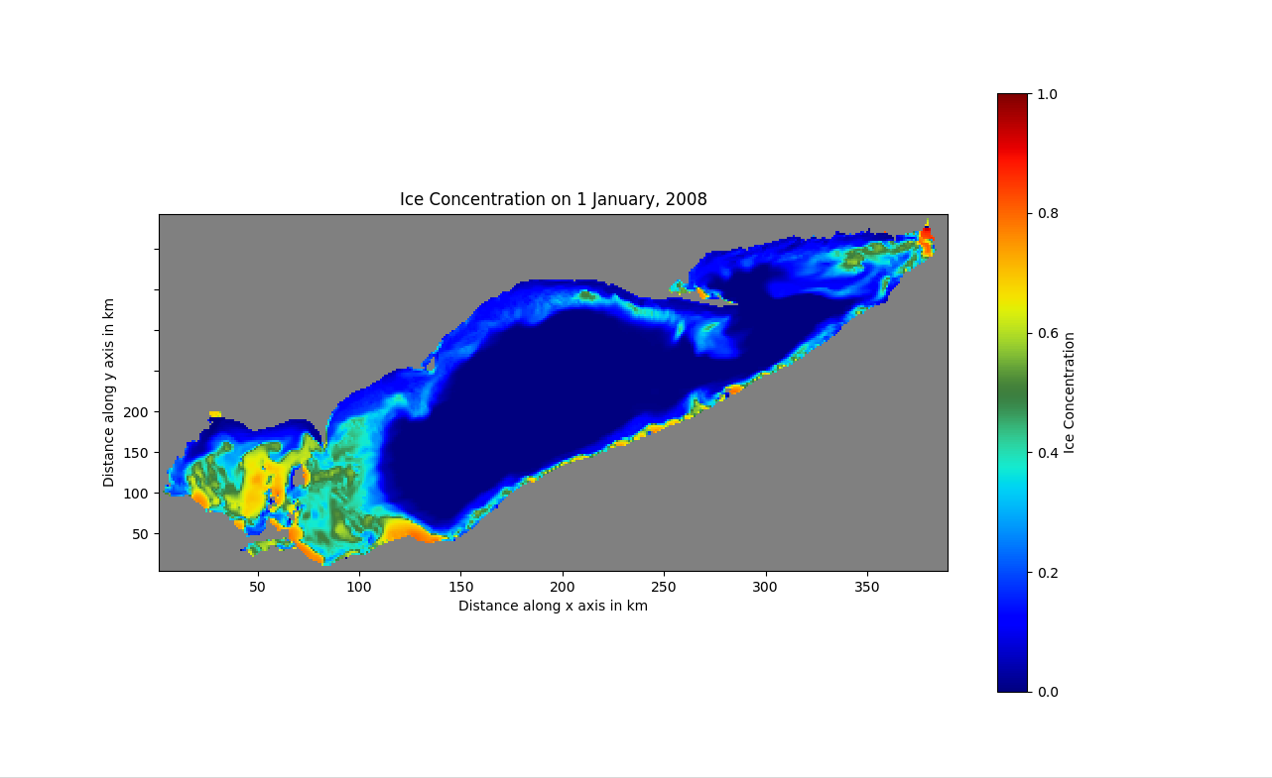
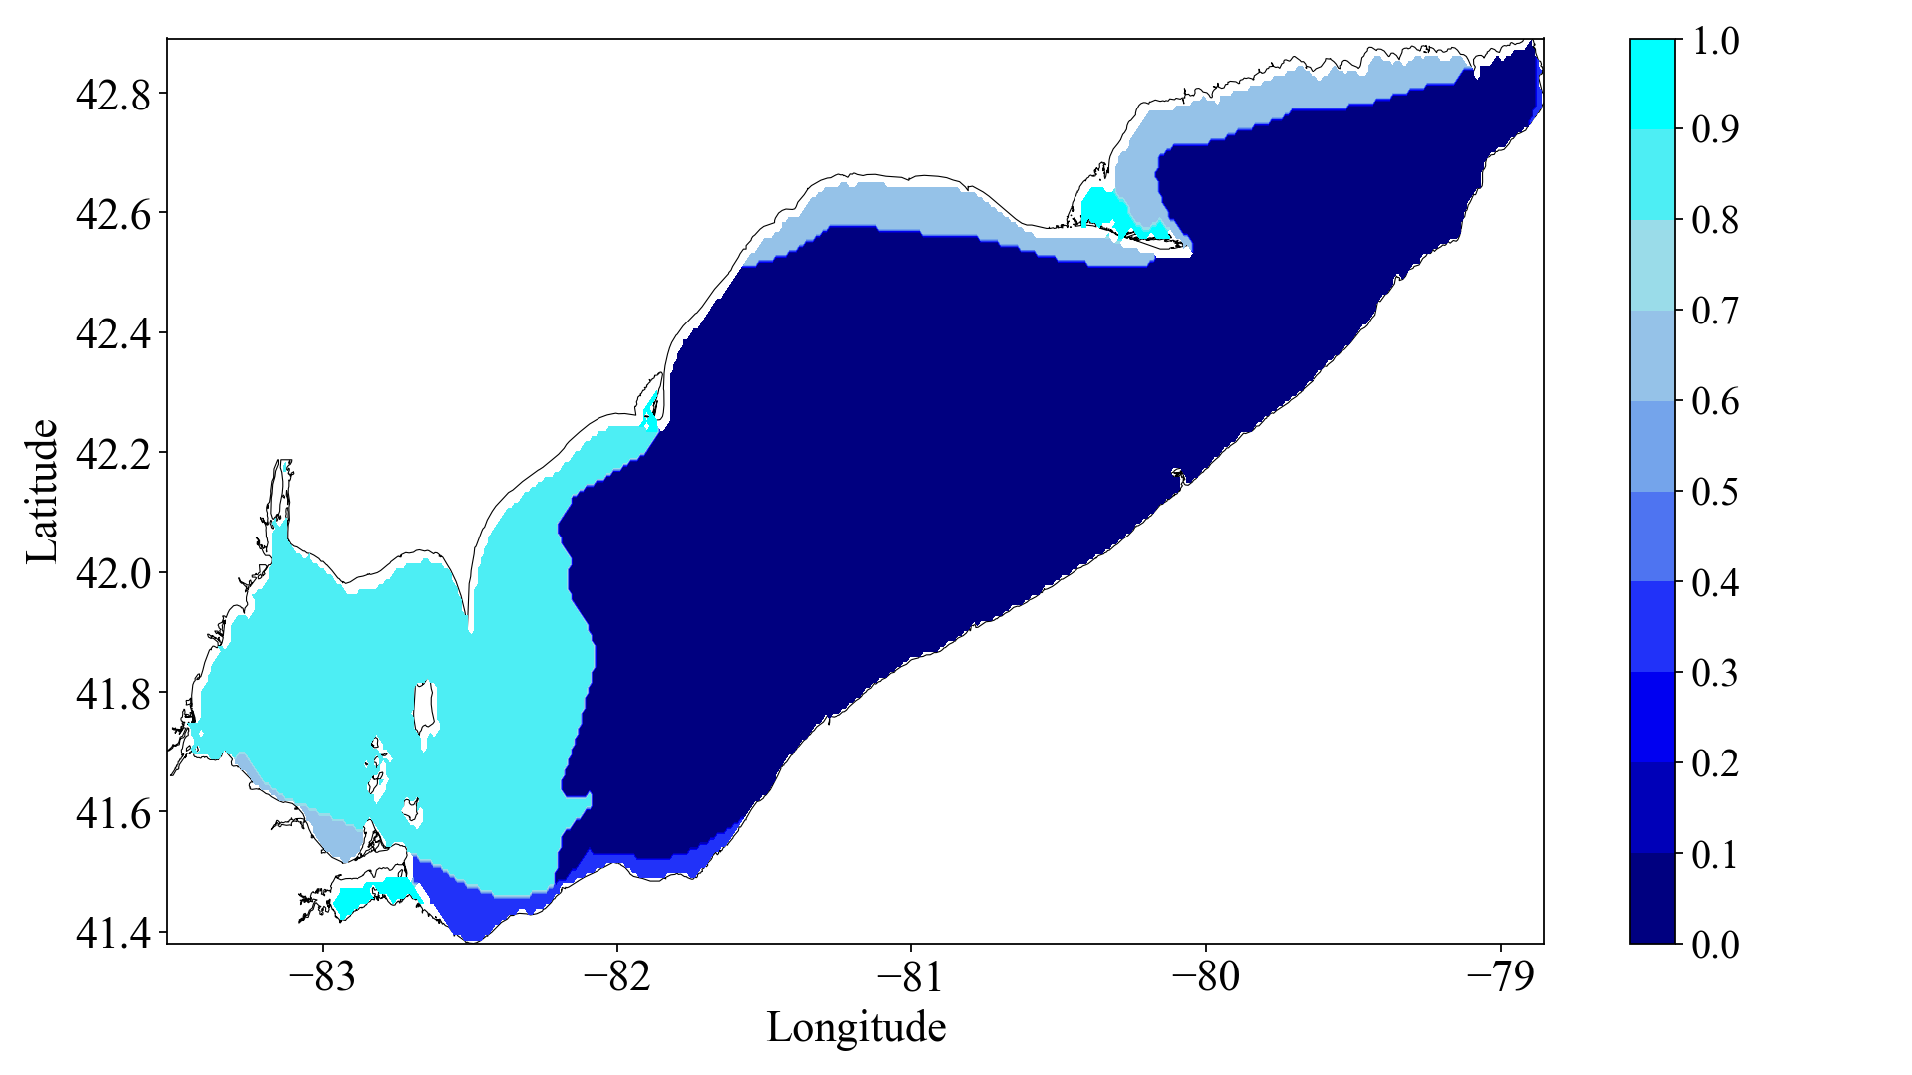
Transformational Science Highlights 1: Ice Onset
Good ice onset comparison between simulation (left) and NOAA observations (right)
Project Title
Evaluation of Ice Models in Large Lakes using Three-dimensional Coupled Hydrodynamic-Ice Models
Notes:
These accomplishments slides will be also be used to build slide bank for use in GWF presentations
How are these results key to advancing the science
How are these results linked to the needs of your partners/users?

Slide 3
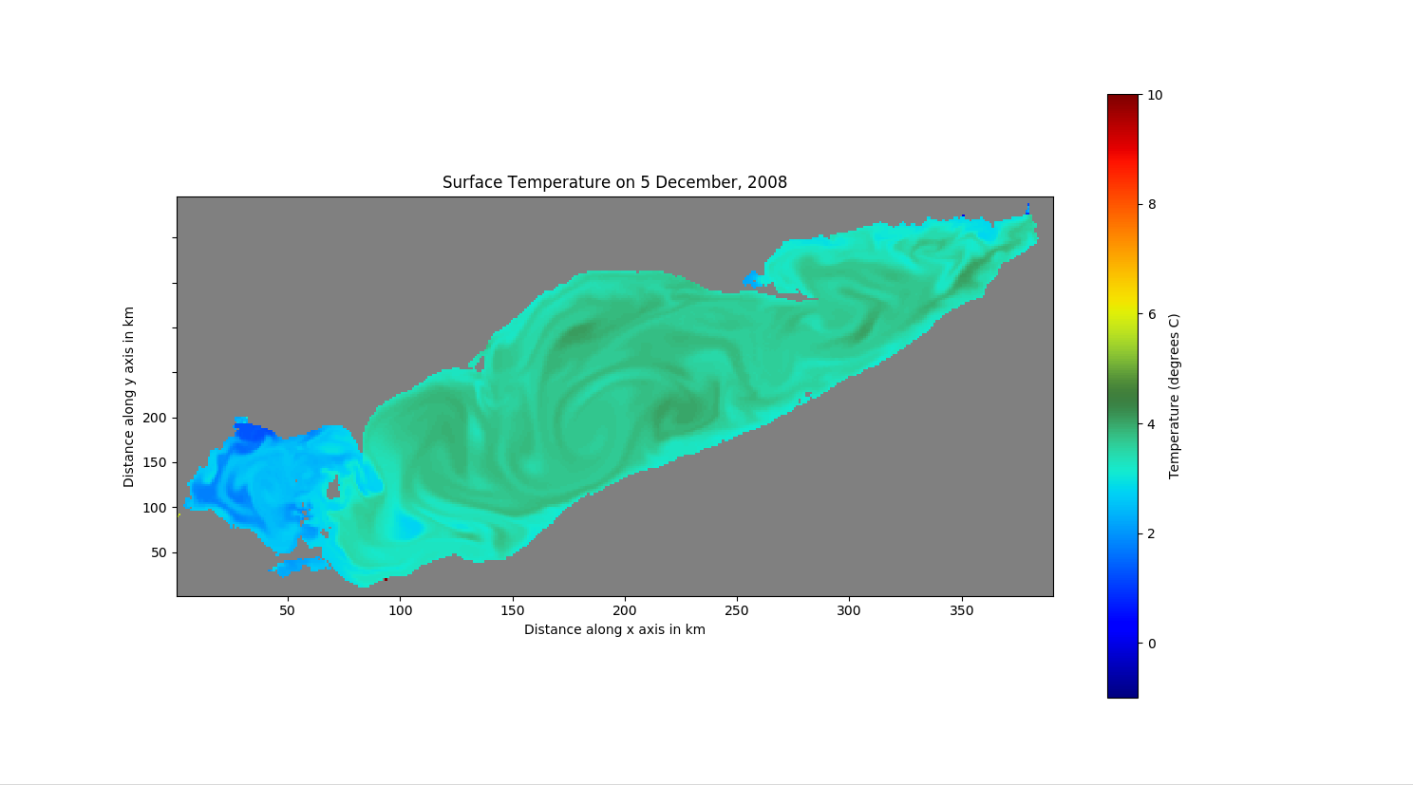
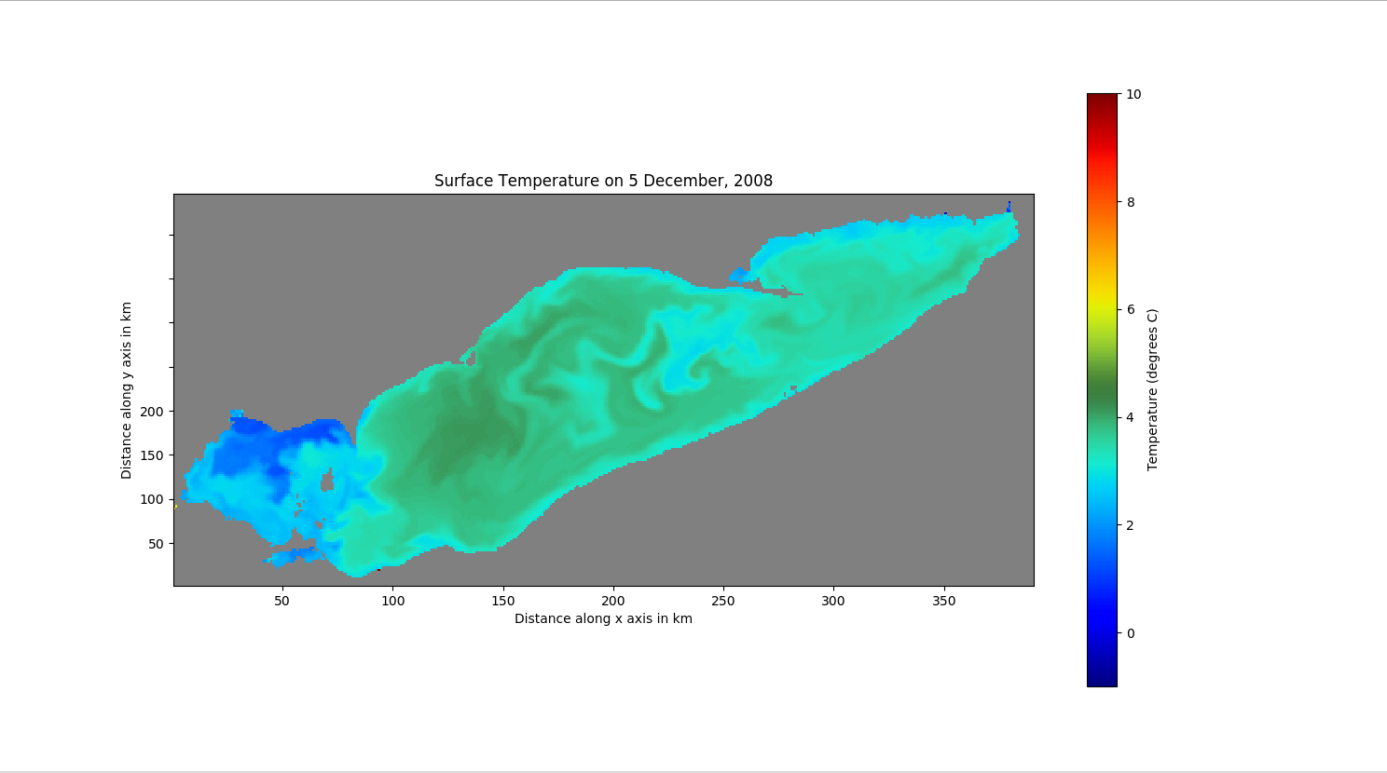
Transformational Science Highlights 2: Wind interpolation
Interpolation of station winds (as opposed to averaging) substantially changes lake simulated temperatures.
Project Title
Evaluation of Ice Models in Large Lakes using Three-dimensional Coupled Hydrodynamic-Ice Models
Notes:
These accomplishments slides will be also be used to build slide bank for use in GWF presentations
How are these results key to advancing the science
How are these results linked to the needs of your partners/users?

Slide 4
Project Impact and Aspirations
The applications of our results:
With increasing winter to winter variability accurate biogeochemical modeling of great lakes must take into account the winter season.
In the long term this could include predictability of algal blooms, including HABs.
In many ways Canadian efforts at Great Lake modeling and data availability are well behind those of our American colleagues.
A long term aspiration would be to have complementary modeling efforts at the same level of openness and scientific sophistication as those at GLERL or similar US labs.
Project Title
Evaluation of Ice Models in Large Lakes using Three-dimensional Coupled Hydrodynamic-Ice Models

Slide 5
Challenges and Cross-project Collaboration Opportunities
As the high resolution simulations hit the production stage we require storage. This includes long term, as well as more immediately accessible storage to allow for analysis.
GWF could play a role in securing Compute Canada allocations as increasingly Compute Canada is moving to an allocation model, as opposed to a community access model.
The knowledge developed on wind data interpolation, and just how sensitive models are to it could be useful to other modeling teams.
The model runs themselves, and details from them (e.g. inter-basin exchange) could be made available to other GWF groups.
Do you need something from the collective Operations Team help you solve these challenges? Yes: access to storage.
Project Title
Evaluation of Ice Models in Large Lakes using Three-dimensional Coupled Hydrodynamic-Ice Models

