Slide 1

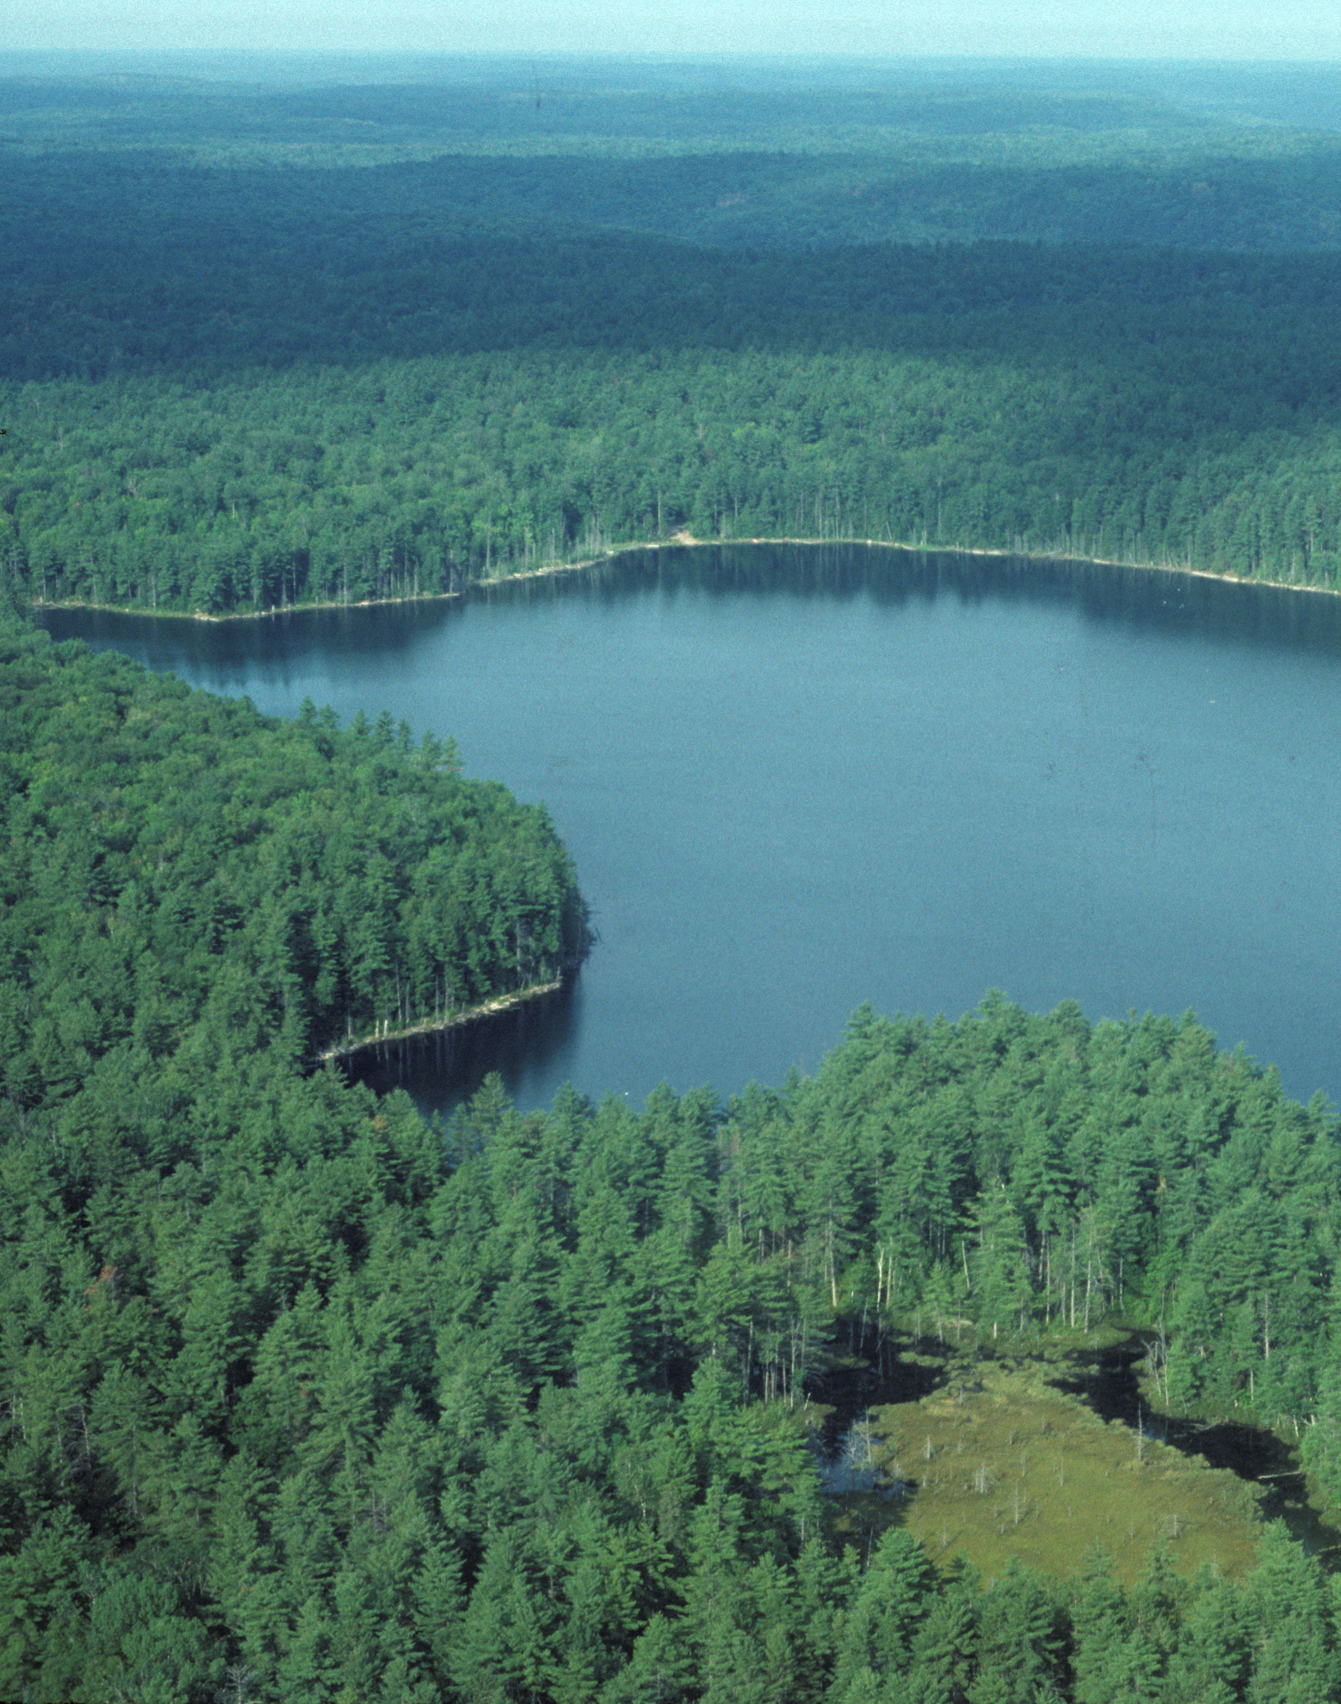
Lake Futures: Project Introduction and Information
Lake Futures: Enhancing adaptive capacity and resilience of lakes and their watersheds
  Main objective: How can we improve water quality and reduce algal blooms in Canadian lakes?
  Approach: Analyze causes and impacts of lake eutrophication, develop watershed-lake models and indicators, assess management options
  Study regions: Great Lakes Basin, expanding to other cold region Lakes
  Principal Investigator: Nandita Basu nandita.basu@uwaterloo.ca
  Project Manager: Kirsten Grant kirsten.grant@uwaterloo.ca
              https://uwaterloo.ca/lake-futures/ Twitter: @Lake_Futures
Project coordinates: PI, email, website, etc
Lake Futures: Enhancing adaptive capacity and resilience of lakes and their watersheds
Notes:
General introduction to your project and research focus
Your main objective: the big water-related social challenge you are trying to solve
The scientific approach you are taking to develop solutions
Study regions
Project contact information: PI, email and website
It can help to frame your main research objective as a question. For example,
How will climate change affect agriculture in Canada?
How can we improve water quality and reduce algal blooms in Canadian lakes?
What are the links between fish health, food safety and food security in the Indigenous North?
What is the significance of groundwater fluxes on surface water flow?

Slide 2
Transformational Science Highlights: Water Quality in the GLB
Analyzed hundreds of water quality station data in Canada and US to find emergent patterns and develop biogeochemical classifications
Available Discharge Data
1960-2016
Project Title
Lake Futures: Enhancing adaptive capacity and resilience of lakes and their watersheds
Notes:
Tell us about some new and exciting transformational results you have or that are emerging that are key to advancing the science
You may use one or two visual results (e.g., graphs or charts) that are easily interpreted and reused for a broad audience
These accomplishments slides will be also be used to build slide bank for use in GWF presentations
How are these results key to advancing the science
How are these results linked to the needs of your partners/users?

Slide 3
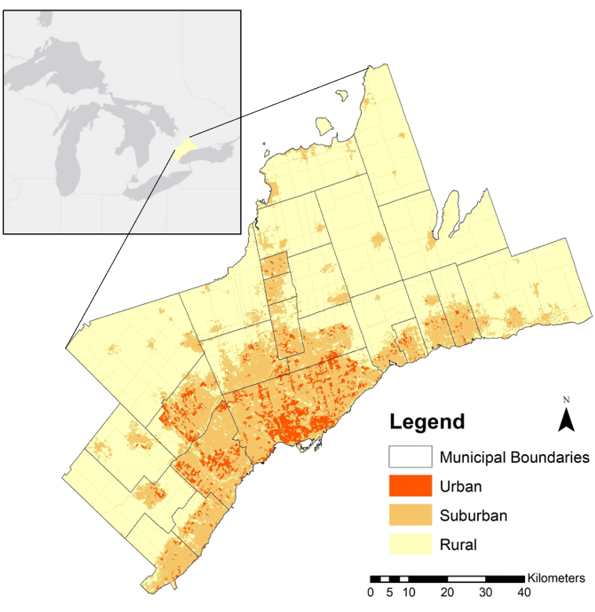
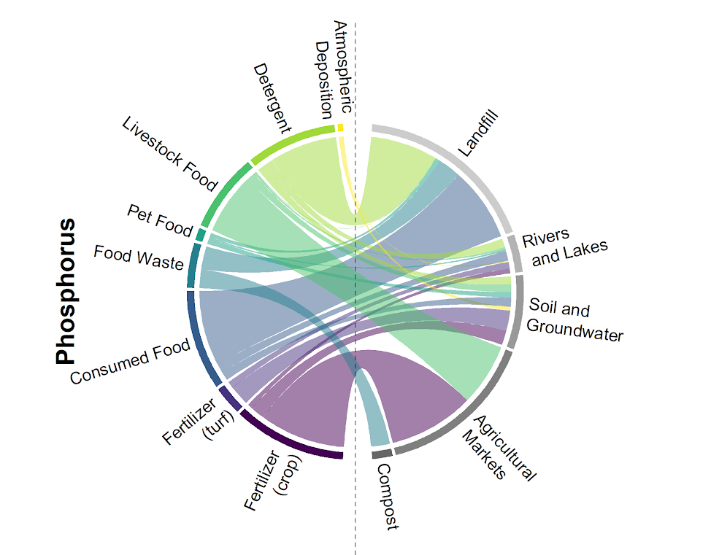
Highlights: Urban Metabolism in the Greater Toronto Area
Analyzed nutrient flows across GTA to find opportunities for increased efficiency
SPG grant with TRCA exploring stormwater BMPs to address these flows
Project Title
Lake Futures: Enhancing adaptive capacity and resilience of lakes and their watersheds
Notes:
Tell us about some new and exciting transformational results you have or that are emerging that are key to advancing the science
You may use one or two visual results (e.g., graphs or charts) that are easily interpreted and reused for a broad audience
These accomplishments slides will be also be used to build slide bank for use in GWF presentations
How are these results key to advancing the science
How are these results linked to the needs of your partners/users?

Slide 4
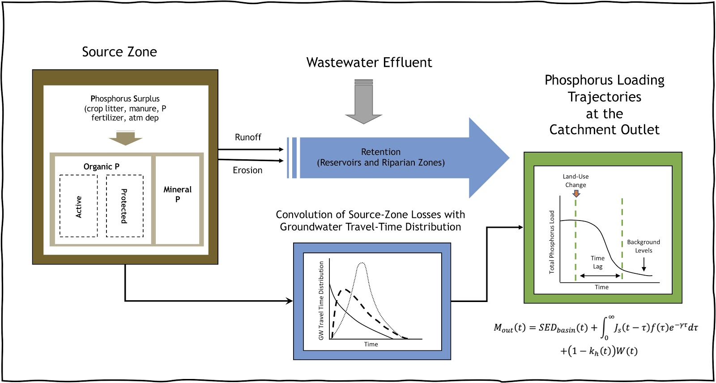
Highlights: Modelling Nutrient Legacies to predict Water Quality Improvement timeframes
ELEMENT Model – if we make a change to the landscape, how long will it take for the water quality to improve?
Funding from ECCC to develop model for the Thames and the Sydenham watersheds
Project Title
Lake Futures: Enhancing adaptive capacity and resilience of lakes and their watersheds
Notes:
Tell us about some new and exciting transformational results you have or that are emerging that are key to advancing the science
You may use one or two visual results (e.g., graphs or charts) that are easily interpreted and reused for a broad audience
These accomplishments slides will be also be used to build slide bank for use in GWF presentations
How are these results key to advancing the science
How are these results linked to the needs of your partners/users?

Slide 5
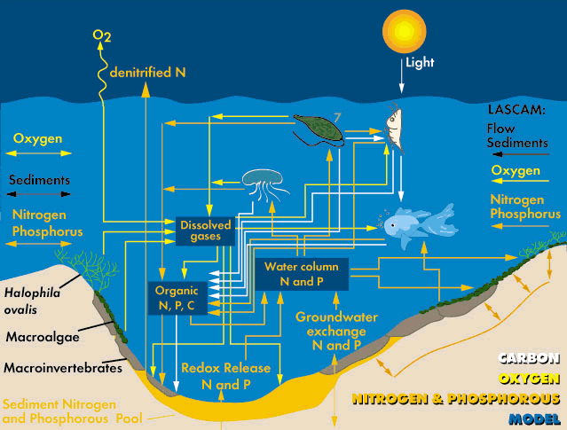
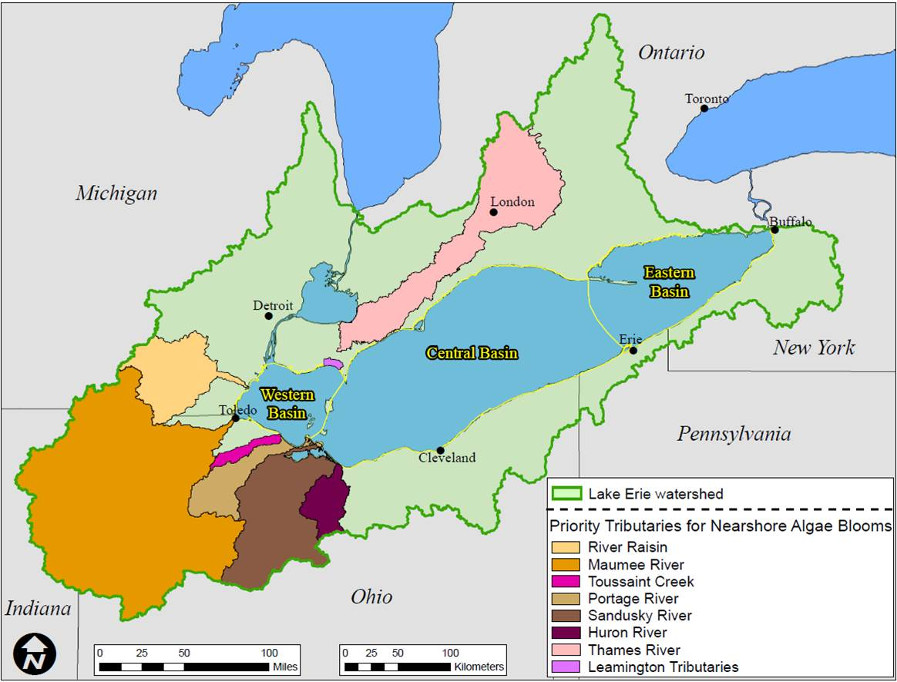
Highlights: Role of a large shallow lake in modulating phosphoru loads to L. Erie
Even with a very short water residence time (<9 days), Lake St. Clair is a net sink for phosphorus retaining about 17% TP and 35% DRP
Applied a 3-D coupled hydrodynamics & WQ model (ELCOM-CAEDYM) for understanding of phosphorus (P) transport
Project Title
Lake Futures: Enhancing adaptive capacity and resilience of lakes and their watersheds
Lake Erie watershed with borders
indicated by green solid line
(d)
Notes:
Tell us about some new and exciting transformational results you have or that are emerging that are key to advancing the science
You may use one or two visual results (e.g., graphs or charts) that are easily interpreted and reused for a broad audience
These accomplishments slides will be also be used to build slide bank for use in GWF presentations
How are these results key to advancing the science
How are these results linked to the needs of your partners/users?

Slide 6
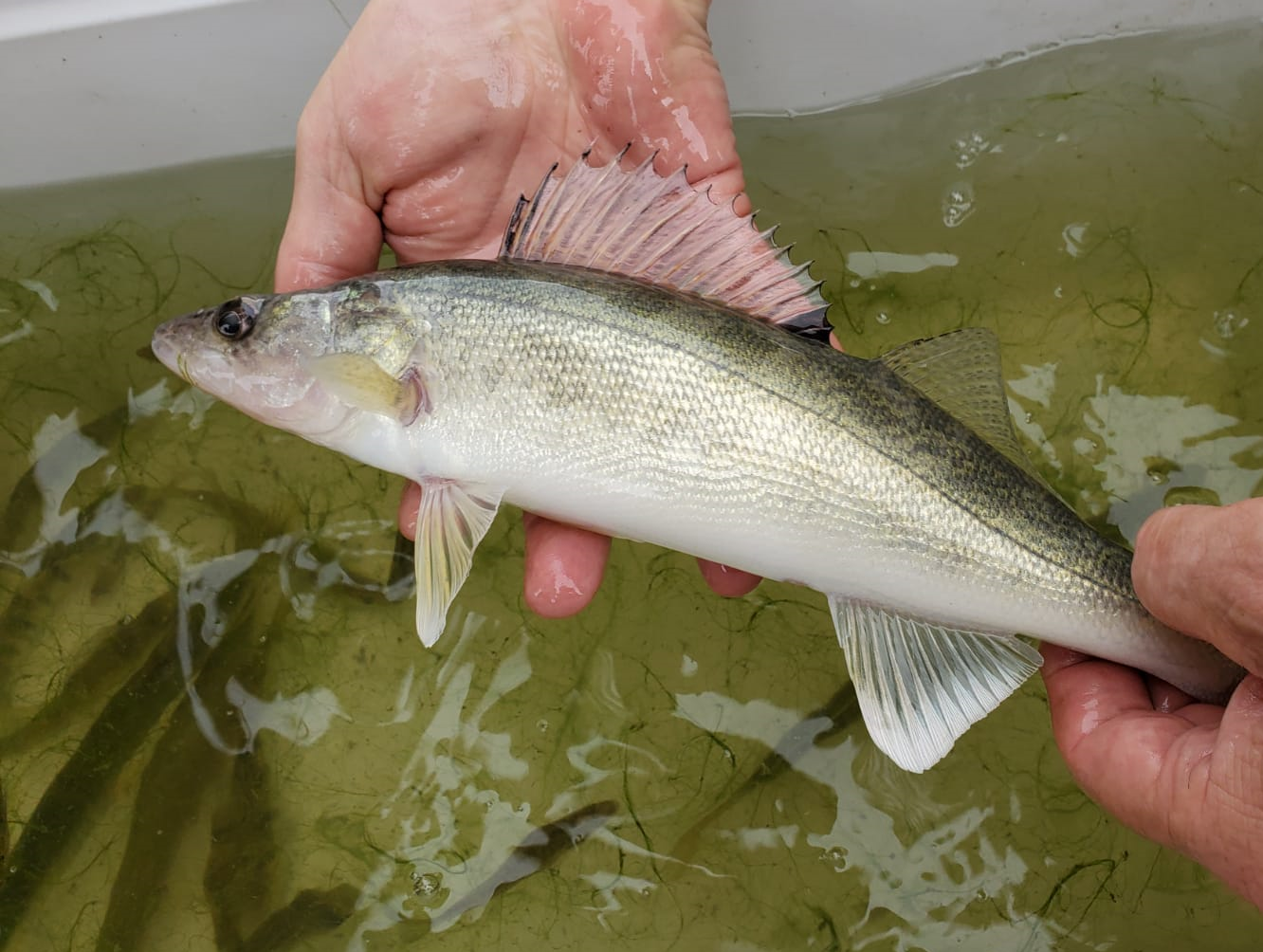
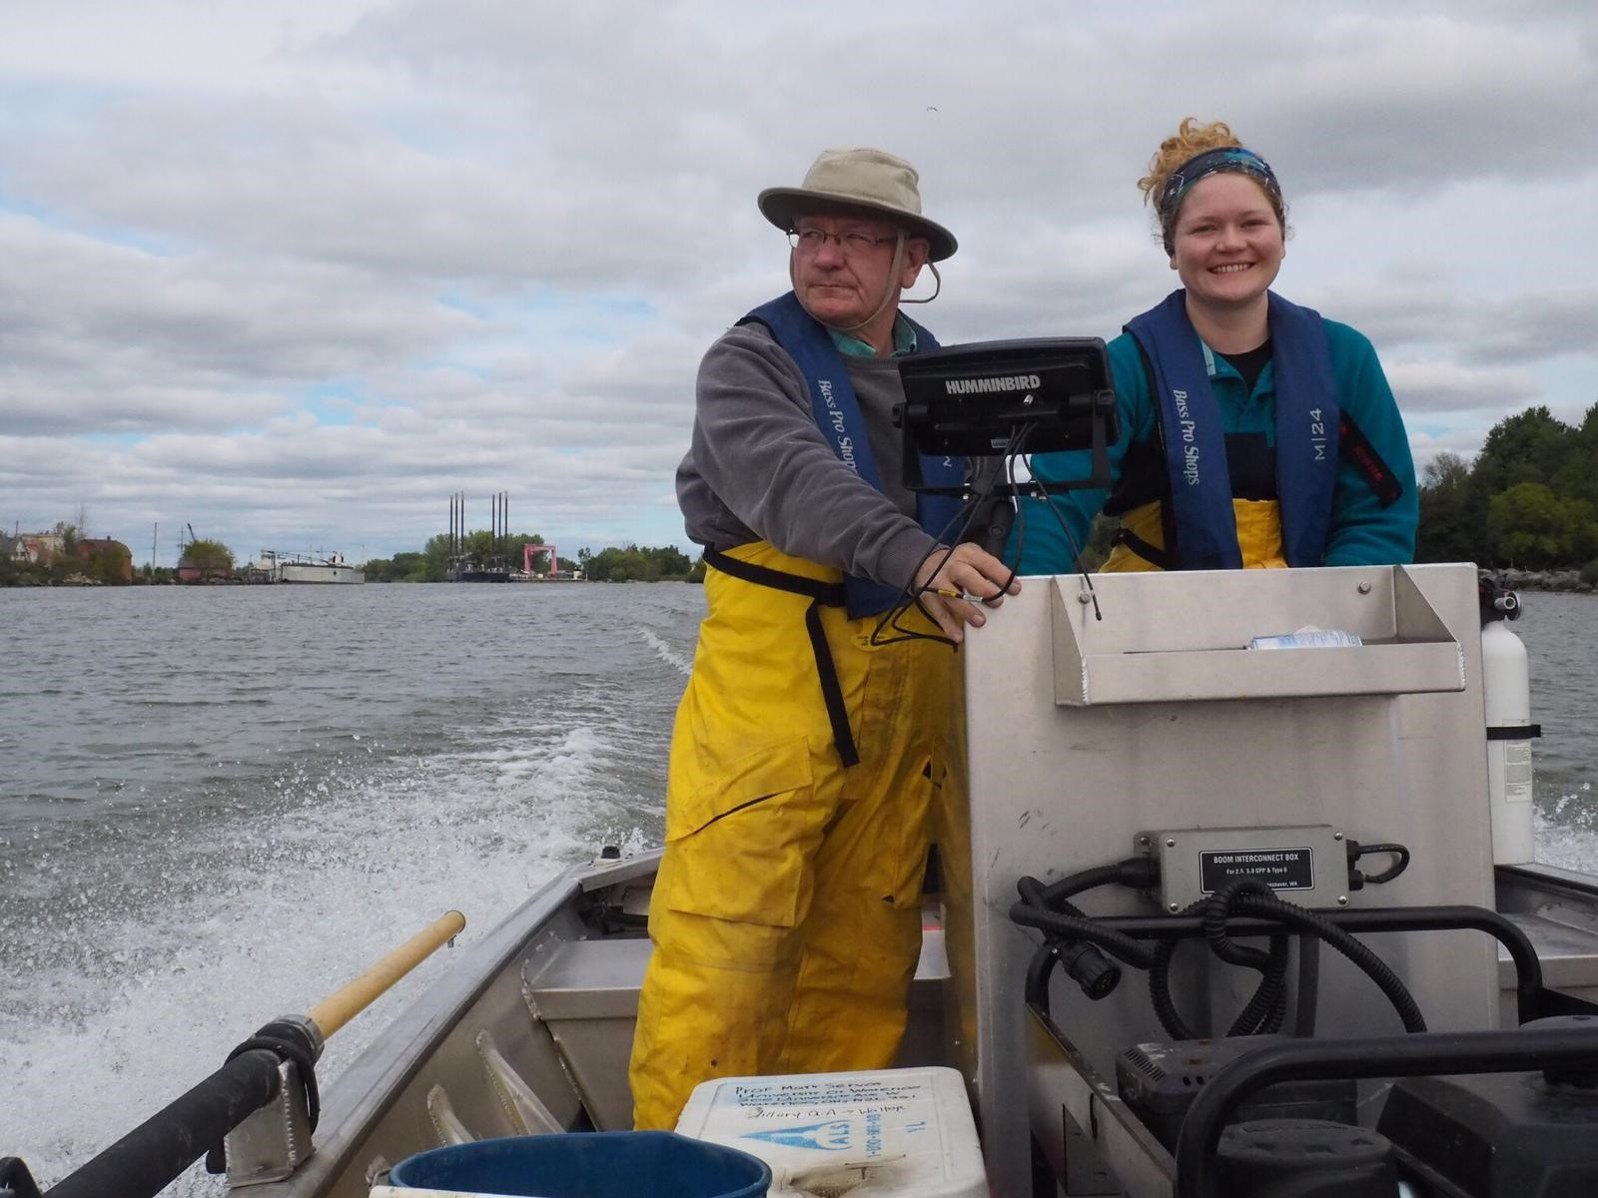
Highlights: Exploring Linkages between Water Quality and Ecosystem Services
With support from OMNRF exploring linkages between environmental quality and recruitment success in a valued ecosystem component (walleye) in the southern Grand River
Project Title
Lake Futures: Enhancing adaptive capacity and resilience of lakes and their watersheds
Lake Erie watershed with borders
indicated by green solid line
(d)
Notes:
Tell us about some new and exciting transformational results you have or that are emerging that are key to advancing the science
You may use one or two visual results (e.g., graphs or charts) that are easily interpreted and reused for a broad audience
These accomplishments slides will be also be used to build slide bank for use in GWF presentations
How are these results key to advancing the science
How are these results linked to the needs of your partners/users?

Slide 7
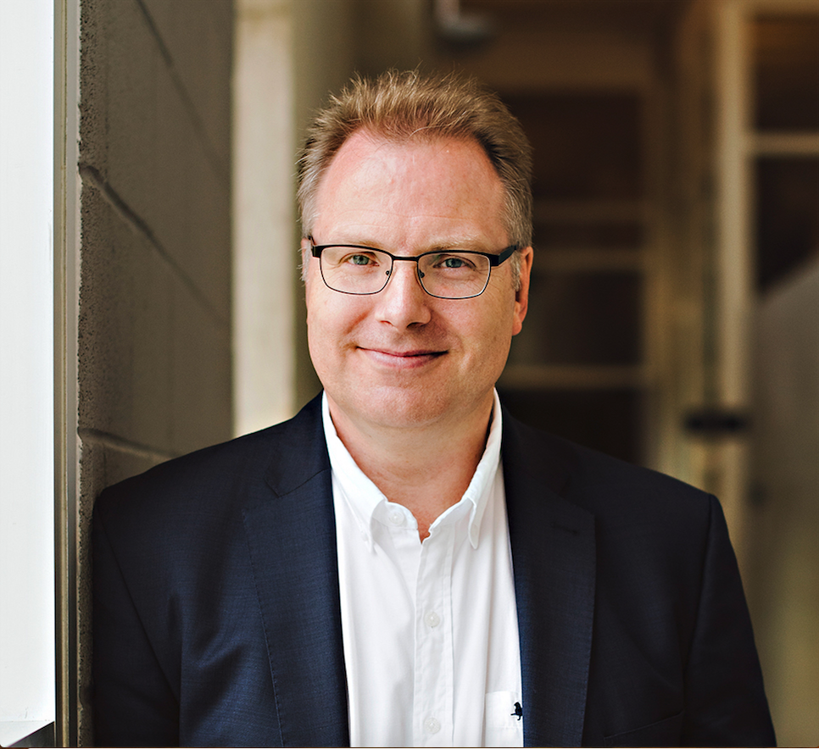
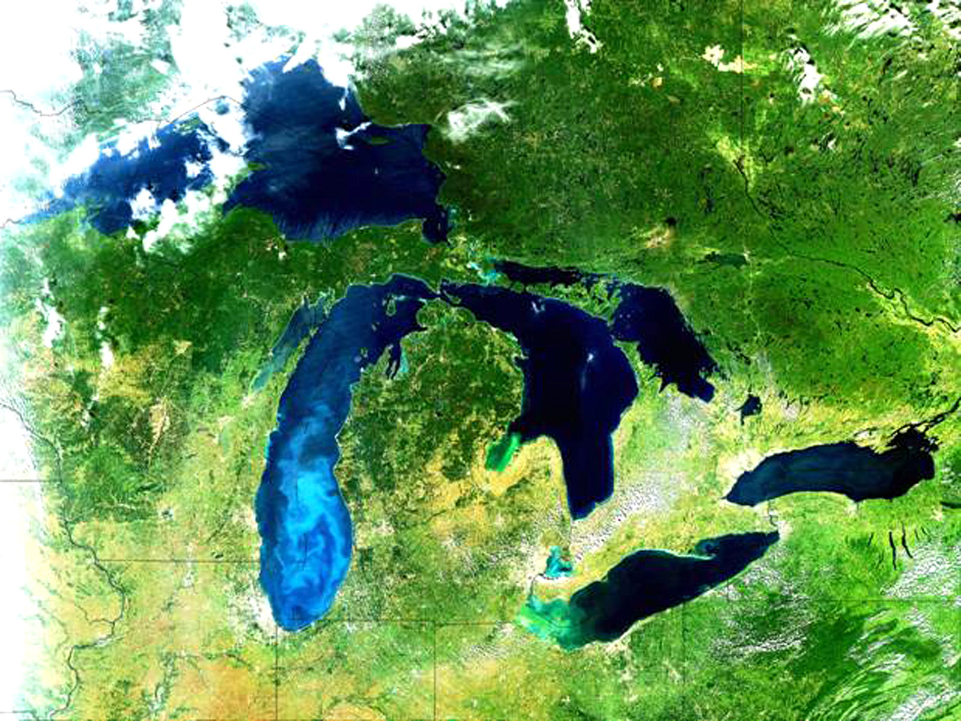
Highlights: Developing Next Generation Water Quality Valuation Tools for the GLB
Working with Environment and Climate Change Canada to update their Water Quality Valuation Tool
Developing models to evaluate cost effectiveness of watershed management in the Grand River Watershed
Project Title
Lake Futures: Enhancing adaptive capacity and resilience of lakes and their watersheds
Lake Erie watershed with borders
indicated by green solid line
(d)
Notes:
Tell us about some new and exciting transformational results you have or that are emerging that are key to advancing the science
You may use one or two visual results (e.g., graphs or charts) that are easily interpreted and reused for a broad audience
These accomplishments slides will be also be used to build slide bank for use in GWF presentations
How are these results key to advancing the science
How are these results linked to the needs of your partners/users?

Slide 8
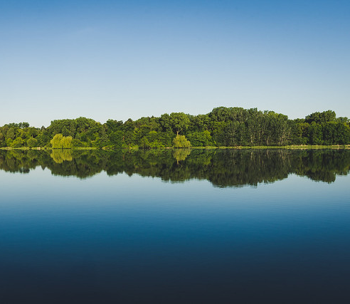
Project Impact and Aspirations
Held a Lake Watershed Modelling Workshop that was attended by stakeholders and academics from US and Canada – synergies identified
Successful partnerships: ECCC granted additional funds to expand the development of ELEMeNT model, OMNRF helped create the walleye project
Contribute valuable insights and science to existing collaborations and initiatives including:
  Nutrient Annex of the 2012 GLQWA (Can we achieve the 40% P reduction target?)
  Binational Cooperative Science and Monitoring Initiative (CSMI)
Deliver risk management solutions and decision support tools
Project Title
Lake Futures: Enhancing adaptive capacity and resilience of lakes and their watersheds
Notes:
This slide should communicate the applications of your results. This could include:
How have the results so far been, or will be, of interest to your partners and other potential users?
What opportunities have you identified to put these results into action that you will be taking up in the coming year?
What do you foresee will be the impact of this research to society?

Slide 9
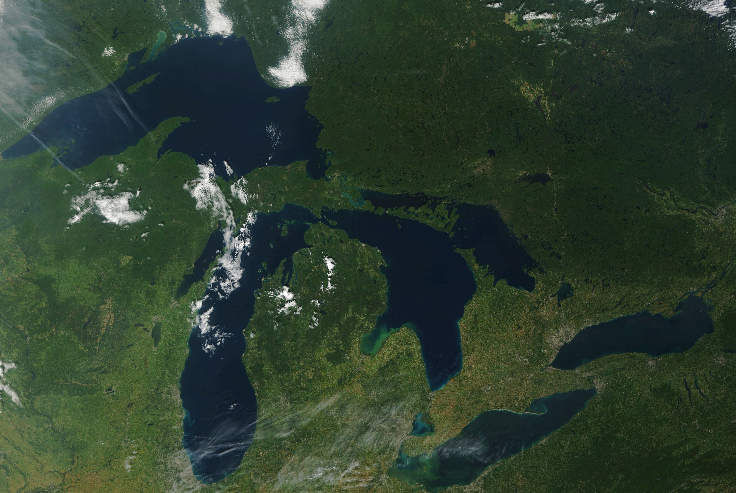
Challenges and Cross-project Collaboration Opportunities
Recruiting in time..
Cross project collaborations
  - Agricultural Water Futures
  - FormBLOOM –watersheds to reservoirs
  - Prairie Water – biogeochemical classification at the Pan Canadian Scale
Project Title
Lake Futures: Enhancing adaptive capacity and resilience of lakes and their watersheds
Notes:
Operational challenges that you want to highlight to the network
Are there opportunities to collaborate with other GWF projects that can help solve those challenges and/or leverage opportunities to have impact (i.e. shared data or coordinated KM activities)?
Do you need something from the collective Operations Team help you solve these challenges?
Note that content from this slide will not be used in the GWF outreach slide bank

