Slide 1
GWF Core Computer Science: Operations Team Meeting Update
Co-Leads: Kevin Schneider, USask and Jimmy Lin, UWaterloo
Faculty: Ray Spiteri, Chanchal Roy, Jyoti Mondal, Carl Gutwin, Banani Roy
Objectives and Deliverables
Improved evolution of hydrological modelling tools (Schneider, CRoy, BRoy)
  Software Reference Architecture and Platform
  Software Co-evolution Toolset and Framework
Improved scalability of hydrological modelling (Spiteri, SimLab)
  Hydrological Model Acceleration Toolset and Framework
Improved delivery of data and knowledge (Schneider, Mondal, Gutwin, BRoy)
  Interactive Visualization Toolset and Framework
Improved management of sensor data (Lin)
  Data Management Toolset and Framework
Core Computer Science
November 19-20, 2019 | Art Gallery of Hamilton | Hamilton, Ontario

Slide 2
GWF Core Computer Science Team Update
Next-Gen Hydrological Modeling Environment (Schneider, CRoy, BRoy)
Next-Gen CRHM (Schneider, CRoy, BRoy)
Visualization (Mondal, Gutwin, Schneider, CRoy)
Improved Scalability of Hydrological Modelling Update (Spiteri)
Data Management (Lin)
Other
  Nutrient App Support
  Copernicus – New Computing Infrastructure (1PB Storage and Multi-core compute servers)
    December deployment
Core Computer Science
November 19-20, 2019 | Art Gallery of Hamilton | Hamilton, Ontario

Slide 3
Next-Gen Hydrological modelling environment
State-of-the-art software development environment for scientists
  Build, test, and release software faster and more reliably
  Automated Testing/Inspection; Release Management; Continuous Integration; Virtualization
Designs to support modularization and improved interoperability
  Software Architecture, Design Patterns, Renovation/Refactoring
  Distributed Computing Environment for Hydrological Modelling
Increased engagement with Core Modelling Team
Joint Workshops with Core Modelling Team
Complementary funding in progress
  CREATE Software Analytics Research (SOAR) Proposal – submitted September 2019
  CFI to be developed on “Research Software DevOps Infrastructure”
Core Computer Science
November 19-20, 2019 | Art Gallery of Hamilton | Hamilton, Ontario

Slide 4
Next-Gen CRHM (Reverse Engineering and Migration)
Establish New software development environment (Dec 2018)
  Modern compiler and libraries
  Distributed Version Control System to support multi-version experimentation
  Automated testing framework to support rapid deployment of new features
  Virtual Containers to support packaging, deployment & portability
V1 Migrate to new software development environment (Dec 2019)
  Remove Borland dependencies
  Separate GUI from CORE
  Re-implement components that rely on old environment (e.g., Macro language, Data flow)
V1.1 Migrate to distributed computing environment (Jul 2020)
V1.2 Next-gen project files (Oct 2020)
V1.3 Migrate to plugin / workflow architecture (Dec 2020)
Core Computer Science
November 19-20, 2019 | Art Gallery of Hamilton | Hamilton, Ontario

Slide 5
Reverse Engineering & Migration - Select Publications (1/2)
Mondal M, Roy B, Roy C, Schneider K. (2019). An Empirical Study on Bug Propagation through Code Cloning. Journal of Systems and Software. 158: 1-18.
Wazed K, Kar K, Roy B, Roy C, Schneider K. (2019). CLCDSA: Cross Language Code Clone Detection using Syntactical Features and API Documentation. Proceedings of the 34th IEEE/ACM International Conference on Automated Software Engineering (ASE 2019)(1026-1037)
Mondal M, Roy B, Roy C, Schneider K. (2019). Ranking Co-change Candidates of Micro-Clone. Proceedings of the 29th Annual International Conference on Computer Science and Software Engineering (CASCON) (244 - 253)
Mondal M, Roy B, Roy C, Schneider K. (2019). Investigating the Relationship between Evolutionary Coupling and Software Bug-proneness. Proceedings of the 29th Annual International Conference on Computer Science and Software Engineering (CASCON 2019) (Acceptance rate: 30%), Toronto, Canada (173 - 182)
Mondal M, Roy B, Roy C, Schneider K. (2019). Investigating Context Adaptation Bugs in Code Clones. Proceedings of the 35th IEEE Int. Conference on Software Maintenance and Evolution (ICSME) (157-168)
Core Computer Science
November 19-20, 2019 | Art Gallery of Hamilton | Hamilton, Ontario

Slide 6
Reverse Engineering & Migration - Select Publications (2/2)
Mondal A, Roy B, Schneider K. (2019). An Exploratory Study on Automatic Architectural Change Analysis Using Natural Language Processing Techniques. Proceedings of the 19th IEEE International Working Conference on Source Code Analysis and Manipulation (SCAM 2019), Cleveland, United States (62-73)
Islam A, Islam M, Mondal M, Roy B, Roy C, Schneider K. (2018). Detecting Evolutionary Coupling Using Transitive Association Rules. Proc. of the 18th IEEE International Working Conference on Source Code Analysis and Manipulation (SCAM 2018) (Acceptance rate: 25%), (113-122)
Wazed., K., Roy, B., Roy, C. K. and Schneider K. A. (2018). CroLSim: Cross Language Software Similarity Detector Using API Documentation. Proc. of the 18th IEEE International Working Conference on Source Code Analysis and Manipulation (SCAM 2018) (Acceptance rate: 25%), Madrid, Spain (139-148)
Golam M, Roy B, Roy C, Schneider K. (2019). Designing for Real-Time Groupware Systems to Support Complex Scientific Data Analysis. Journal Proc. of the ACM on Human-Computer Interaction. EICS: 9:1-9:28
Core Computer Science
November 19-20, 2019 | Art Gallery of Hamilton | Hamilton, Ontario

Slide 7
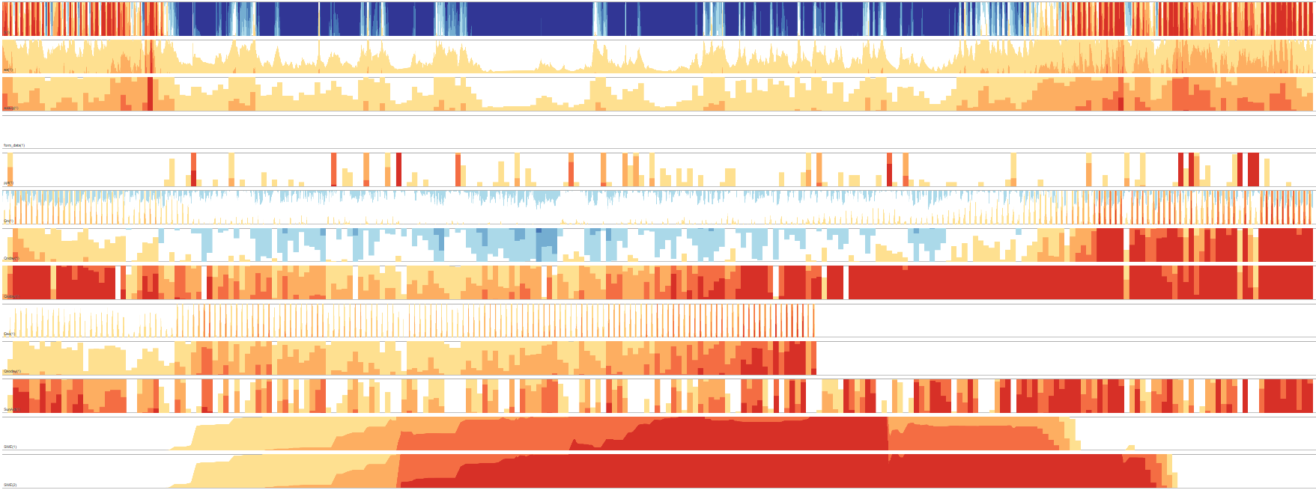
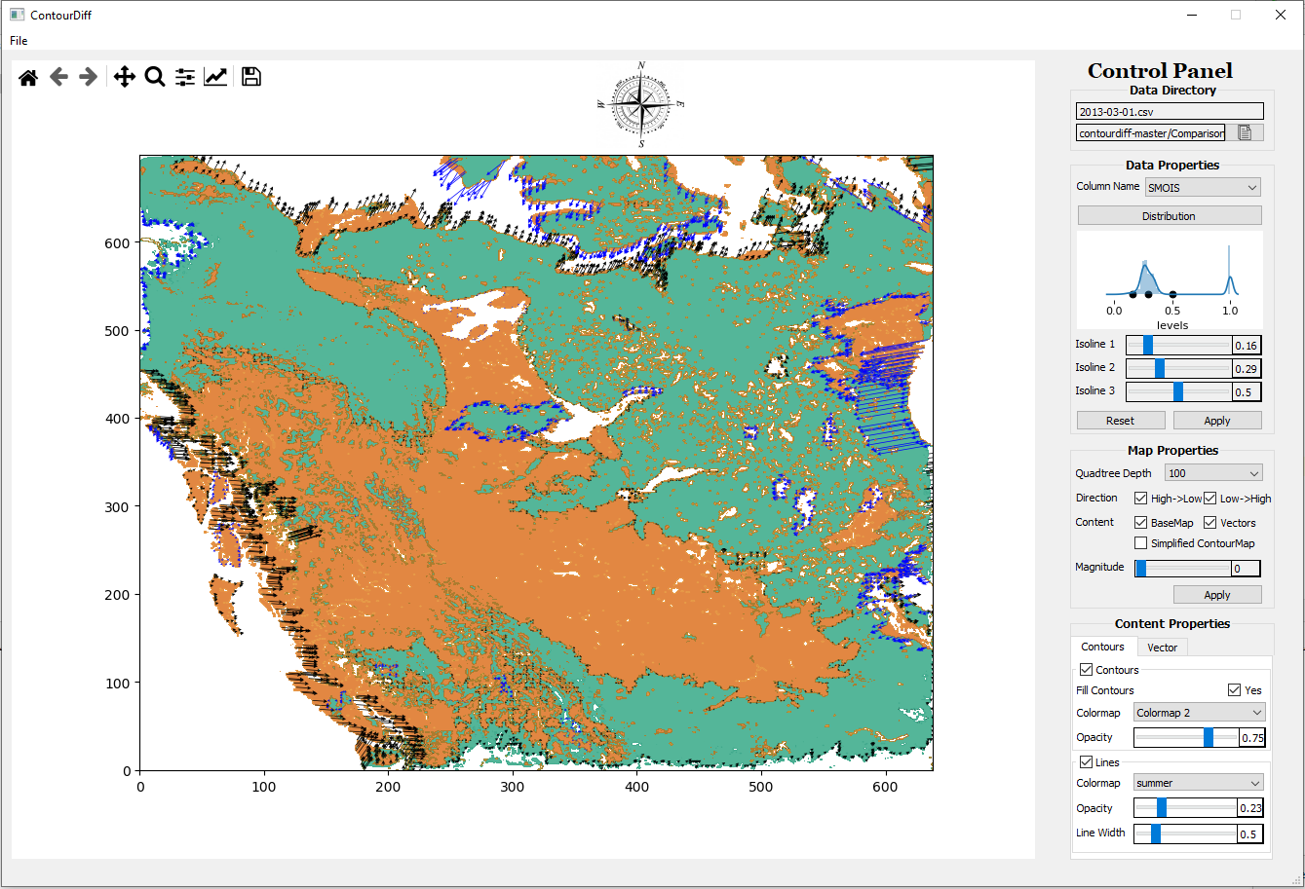
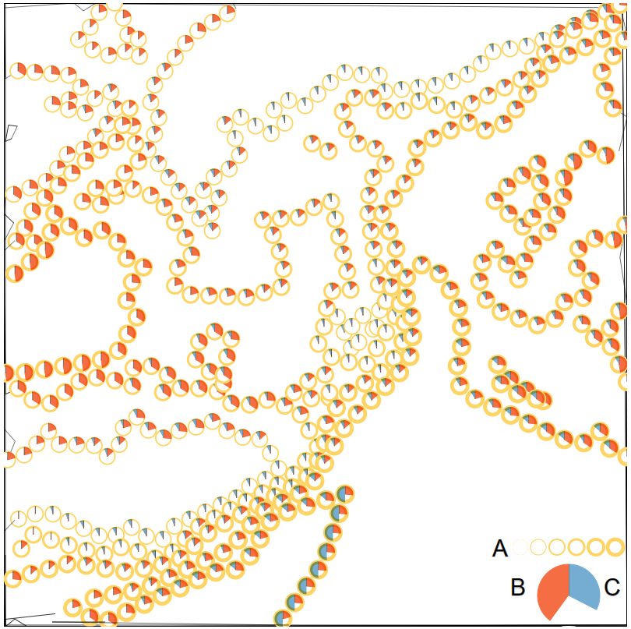
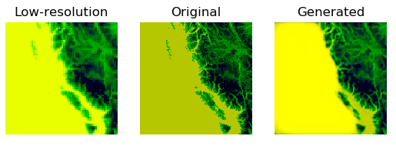
Visualization (Mondal)
Horizon Charts: Analysis of Time Series Data
ContourDiff: Explore differential changes of geospatial variables
Correlation Analysis of Geospatial Variables
Image Compression to support mobility and performance
Core Computer Science
November 19-20, 2019 | Art Gallery of Hamilton | Hamilton, Ontario

Slide 8
Visualization – Select Publications
Debajyoti Mondal, Manishankar Mondal, Chanchal K. Roy, Kevin A. Schneider, Shisong Wang, Yukun Li, Clone-World: A Visual Analytic System for Large Scale Software Clones. Visual Informatics, 3(1):18-26, 2019.
Debajyoti Mondal, Manishankar Mondal, Chanchal K. Roy, Kevin Schneider, Shisong Wang, and Yukun Li, Towards Visualizing Large Scale Evolving Clones. The 41st International Conference on Software Engineering (ICSE), 2019.
Core Computer Science
November 19-20, 2019 | Art Gallery of Hamilton | Hamilton, Ontario

Slide 9
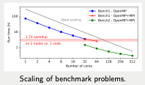
Improved Scalability of Hydrological Modelling (Spiteri)
Numerical Simulation Research Lab: SimLab
  Spiteri (PI), Green, Wang, Guo, Guenter
Increased spatial areas simulated
  Up to 60X to 1.3M km2 on 100 compute nodes
  (3,200 cores) of graham.computecanada.ca
Increased performance on benchmark test problems
  12X speedup on 16 nodes vs. 1 node
More fully distributed capabilities by April 2020
  Met forcing data input.
  Distributed reading of mesh data.
  Incorporation of fully coupled(domain-wide) algebraic solvers.
Core Computer Science
November 19-20, 2019 | Art Gallery of Hamilton | Hamilton, Ontario

Slide 10
Improved Scalability of Hydrological Modelling - Select Publications
Green, K. R., Bohn, T. A., & Spiteri, R. J. (2019). Direct function evaluation versus lookup tables: when to use which? SIAM Journal on Scientific Computing, 41(3), 194–218.
Green, K. R., & Spiteri, R. J. (2019). Extended BACOLI: Solving one-dimensional multiscale parabolic PDE systems with error control. ACM Trans. Math. Softw., 45(1), 8:1–8:19. http://dx.doi.org/10.1145/3301320
Marsh, C.B., Spiteri, R.J., Pomeroy, J.W., & Wheater, H.S. (2018). Multi-objective unstructured triangular mesh generation for use in hydrological models, Computers and Geosciences, 119, 49-67.
Core Computer Science
November 19-20, 2019 | Art Gallery of Hamilton | Hamilton, Ontario

Slide 11
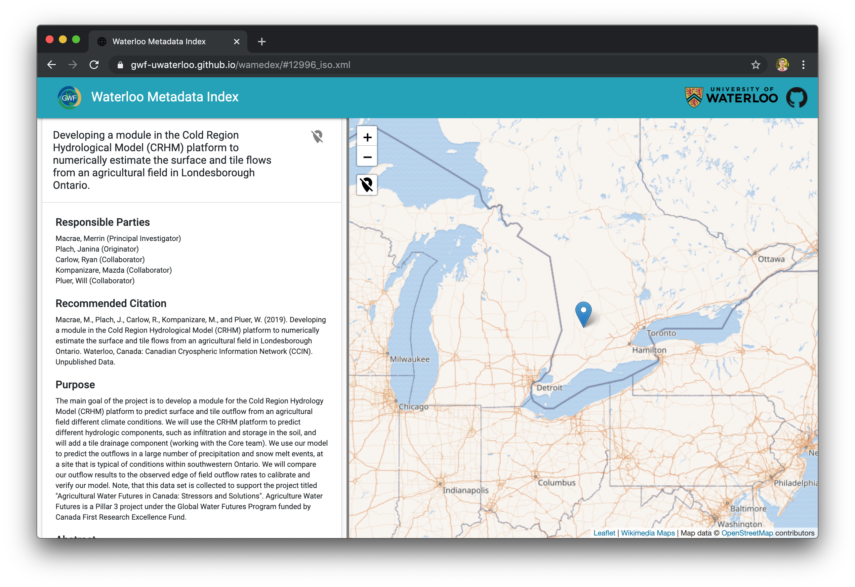
Wamedex to GeoNetwork
Metadata management: continued collaboration with DM
Wamedex: browser for ~60 metadata records from Waterloo
What’s next?
GeoNetwork is an open-source catalog application to manage spatially referenced resources
NLP techniques to semi-automatically extract information from scientific publications
Core Computer Science
Project Title
November 19-20, 2019 | Art Gallery of Hamilton | Hamilton, Ontario

Slide 12
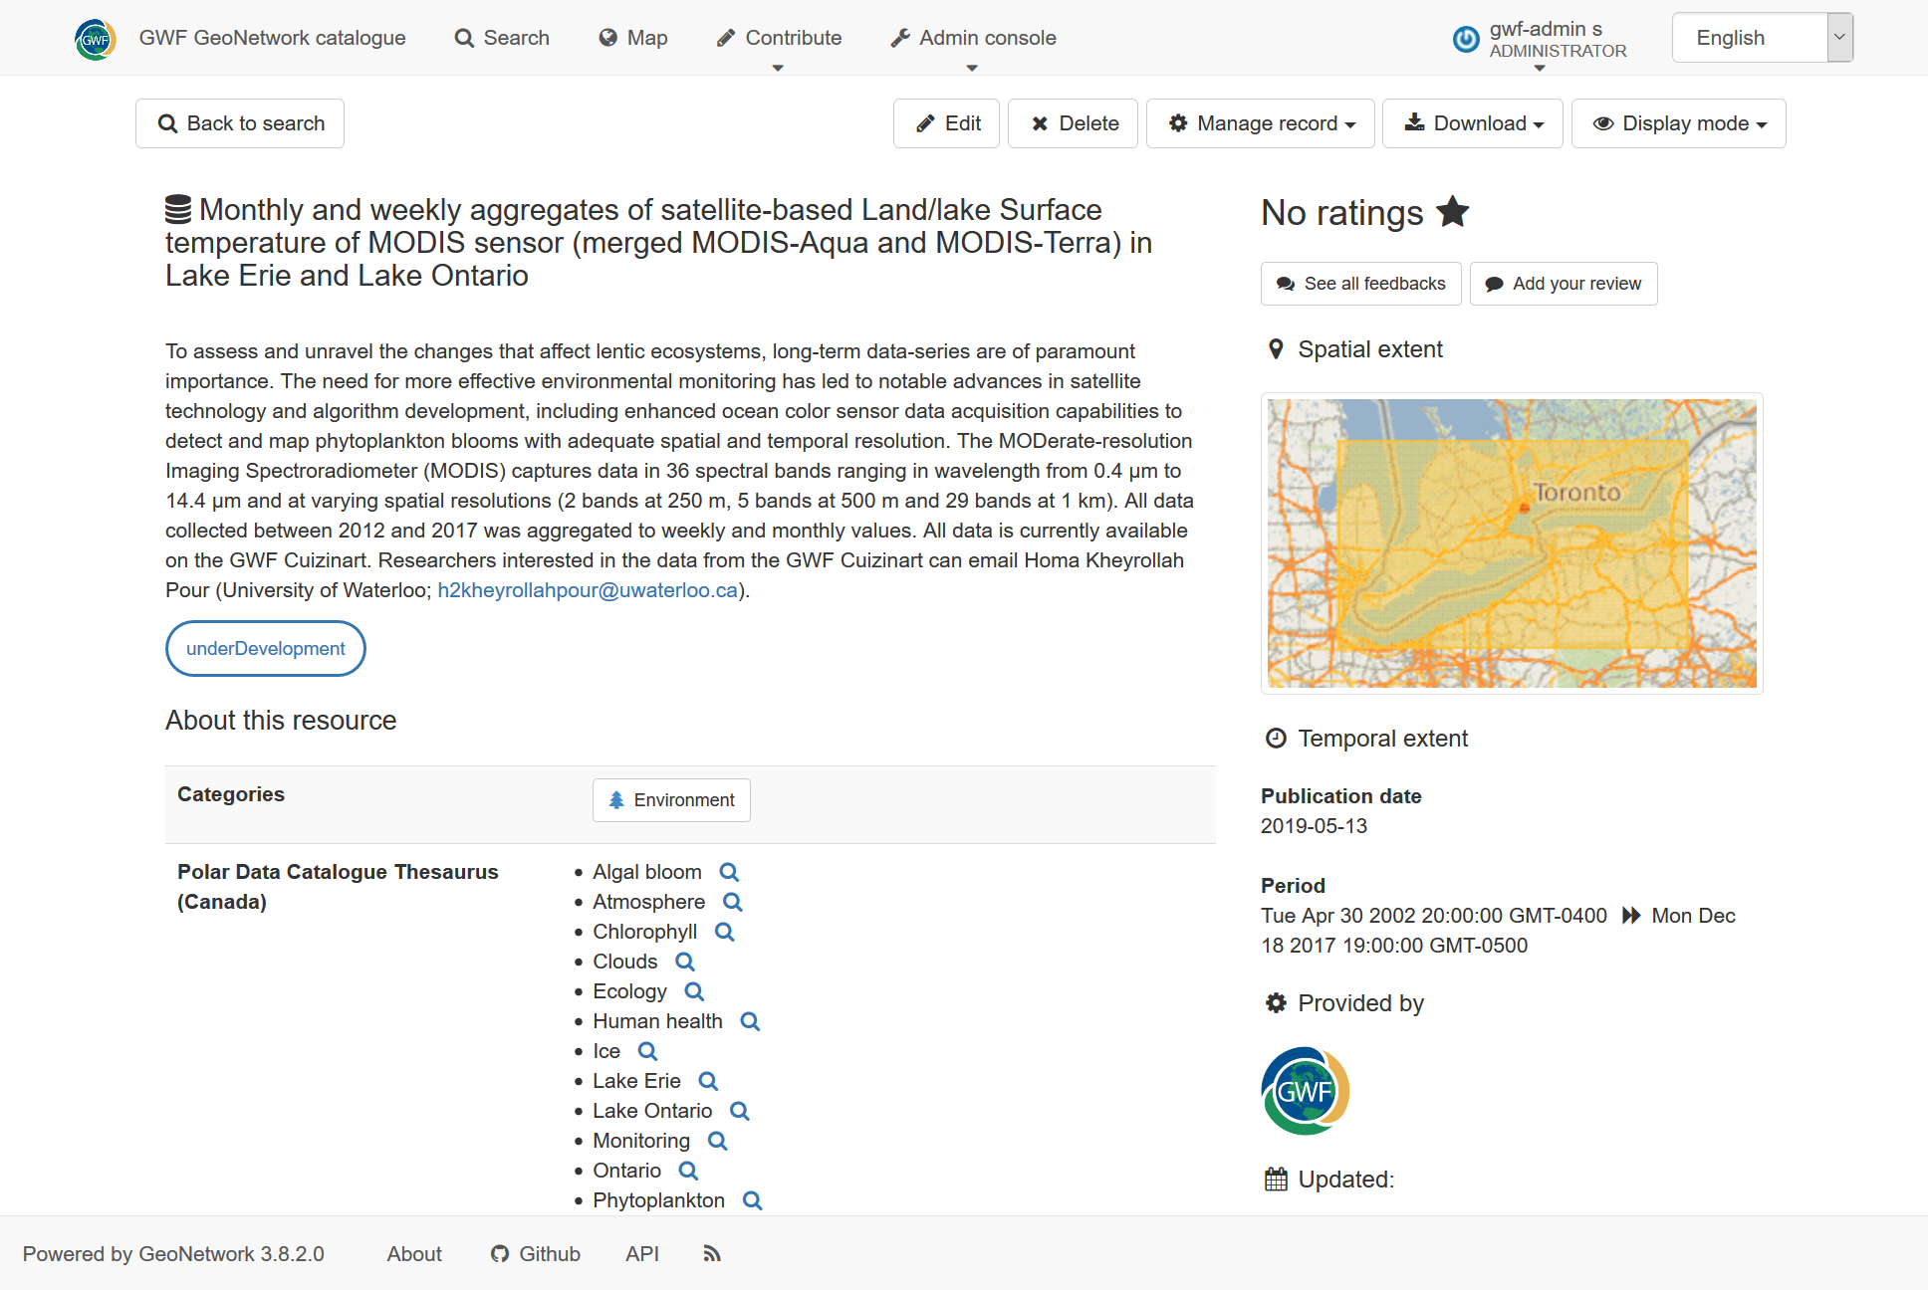
Core Computer Science
Project Title
November 19-20, 2019 | Art Gallery of Hamilton | Hamilton, Ontario

Slide 13
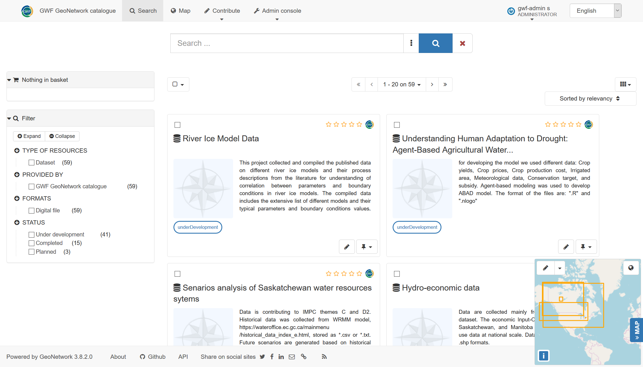
Core Computer Science
Project Title
November 19-20, 2019 | Art Gallery of Hamilton | Hamilton, Ontario

Slide 14
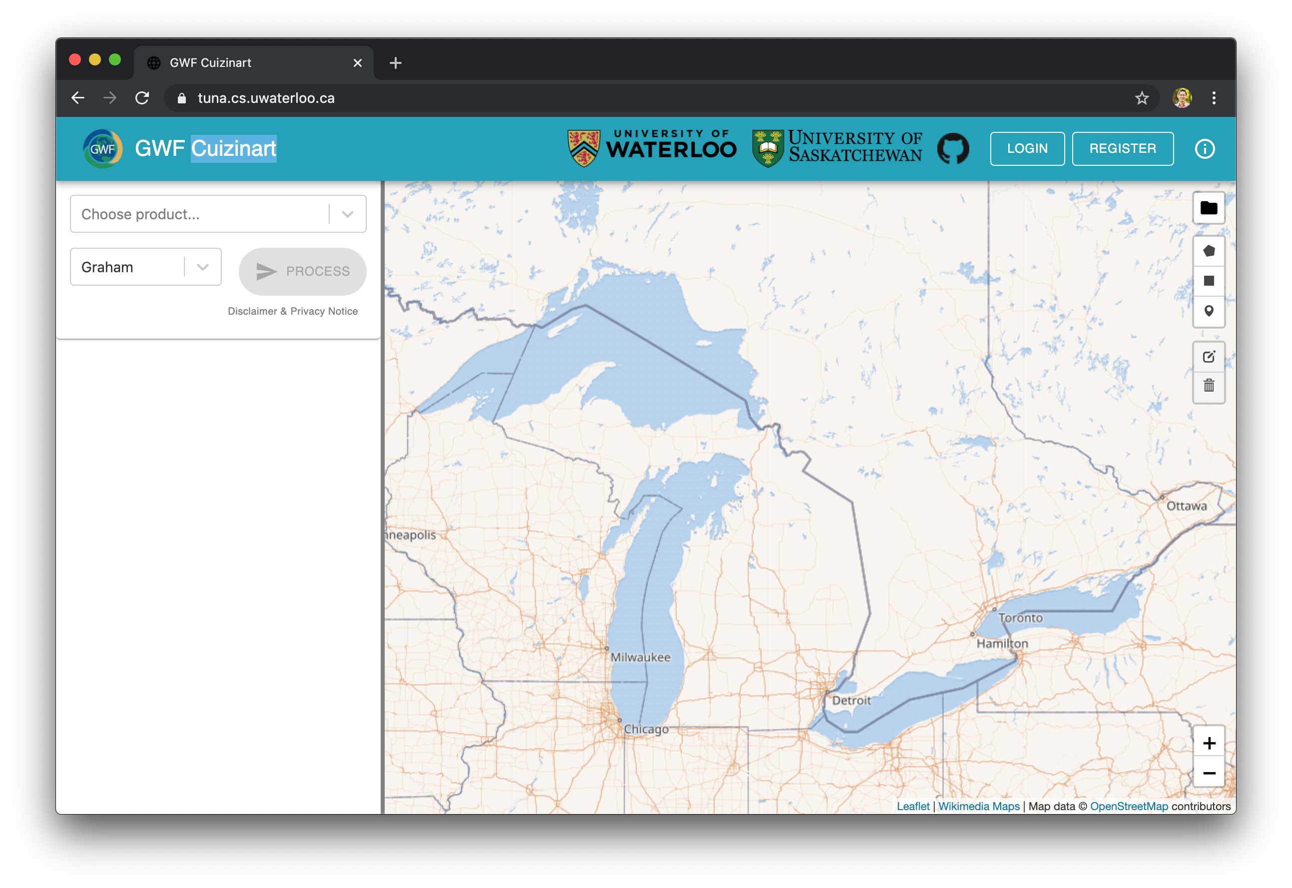
GWF Cuizinart
“Slice and dice” your NetCDF data based on your variable of interest!
We continue to (slowly) ingest data…
Core Computer Science
Project Title
November 19-20, 2019 | Art Gallery of Hamilton | Hamilton, Ontario

Slide 15
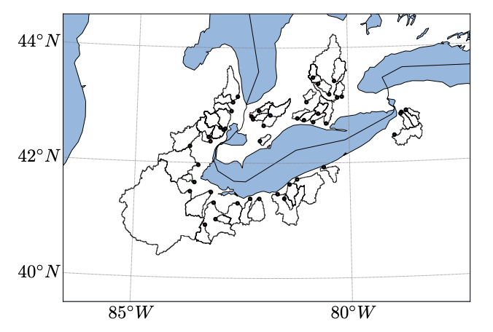
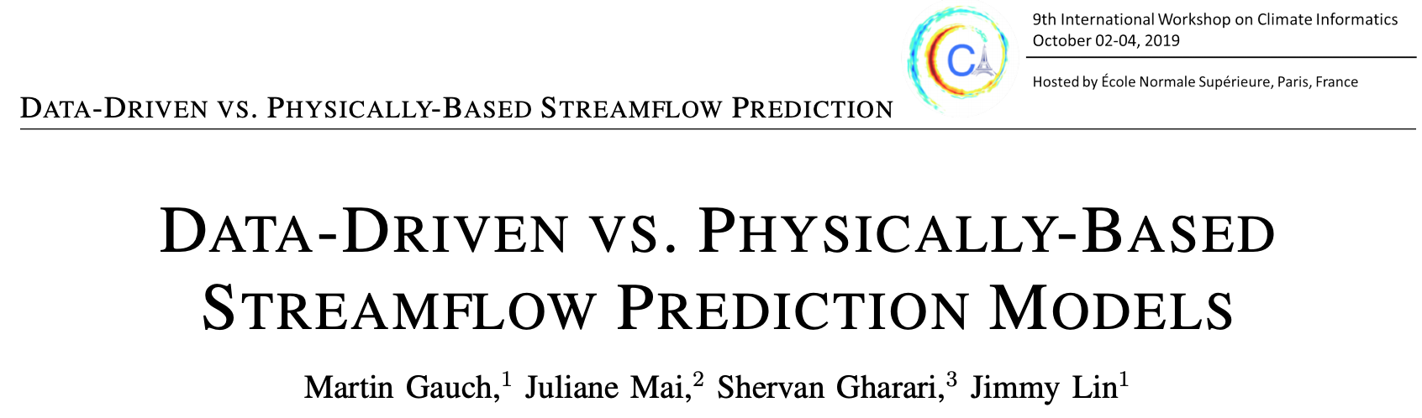
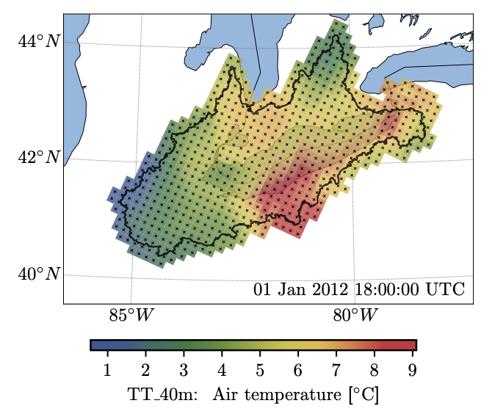
What do we do with all that data? Machine Learning!
New collaboration with core modeling:
Great Lakes Runoff Inter-comparison Project for Lake Erie (GRIP-E)
Project Title
Project name
November 19-20, 2019 | Art Gallery of Hamilton | Hamilton, Ontario

Slide 16
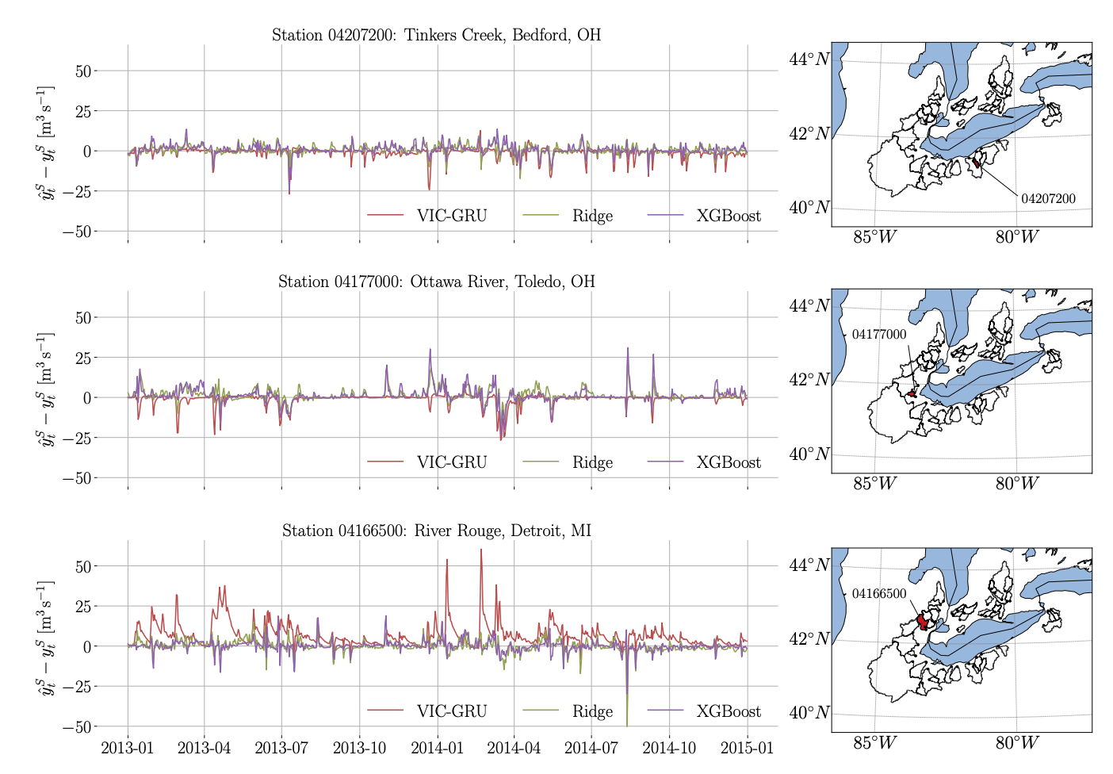
What do we do with all that data? Machine Learning!
VIC-GRU: median NSE 0.328
XGBoost: median NSE 0.522
Core Computer Science
November 19-20, 2019 | Art Gallery of Hamilton | Hamilton, Ontario

Slide 17
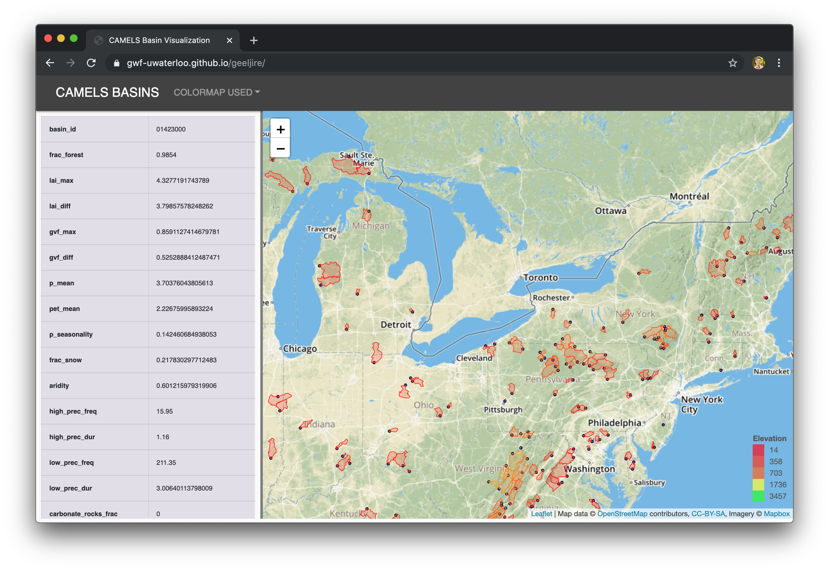
Still Missing Something… Neural Networks!
CAMELS dataset (NCAR): comparisons across 531 basins
Enough data to throw neural networks at it!
Core Computer Science
November 19-20, 2019 | Art Gallery of Hamilton | Hamilton, Ontario

Slide 18
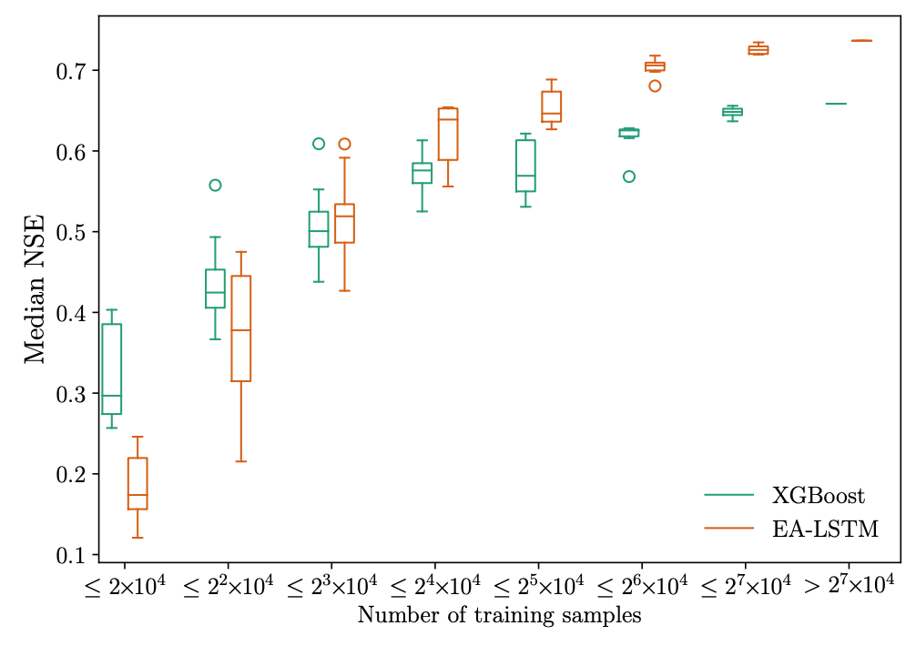
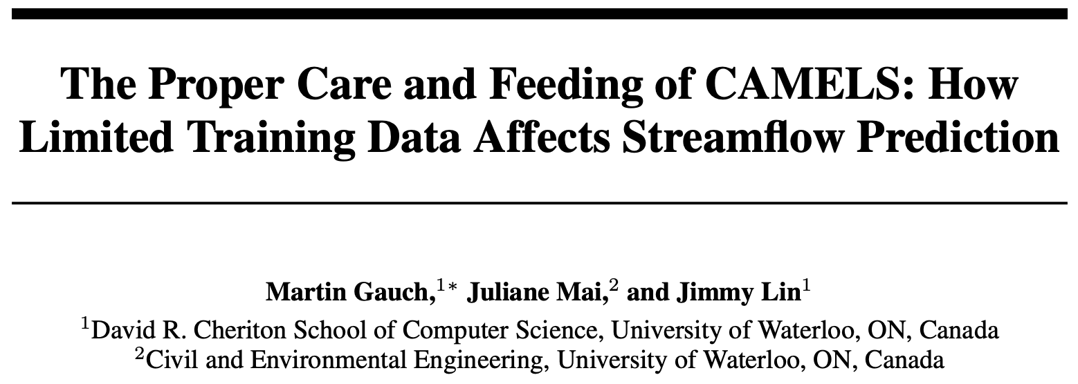
Still Missing Something… Neural Networks!
When do neural networks win?
Both in terms of calibration period length and number of basins?
Core Computer Science
November 19-20, 2019 | Art Gallery of Hamilton | Hamilton, Ontario

Slide 19
Other - Nutrient App
Diogio Costa, Riya Kurian, Uswah Aziz, Jane Elliot, Helen Baulch, John Pomeroy
Push Interactions
  iPhone and Android versions
Core Computer Science Team
  Server
  Web Interface
Core Computer Science
November 19-20, 2019 | Art Gallery of Hamilton | Hamilton, Ontario

Slide 20
Challenges and Cross-project Collaboration Opportunities
Collaboration Opportunities
  Further engagement with GWF core modelling team
  Further engagement with other research groups that require core computer science support
Challenges
  Ensure priorities align with GWF groups
  Ensure engage with GWF groups
Do you need something from the collective Operations Team?
  Priority setting
  Engagement
  Adoption
Core Computer Science
November 19-20, 2019 | Art Gallery of Hamilton | Hamilton, Ontario

