Slide 1
Significance of Groundwater Dynamics within Hydrologic Models
Xin Tong, Walter A. Illman (PI), Young-Jin Park, David L. Rudolph, Steven J. Berg
Department of Earth & Environmental Sciences
University of Waterloo
Third Annual GWF Operations Team Meeting
November 19-20, 2019
Art Gallery of Hamilton
Hamilton, Ontario
Project coordinates: PI, email, website, etc
Notes:
It can help to frame your main research objective as a question. For example,
What is the significance of groundwater fluxes on surface water flow?

Slide 2
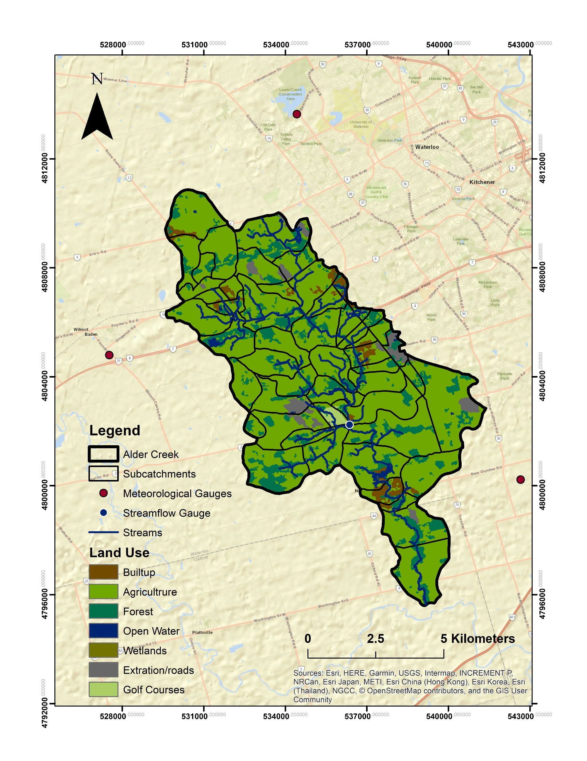
Project Introduction and Objectives
Objective: What is the significance of shallow/deep groundwater flow (including unsaturated flow) on watershed fluxes?
Utilize HydroGeoSphere (HGS), a fully-integrated hydrologic model, for high-resolution simulations;
Utilize 3-year record of data from the Alder Creek Watershed (ACW);
How does importance of groundwater flow vary with natural & anthropogenic changes to watershed?
Any model can be calibrated; but can it be validated?
Alder Creek Watershed (ACW)
Significance of Groundwater Dynamics within Hydrologic Models
Project coordinates: PI, email, website, etc
Notes:
Many existing watershed models do not consider groundwater flow rigorously;
3-year record of various hydrologic data for model calibration/validation;

Slide 3
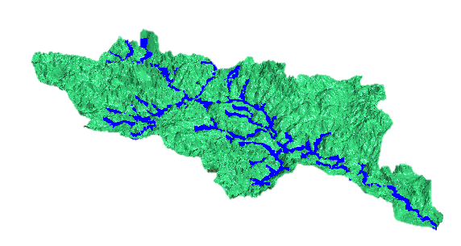
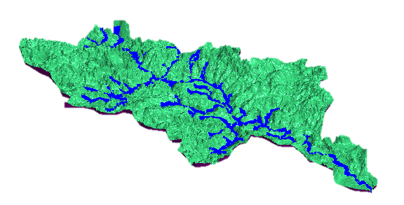
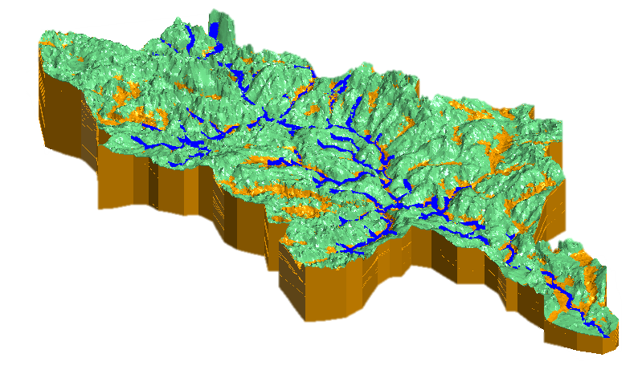
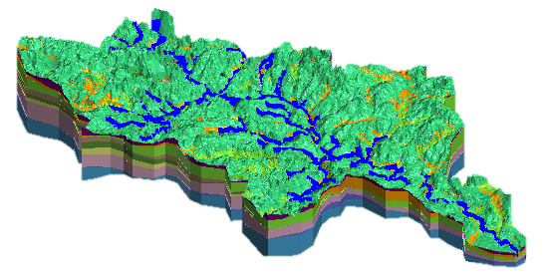
How Complex Should We Make Watershed Models?
HydroGeoSphere (HGS), a fully integrated hydrologic model used to build high resolution numerical models of various complexities:
Model 1 (Surface): surficial layer only
Model 2 (Surface_Soil): surficial layer + 1-meter thick soil layer
Model 3 (Geo_Uni): surficial layer + thick subsurface (uniform & isotropic hydraulic parameters);
Model 4 (Geo): surficial layer + thick subsurface (detailed stratigraphy with uniform & anisotropic geologic layers).
Project Title
Significance of Groundwater Dynamics within Hydrologic Models

Slide 4
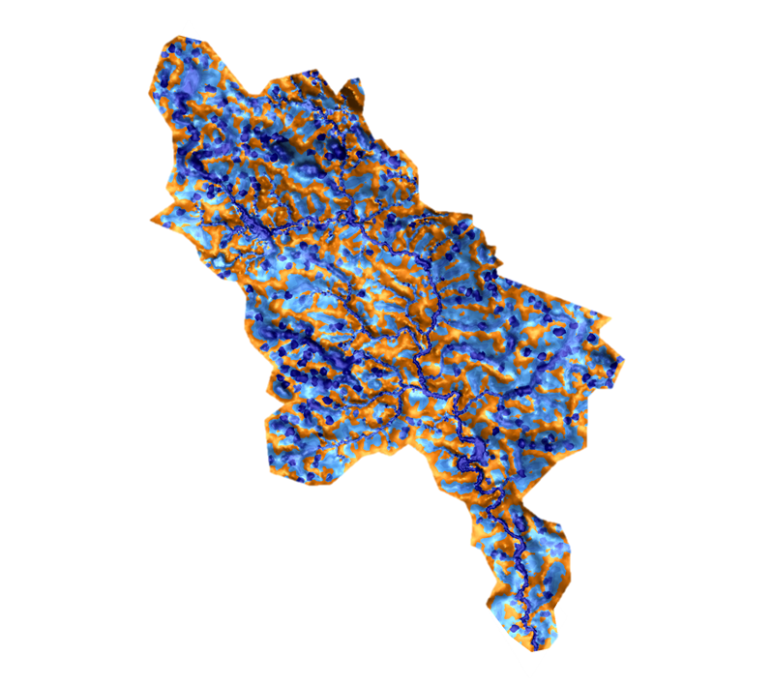
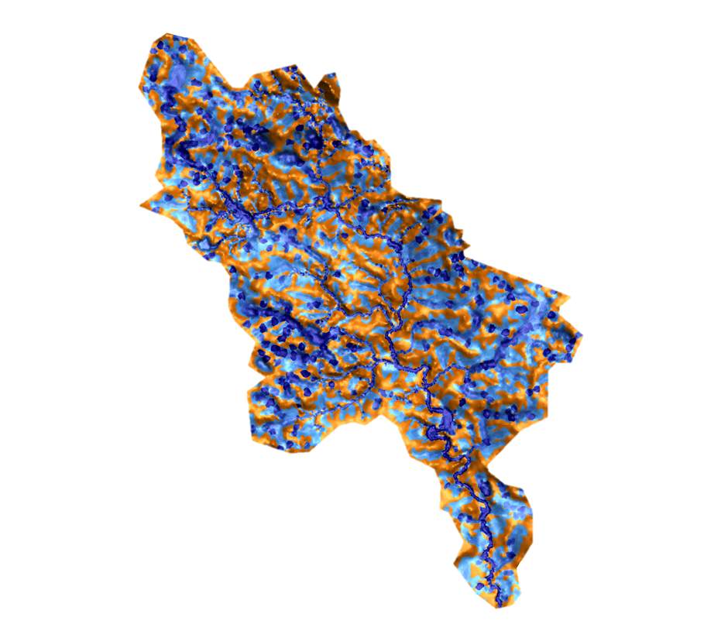
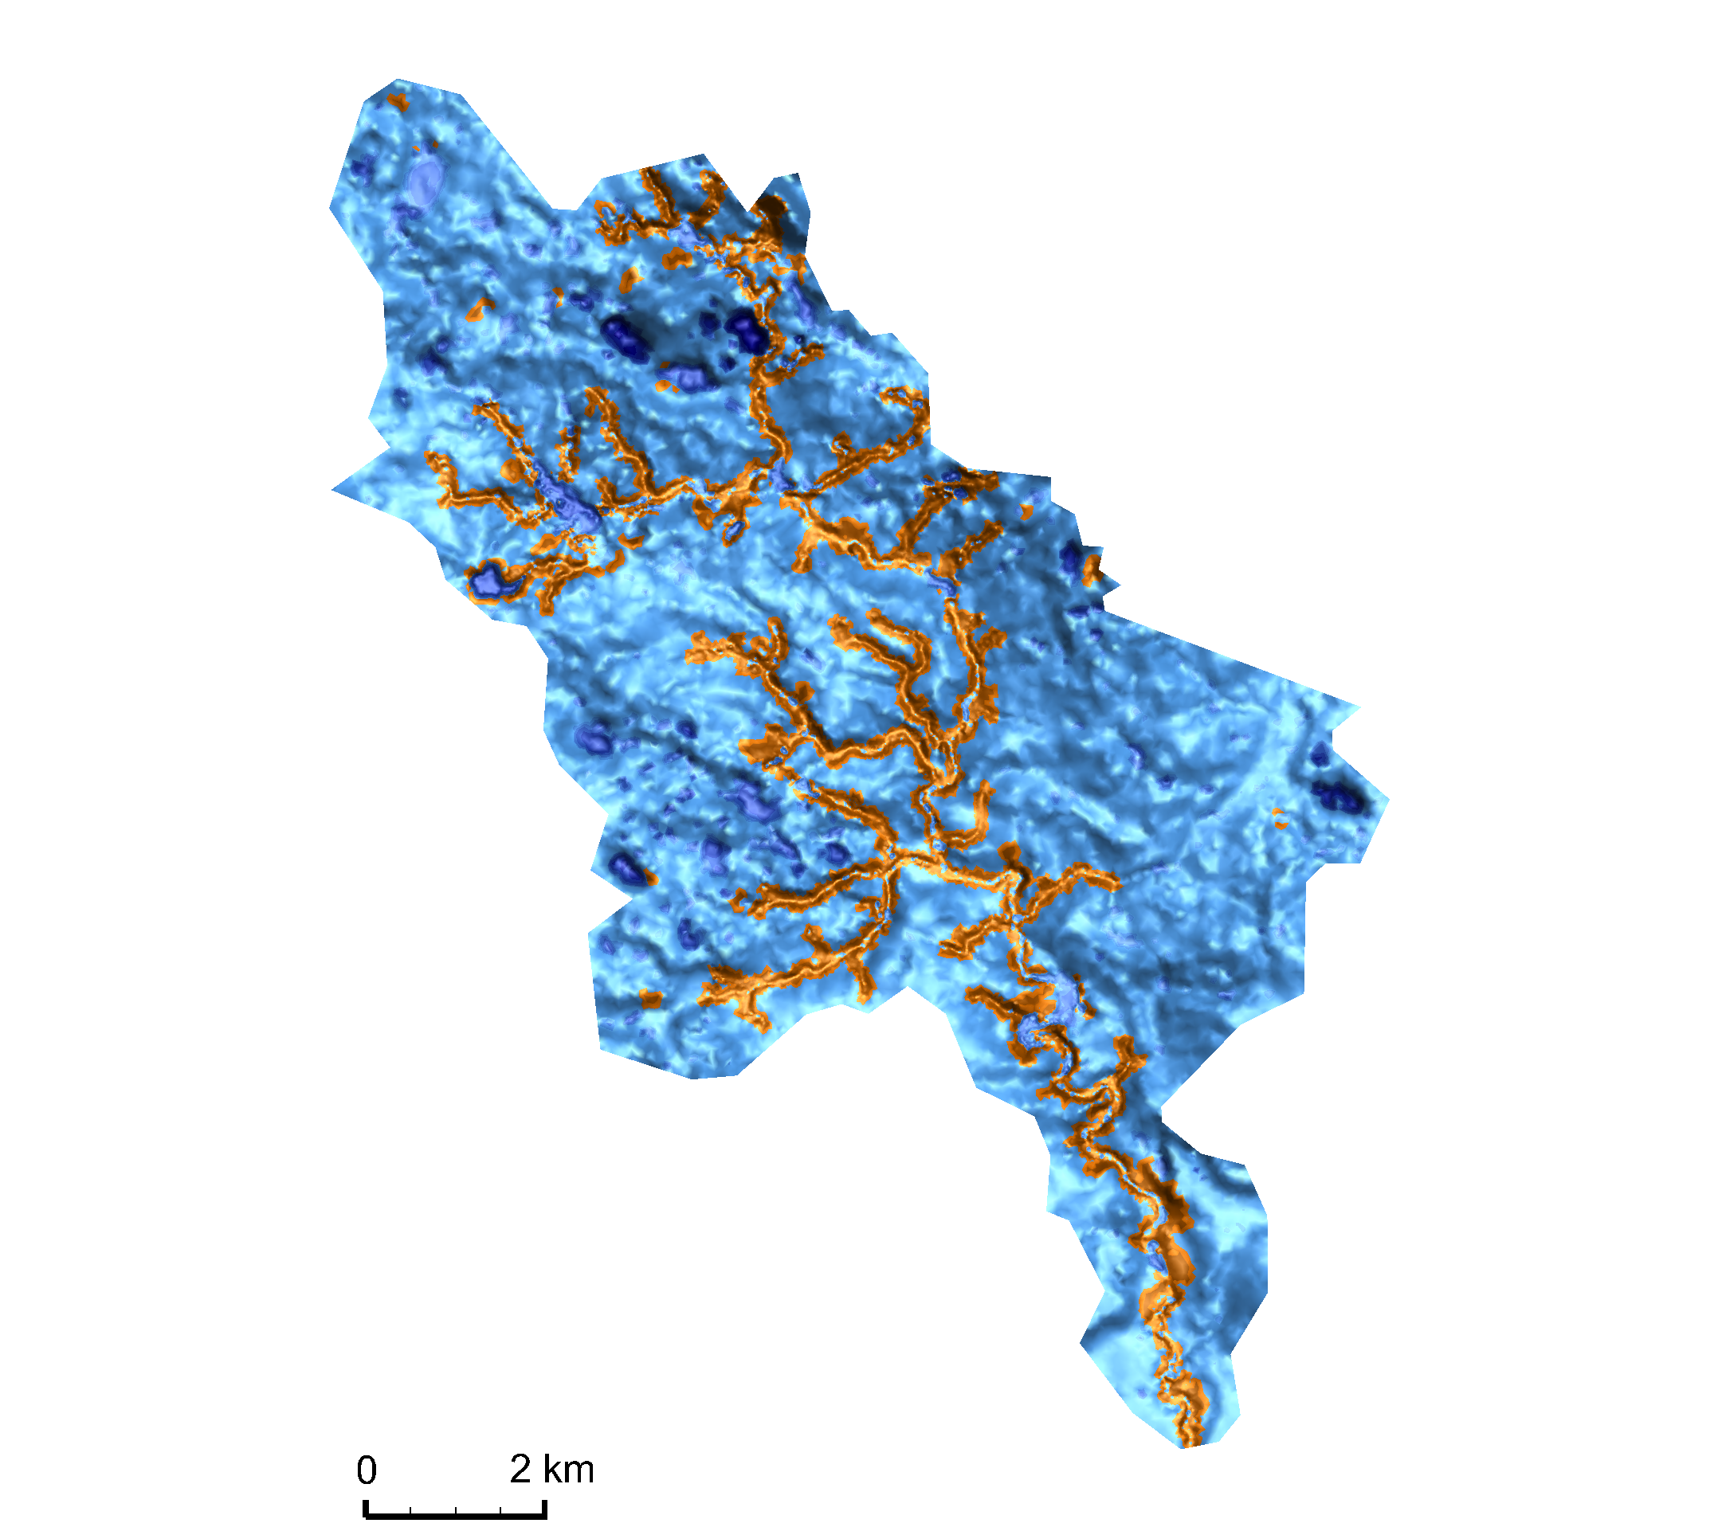
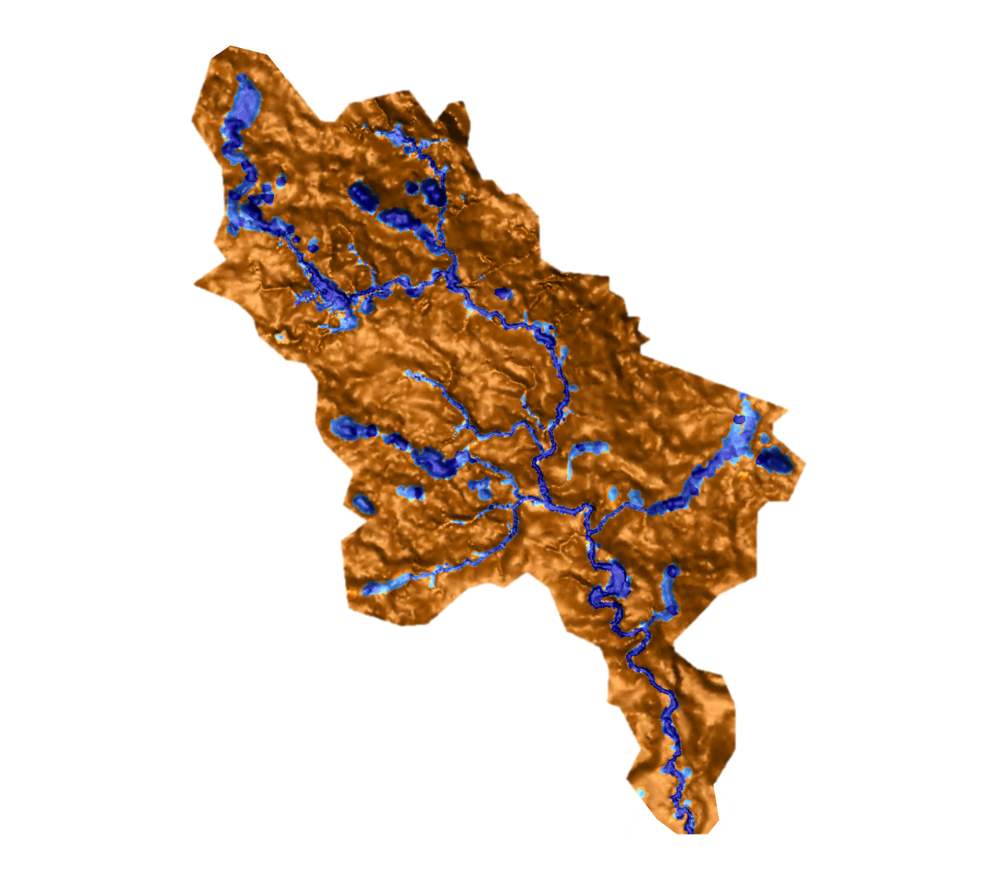
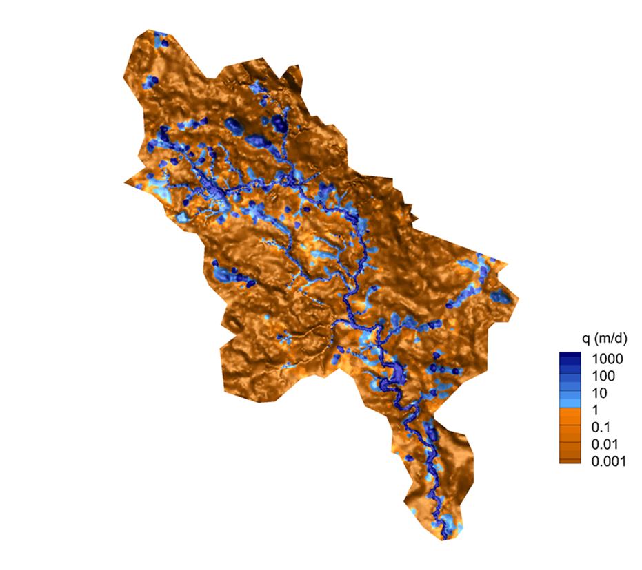

Model Conceptualization Strongly Impacts Surface Water Fluxes
Model 1:
Surface
Model 2: Surface_Soil
Model 3: Geo_Uni
Model 4:
Geo
Significance of Groundwater Dynamics within Hydrologic Models
Notes:
Differences in model conceptualization leads to different results in surface water fluxes
Similar with the water depth, the surface water flux for model 3 and 4 are more representative for the real situation.

Slide 5
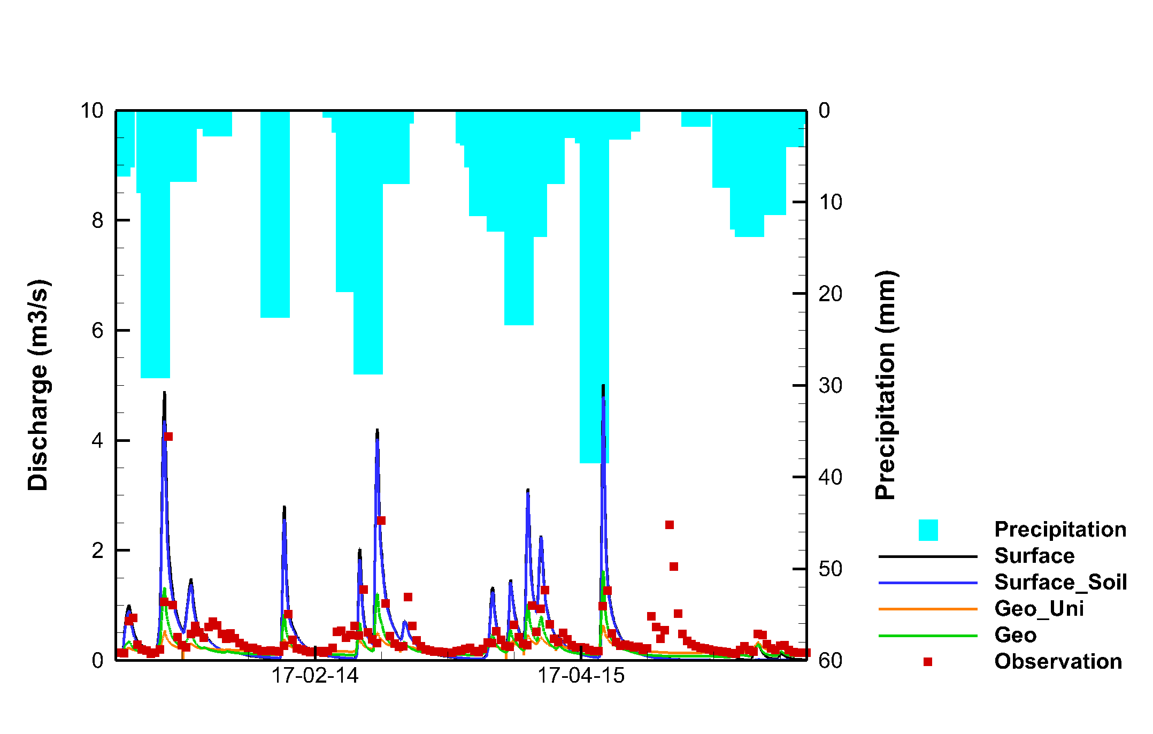
Transient Simulations & Comparison with Discharge Data
 | L1 | L2
Surface only | 0.56 | 1.50
Surface_Soil | 0.53 | 1.31
Geo_Uni | 0.26 | 0.24
Geo | 0.22 | 0.21
L1 = mean absolute error norm
L2 = mean square error norm
Significance of Groundwater Dynamics within Hydrologic Models

Slide 6
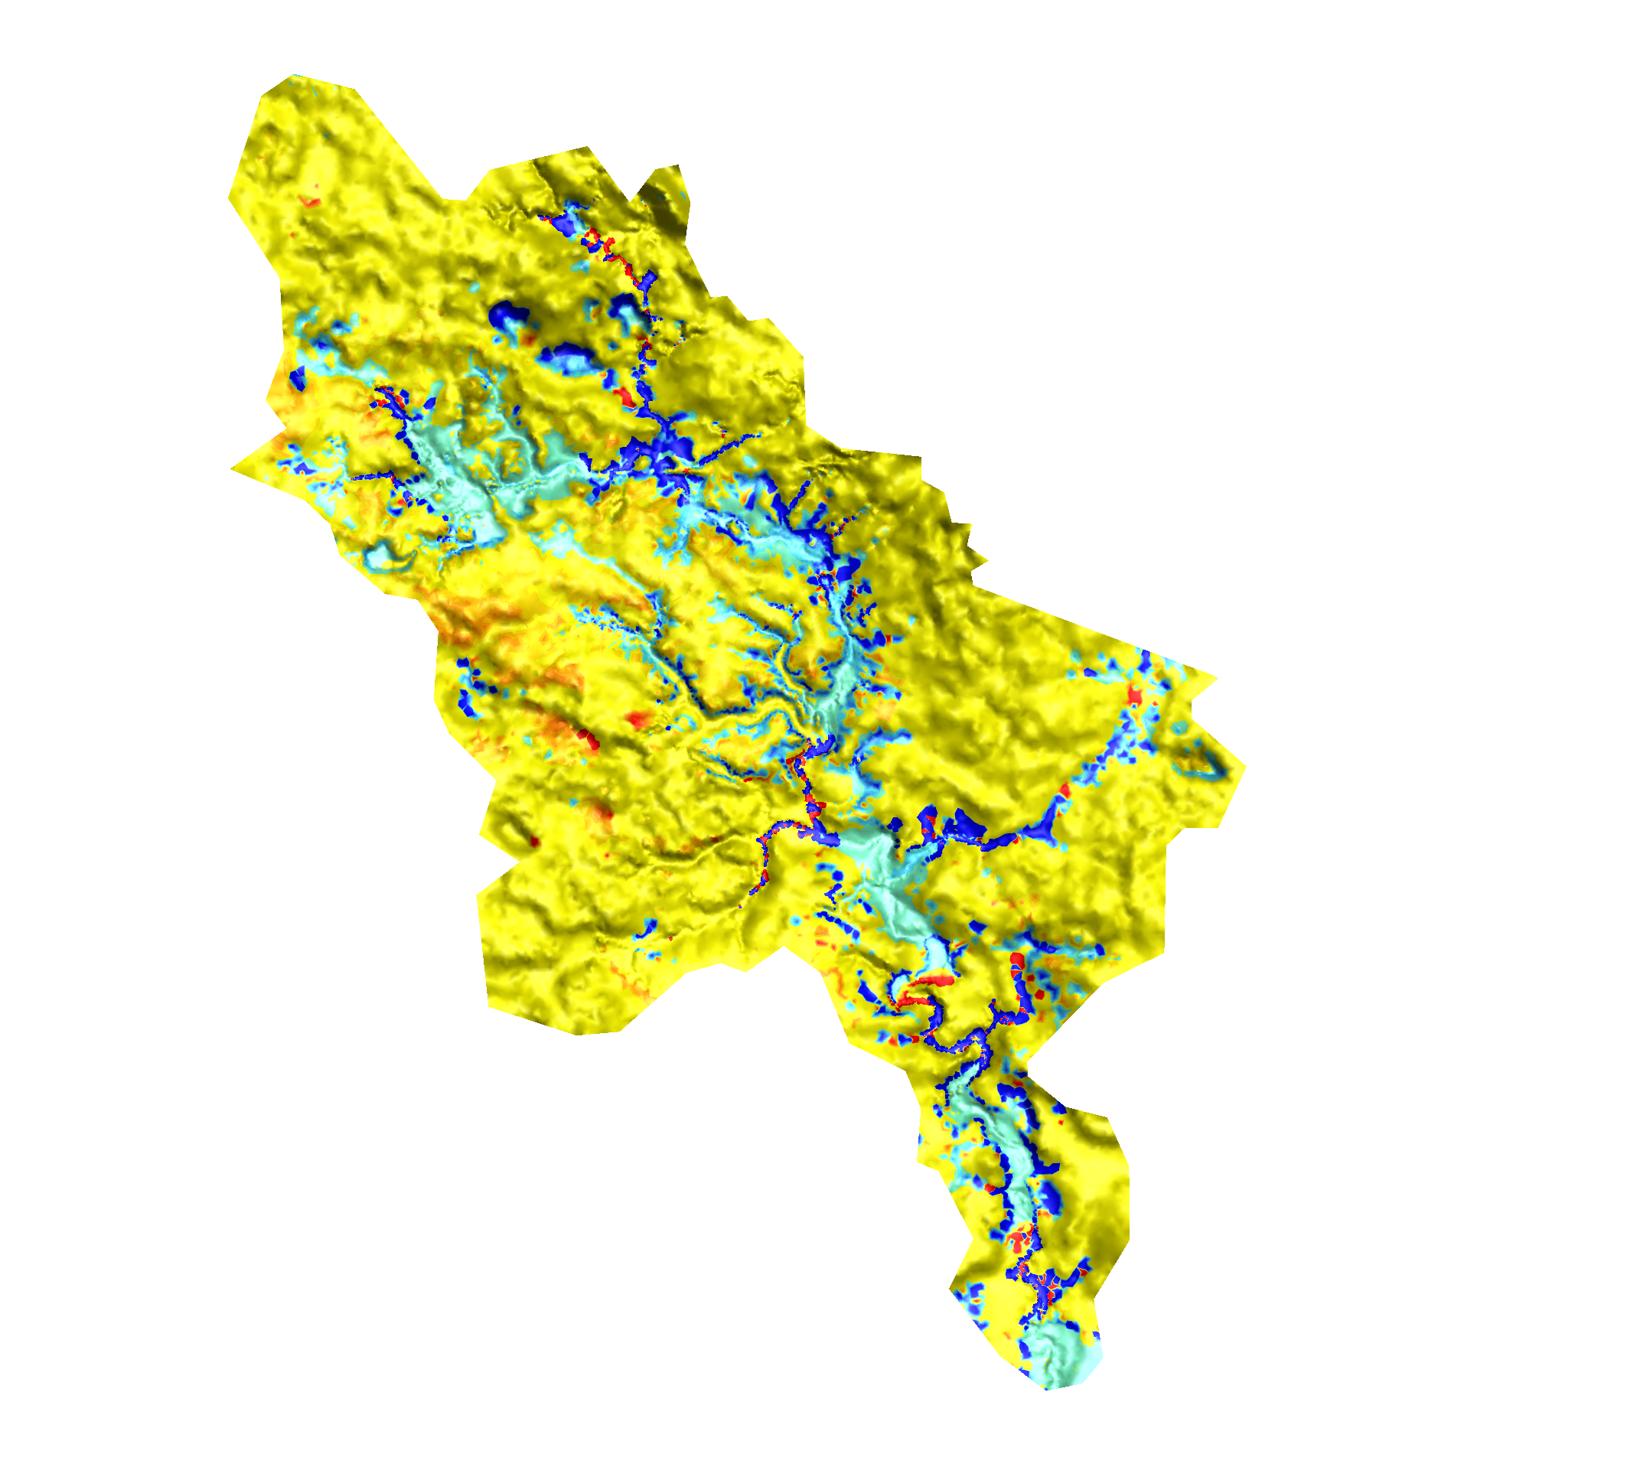
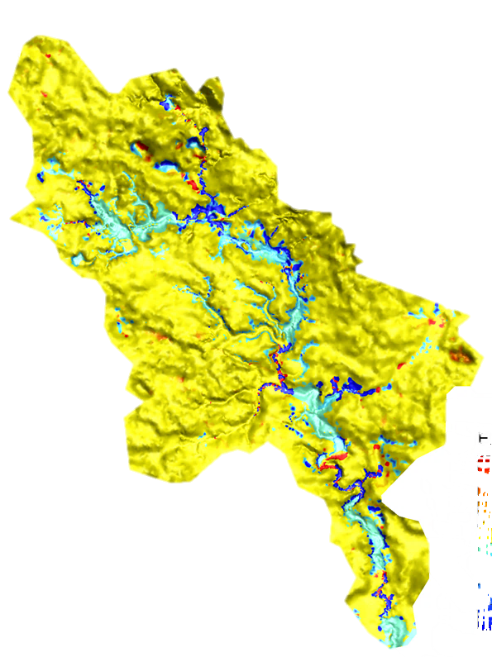
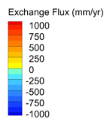

Surface Water/Groundwater Exchange Flux Can Vary with Space and Time
Differences in exchange flux of dry and wet periods show the importance of groundwater fluxes along the reach and its spatial/temporal variability;
Such investigations are important in research on water quantity and quality issues, as well as studies on aquatic life & riparian zones.
Model 4: Geo
Dry Periods
Wet Periods
Significance of Groundwater Dynamics within Hydrologic Models
Notes:
Is groundwater flux constant over time? Simulations show that groundwater inflow and outflow vareis with time and also with space along the reach.
Negative exchange flux (cool colours) is groundwater discharge, while positive exchange flux (warm colours) is groundwater recharge;

Slide 7
Project Impact and Aspirations
Impact: Study should contribute to development of guidelines for when to include groundwater (and to what complexity) in watershed models.
Aspirations: Developed “physically-based” models should be used to examine watershed responses due to impacts of: a) extreme hydrologic events (precipitation/ drought); b) land use change; c) climate change; d) groundwater extraction; and e) contaminant transport.
Significance of Groundwater Dynamics within Hydrologic Models
Project coordinates: PI, email, website, etc
Notes:
Impact: Study will contribute to development of guidelines for when to include groundwater (and to what complexity) in watershed models.

Slide 8
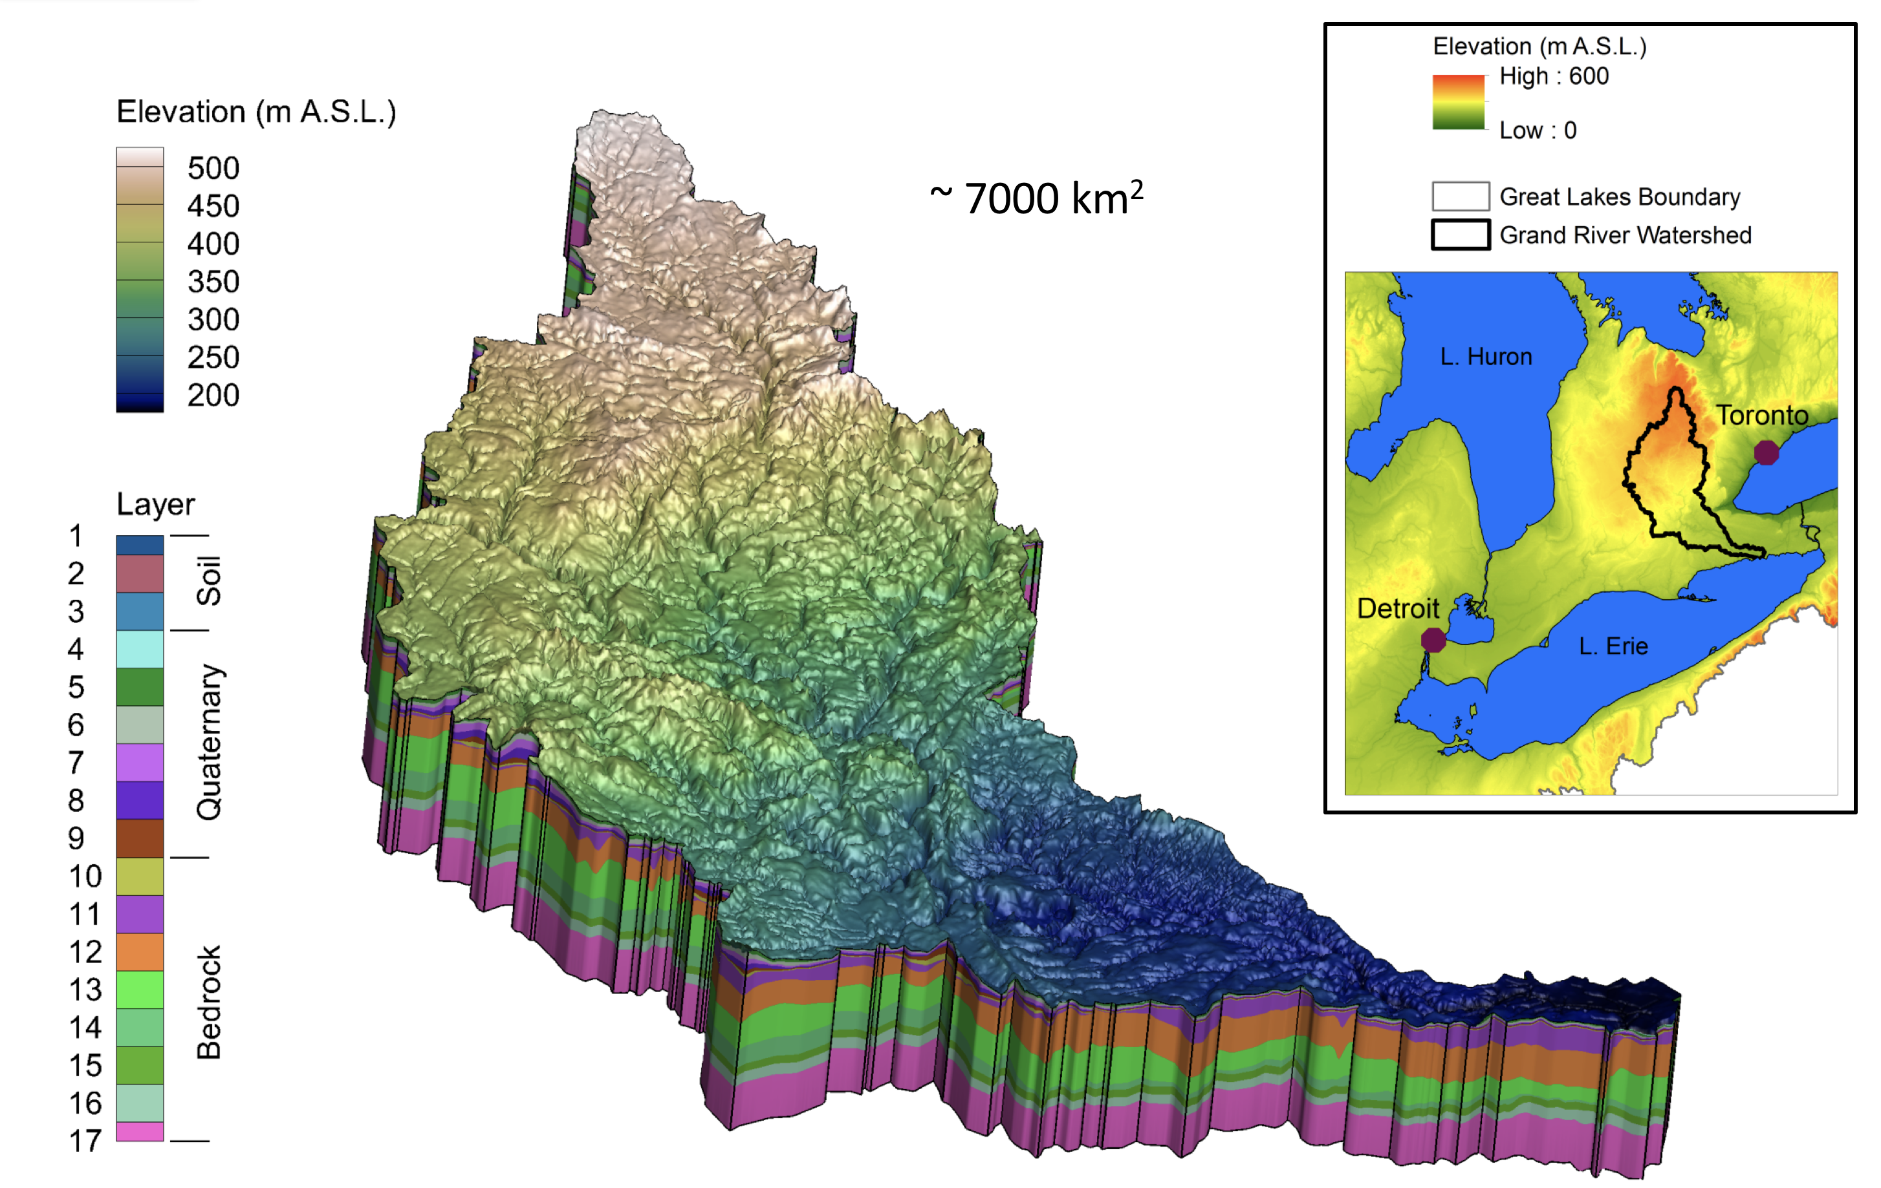
Challenges and Cross-Project Collaboration Opportunities
Challenges: Achieving computational efficiency for effective model calibration with diverse data types;
Cross-project collaboration opportunities: testing of approach at different watersheds with different characteristics (e.g., size, geology, land use, topography, etc.) for further assessment.
Significance of Groundwater Dynamics within Hydrologic Models
Project coordinates: PI, email, website, etc

