Slide 1


GWF Visualization Task Force Plans
Dr. Kevin Schneider
November 19-20, 2019 | Art Gallery of Hamilton | Hamilton, Ontario
Core Computer Science

Slide 2
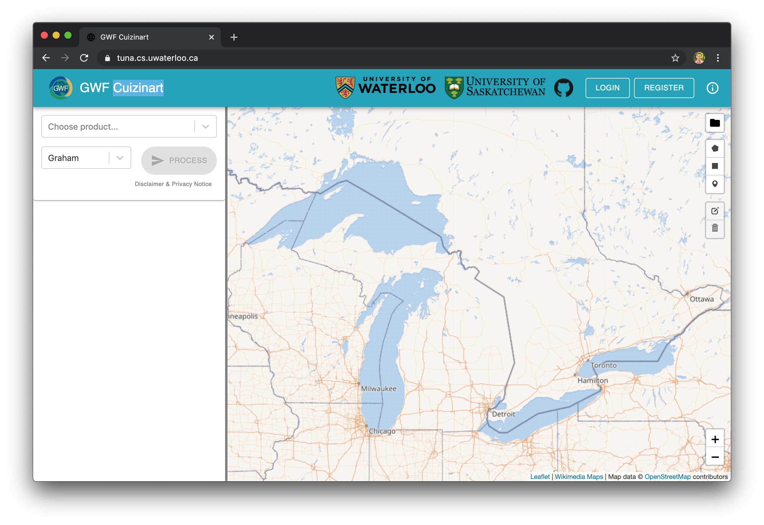
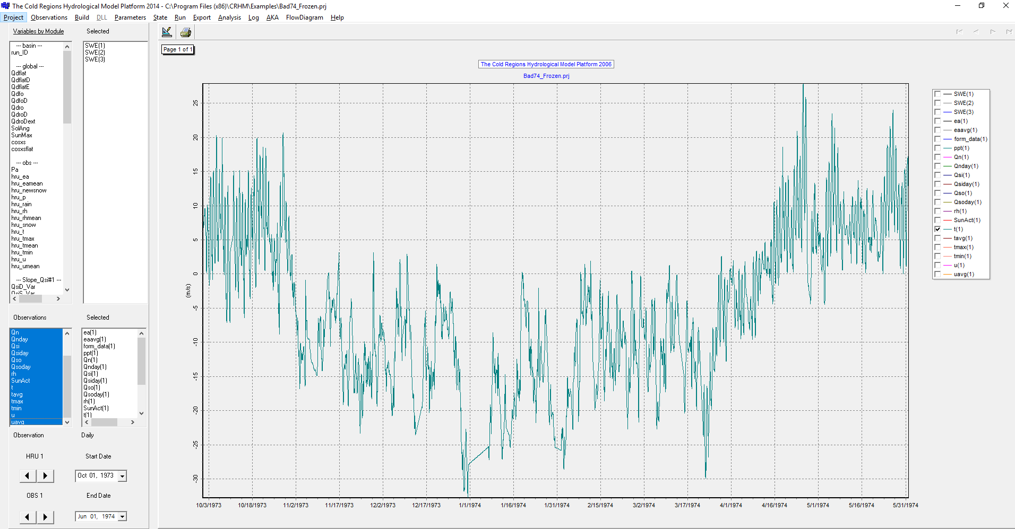
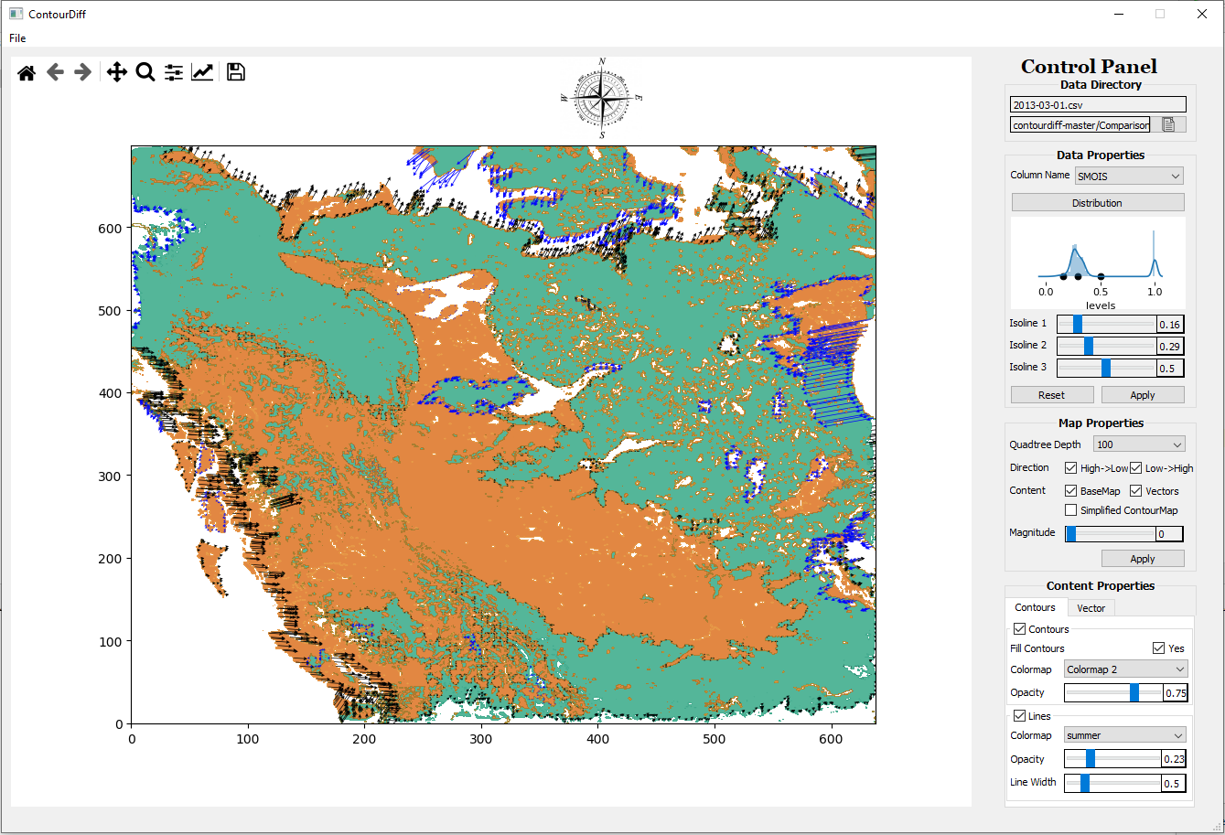
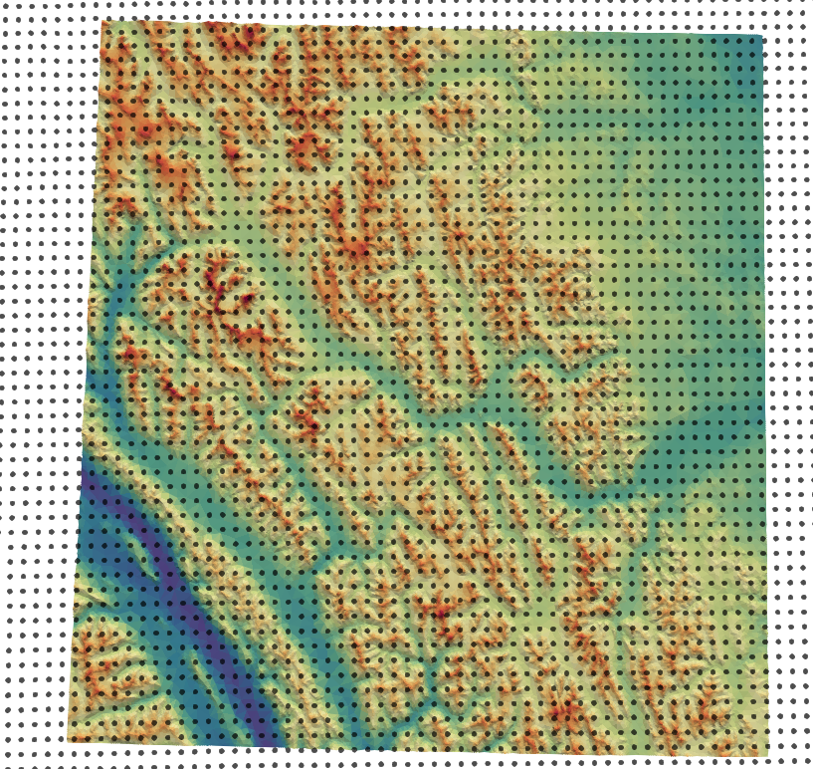
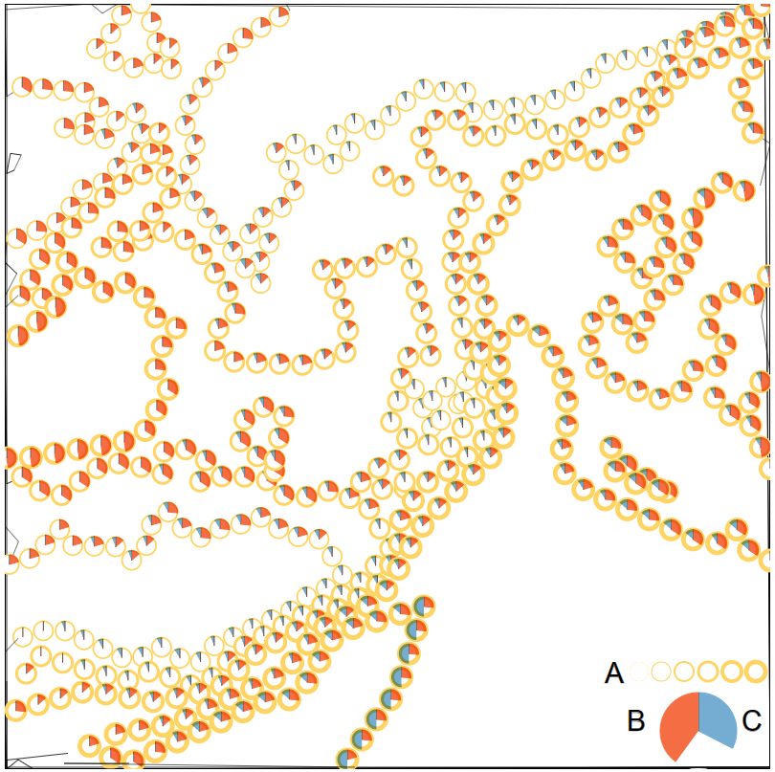
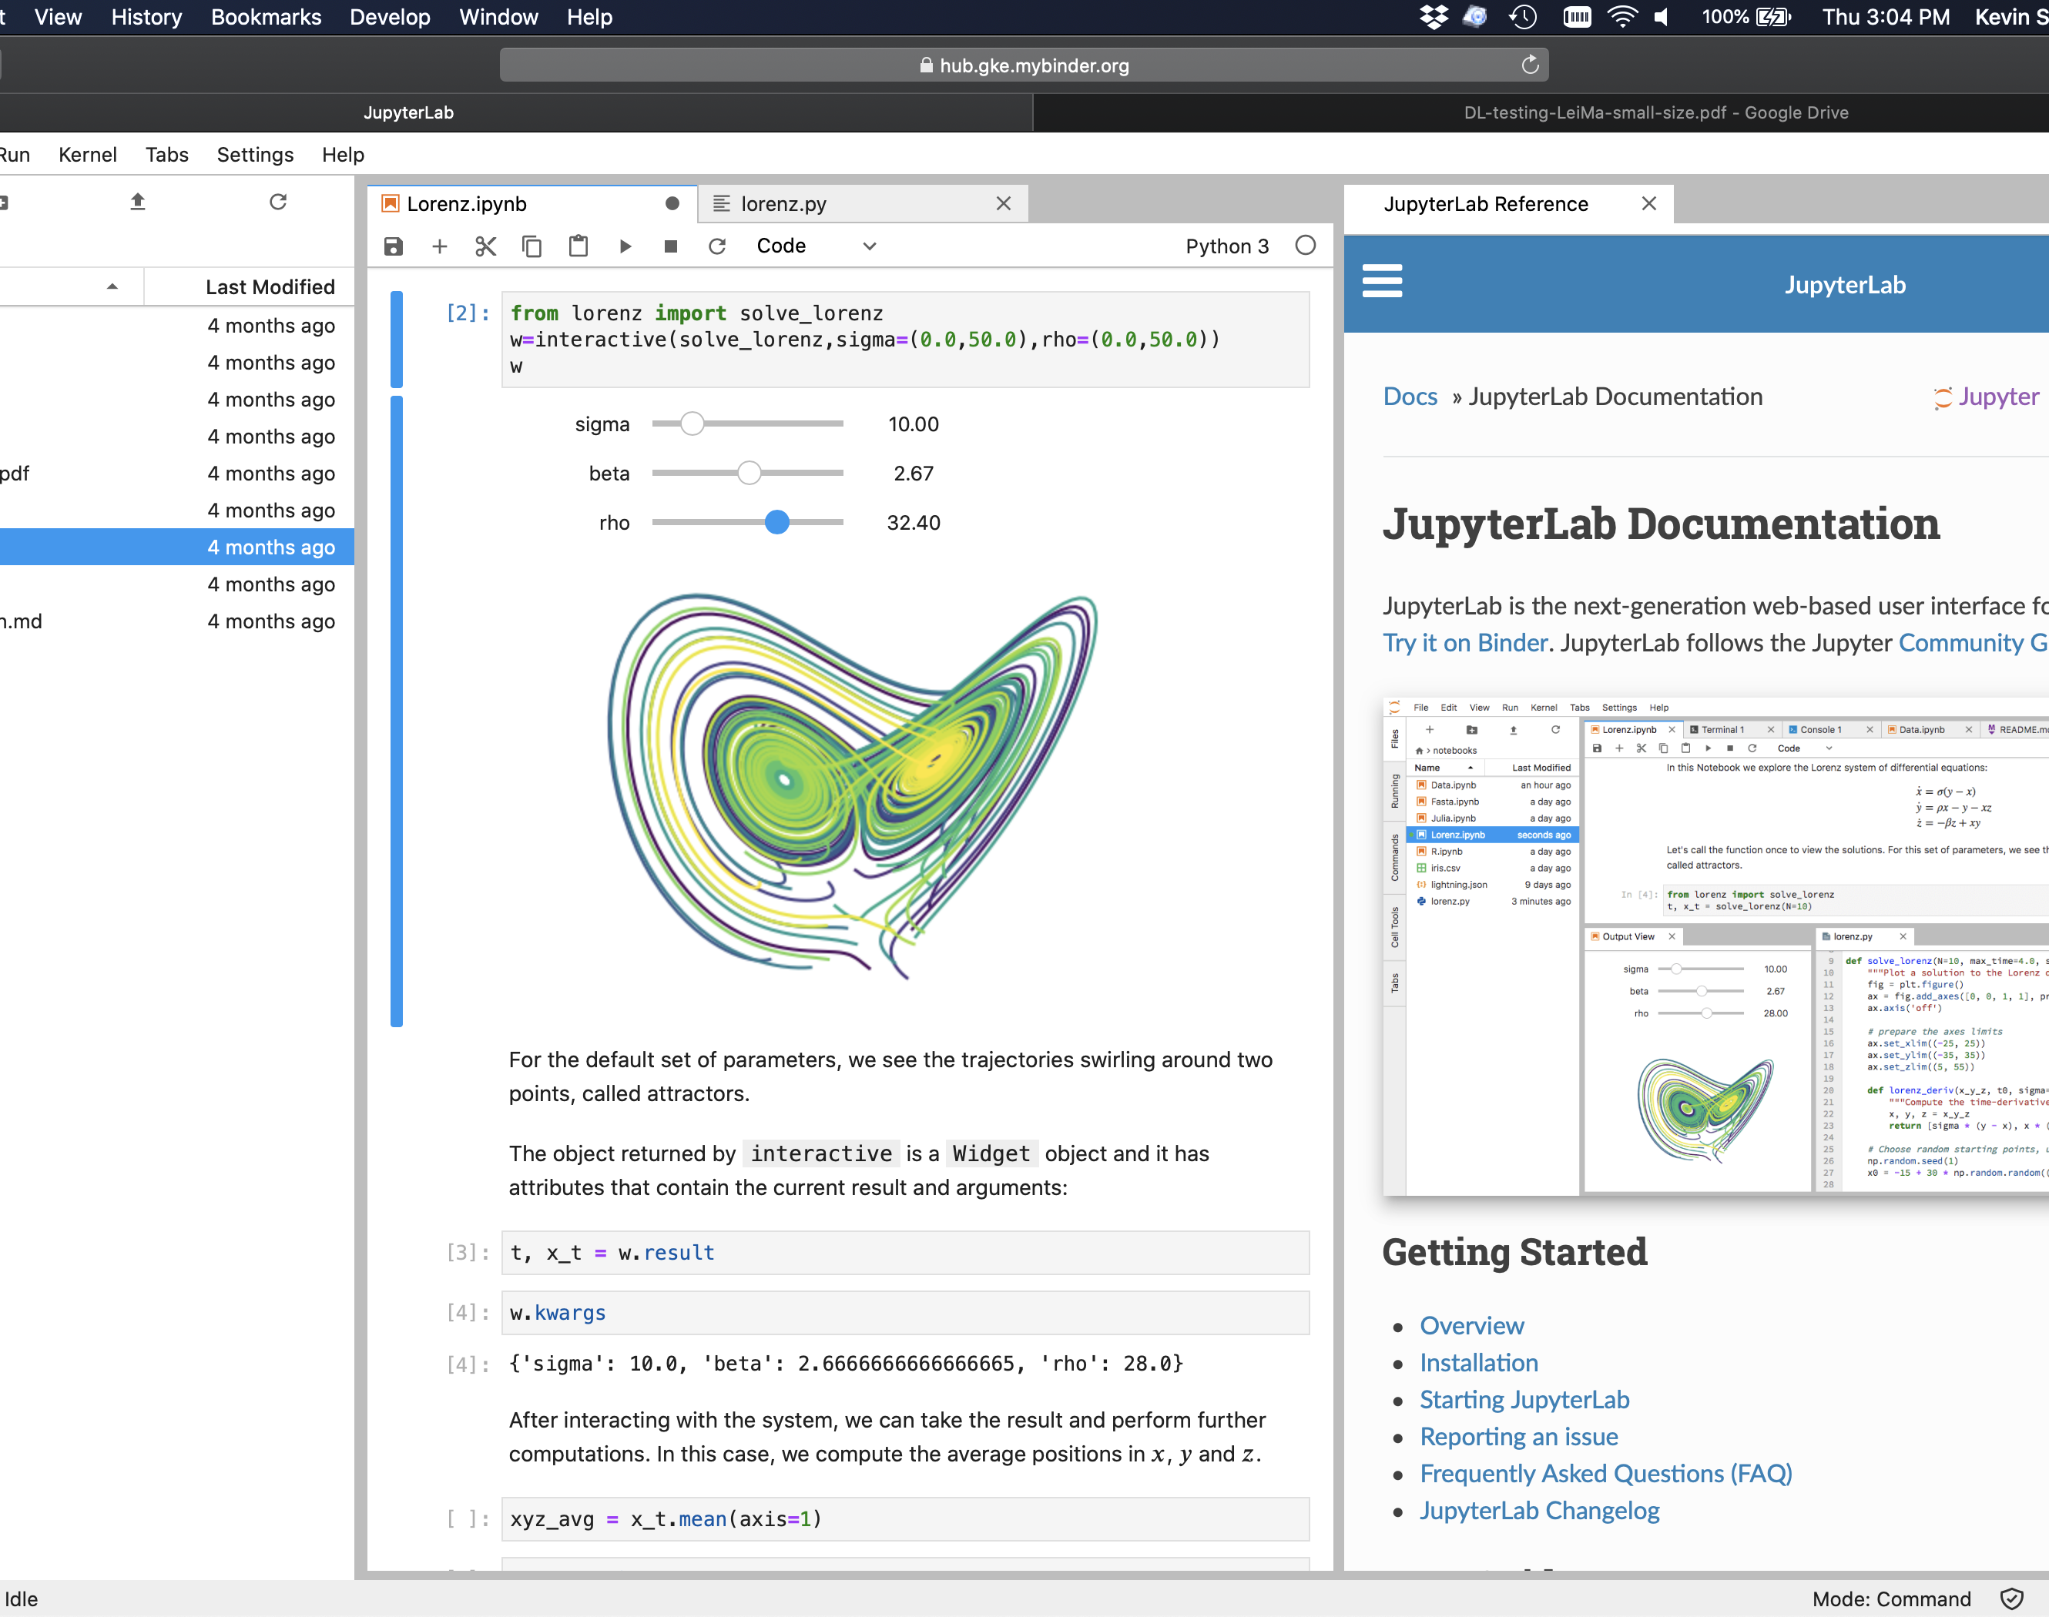
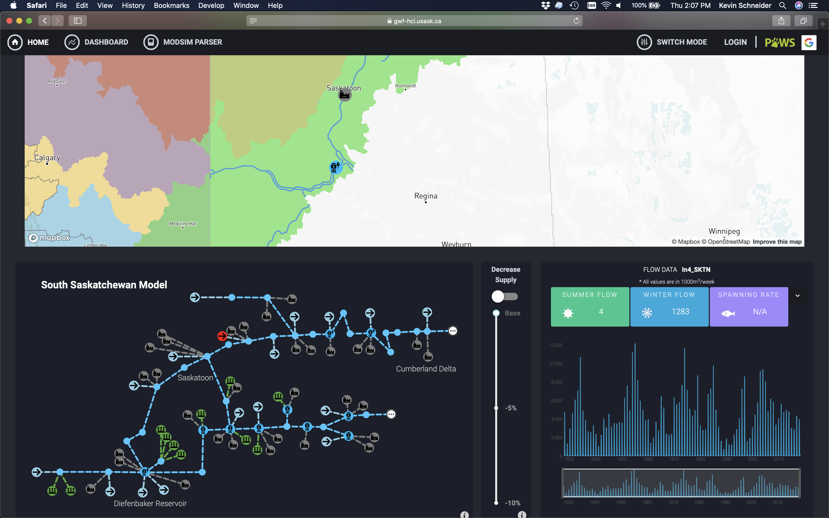
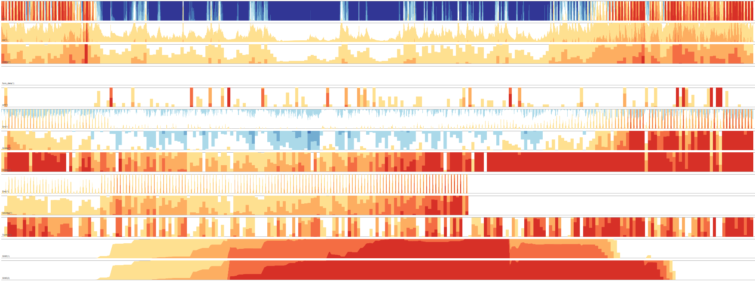
GWF Visualization
Cuizinart
Modelling Software (e.g., CRHM, CHM VTU in ParaView)
ContourDiff
IMPC DAVIS Platform
CHM NetCDF
GeoSpatial Correlation Analysis
Notebooks: Jupyter, R, Python
IMPC Dashboard for Decision Support
Horizon Chart

Slide 3
GWF Visualization Approaches
Notebook
Jupyter, R, Python, Julia
Modelling Software
CHM, CRHM, Mesher, …
Cuizinart
GWF Dataset Geospatial Search
Visualization Research Prototypes
ContourDiff
Image Compression
Horizon Charts
Geospatial Correlation Analysis
Visualization Platforms
DAVIS: Maps with layers, heatmaps
GWF Dashboard for Decision Support

Slide 4
GWF/IMPC¹ Data and model visualization (DAVIS)
Project Lead
Saman Razavi
Carl Gutwin
HQP
Ehsan Sotoodeh Mollashahi
Shervan Gharari
Aim of project
Communicate IMPC/GWF scientific outputs to public
¹Integrated Modelling Program for Canada (IMPC)

Slide 5
GWF/IMPC¹ Dashboard
Faculty Leads
Carl Gutwin, Saman Razavi, Patricia Gober
IMPC Manager
Hayley Carlson
Highly Qualified Personnel
Leila Eamen, Mustakim Ali Shah, Nhu Do, Ishan Saxena, Ricardo Rheeder, Venkat Bandi
Aim of project
User-Centric
Decision Support
¹Integrated Modelling Program for Canada (IMPC)

Slide 6
ContourDiff, A vector-based visualization
Menubar (Hovering on the icon displays Hint)
Indicates the recent most file and data dictionary
Indicates the columns in data file and lets user select the isopoints to induce the quartiles in data distribution (deafault isopoints: 0.25, 0.5 and 0.75 )
Visualization Panel (Hovering will display X and Y coordinates in the top right corner)
Indicates different user interaction choices in the map
Indicates different user interaction choices for contourmap, contourlines and vectors on top of contourmap
Figure 3: An overview of the System
Notes:
Menubar -> Home (Reset), Go to Forward Image, Go to Backward image, Configure subplots, Axis, Curve and Image parameters, Saving Image

Slide 7
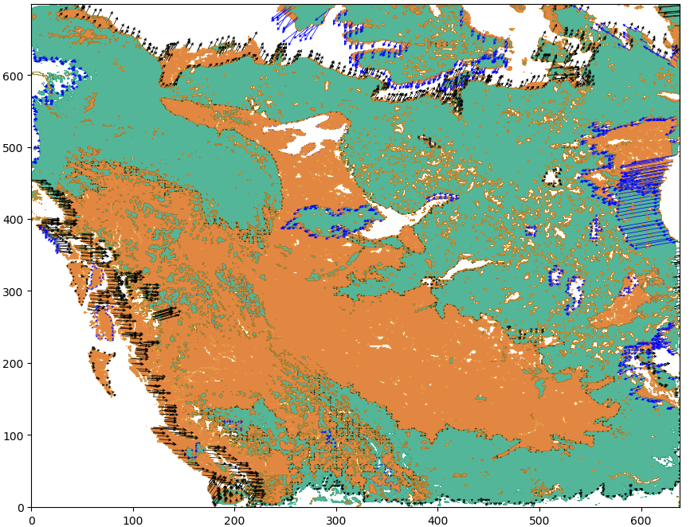
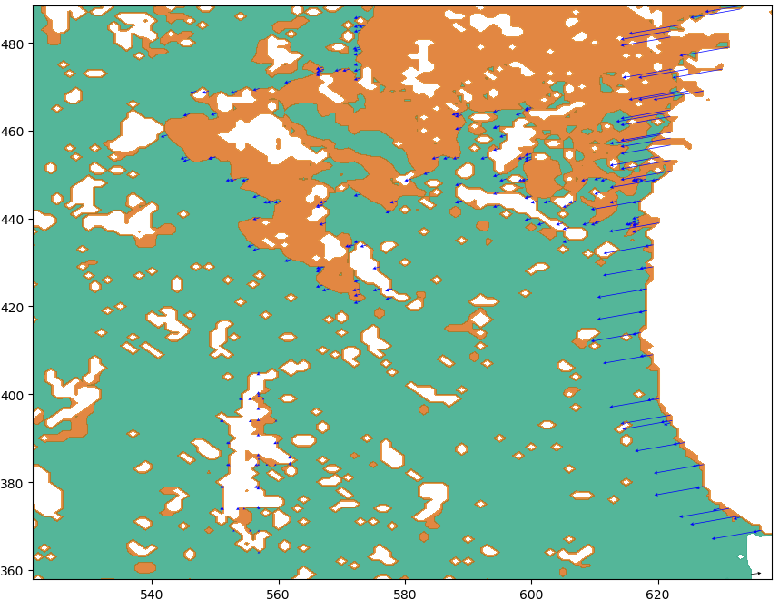
Answers to Research Questions
RQ1. Can differential trends over time be visualized effectively over the spatial domain using a vector based approach?
Answer: ContourDiff visualizes changes of any matrix ensemble dataset across spatial regions and temporal domain through overlaying the prominent vectors along the simplified contour paths, revealing the differential trends that the contour lines experienced over time.
Zoomed
Figure 4: ContourDiff (Left) and zoomed version of it (Right) shows changes in Soil Moisture from March, 2013 to March, 2015 over western Canada

Slide 8
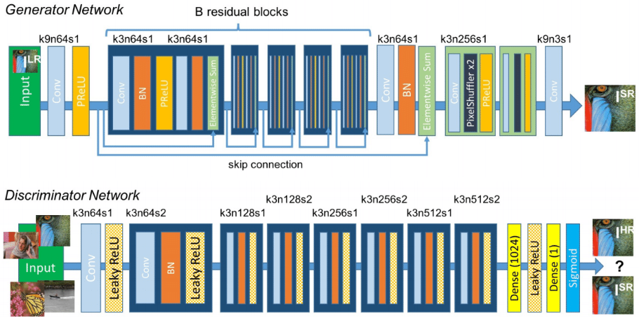
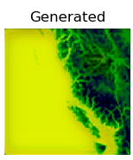
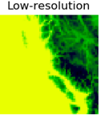
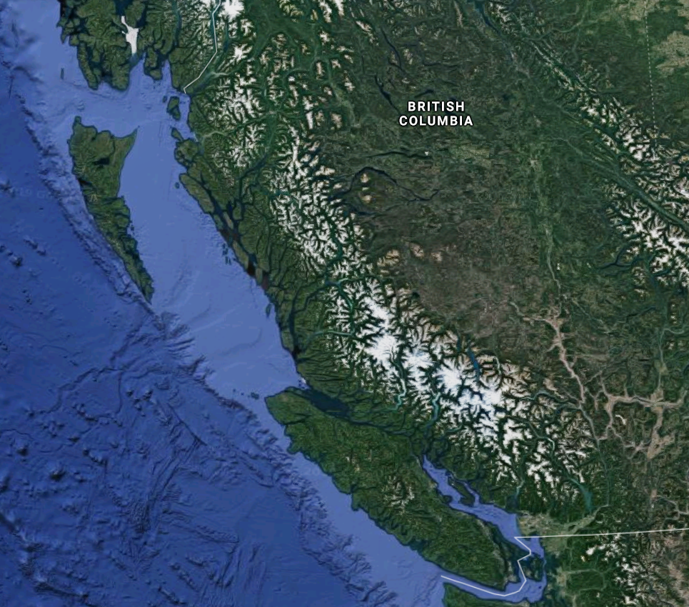
Compression, Reconstruction & Prediction A Deep Learning approach to Learn Weather
Benefit: Compress petabytes of historical sensor data and Satellite images, reduce server to client data transfer load, store the deep learning model in the client and generate image on the fly as needed
Current Progress – Development and Testing an SRGAN model with WRF dataset
Low resolution training set
Output
Original
Deep learning architecture being used

Slide 9
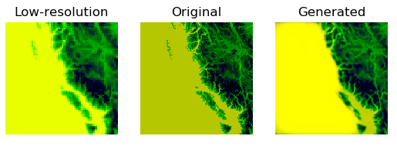
Compression, Reconstruction & Prediction A Deep Learning approach to Learn Weather
Benefit: Compress petabytes of historical sensor data and Satellite images, reduce server to client data transfer load, store the deep learning model in the client and generate image on the fly as needed
Current Progress – Development and Testing an SRGAN model with WRF dataset
Low resolution (64 by 64 lat-lon) soil moisture samples has been enhanced by the SRGAN model to a high-resolution (256 by 256 lat-lon) image. The generate image is quite similar to the original image. The effectiveness of the model shows us the potential of this approach to be used to for deep learning based weather simulation

Slide 10
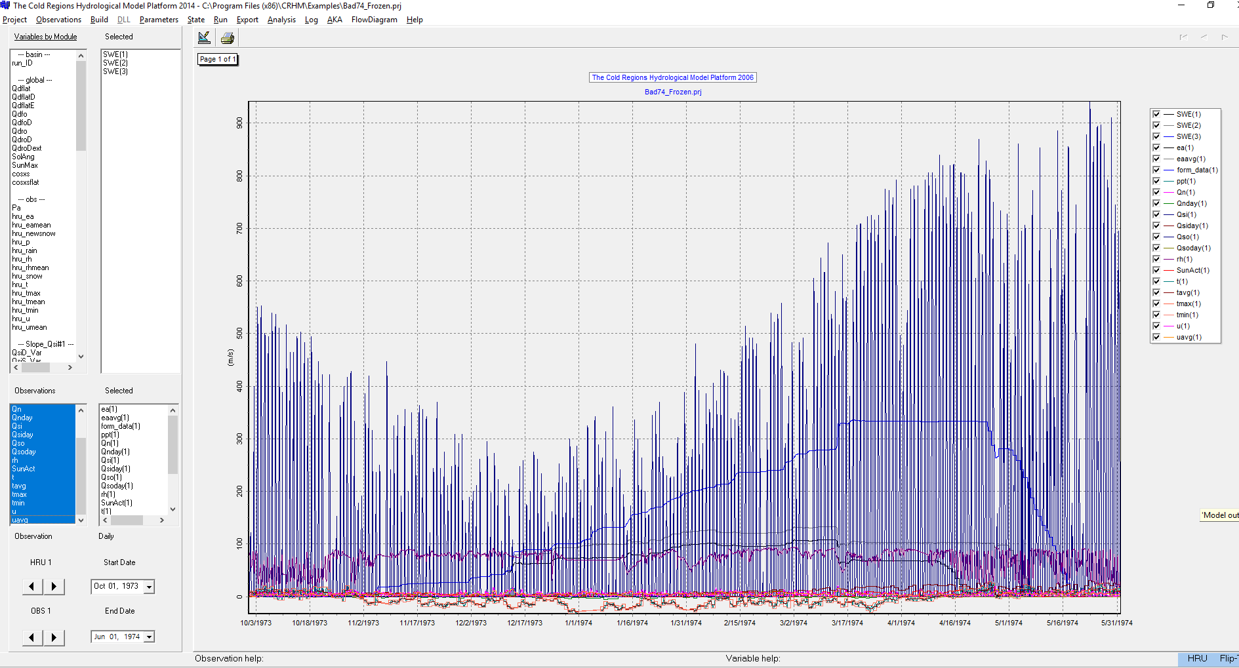
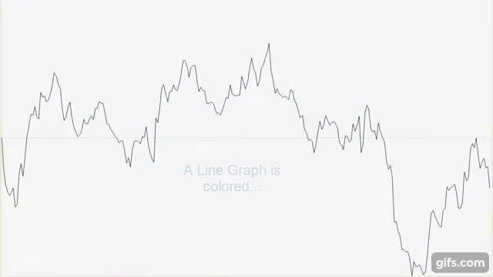
Horizon Charts
Benefit: Better analysis of correlation among the many time series datasets
Finding out periodic patterns, how one time series is influenced by the other?
Other possible use: Automatic detection of interesting patterns

Slide 11
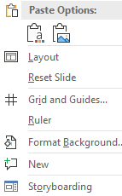
Horizon Chart – Analytics – Adding custom functions
f(x) = |t(a)/t(b) – t(c)|

Slide 12
Horizon Chart – Automated Pattern Discoveries

Slide 13
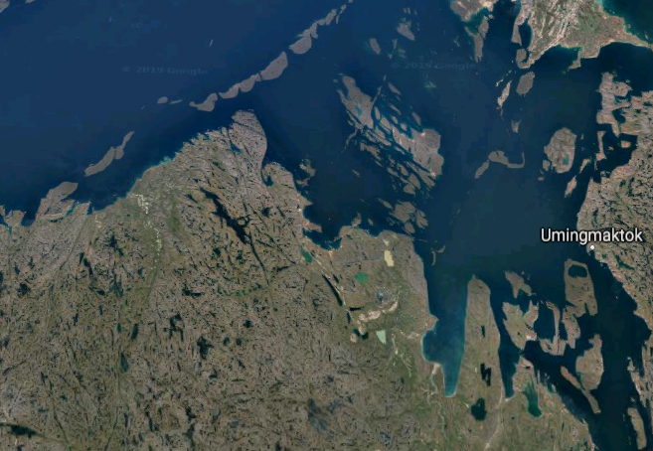
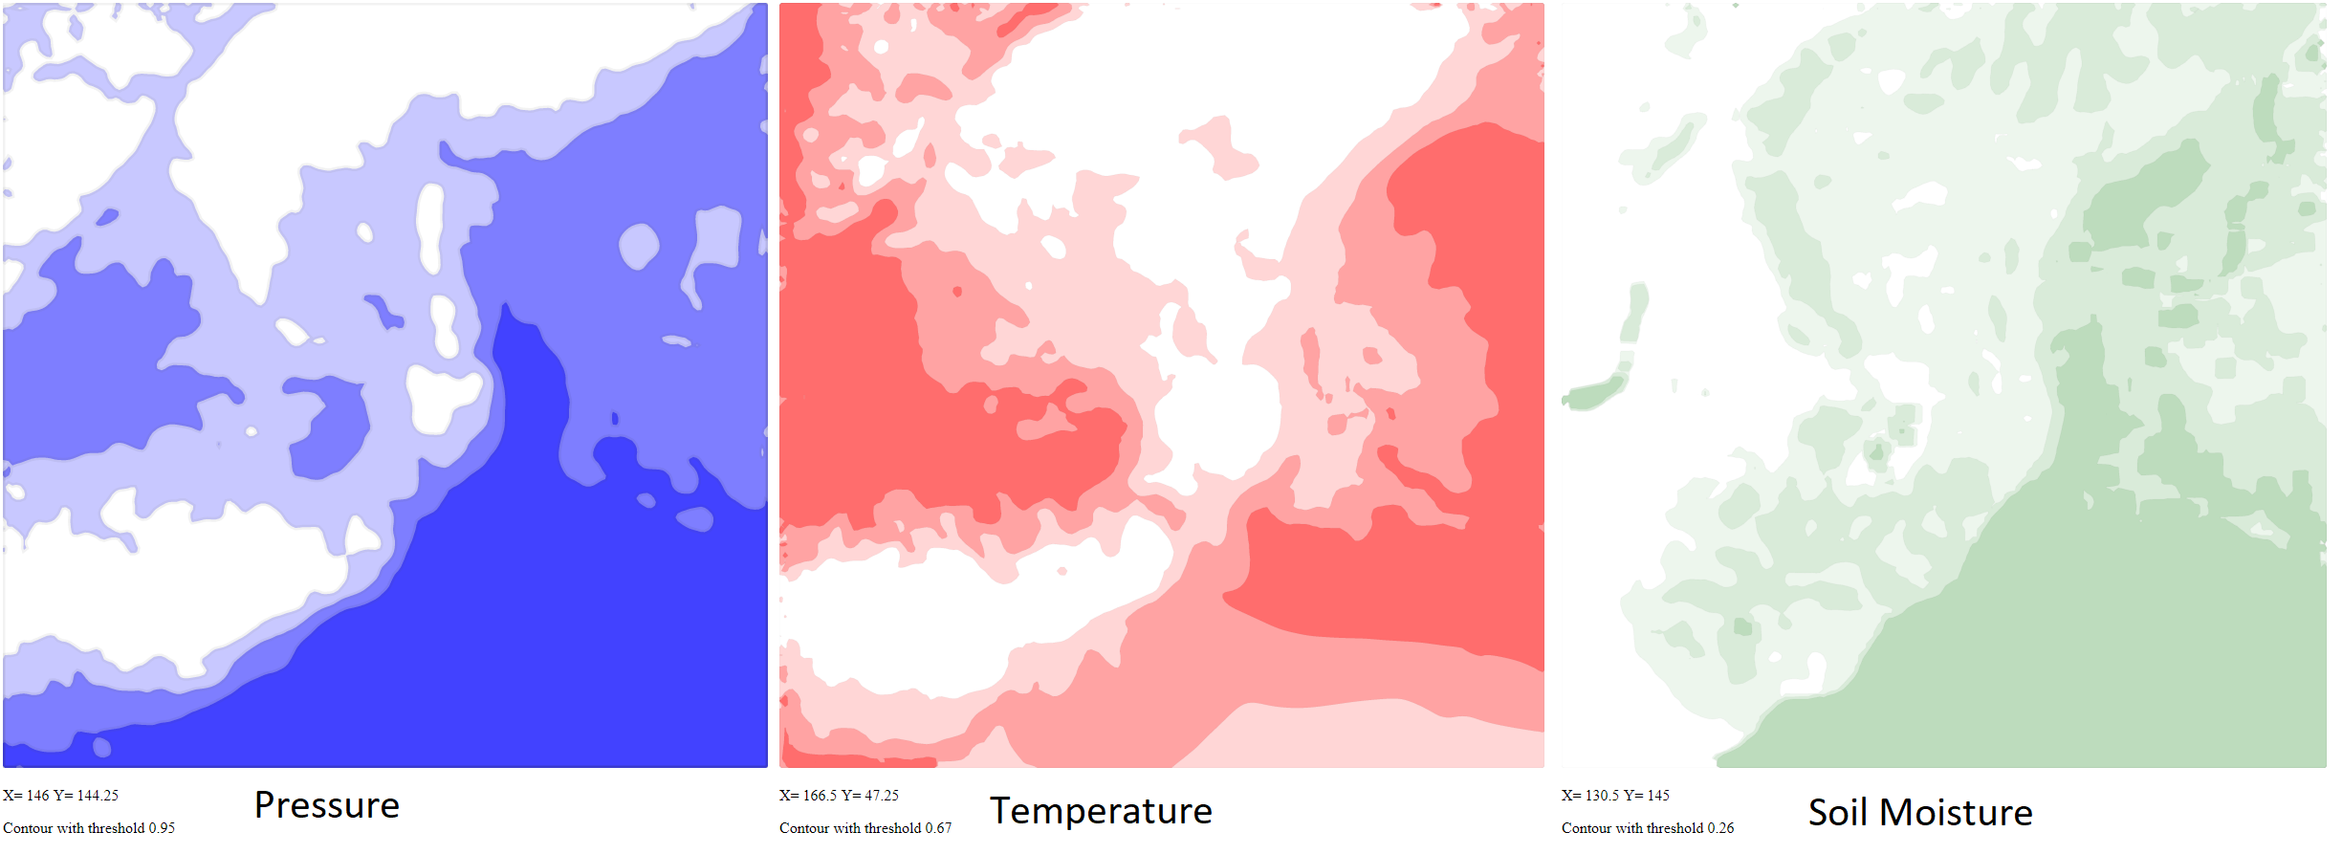
Correlation Analysis on Geospatial Parameters
Side by side analysis or blending is difficult to analyze
Blending does not work well beyond 2 variables, and overlapped contours creates clutter
Data: GWF Weather data (September 1 , 2015) of western Canada (a 200 latitude by 200 longitude space). Therefore, all implementations here are on a real life dataset.

Slide 14
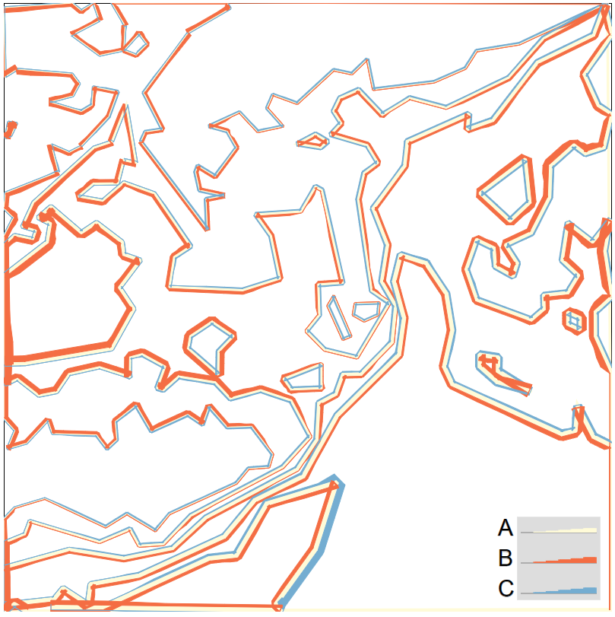
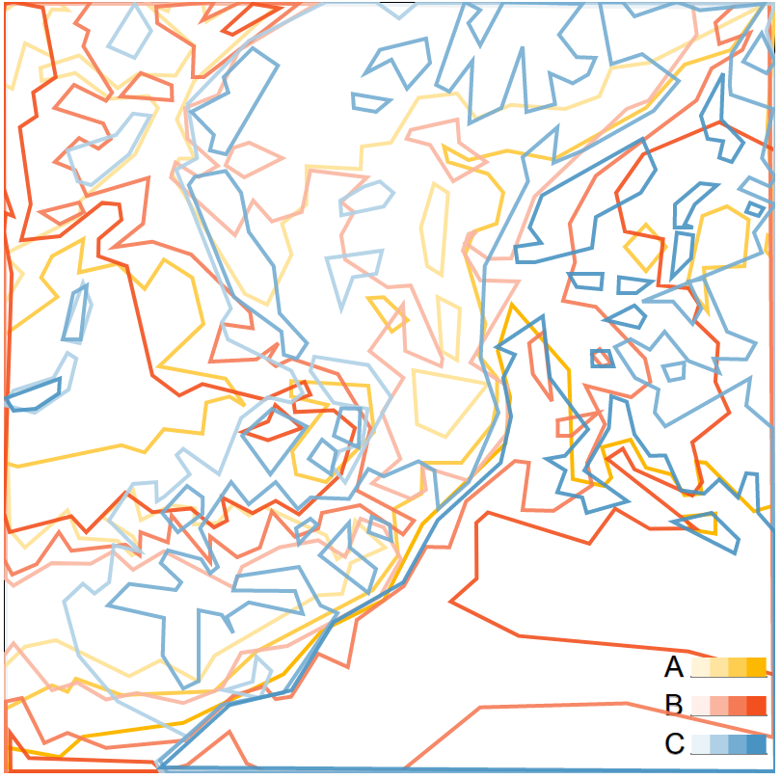
Correlation Analysis on Geospatial Parameters
Statistical analysis and contour integrations to depict correlation along the contours
Computation of contours for different variables
Statistical Analysis and Integration

Slide 15
Research Prototype to Research Product
Research Prototype
Design: Idea
Build: Minimum Viable Prototype
Purpose: Measure results to answer research question
Challenges: Brittle, Poor Usability, Slow, Standard Functionality Missing, …
Research Product
Reliability
Efficiency
Usability
Maintainability
Security
Includes standard features
https://zurb.com/blog/foundation-6-prototype-to-production

Slide 16
Research Product Platform
Key Users
Public, Decision Makers, Researchers
Key Qualities
Scalable, Adaptable, Sustainable
Key Features
GeoSpatial
(e.g., Heatmaps, Layers)
Dashboard / Decision Support
Novel Visualizations
Dedicated DevOps Team

Slide 17
GWF Visualization Task Force – Terms of Reference
Steering/Advisory Committee (monthly meetings)
Coordinate visualization efforts for GWF
Set priorities for visualization research platform(s) development
Image Compression
ContourDiff
Modelling Software (e.g., CRHM, CHM VTU in ParaView)
IMPC DAVIS Platform
CHM NetCDF
GeoSpatial Correlation Analysis
Notebooks: Jupyter, R, Python
IMPC Dashboard for Decision Support
Horizon Chart

Slide 18
GWF Visualization Task Force – Membership
John Pomeroy
Al Pietroniro
Carl Gutwin
Razavi Saman
Stephanie Merrill
Juliane Mai
Jimmy Lin
Kevin Schneider
Adapa Phani
Martyn Clark
Stephan O’Hearn

Slide 19
GWF Visualization Task Force - Next Steps
Confirm terms of reference and membership
Confirm strategy
research product platform for external stakeholders
Establish DevOps Team
Develop feature request protocol
Ideally platform configuration will handle many requests
Ideally new features serve more than one research group
Focus on features for external stakeholders
Part of next-gen modelling environment

