Slide 1
Updates on Core Modelling
Martyn Clark and Alain Pietroniro
17 November, 2019

Slide 2
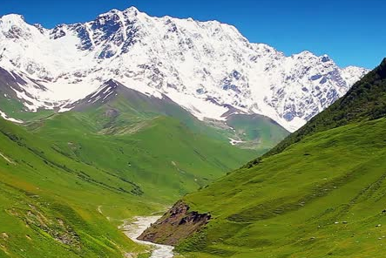
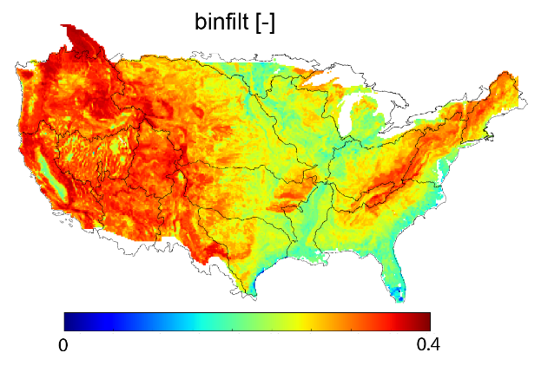
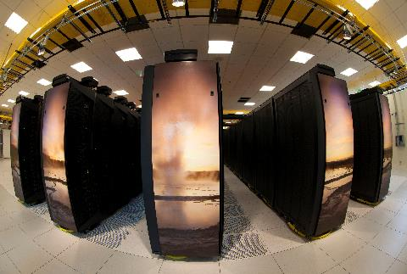
GWF Core Modelling
Computational and data infrastructure to advance mechanistic models of hydrology, water quality, water management and hydro-economics
Topics for today:
  Transition to phase II
  Summary of modelling themes
  Governance and collaborative development
  The Planetary Water Prediction initiative

Slide 3
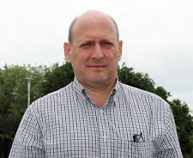
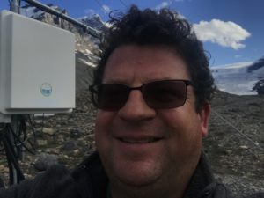
Transition to phase II
Restructure:
  Structure core modelling around high-priority tasks necessary to achieve GWF mission
  Coordinated management: Core modelling executive (theme leads et al.) advance/coordinate efforts in mission-critical areas
  Collaborative approach to model development: Unify model workflow and adopt team-based development
Process/timeline:
  Winter/Spring 2019: Planning: Synthesize current research foci, define new research themes, identify theme leads and faculty supervisors, and assign research personnel.
  Summer 2019: Revised Core Modelling plan presented to the GWF community at the GWF Annual Science Meeting and the IMPC meeting.
  September 2019: Core Modelling Plan was approved by the SMC.
  October 2019: The Core Modelling Executive met to coordinate work on Core Modelling implementation.
  Now: Theme leads and faculty supervisors working to refine the research plan for their modeling theme

Slide 4
Modelling themes
Spatial meteorological Data: Julie Theriault, Martyn Clark, John Pomeroy, Yanping Li, Simon Papalexiou
Geospatial intelligence: Martyn Clark, Kevin Shook, Lawrence Martz, Bryan Tolson, Al Pietroniro, John Pomeroy, Markus Schnorbus, Saman Razavi, Jule Mai
Current-generation hydrological modelling: Bruce Davison, Alain Pietroniro, Martyn Clark, Saman Razavi, John Pomeroy, Karl-Erich Lindenschmidt, Tricia Stadnyk
Next-generation hydrological modelling: John Pomeroy, Martyn Clark, Ray Spiteri, Kevin Schneider, Kevin Shook, Grant Ferguson, Andrew Ireson, Saman Razavi
Water quality modelling: Philippe van Cappellen, Karl-Erich Lindenschmidt, Sean Carey, Helen Baulch, Diogo Costa, Markus Brinkmann, Nandita Basu, Alain Pietroniro
Hydrological forecasting: Alain Pietroniro, Karl-Erich Lindenschmidt, Martyn Clark, John Pomeroy, Paulin Coulibaly, James Craig
Water Resources Modelling: Tricia Stadnyk, Saman Razavi, Martyn Clark, Bruce Davison
Hydro-Economics: Roy Brower, Patrick Lloyd-Smith, Saman Razavi

Slide 5
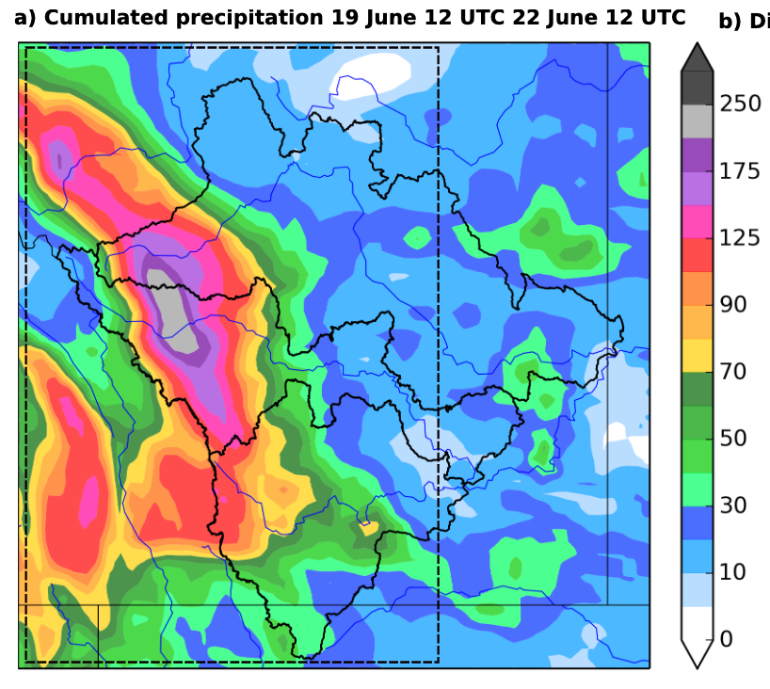
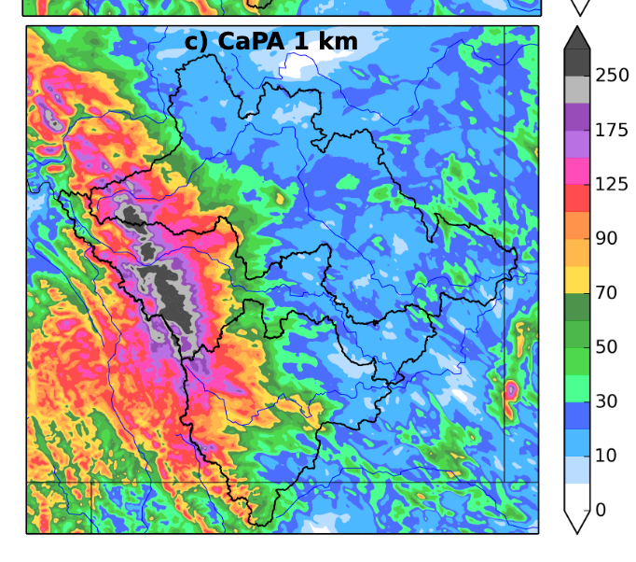
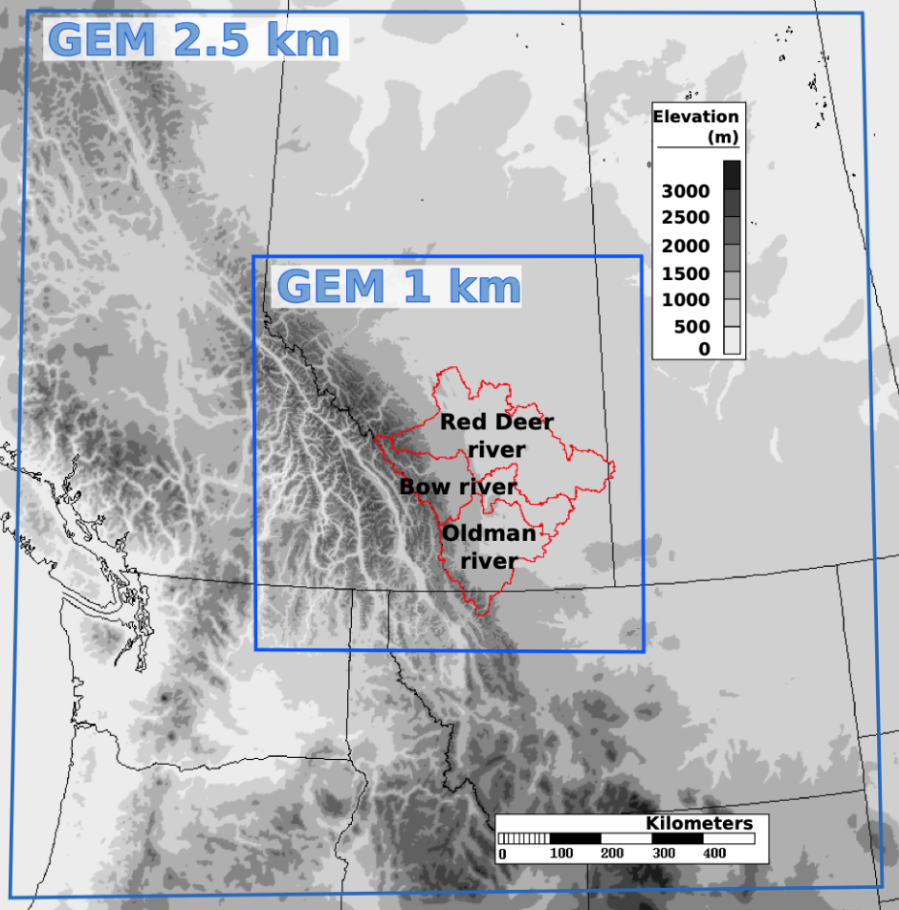
Spatial meteorological forcing data
Spatial meteorological forcing datasets are used to correct biases in atmospheric models and to drive hydrological models
Research foci:
Reanalysis datasets
  New probabilistic forcing dataset (additional information sources, alternative spatial interpolation schemes, quantify uncertainty).
New regional climate model simulations
  GEM simulations with stronger observational constraints (reanalysis)
  GEM simulations forced by an ensemble of climate models
  Assist with continental-domain WRF CONUS-II
Bias correction
  CONUS-II
  Other datasets
GEM-CaPA 10-km
GEM-CaPA 1-km
From Vincent Vionnet: 1-km GEM-CaPA improves simulations of the 2013 Canmore-Calgary flood

Slide 6
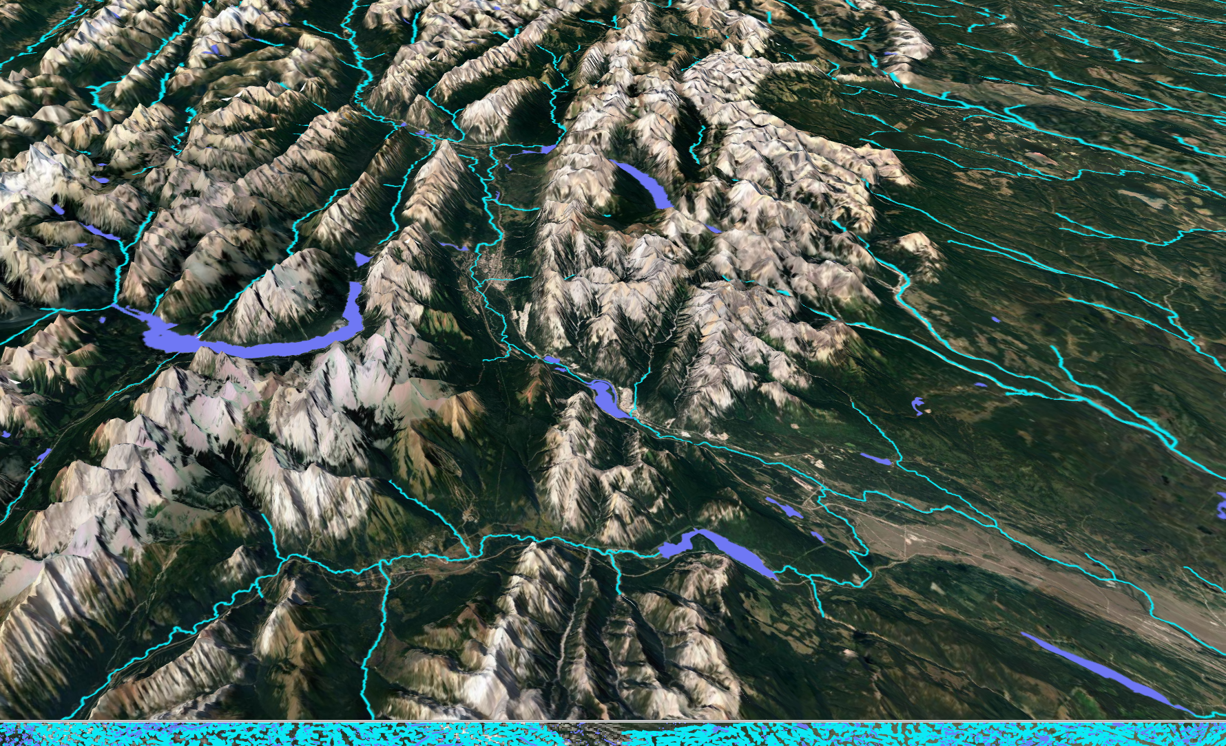
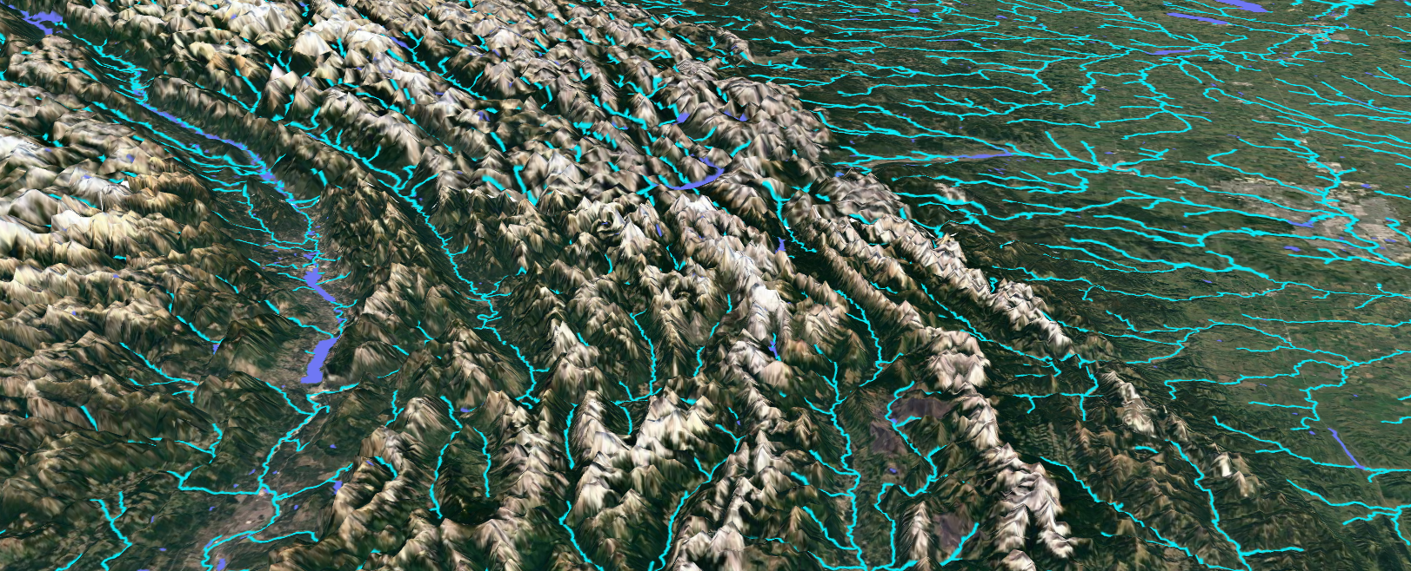
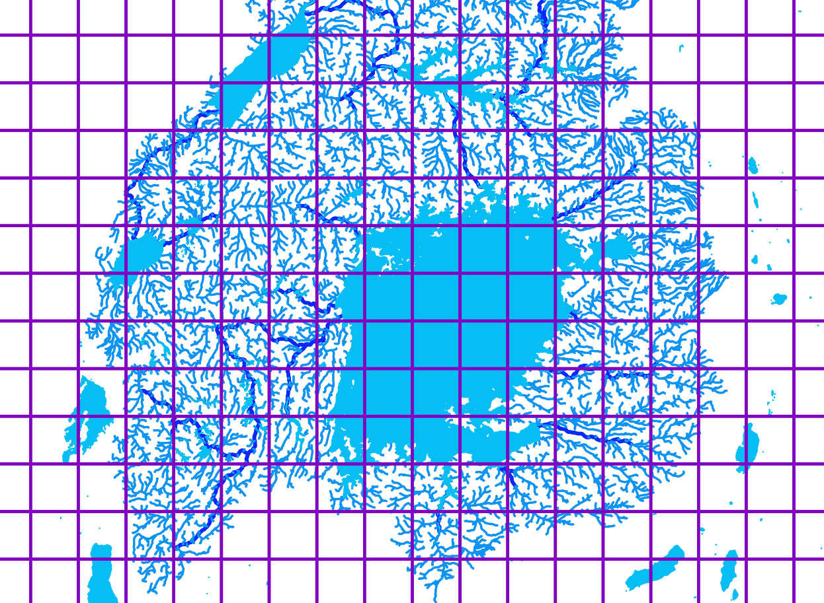
Geospatial intelligence
Hydrological models have common requirements for DEM analysis, parameter inference, etc., but different models use different geospatial tools
Research foci:
New datasets and model workflows
  Model-agnostic geospatial intelligence
  Share pre-processing using jupyter notebooks
  Focus on developing publishable general tools to reduce workload for model applications
Process-based parameter inference across large regions (inter-comparison project)
  Evaluate alternative parameter estimation strategies (e.g., landscape calibration, etc.)
  Multiple datasets/signatures (e.g., snow extent, permafrost extent, streamflow, etc.)
  Multi-objective / multi-response parameter estimation strategies (e.g., ABC).
Formal benchmarking system
  Multi-scale process-based model evaluation
  Catalog of past modeling efforts
  Data integration/synthesis
Hydrography datasets from globally- available elevation and lakes data. The figure shows Canadian Rockies (top) and the Nile headwaters (bottom).

Slide 7
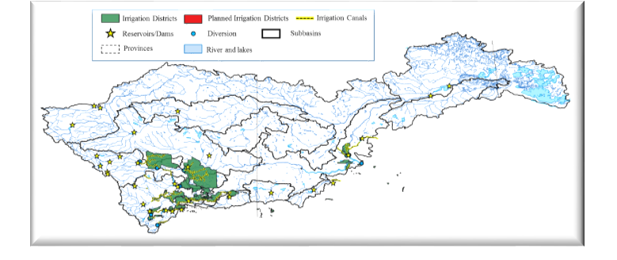
Current-generation modeling
Pan-Canadian simulations using existing models
Research foci:
Hydrological reanalyses & scenarios of change
  Production runs using MESH (plus HYPE and VIC simulations as benchmarks).
  These runs are critical to provide baseline multi-model water security assessments for Canada.
Process upgrades in MESH and CRHM.
  Improve representations of glacier, permafrost, prairie pothole, groundwater, small lakes and wetlands
  Additions of water temperature, sediment and nutrient models in MESH will continue with a goal to move towards the CHM integrated platform.
Support for MESH and CRHM
  The core modeling team will provide other GWF projects with support for using MESH and CRHM.
MESH in the Saskatchewan River basin

Slide 8
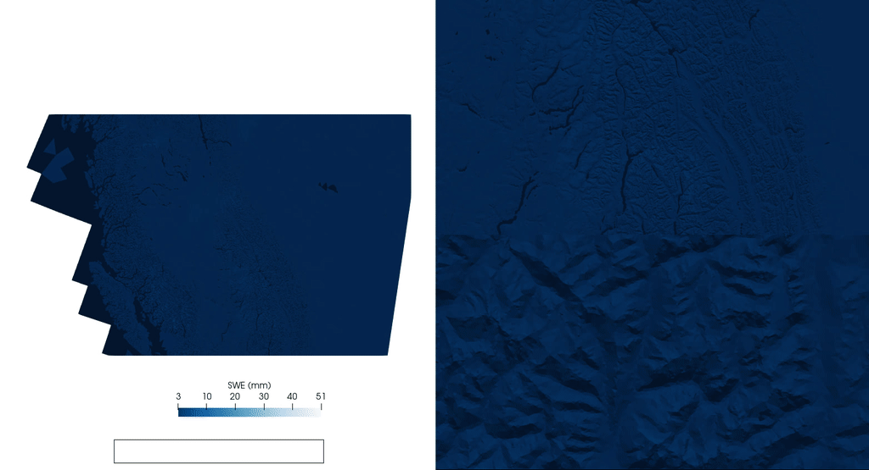
Next-generation modeling
International leadership in developing next-generation hydrological modelling capabilities
Research foci:
Multiscale / multi-physics modeling capabilities
  Flexibility in process representation (multiple representations of a given process)
  Flexibility in spatial configuration, including horizontal interactions (snow redistribution, runoff processes [shallow groundwater, connectivity],
  All dominant processes from headwaters to estuaries, canopy to bedrock
Hierarchal coupling/workflow infrastructure
  Intra-component coupling (e.g., adding new capabilities to an existing model)
  Inter-component coupling (e.g., managing exchange of information and time stepping for different model components)
  Multi-model coupling (e.g., a chain of discrete models with one-way flow of information)
  Workflow management (e.g., managing flow of information in a complex forecasting system).
From Chris Marsh: Example CHM simulations for a 96-hour storm in western Canada

Slide 9
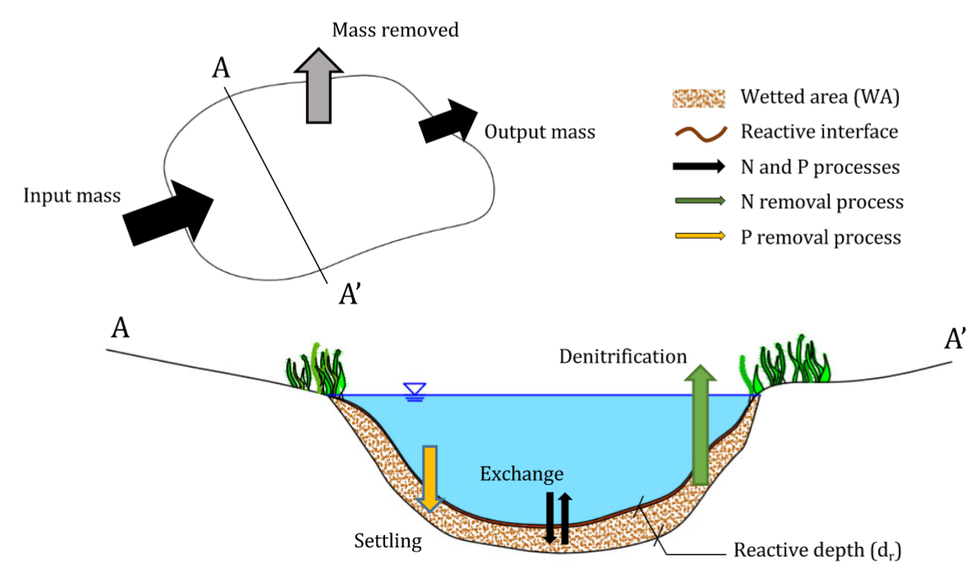
Water quality modeling
Inform and steer the implementation and interpretation of predictive water quality modeling, from the sub-watershed to continental scale
Research foci:
Re-analysis of historical water quality data and trends
Develop, benchmark and apply process-based and regionally-integrated nutrient models
Improve algorithms to simulate water quality in headwater catchments, littoral zones of lakes, and groundwater environments (temperature, sediment transport, nutrients, contaminants).
Cheng and Basu, 2017: Biogeochemical hotspots: Role of small water bodies in landscape nutrient processing Water Resources Research 53 (6), 5038-5056.

Slide 10
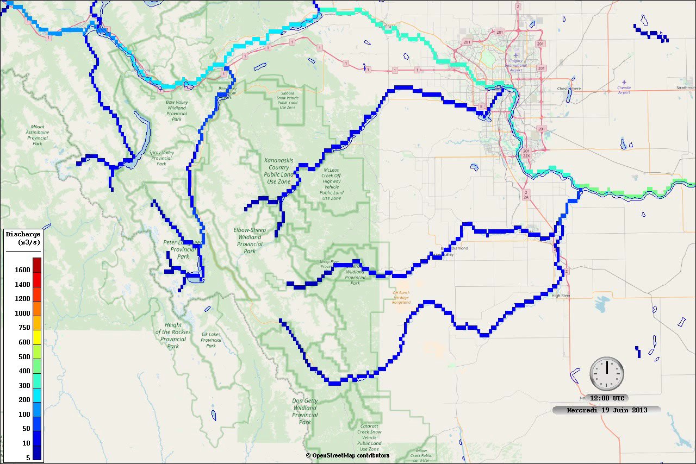
Hydrological forecasting
Comprehensive evaluation/advances in operational hydrologic forecasting
Research foci:
System development
  Develop a system to couple and schedule forecasting components (model spin up, data assimilation, downscaling numerical weather prediction model output, forecast runs, post-processing, visualization, etc.).
Hydrologic prediction development
  Focused development on critical topics in hydrologic forecasting, especially downscaling, data assimilation, and forecast post-processing
Hydrologic prediction testbeds
  Implement test-beds for specific basins (e.g., the Bow and the Grand) to enable rapid prototyping of new prediction methods
Example streamflow forecasts for the 2013 Calgary flood
This work will evolve in close collaboration with the NHS hydrologic prediction effort

Slide 11
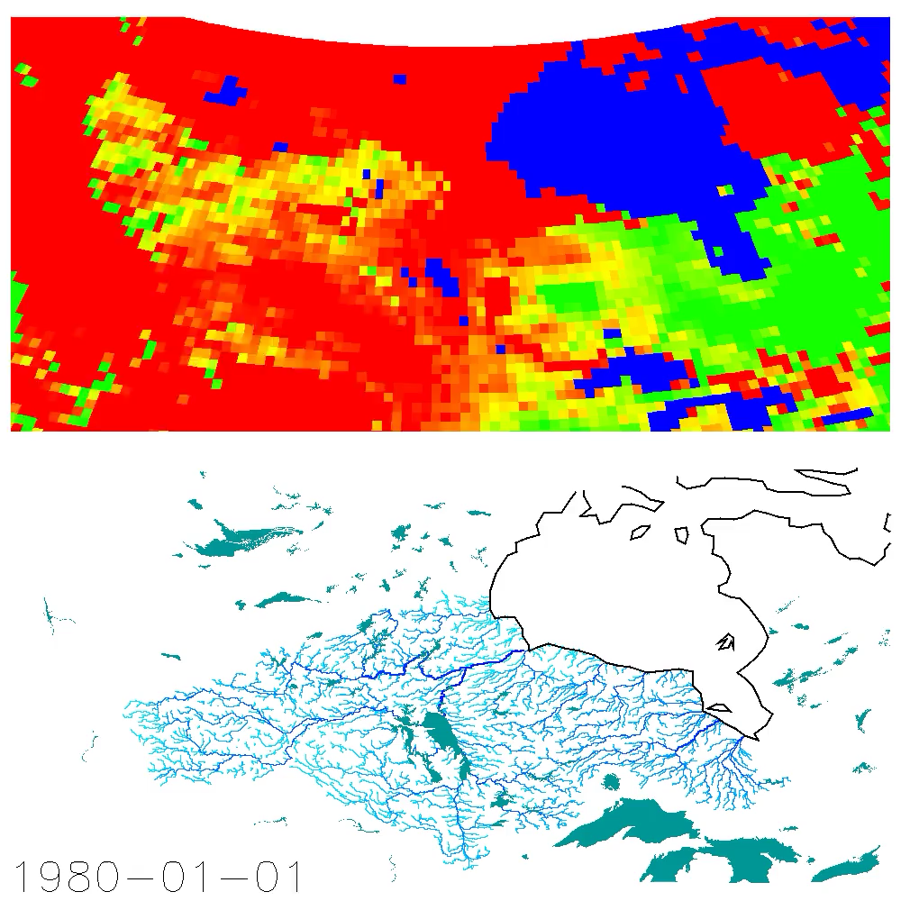
Water resources modeling
Represent the human impacts on the terrestrial water cycle across Canada.
Research foci:
Develop water management benchmarks
  Apply existing water management models (e.g., WEAP) to provide a benchmark for the representation of water management in ESMs.
  Detailed comparison between land models and water management models is necessary to identify key development needs.
Advance water management in ESMs
  Small lakes (i.e., sub-grid lakes that are not represented as objects on the river network)
  Large lakes (i.e., the lakes that are represented as objects on the river network)
  Managed lakes (i.e., representation of reservoir management)
  Water diversions and irrigation.
  A key issue is the coupling of the lake water balance and the lake energy balance.
Human impacts on the terrestrial water cycle are ubiquitous and must be an essential component of ESMs

Slide 12
Core Modelling Governance
Core modeling co-leads have overall responsibility for the direction and implementation of core modelling activities.
Theme leads have responsibility for a modelling theme
  Coordinate research for the faculty members and HQPs involved in their specific themes.
  Meet regularly with the faculty leads and research personnel in their theme.
  Part of the core modelling executive and report progress at the monthly executive meetings.
Faculty supervisors have responsibility for supervising research personnel (HQPs etc)
  Develop detailed work plans, track progress, and mentor their research personnel.
  Any deviations from the work plan (e.g., move tasks from one HQP to another, change research direction) should be discussed with the theme leads and core modelling co-leads.
Research personnel (primarily HQPs) have responsibility for collaborative research.
  Model development/application, model documentation, code review, third-party tests, developing reproducible workflows.
  Research personnel are expected to work extensively with each other and support each other to advance progress on key deliverables.
  Research personnel report directly to their faculty supervisor.
The core modelling manager will organize and participate in core modeling executive meetings, organize meetings for core modeling themes, track progress on action items, identify linkages with other projects, and mange collaborative model development.

Slide 13
Core Modelling coordination
The Core Modelling Executive will meet once per month to coordinate research activities across themes.
The Core Modelling themes will communicate regularly to coordinate research among the faculty and research personnel in their specific theme.
Research personnel will work with their faculty supervisors to develop individual workplans that contribute to the goals in each theme.
Core Modelling will adopt more collaborative approaches to model development to improve the effectiveness and efficiency of core modeling activities:
  Unifying the model workflows, i.e., defining a "common" model workflow, unifying/cleaning the code to converge on a consistent set of scripts that can be used across multiple models;
  Unifying/organizing the data, i.e., defining the provenance of the different datasets, defining single "trusted" data products, and creating a data catalogue so folks know what datasets exist and where they are located; and
  Adopting more formal approaches for model development, i.e., clear coding standards, rigorous testing procedures, and pivoting from centralized code review system to a distributed peer-based code review system

Slide 14
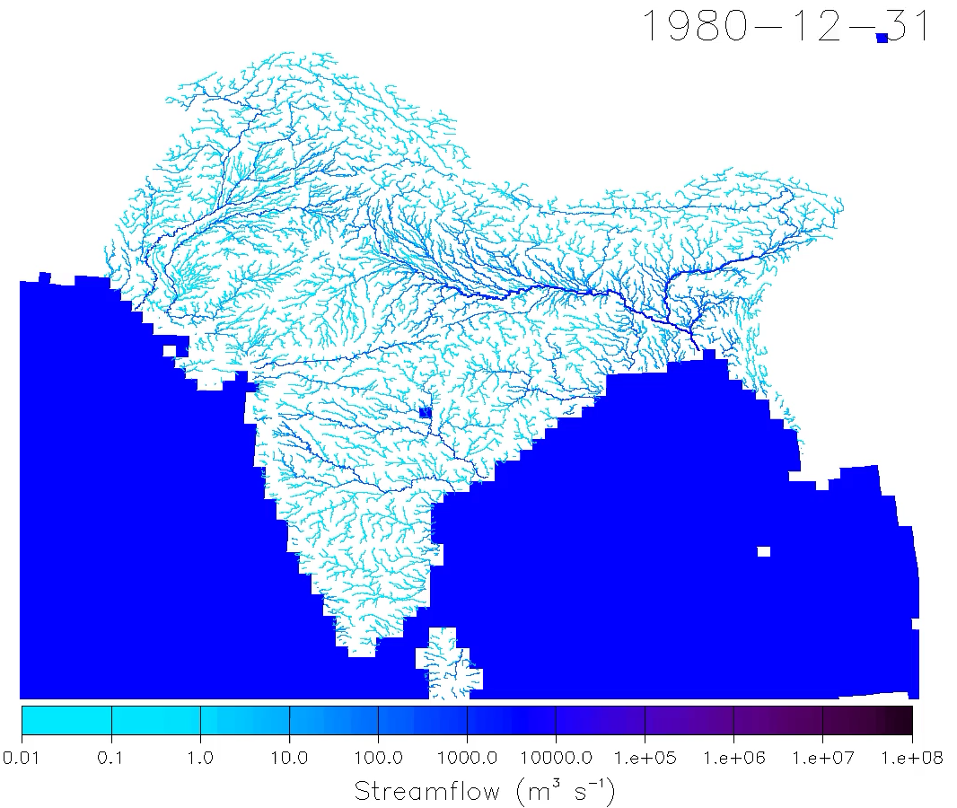
The Planetary Water Prediction Initiative (PWPI)
Exploit GWF science advances to improve our understanding and predictions of the global hydrological cycle
Build computational infrastructure (models, data) to enable state-of-the-art hydrological simulations anywhere on the planet.
  Improve global datasets on climate forcing, DEMs, veg, soil etc.
  Use these datasets to configure hydrological models for the global domain.
  Address challenging questions of global hydrological change
Develop regional models in key areas where GWF has strong collaborations (Arctic, Himalaya, Andes, central Asia) to address pressing societal needs.
  The regional models will be constructed as cut-outs from the global-scale fabric
  Address challenging questions of regional hydrological change
mizuRoute simulations of streamflow for South Asia
Land Model: CTSM (CLM5)
Hydrography: MERIT DEM

Slide 15



Employment opportunities…
Graduate students
Postdoctoral scholars
Research scientists
The Global Water Futures program currently has several new employment opportunities to advance mechanistic model simulations of hydrological processes across Canada (and the world). Current opportunities include the science manager for the core modelling program, two research scientists, six postdoctoral scholars, and four PhD students. Successful candidates will have the opportunity to work for the largest modelling project ever conducted in Canada (with global scope), working with GWF Director John Pomeroy, GWF core modelling co-leads Al Pietroniro and Martyn Clark, and other faculty across the GWF partner universities. Work locations include the Canmore Coldwater Laboratory in the Canadian Rocky Mountains and Innovation Place on the University of Saskatchewan campus.
Please contact Phani Adapa for further information (phani.adapa@usask.ca).

