Slide 1
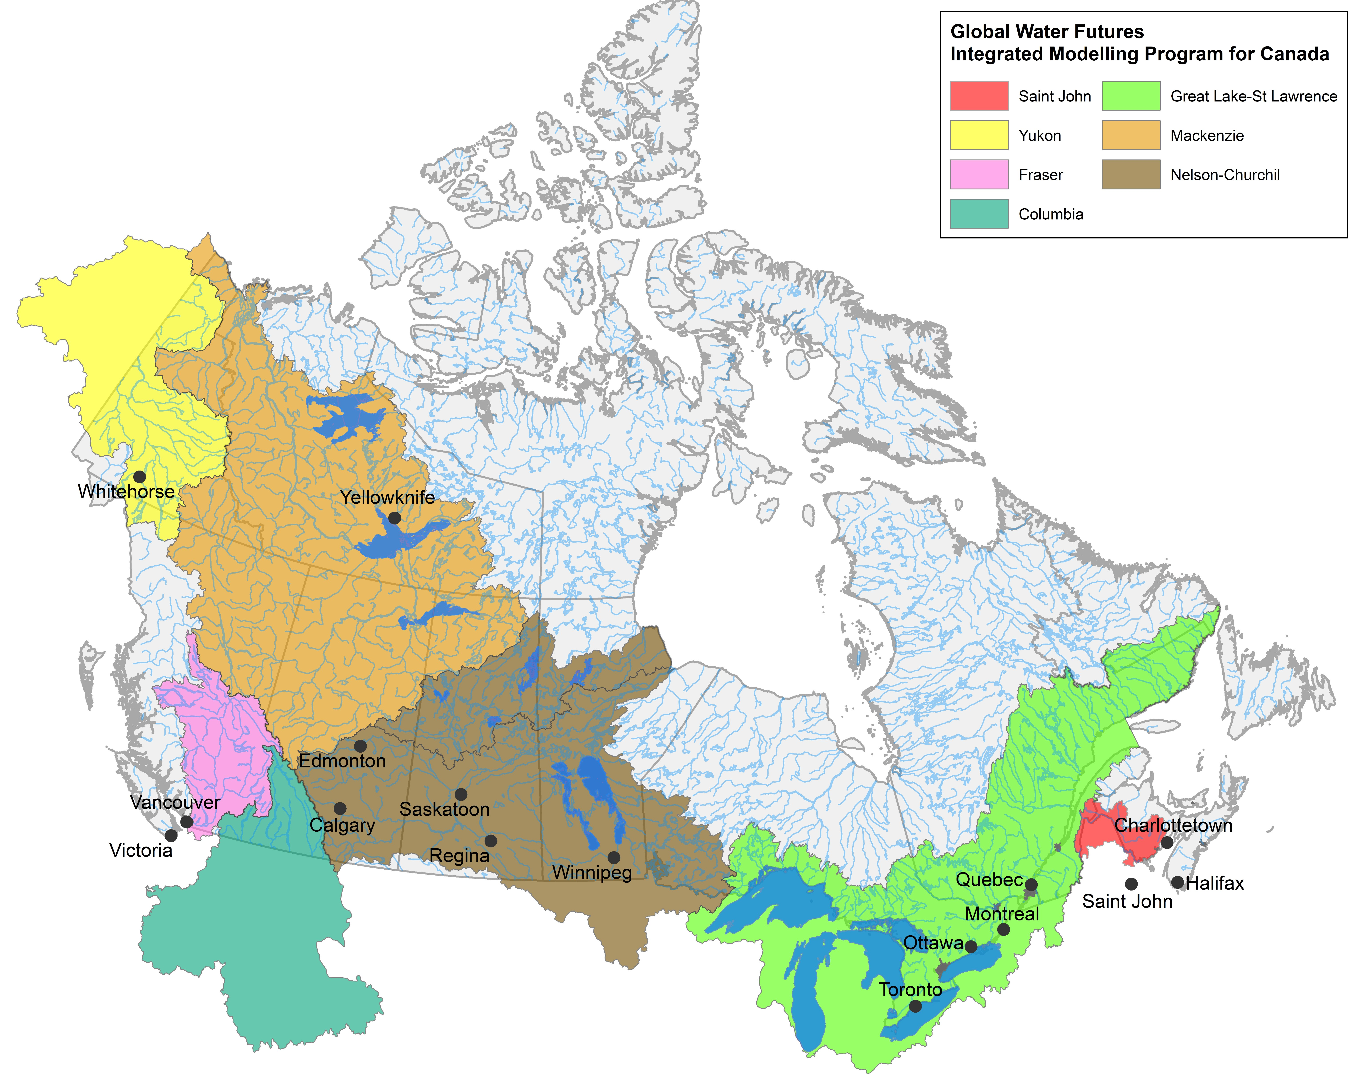

Project Introduction and Information
Unprecedented climate and environmental change pose major challenges to the management of the quantity and quality of water at local, regional, and national scales in Canada. The Integrated Modelling Program for Canada (IMPC) aims to diagnose, simulate, and predict interactions amongst natural and human-driven components of changing water systems, and deliver tools to support decision making for uncertain water resources, considering the range of stakeholder needs in Canada’s major river basins.
Led by Dr. Saman Razavi, University of Saskatchewan
Project coordinates: PI, email, website, etc
Integrated Modelling Program for Canada
Notes:
Speaking Notes:
The Integrated Modelling Program for Canada – or IMPC for short – responds to the complexity and uncertainty posed by climate by developing complex modelling tools that will allow us to explore future scenarios, the triple bottom line trade-offs of our decisions about water and ultimately, aid us in developing robust solutions.
Our program responds to the major challenges that impede the effective characterization, prediction and management of future water resources in a climate change context, including the failure to link important features of human and natural systems, fragmentation in options and governance, and the assumption of stationarity in current practice and design.
Our project is pan-Canada in scope, but in the first three years, research focuses on the Nelson-Churchill, Mackenzie, Great-Lakes St. Lawrence, and Yukon River Basins. In six years, the program aims to include other Canadian major river basins, including the Columbia, and Saint John Basins.
The program is led by Dr. Saman Razavi at the University of Saskatchewan who was unfortunately unable to make it today.

Slide 2
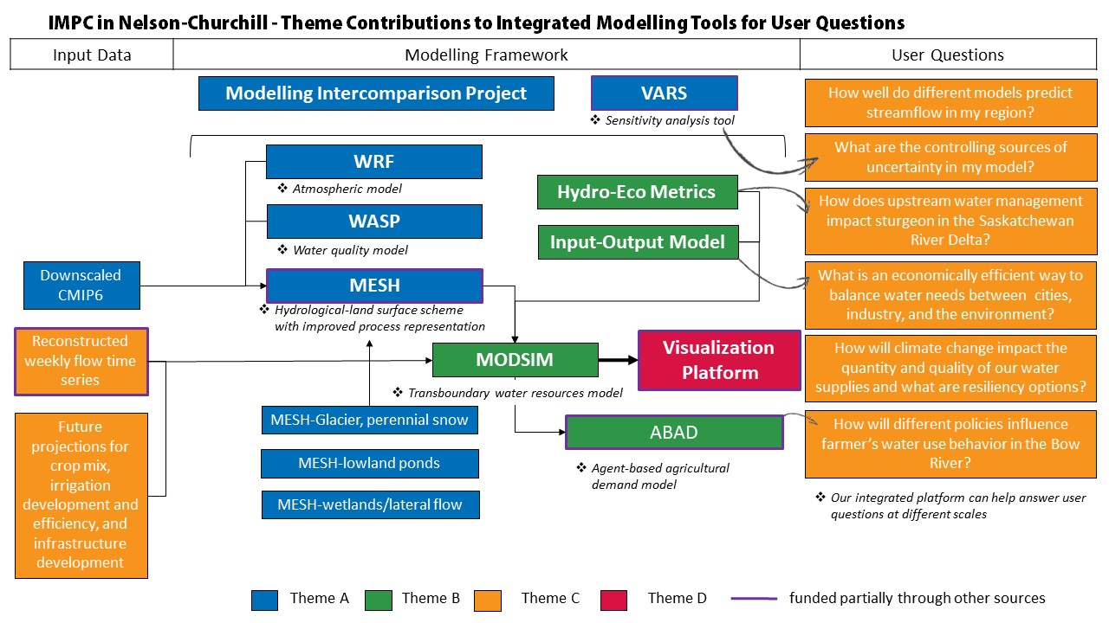
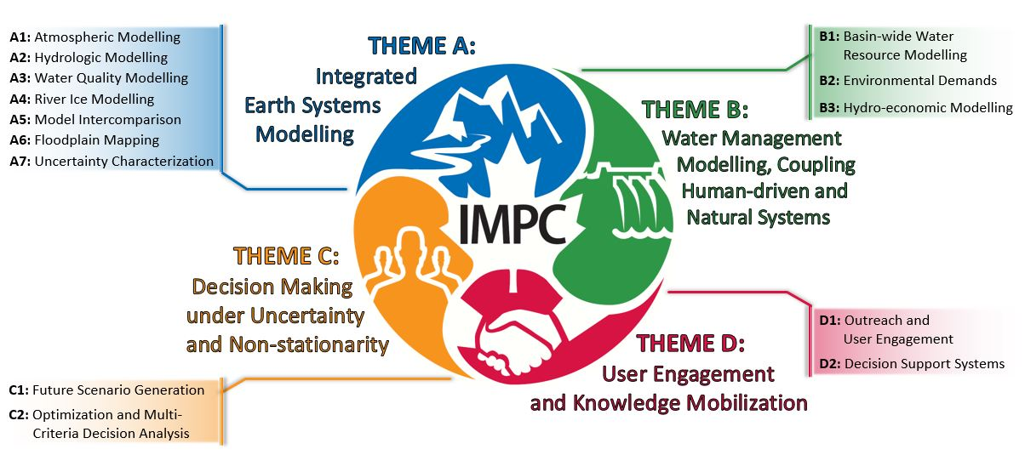
Project coordinates: PI, email, website, etc
Integrated Modelling Program for Canada
Notes:
Speaking Notes:
The IMPC research program is large, and extends into many domains at different scales. The program is organized around four themes.
Theme A provides high resolution scenarios of future climate and climate-driven hydrological changes, addresses inadequate model representation of key processes of major concern to users such as glacier retreat, river ice jams, wetlands, and water quality processes, and provides tools to address modelling uncertainties.
Theme B addresses user needs for integrated assessment tools that recognize the profound effects of land management on water quantity and quality, ecosystem needs, and the importance of economic modelling to explore policy and governance options. The focus is on model integration to capture system dynamics, critical feedbacks, and tipping points.
In Theme C, Decision Making under Uncertainty strategies will develop new probabilistic methods of using downscaled climate models for risk analysis of extreme events and engage users in active ways for scenario planning using suites of models for exploratory purposes.
Theme D explicitly addresses knowledge mobilization, integrating users in problem framing, development of decision support systems (including visualization), and their application.
The art of our research program is combining these diverse work packages into integrated tools and knowledge products to inform users in various locations, sectors and scales. So this diagram represents some of the work we’ve done in the Nelson-Churchill around linking our various modelling tools to answer a variety of user questions…
This diagram represents how some of the various components of our research program come together using an example of our work in the Nelson-Churchill Basin. Here, we have worked with partners such as the Saskatchewan Water Security Agency and Alberta Environment and Parks to successfully develop and test a detailed, transboundary water resources model (MODSIM) and an inter-regional, multi-sector economic Input-Output model for the Saskatchewan River Basin. We integrated these two models to examine economic impacts of water allocation decisions across the system and shared results with our partners such as the Saskatchewan Chamber of Commerce. We developed preliminary climate change scenarios (a set of tree-ring reconstructed weekly time flow series from 1600 to 2011 and flow scenarios developed through a stochastic weather generator and hydrological modelling), and development and policy scenarios (future projections for crop mix and potential irrigation developments) with feedback from our collaborators. Pilot versions of a user interface and data vitalization platform enables our team to communicate findings with a variety of audiences, and we are working with our partners such as Cumberland House and the City of Saskatoon to add new features. We are now applying this integrated system to analyze decision problems in collaboration with partners. For example, we are working with Western Economic Diversification to analyze the implications of the construction of a major water conveyance structure in Saskatchewan.

Slide 3
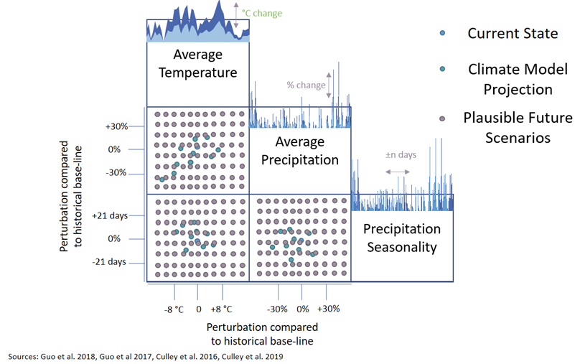
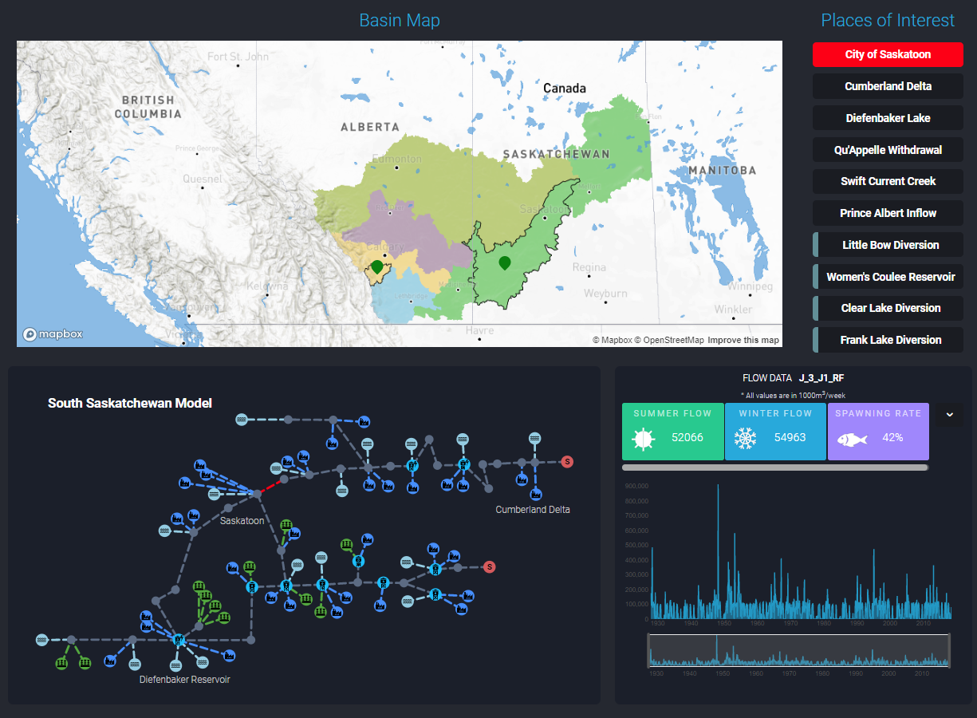
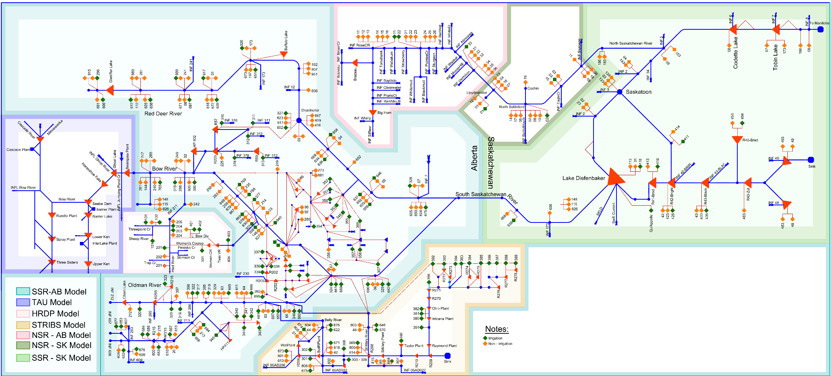
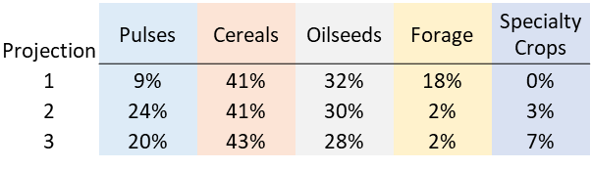
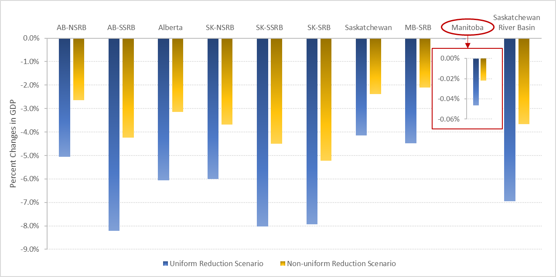
Transformational Science Highlights
In 2018-2019, our team…
Produced 49 referred papers;
Made 106 presentations;
Received 8 awards, including Research Chair in Water Resources Economics, the Young Scientist Award of Canadian Geophysical Union.
Co-hosted an Agriculture-Water research Expo with >100 agricultural stakeholder attendees.
Hosted an Annual Meeting with >100 attendees, and third of which were stakeholders.
Key Accomplishments:
Improving the representation of climate-driven cold region processes in hydrological and land surface models in new modelling frameworks (e.g. Mesh-Glacier, MESH-WASP, MESH-RIVICE)
Coupling water resources models with economic input-output model
Developing future development scenarios and visual interface to represent complex modelling
MODSIM Decision Support System for SRB
User interface to integrate results across engineering, science, social science disciplines
Project coordinates: PI, email, website, etc
Integrated Modelling Program for Canada
Notes:
Our project has many new and exciting transformational science and user engagement results. A few highlights:
Results so far from theme A have led to the improved representation of climate-driven cold region processes in various models – for example, glacier and perennial snow components have been added to MESH, and MESH has been linked to stream temperature, water quality and river ice models.
In Theme B, we have developed the water management model MODSIM which simulates the operation of the existing water infrastructure, updated to 2018 and a range of what-if scenarios, including any change in water supply, allocation policy, demand development, infrastructure development, etc. Has the potential to fully couple with the hydrologic model, economic model (in progress), social processes model (in progress), etc.
In Themes C and D we are developing a series of future projections for climate change, irrigation expansion, crop mix and other decision and development variables which we are visualizing in an online user interface so results can be disseminated to a wide range of users.

Slide 4
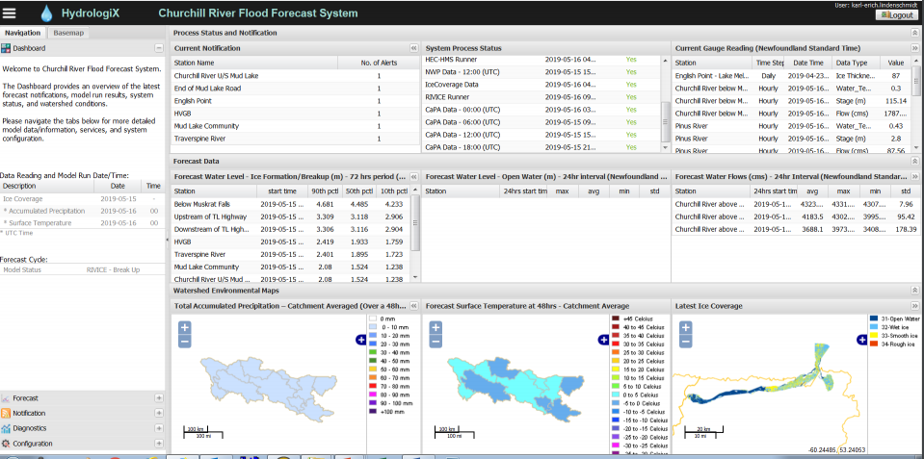
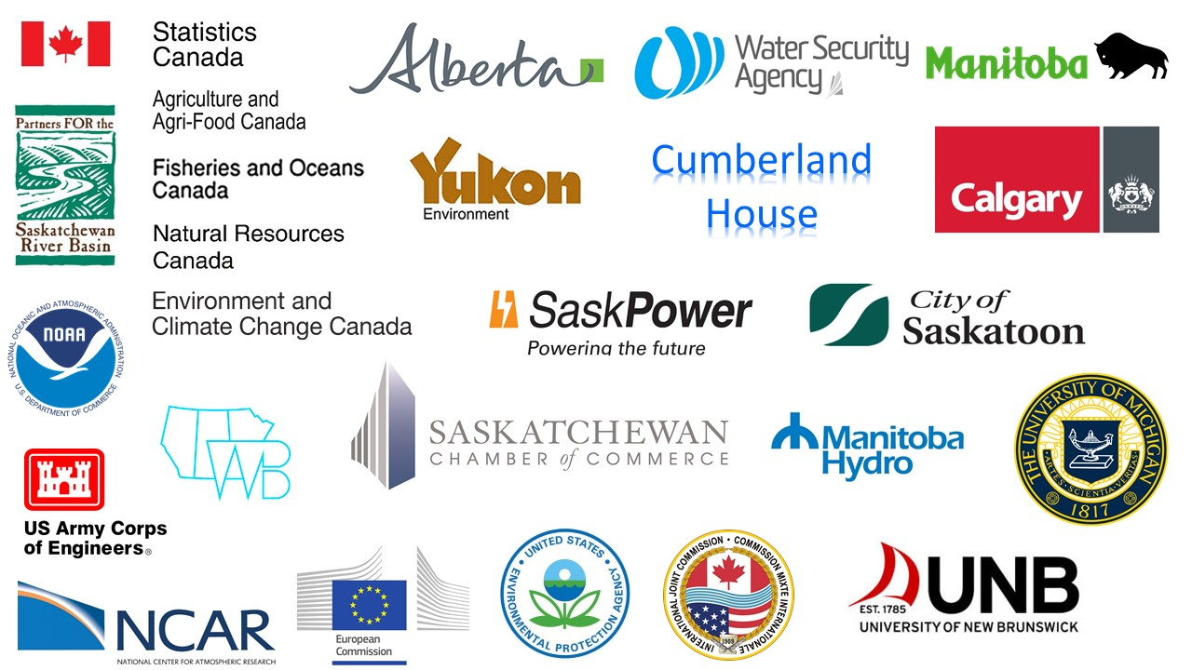

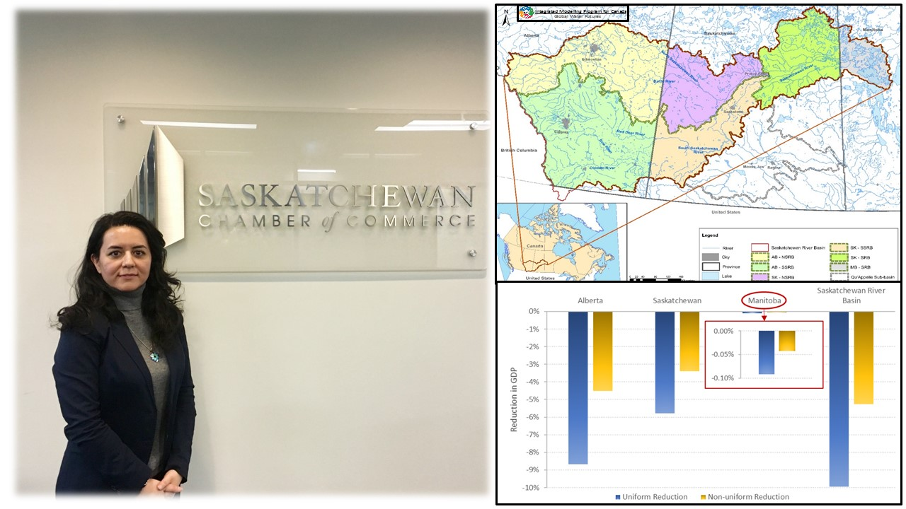
Project Impact and Aspirations
Operational ice-jam flood forecasting system in Churchill River in Labrador, and soon to be in Manitoba
Computationally-efficient sensitivity analysis toolbox downloaded and used by organizations like AAFC
Sharing results with Sask Chamber of Commerce to help them understand economic impacts of water management decisions
Project coordinates: PI, email, website, etc
Integrated Modelling Program for Canada
Notes:
IMPC has many partners and they work with each of our work packages in unique ways. Ultimately, we hope that people can use our work as a holistic tool to manage changing water systems across political boundaries, and help them explore solutions to a variety of water issues with increased awareness of economic, social and environmental impacts of their decisions. However, depending on the work package they are involved with, our partners are using our results and tools in different ways. For example:
The river ice modelling framework generated as part of Work Package A4 is used operationally to forecast ice-jam related floods by groups like the Government of Newfoundland, and is currently being implemented by Manitoba Infrastructure.
Work Package A7 Generated VARS, a sensitivity analysis toolbox with minimal computational cost. Software has been downloaded from organizations such as BASF Canada, Agriculture and Agri-Food Canada and the US Environmental Protection Agency.
Work Package B3 (Hydro-Economics) Met with the Saskatchewan Chamber of Commerce (Water Council) to discuss preliminary results and incorporate Chamber feedback into further research activities.
In the future, we hope to be able to communicate a variety of results from our entire research program to a variety of audiences – from high school students to operations staff in government departments – using our visual online interfaces and decision support systems.

Slide 5
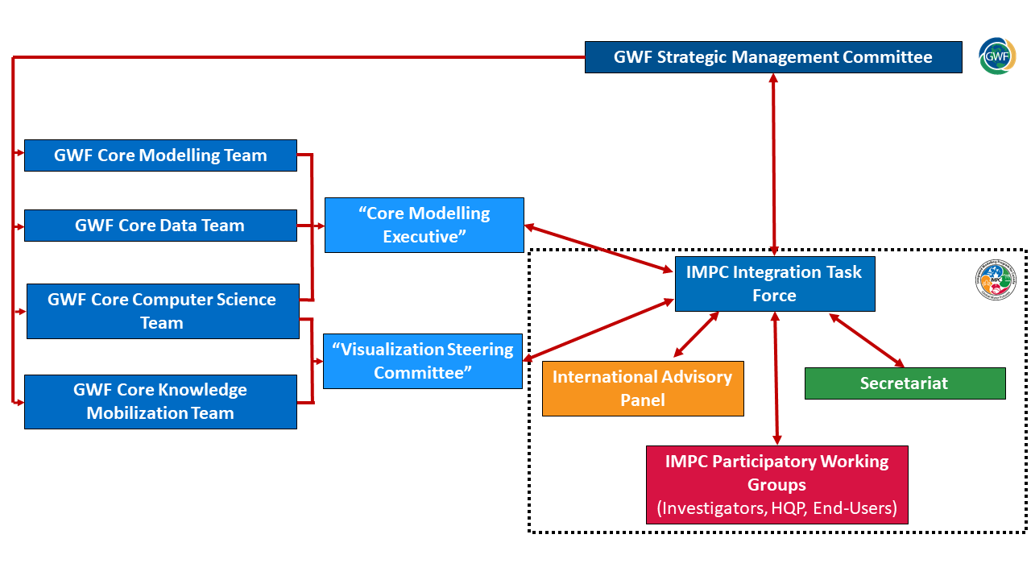





Challenges and Cross-project Collaboration Opportunities
Exploring solutions to enhance coordination across network-level modelling and visualization activities
Exploring project management software
?
Project coordinates: PI, email, website, etc
Integrated Modelling Program for Canada
Notes:
We are exploring solutions to enhance coordination across modelling and visualization activities – doing this in coordination with the GWF Core Teams and hopefully through two new groups set up in the coming months (The Core Modelling Executive and Visualization Steering Committee)
We are exploring the potential to introduce some common project management software/platform across the project to enhance coordination and integration across the various work packages – would allow informal project-related communication, access to data and material across the project, links to various resources and modelling code storage platforms already in existence.

