Slide 1
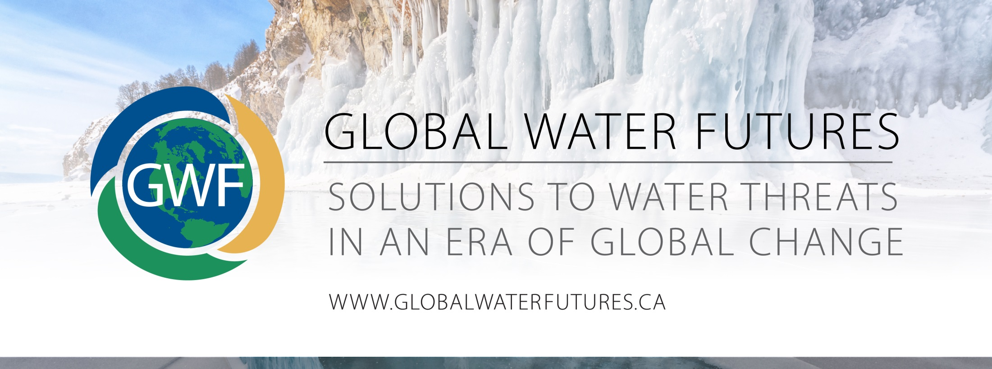
Knowledge Mobilization Team
Operations Meeting Update
November 19, 2019
Stephanie Merrill, Nancy Goucher
Andrew Spring, Stephanie Morningstar
Notes:
Thank you for the opportunity to present a brief update to you today.
Here on behalf of our team members - Morningstar, Andrew, Merrill
We have divided the presentation into two parts
I will provide an overview of what the KM team has been up to - which we hope will inspire ways we can support your individual projects even more
S. Merrill will discuss the latest and greatest of our thinking about ways we can start thinking about Documenting the Impact of our collective work. This will be critical in articulating the success of all our hard work

Slide 2




Horizontal & vertical programing / support to:
Increase the Appreciation of KM
Foster relationship-building
Build KM Toolbox of Resources
Document Impact
Notes:
As a team we have two layers of work: what we call Horizontal Programming - services that we offer as a whole team, to the entire GWF network, and then Vertical Programming to offer specific support to projects as per their KM plans.
Of these foci, our work has fallen into 4 themes:
Increase appreciate of knowledge mobilization
Supporting the fostering of internal and external relationships
Creating a toolbox of best practices for improving KM
Documenting the research impact outcomes

Slide 3
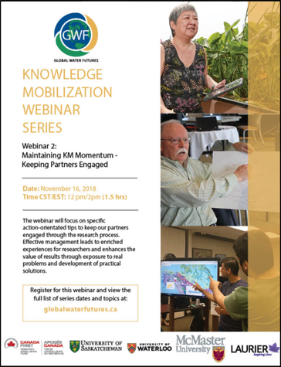
Increasing KM Appreciation
Building a common understanding of KM
and its value
KM Webinar Series
Topics covered (examples):
Writing KM plans for proposals, digital storytelling, conducting Indigenous research, etc.
Coming up in 2020...
Successful end user engagement, professional development opportunities in KM, use of science in various sectors
Notes:
One of the things we are doing to enhancing appreciation for KM is to host a webinar series to:
Teach concrete skills and concepts; tips on how to do KM
Illustrate how to identify opportunities and strategies to promote a cultural shift towards doing impact-oriented research.
Topics covered so far…
Topics this coming year...
OTHER
Other workshops and training such as in person trainings...at ASM last year and at each institution
1st and 2nd ASM KM workshops
HQP training ~25 workshops this past year (Digital storytelling, Plain language writing and communication, designing infographic posters, elevator pitches/lightning talks, developing a KM plan, etc(
COllaborative project workshops/meetings/engagement with stakeholders (Water Solutions Workshop UW, Ag-water expo USask)
KM Webinar series 5 topics this past year; archives on the website

Slide 4
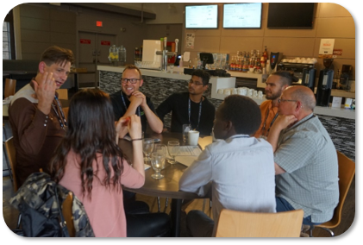
2. Relationship Building
Building relationships and maintaining engagement with end-users at every stage of research is key to KM success
Saskatoon Ag-Water Research Expo
Over 100 researchers + end users
Innovative dialogue format
Opportunities to consider how GWF research could best support decision-making, practice and programs
Over 80% of participants wanted ​
further discussions
Notes:
Impact based research requires mutually beneficial relationships with the indiv and organizations that are targets of your science
KM team supports relationship building in many ways: matchmaking, land camps, training on things like elevator pitches, and by organizing workshops and events where researchers and end users can meeting
Ex - saskatchewan Ag-Water Expo
57 researchers, 33 orgs,
Great feedback - 100% come to similar events, 80% pursuing further conversations
Loved they felt heard, loved interactive format, students are tweaking research approach and strengthened connections
OTHER
Relationship-building examples (not exhaustive)
Great Bear Lake Biosphere Reserve monitoring
Based on his knowledge of research interests and capacities within GWF and other networks, Andrew has been key to the organizing of meetings to co-develop a monitoring framework and plan for the Great Bear Lake Biosphere Reserve - the only Indigenous led Biosphere REserve in the world.
GWF Stakeholder database
Stephanie Merrill maintains a shared list of all the partners identified by our projects in a database that can be used to build further connections / redundancies, strengthen our network, support one another and improve how overall relationships the GWF program has with our end users. It is an ongoing living database. We have already been able to identify potential partner sharing and relevant information for communicating with partners based on their existing connection to projects
Tapping into the diverse network of our Team specialists: Nancy invited over 50 of her professional network contacts; many of which were at the time outside of the GWF project reach; Merrill tapped into her diverse professional network contacts to help the eDNA project identify, contact, and generate participation in a eDNA opportunities and limitations survey by potential users in legal, non-profit, consulting, research, regulatory fields.
Newsletters and booklets help us stay connected with stakeholders in an ongoing way.
Ex - NWF and SAMMS have a newsletters that reach ~250 people (and growing). Combination of stories written by HQP, events and activities that have happened
Ex - Mac created a booklet for their project oriented towards their indigenous partners (incl framing research in terms of indig values)
On-the-land science camps in NWT - youth, elders and knowledge holders come together with NWF researchers to share knowledge, build relationships and learn from each other
Building relationships with Indigenous communities
Last year’s ASM included the First Nations Climate Change & Water Security Symposium on Six Nations organized by Stephanie Morningstar and she continually Co-organizes outreach events with partners such as the Decolonizing Water Research symposium organized by Mac
Water Security for Canadians Initiative: An effort that brought together experts in science - policy and law - governance - Indigenous rights for a collaborative set of recommendations for modernizing the Canada Water Act, which if implemented can be a key mechanism to enhancing relationships between water management jurisdictions: federal, provincial/territorial, Indigenous governments

Slide 5
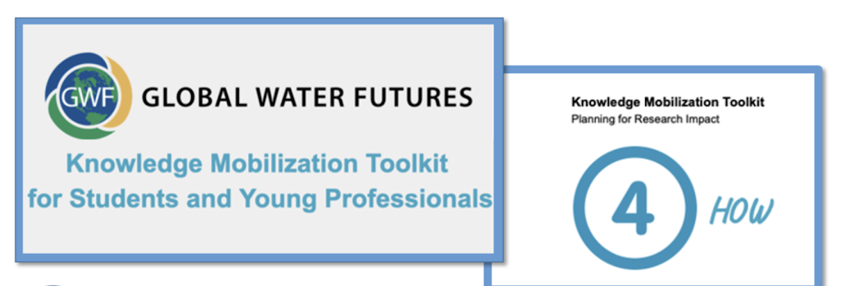
3. Toolbox of Resources
Develop resources/tools to support projects and to share concepts and ideas across GWF network.
The KM Planning Guide - a 5-step series of worksheets to help researchers engage stakeholders and partners to develop an effective KM Plan.
Notes:
Were also continuously building our resources, tools, templates that we use to provide guidance to projects, and all researchers can access to make implementing their KM strategies easier. Some of these are available on our website, other are being finalized and posted as soon as possible:
One thing we created for last year’s ASM was a 5-step guide for drafting a KM plan….lots in there including how to ID relevant end users, and the most appropriate tools for meeting your objectives
Examples:
A guide to interactive polling
Training modules- communication plans, elevator pitches, plain language writing
Webinar/workshop evaluation templates
Infographic-style poster template
KM Toolkit for YPs: steps for how to develop a KM plan
A guide to hosting stakeholder workshops
Searchable GWF partners database
Revised KM website - where we are articulating our current thinking and building out our resources and templates for projects to use
In the midst of developing an Indigenous Community Water Research engagement strategy to improve how researchers are considering indigenous issues and engaging with communities

Slide 6
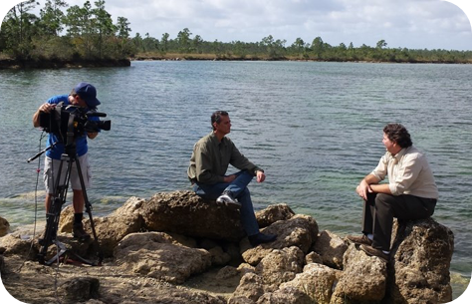
4. Documenting Impact
Articulating when & how is GWF having a meaningful impact on water management practices in Canada.
Digital storytelling
Harness the power of voice, visuals, and digital media to record and share stories.
Compelling and emotional information complements more conventional measures
Notes:
Documenting successful KM processes and research impact is increasingly a focus as we move into stages of the research where tangible partnerships are producing tangible results. Evaluating success with metrics that can be applied across projects is a challenge, and we often get asked about how to do this. Evaluating is very dependant on the intentions of each project, and the intended outputs and outcomes.
OTHER
The KM team has developed a webinars and has provided specific to project one-one guidance on how to measure KM processes, and shorter term outcomes and longer term impacts that researchers may not see until longer than the life of GWF program.
We have also provided annual check-ins to discuss progress towards KM plans, and forward looking conversation and planning towards achieving deliverables with partners.
We have started to identify KM successes and potential case study documentation opportunities (for webinar content, network sharing, and for publication)

Slide 7
What’s coming up for KM in 2020...
Highlights
KM webinar series (ongoing)
GWF “travelling roadshow”
KM Toolkit and webpage revamps
Journal article documenting GWF KM
Enhanced support for Indigenous-led projects
Contributing to Annual Science Meeting planning
Ongoing assistance in implementing project KM strategies
Impact stories, measuring/documenting KM success
Notes:
Journal article - draft in Dec

Slide 8
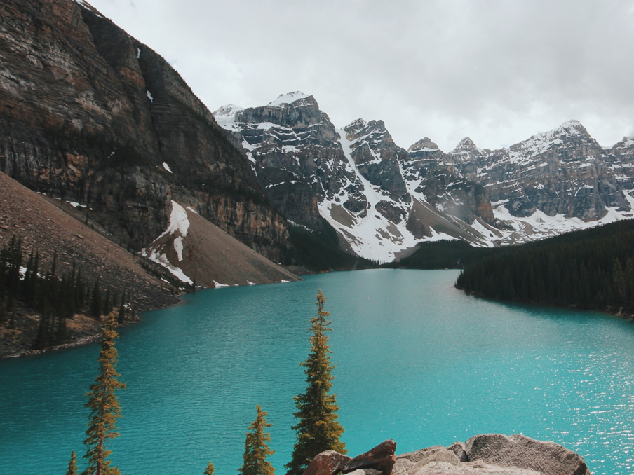
GWF Impact
and Legacy:
How have we made a difference in water sector engagement, water management practices and related public policy?
Notes:
As we have been discussing, it is important to document the impact of individual projects
...but it’s also important to think about the impact of the GWF Program as a whole
In other words, what will GWF’s Impact/Legacy be?
Importance - This is important to think about because...
Our partners, funders and end users will want to know what is different because of this enormous investment in water research; is water being managed better? Will people be better protected from floods and extreme events? Will we have more secure water supplies, etc.
We have an opportunity to define for ourselves what our story will be...what will we be remembered for?
Challenge
The challenge for us is to aggregate the work of GWF’s 500 researchers and partners to make sense of the work of the 39 main projects...and to find a way to tell this story so that it resonates with our various audiences.
This is not going to happen on it’s own, we need a framework for collectively talking about our impact

Slide 9
Potential collective “impact themes”
Decision- support tools to protect /enhance water quality
Water risk/liability assessment tools
Predicting water availability
Inputs for sector-based BMPs
Mitigating, adapting to climate change risk
Notes:
These are early thinking - language pulled from existing GWF documentation like the proposal, etc. Do these make sense? Are there others? Are they the right scale? Starting point ...
KM team has been putting more thought into how we organize our work to support the development and telling of the GWF Impact
The KM team can also play a part in connecting our work with individual projects to horizontal program goals. For instance, our work in designing processes that allow researchers to understand end user needs can be applied at the program level to help GWF communicate its relevance to end users at a national level

Slide 10
A synthesis framework based on Impact can provide:
A cohesive network-wide narrative
A structure to summarize diverse research
Story-telling hooks
Annual Operations Meeting organization
Annual Science Meeting organization
Notes:
The objectives/themes can actually make our big messy network easily understood and organized if they become embedded in how we talk/work/organize/measure success. They can provide us with :
Cohesive narrative - common vision for how we are working together to achieve success
Reporting structure
-common organizing framework for projects annual reporting to GWF ; provides consistency, comparability between projects and over time
-summarizing 500 page annual reports in distilled, digestible ways, infographics
Storytelling hooks = Encourages projects to articulate benefits to society and provides communications team with content/sharables
Annual Meeting organizing = provides clear objectives for discussing progress and management at the Ops meetings and for ASM helps frames the science advancements in terms of impact themes rather than disciplines
We are also putting thought into how we can capitalize on the times when we gather in person - like this meeting and the ASM - to aggregate and find alignment across projects. Perhaps some common themes and objectives could inform the structure of these meetings?

Slide 11

Notes:
As we move into the second half of GWF, the team has been thinking about the these challenges and opportunities to ensure we organize and document our success.
The KM team is at a nexus between individual projects and horizontal program goals. For instance, our work in designing processes that allow researchers to understand end user needs can be applied at the program level to help GWF communicate its relevance to end users at a national level
We wanted to start this discussion. Perhaps there’s a breakout discussion table that this can be incorporated into, or there’s a group of folks who would like to carry this on after the meeting. We welcome your thoughts and ideas so please don’t hesitate to reach out to any of the KM leads as we continue to think about linking legacy to our KM strategies.

Slide 12
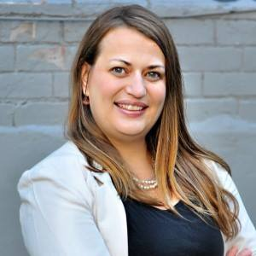
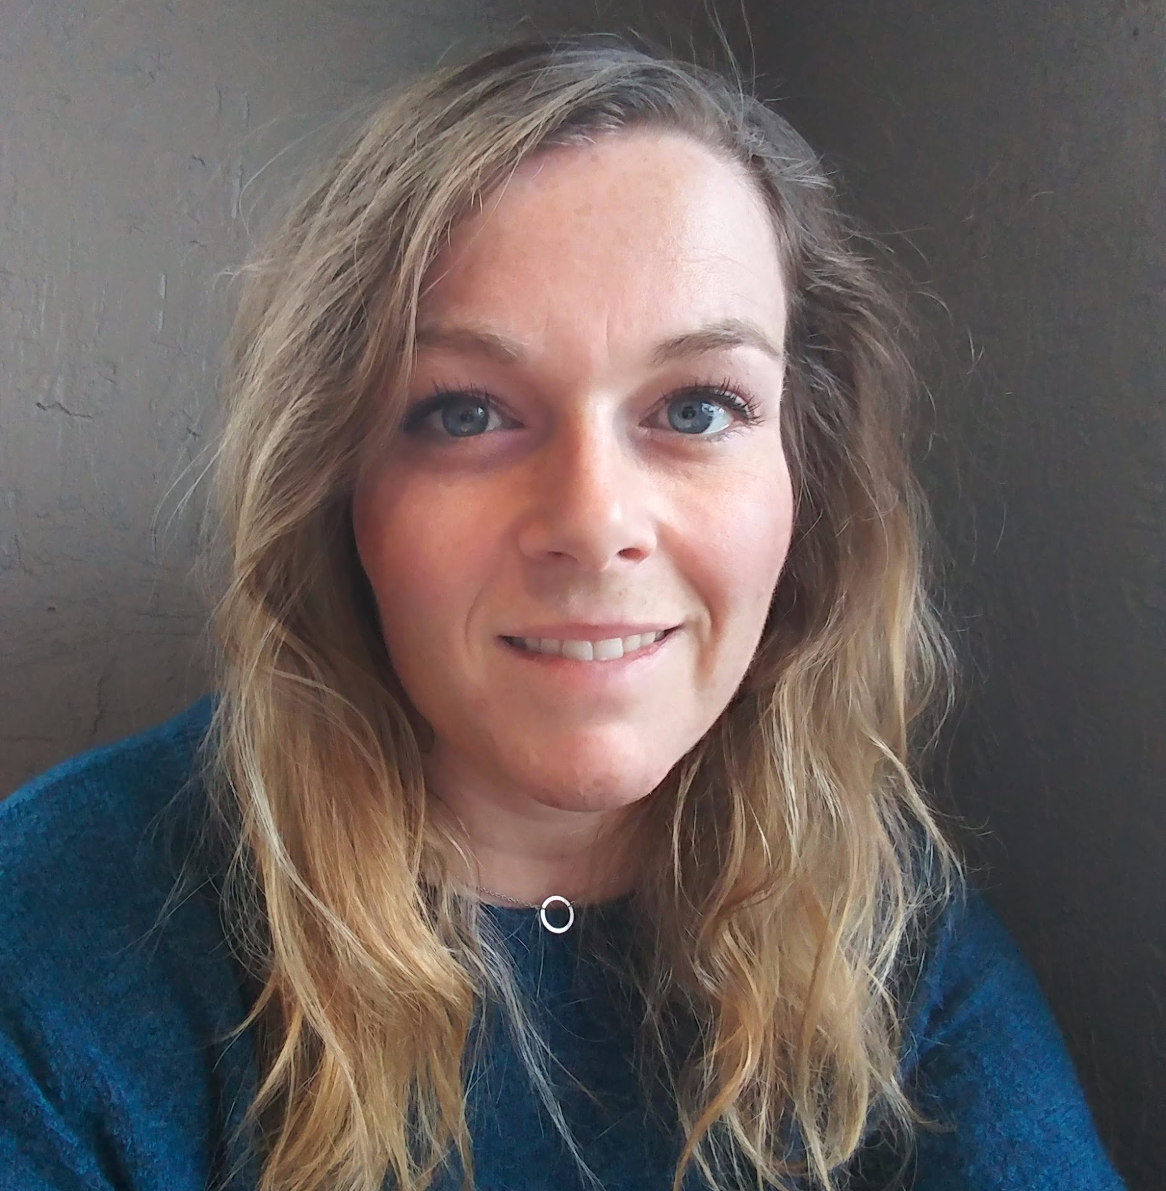
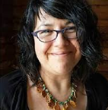
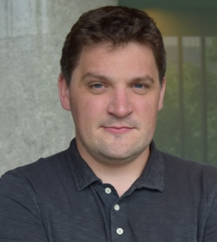
We support best practices & innovation in KM
Nancy Goucher
University of Waterloo
Nancy.goucher
@uwaterloo.ca
Faculty Lead:
Kevin Boehmer
Stephanie Merrill
University of Saskatchewan
Stephanie.Merrill
@usask.ca
Faculty Lead:
Lawrence Martz
Stephanie Morningstar
McMaster University
mornings@mcmaster.ca
Faculty Lead:
Sean Carey
Andrew Spring
Wilfrid Laurier University
aspring@wlu.ca
Faculty Lead:
Kelly Munkittrick

