Slide 1
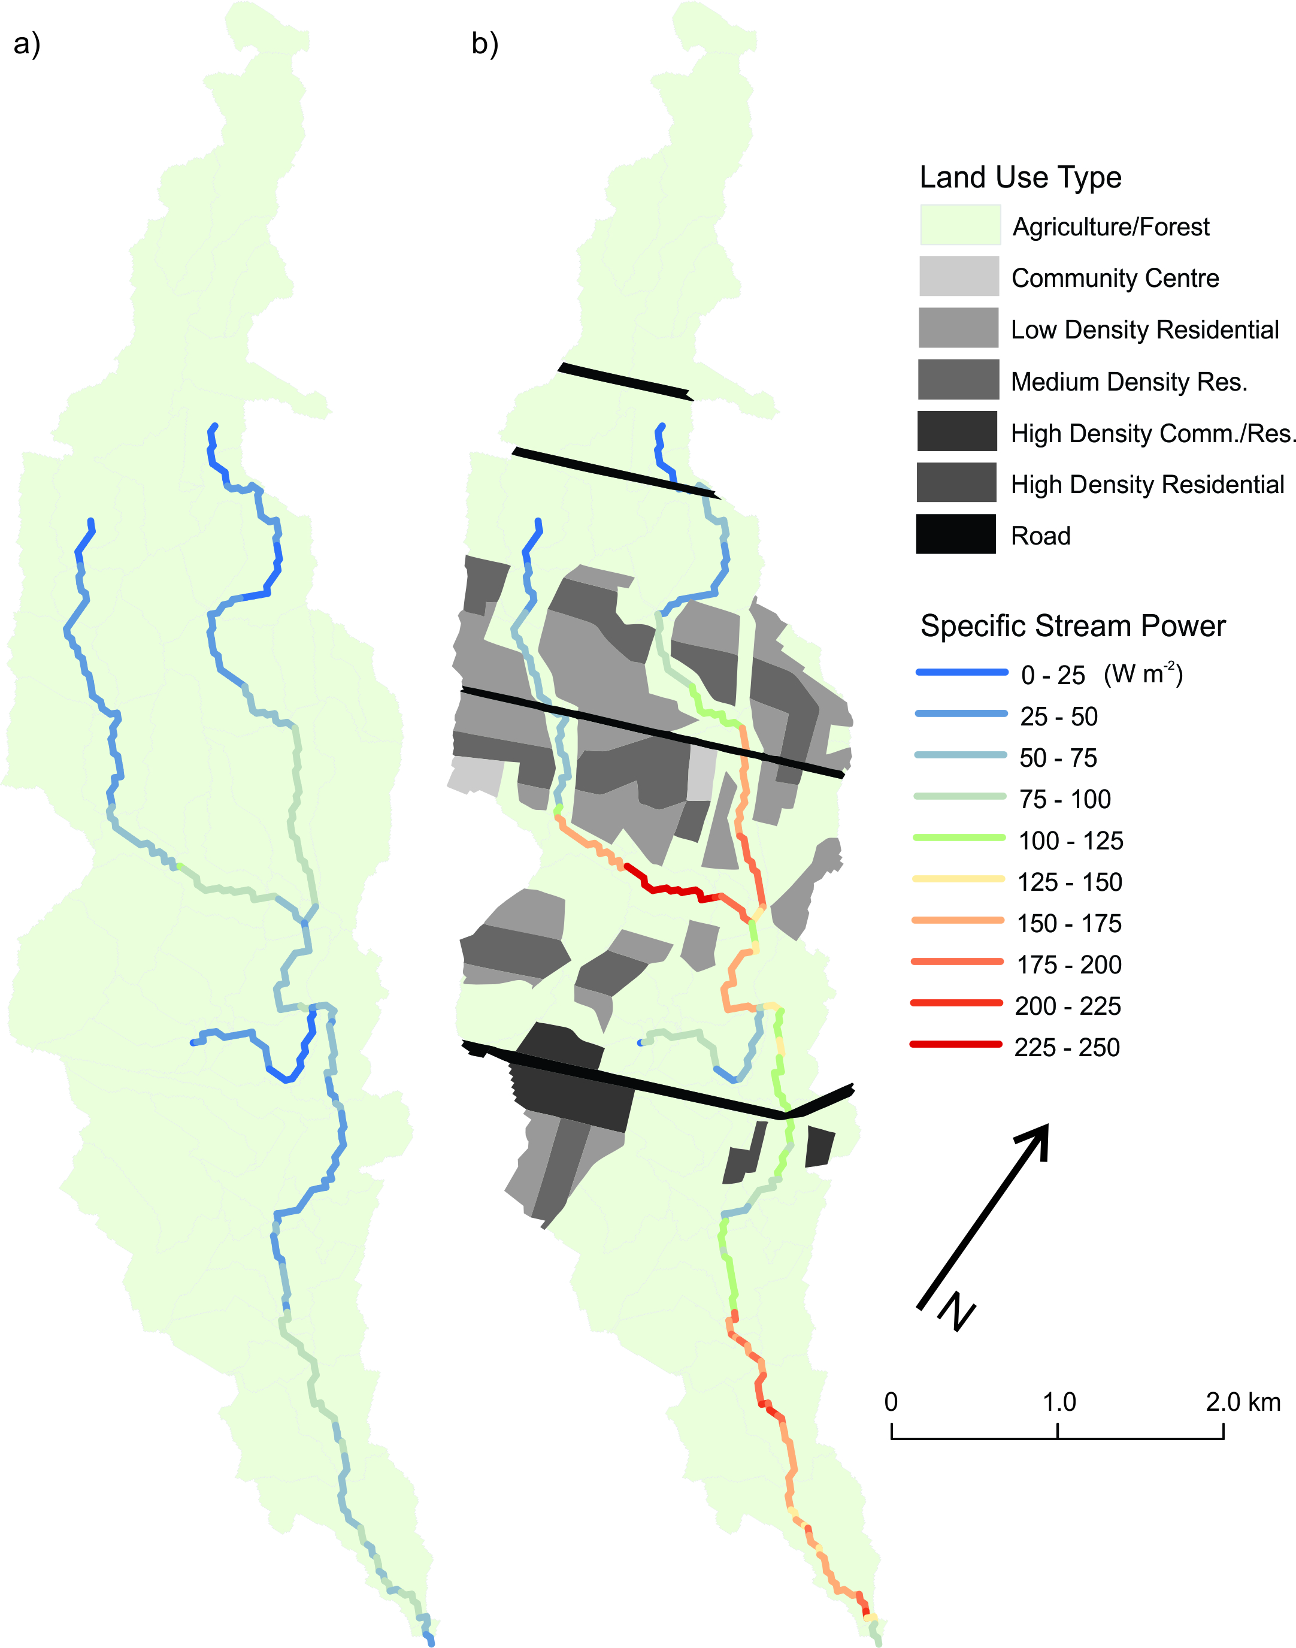
Linking stream network process models to robust data management systems
How does the growth of cities affect rivers?
Aim is to develop decision support systems that integrate best available science for land-use change;
Key hypothesis is that sediment dynamics can be used to link hydrologic change with geomorphic and ecological outcomes.
Sites are urban streams in Southern Ontario
Contact: Bruce MacVicar, bmacvicar@uwaterloo.ca
from: Ghunowa et al. (in preparation) Stream power index for networks (SPIN) tool for decision support in urbanizing watersheds, Environmental Modelling and Software
Project coordinates: PI, email, website, etc
Linking stream network process models to robust data management systems
Notes:
Project extends results from a Strategic Project Grant, which allowed much of the data collection and exploration of tools that could be harnessed to support decision making in rivers with respect to urban land use.
We are working with municipalities, conservation authorities, and consultants to get the data, develop the models, and incorporate both into decision support systems.

Slide 2
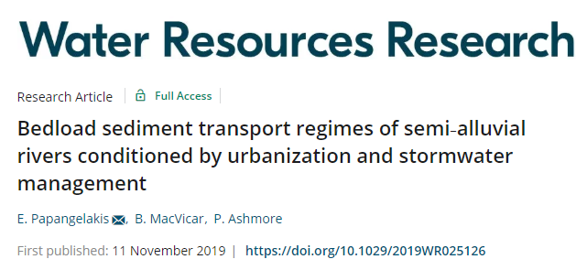
Transformational Science: Urbanization accelerates sediment moving through stream networks
Sediment moves downstream up to 5x faster in a fully developed urban catchment. Frequent mobilization is to blame (>20 events per year).
We can model it.
Project Title
Linking stream network process models to robust data management systems
Notes:
We are happy with this recent paper that presents a wonderful data set on sediment transport in urban rivers with a level of detail that goes beyond what is available in other studies.
The results distill down to a relatively simple concept – that the changes in hydrology that are ubiquitous in urban streams lead to an evacuation of sediment because the long term average rate at which particles move downstream is accelerated in comparison with non-urban examples.
Stormwater management can slow it down, but it further distorts the sediment regime so that unintended consequences may occur. In particular, the channel in the managed river became armored, similar to channels downstream of hydropower dams, which means that sediment is rarely mixed by transport in floods and transport occurs mostly as fines over a paved bed.
Perhaps most importantly for our efforts to develop decision support systems, we can model the change and have come up with a simple relation that works for streams with different hydrologic regimes and for all sizes of bed particles.
This is the type of model we were hoping for and hypothesized we would be able to obtain if we properly designed the experiment to isolate the variables we needed to produce a robust model.

Slide 3
Project Impact and Aspirations: Decision Support Systems
Stream power index approach for networks (SPIN) available as an ARCGIS toolbox
SPIN is integrated with a Risk and Return on Investment Tool for assessing the cost of land-use change (Credit Valley Conservation Authority, Engineers Canada initiative).
Framework for hydraulic, geomorphic and ecological integrated model for assessing land use change outcomes will be developed for iEnvironment
Project Title
Linking stream network process models to robust data management systems
Notes:
We are working to support decision making in a number of directions.
I believe we have to be

Slide 4
Challenges and Cross-project Collaboration Opportunities
Student recruitment and advancement is not a straight line.
Three key, new Ph.D. students are just now getting to their comprehensive exams (W20).
Project cannot be renewed, which restricts cross-project opportunities.
Hope in the next year or two that the array of tools will increase for interoperability of hydraulic and hydrologic models, probabilistic flooding and erosion risk assessment, and combination of ecologic and geomorphic analysis will lead to new insight.
In discussions for addition of locations for future projects – Grand River Watershed, Northwest Territories.
Project Title
Linking stream network process models to robust data management systems

