Slide 1
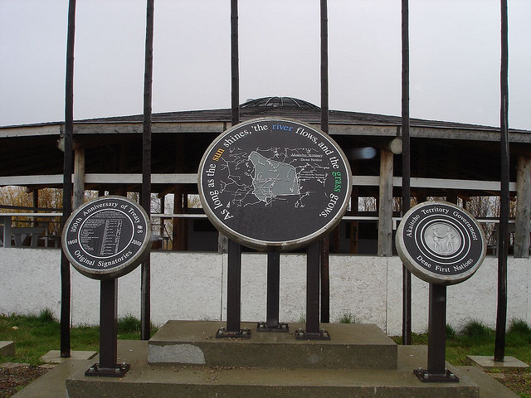




Is our Water Good to Drink?
Water-related practices, perceptions, and Traditional Knowledge indicators for human health
Mike Tollis AAROM, Akaitcho Territory Government
Saskatoon, November 2019

Slide 2
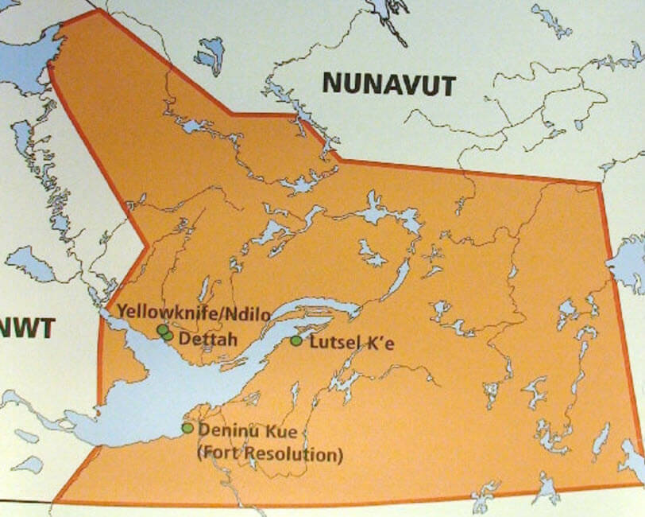
Project Progress to Date
Initial ethics certificate
  Co-developed
  Issued by U Sask
  To be finalised once community pre-testing complete
PhD student starts January 2020
Draft ATG Research Agreement
  Approved by all Chiefs
  To be submitted to U Sask for signatures
Aurora Inst research license
  In progress as joint submission

Slide 3
Exciting Opportunities
ATG Research Workshop
  December 2019
  Final Research Plan for spring/summer 2020
Community youth workshops
  video storytelling, research
  Let’s Talk About Water Film Prize
Project launch events
  Approved by all Chiefs
  To be undertaken in February / March 2020
  Water Ceremony
  Elder meetings
  Community Water Day
  Data collection tool completion

Slide 4
Research Team
Diane Giroux, Corinne Schuster-Wallace, Lalita Bharadwaj
Richard Simon (Deninu K’ue First Nation), Johanne Black (Yellowknives Dene First Nation), Prairie Desjarlais (Lutsel K’e Dene First Nation)
  ATG Aboriginal Aquatic Resource & Oceans Management Technical Board
Sarah Dickson Anderson, Susan Watt (McMaster University)
4 summer students, 2 Master’s students, 50 youth

