Slide 1
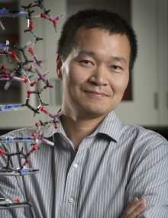

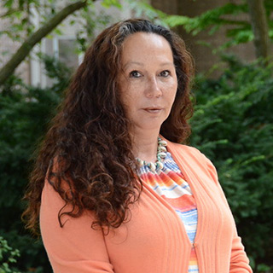
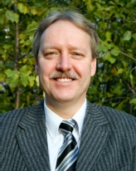

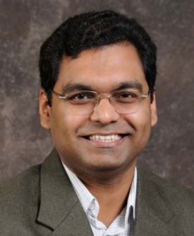
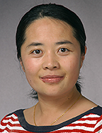
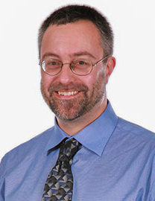
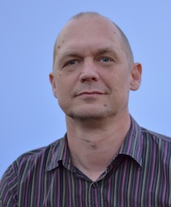
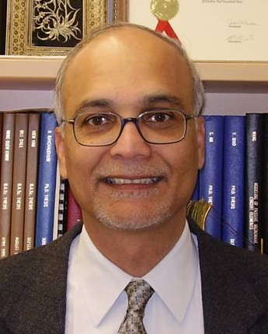
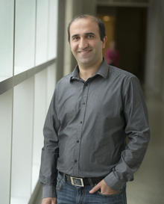

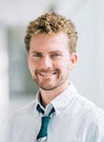
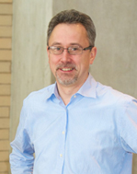

Sensors and Sensing Systems for Water Quality Monitoring
Project coordinates: PI, email, website, etc
Notes:
It can help to frame your main research objective as a question. For example,
How will climate change affect agriculture in Canada?
How can we improve water quality and reduce algal blooms in Canadian lakes?
What are the links between fish health, food safety and food security in the Indigenous North?
What is the significance of groundwater fluxes on surface water flow?

Slide 2
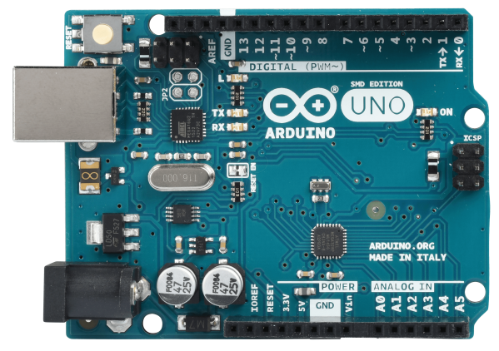
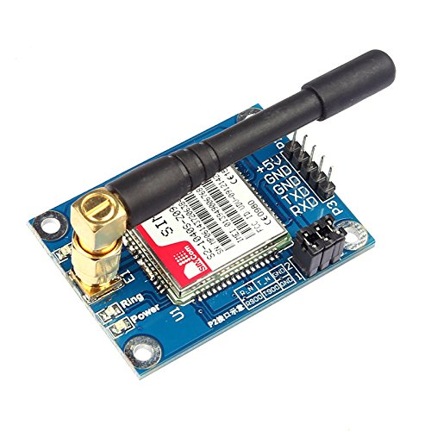
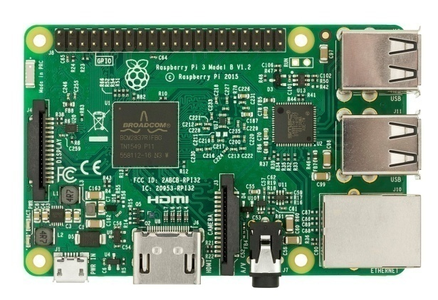
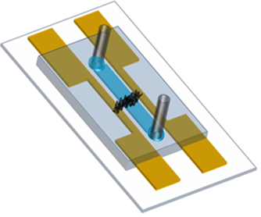

Project Introduction and Information
KEY OBJECTIVES:
One of GWF key objectives - integrate water quantity and quality data in real-time, make it readily available to users wirelessly.
This involves the use of sensors and sensing systems that can be deployed in the environment (e.g. rivers, lakes, agricultural fields, mining sites, indigenous communities) to monitor contaminants and their variation over the short and long time scales.
OVERARCHING GOALS:
Development of low-cost sensing systems for long term monitoring of water quality.
Development of specific low cost sensors and integrate them with the sensing system.
Low Cost Sensing Systems
New Sensor Designs
CONTACT INFO
Free chlorine
Biofouling prevention
Aptamer for heavy metals
Dr. Ravi Selvaganapathy
selvaga@mcmaster.ca
www.gwfsensors.com
Surface
Bacterial biofilm
20 µm
Commercial, custom built, software-based
Analytes: heavy metals, oxidants, nutrients, pathogens
Project coordinates: PI, email, website, etc
Sensors and Sensing Systems for Water Quality Monitoring
Notes:
It can help to frame your main research objective as a question. For example,
How will climate change affect agriculture in Canada?
How can we improve water quality and reduce algal blooms in Canadian lakes?
What are the links between fish health, food safety and food security in the Indigenous North?
What is the significance of groundwater fluxes on surface water flow?

Slide 3
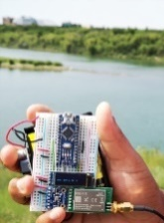
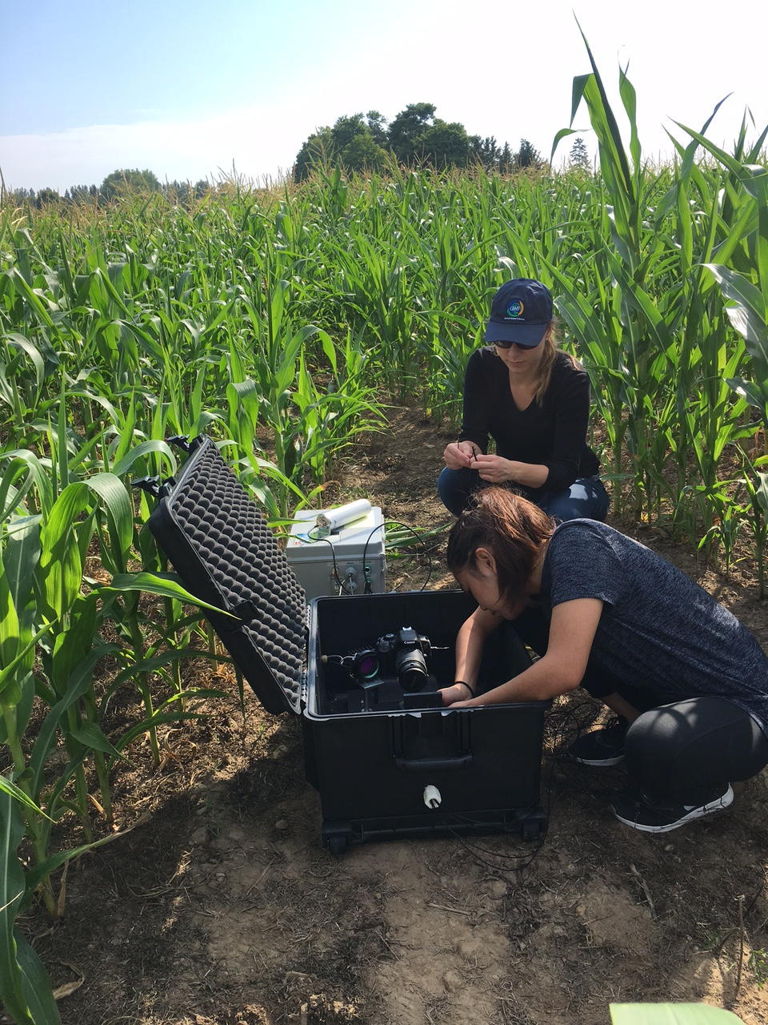
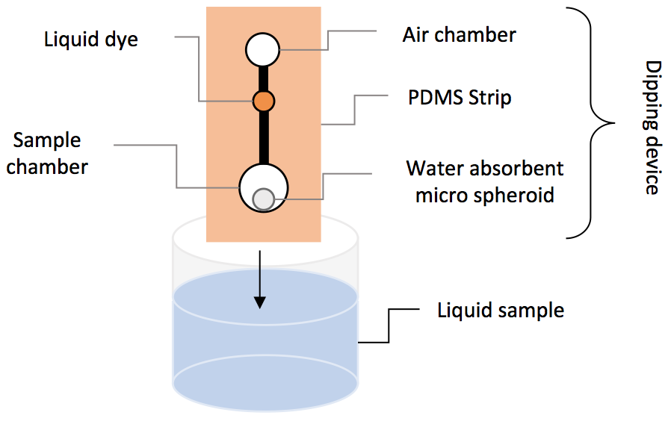
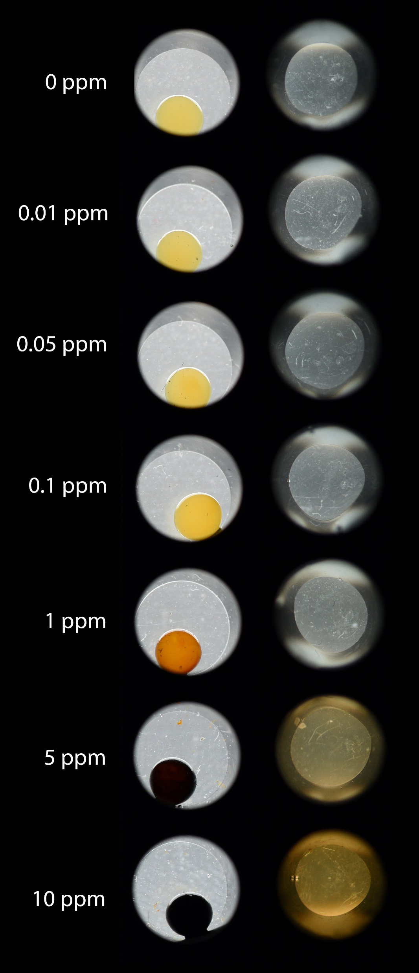
Transformational Science Highlights
FIELD DEPLOYMENT
PROTOTYPE
Multi-fibre optode (MuFO) sensor is designed for long-term, in situ and remote monitoring of dissolved oxygen (O₂) in soils and sediments under variable soil environmental conditions
Deployed in two highly instrumented agricultural lysimeter systems since Sept 2018.
Water sources that require monitoring - not easily accessible, no cellular coverage, limited power sources
Smart Node developed – successfully connects to IoT wireless network to transmit data over long ranges (the length of river or lake) and using very low power (2 year lifetime using only 3 lithium batteries)
LAB TESTING
Regular analytical techniques require large sample volumes – miniaturizing the sample allows automated (instead of manual) monitoring of contaminants
Novel “dipping” method for copper sensing developed –lIiquid sample containments are confined, forming a solid phase and allowing for enhanced color intensities using micro amounts of samples
Project Title
Sensors and Sensing Systems for Water Quality Monitoring
Notes:
These accomplishments slides will be also be used to build slide bank for use in GWF presentations
How are these results key to advancing the science
How are these results linked to the needs of your partners/users?

Slide 4
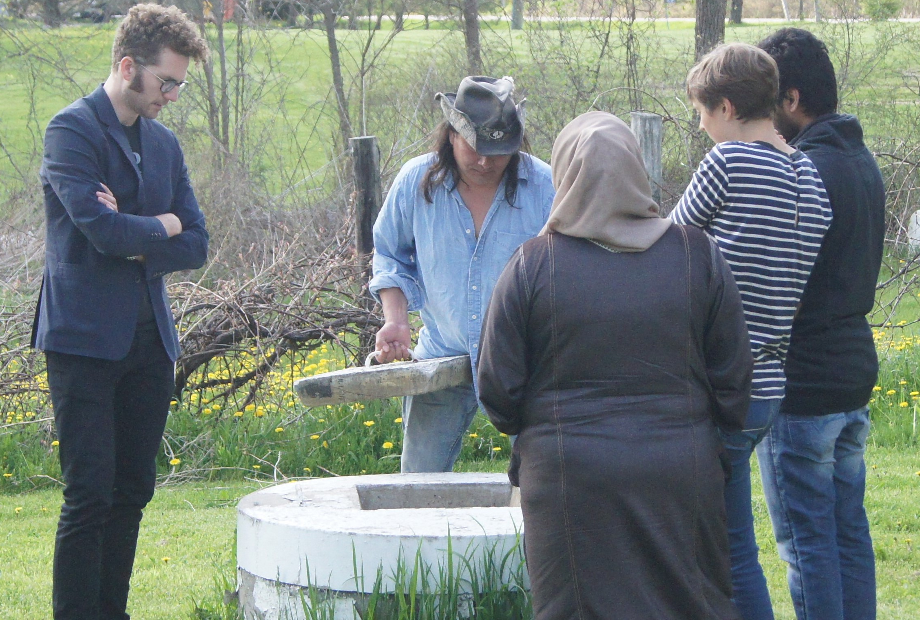



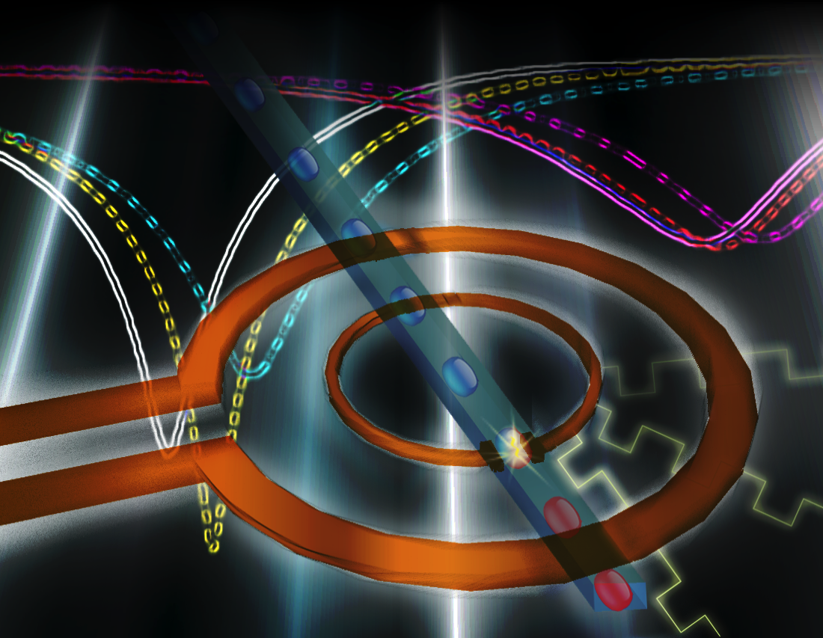
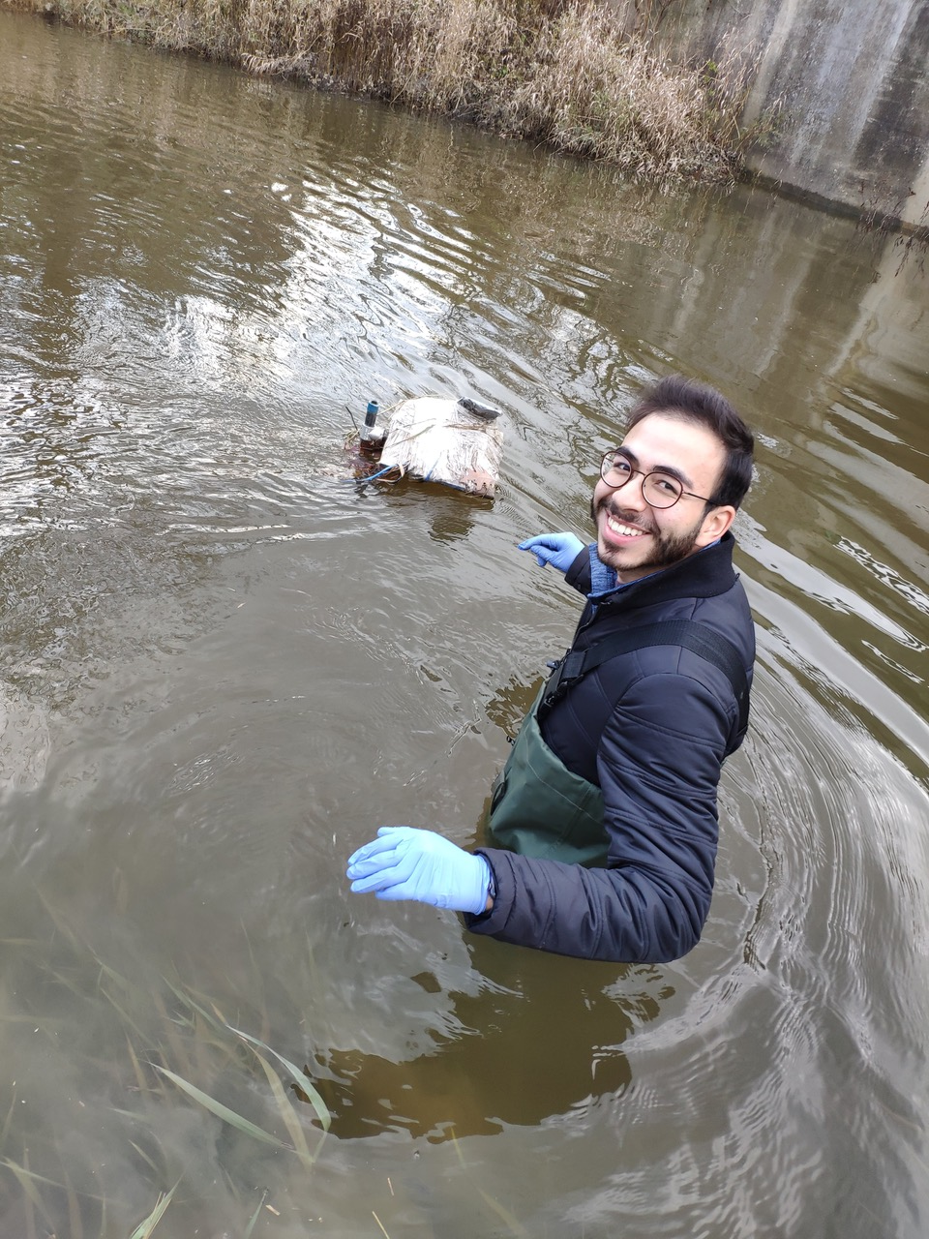
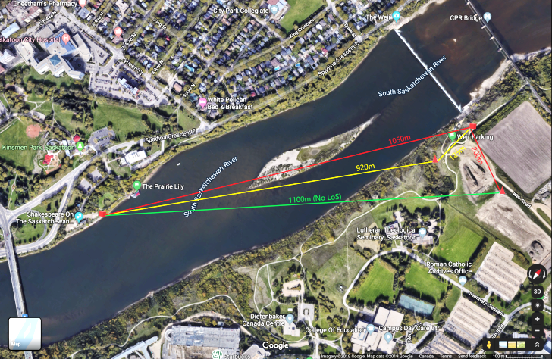




Collaborations
CROSS-PROJECT COLLABORATIONS:
(Top) Well water sampling at Six Nations community in Ontario, to measure coliform concentration and physical/chemical water parameters
(Bottom) Sensor deployed in Six Nations creek to monitor pH (related to e.g. spills from highway, pesticide runoff), dissolved oxygen (related to fish survival), turbidity (related to cloudiness), temperature (track seasonal changes)
Sensor network testing across Saskatchewan river (below) as well as Buffalo Pound lake and Lake Diefenbaker
Developed microwave sensors (top right) to be used for multiplexed on-site metal contamination
Microwave sensors would be placed on 3 drones
Proposed to have multiple sensors in one location and various water depths
INDUSTRY COLLABORATIONS:
Project Title
Sensors and Sensing Systems for Water Quality Monitoring

Slide 5
Challenges
Major challenge in the risk assessment of contaminated waters, whether from agricultural or municipal operations, is the fluctuating nature of contaminant concentrations in those waters.
Protecting the sensors from harsh environmental conditions: waterproof cases for hardware, reinforced wires to mitigate damage from animals, functionality over wide range of temperatures
Sensor maintenance: traveling to troubleshoot the sensors in remote locations can be difficult
Delays in deployment due to technical or logistical issues
Project Title
Sensors and Sensing Systems for Water Quality Monitoring

Slide 6
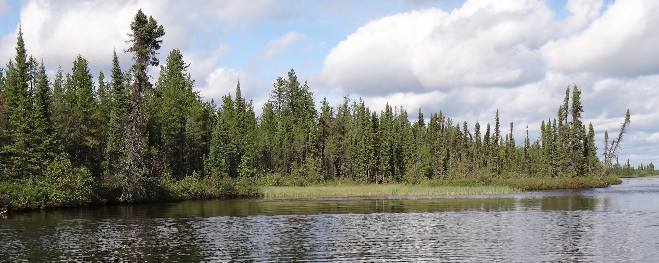
Project Impact and Aspirations
Environmental and Agricultural Perspectives:
                - nutrient loads and eutrophication of waterbodies remain serious concerns
                - can result in cyanobacterial blooms with toxic consequences.
Community and Drinking Water:
  - measurement level of free chlorine, dissolved oxygen and pathogens present
  remains an important consideration.
UN Sustainable Development Goals:
- support and strengthen the participation of local communities in improving water
and sanitation management
- achieve universal, equitable access to safe, affordable drinking water for all
- protect and restore water-related ecosystems, including mountains, forests,
wetlands, rivers, aquifers and lakes
Project Title
Sensors and Sensing Systems for Water Quality Monitoring

