Slide 1
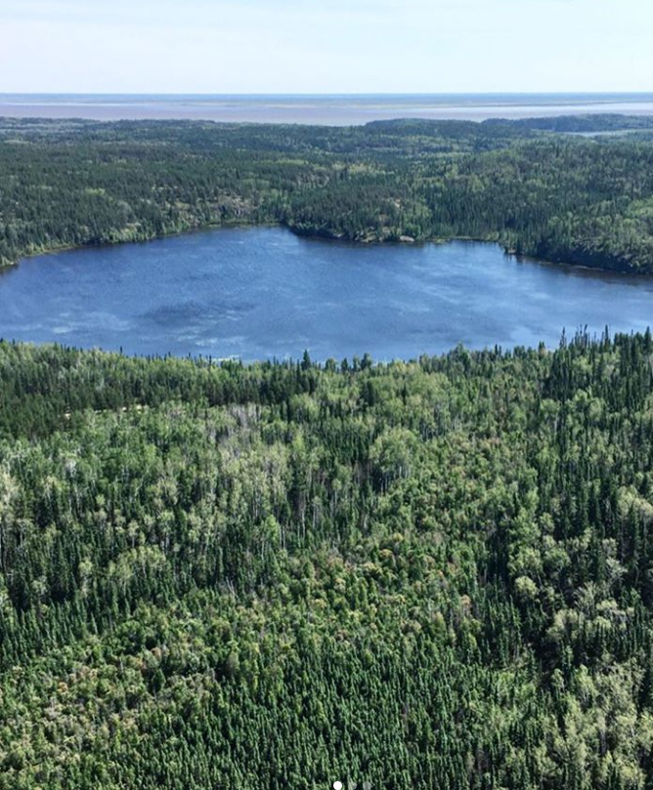

SAMMS: Sub-Arctic Metal Mobility Study
Current and future mobility of legacy atmospheric-source contaminants from the Giant Mine (As, Sb) with in a 200 km airshed
  Model for future mining development
  Holistic catchment–studies to quantify stores and movement of metals/metalloids
Jason Venkiteswaran jvenkiteswaran@wlu.ca
Brent Wolfe bwolfe@wlu.ca
samms.ca
Project coordinates: PI, email, website, etc
SAMMS
Notes:
It can help to frame your main research objective as a question. For example,
How will climate change affect agriculture in Canada?
How can we improve water quality and reduce algal blooms in Canadian lakes?
What are the links between fish health, food safety and food security in the Indigenous North?
What is the significance of groundwater fluxes on surface water flow?

Slide 2
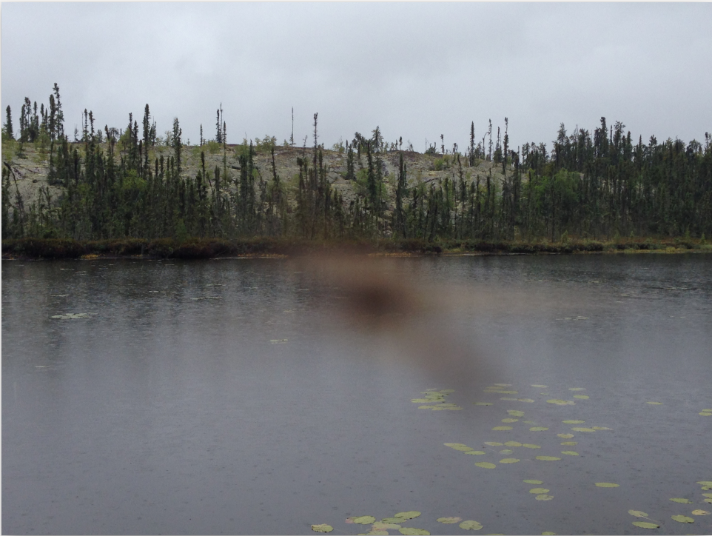
Transformational Science Highlights
factors such as how As is stored in sediments matter more than distance from Yellowknife
DOC and As are broadly predictable from water isotopes
disconnect lake water residence time and water quality due to variable importance of terrestrial inputs
between 0 and 50% of historical As has been mobilized from the sediment profile
increases in summer precip increase water colour, DBP formation and metal mobility
Project Title
SAMMS
Notes:
These accomplishments slides will be also be used to build slide bank for use in GWF presentations
How are these results key to advancing the science
How are these results linked to the needs of your partners/users?

Slide 3
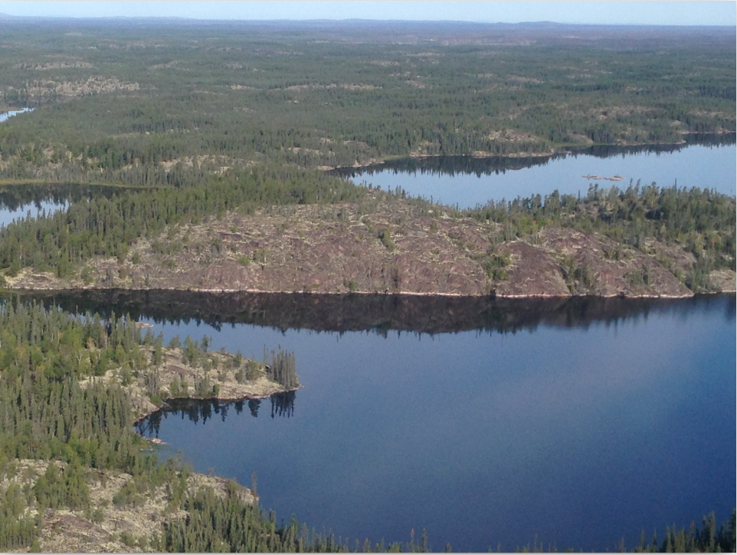
Project Impact and Aspirations
Rethink fate of Giant Mine As
Model future fate of sediment As
Predictability relationships for DOC-As mobility
Paleo-ecotoxicology
Project Title
SAMMS

Slide 4
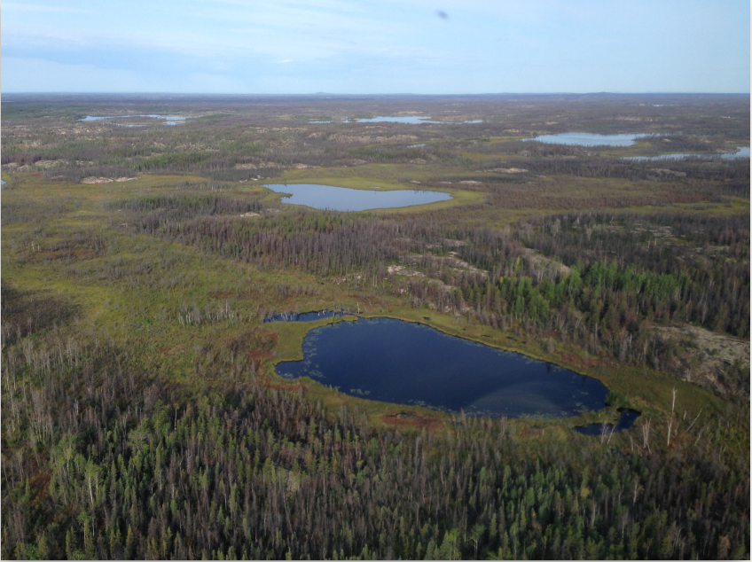
Challenges and Cross-project Collaboration Opportunities
Opportunities:
Sampling
Challenges:
Expensive
Data-poor
Project Title
SAMMS

