Slide 1

THE UN WATER ACTION DECADE (2018-2028) AND CANADA’S CONTRIBUTION
Vladimir Smakhtin
United Nations University Institute for Water, Environment and Health
Hamilton, ON, Canada
Third Annual GWF Operations Team Meeting. November 19–20, 2019;
Hamilton, ON, Canada

Slide 2
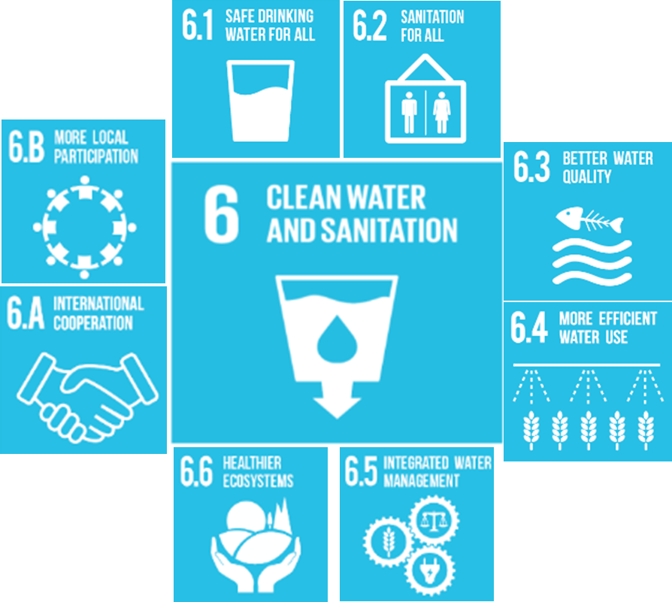
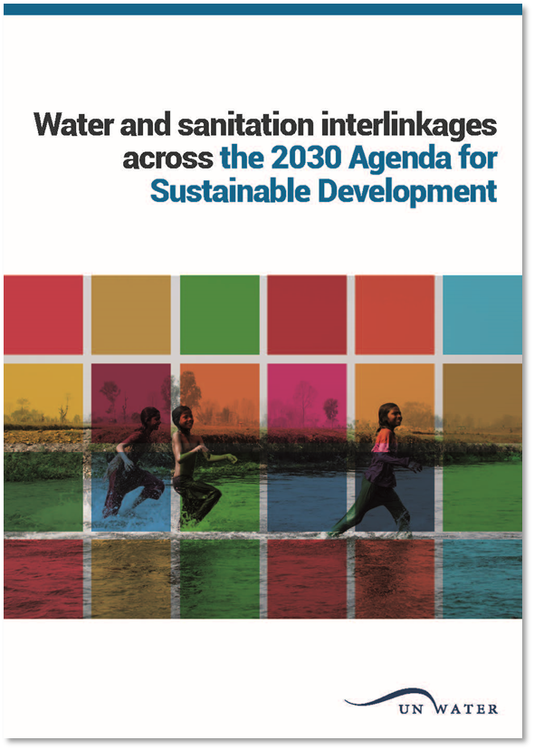

















SUSTAINABLE DEVELOPMENT GOALS (SDGs)

Slide 3
UN DECADES
UN Decade of Sustainable Energy for All: 2014-2024. UNE
UN Decade of Action on Nutrition: 2016 – 2025. WHO
UN Decade on Family Farming: 2019 – 2028. FAO
UN Decade on Ecosystem restoration: 2021 – 2030. UNE
UN Decade on Ocean Science for Sustainable Development: 2021-2030. UNESCO
UN Decade of Action- Water for Sustainable Development: 2018-2028. UN-Water
All Decades:
Are driven by member states
Have champions and underpinning UN Resolutions
Have objectives and action plans
Are periodically reviewed
Notes:
All Decades have UNGA Resolution that backs the Decade up, objectives and action plan, key implementing agency or network, web sites and communication mechanisms, interim reviews

Slide 4
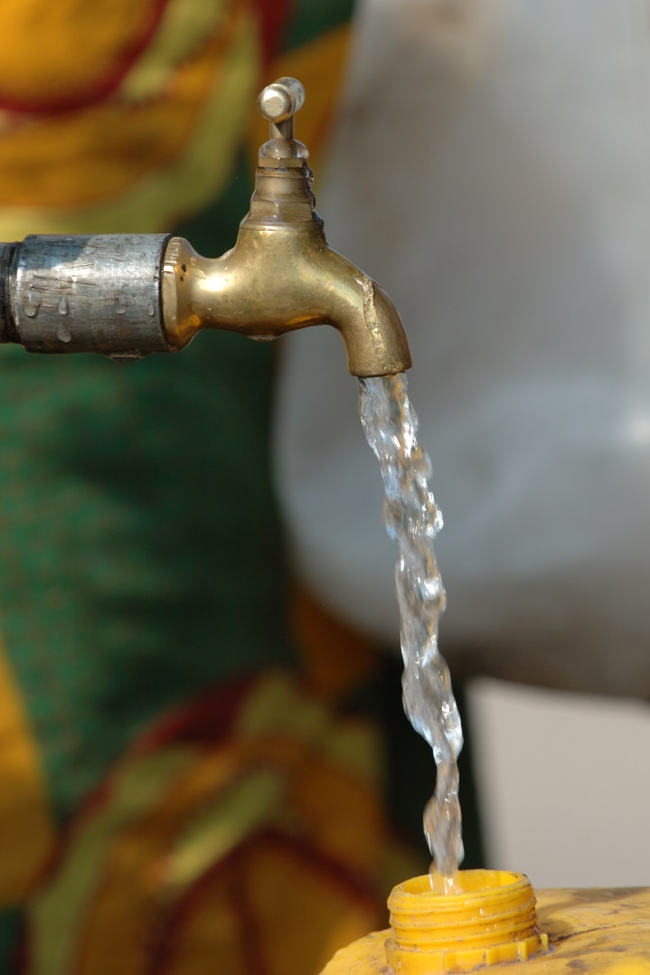

“WATER DECADE” IN A NUTSHELL
Objectives
Advance sustainable development (from silos to integration)
Accelerate implementation of existing programmes and projects (align them with Agenda 2030)
Inspire action to achieve the 2030 Agenda (generate political will)
Work streams
Facilitate access to knowledge and exchange of good practices
Improve knowledge generation and dissemination
Pursue advocacy and promote partnerships
Strengthen communication for implementation of water-related SDGs
UN-Water Task Force
Coordinated by UNU and UN-DESA; 12 more members
Decade Web Site
www.wateractiondecade.org
Notes:
Interpretation of objectives:
transforming the current silo-based approach to water supply, sanitation, water management and DRR into an integrated one;
aligning existing water and sanitation programmes and projects with the 2030 Agenda;
and generating the political will for strengthened cooperation and partnerships

Slide 5
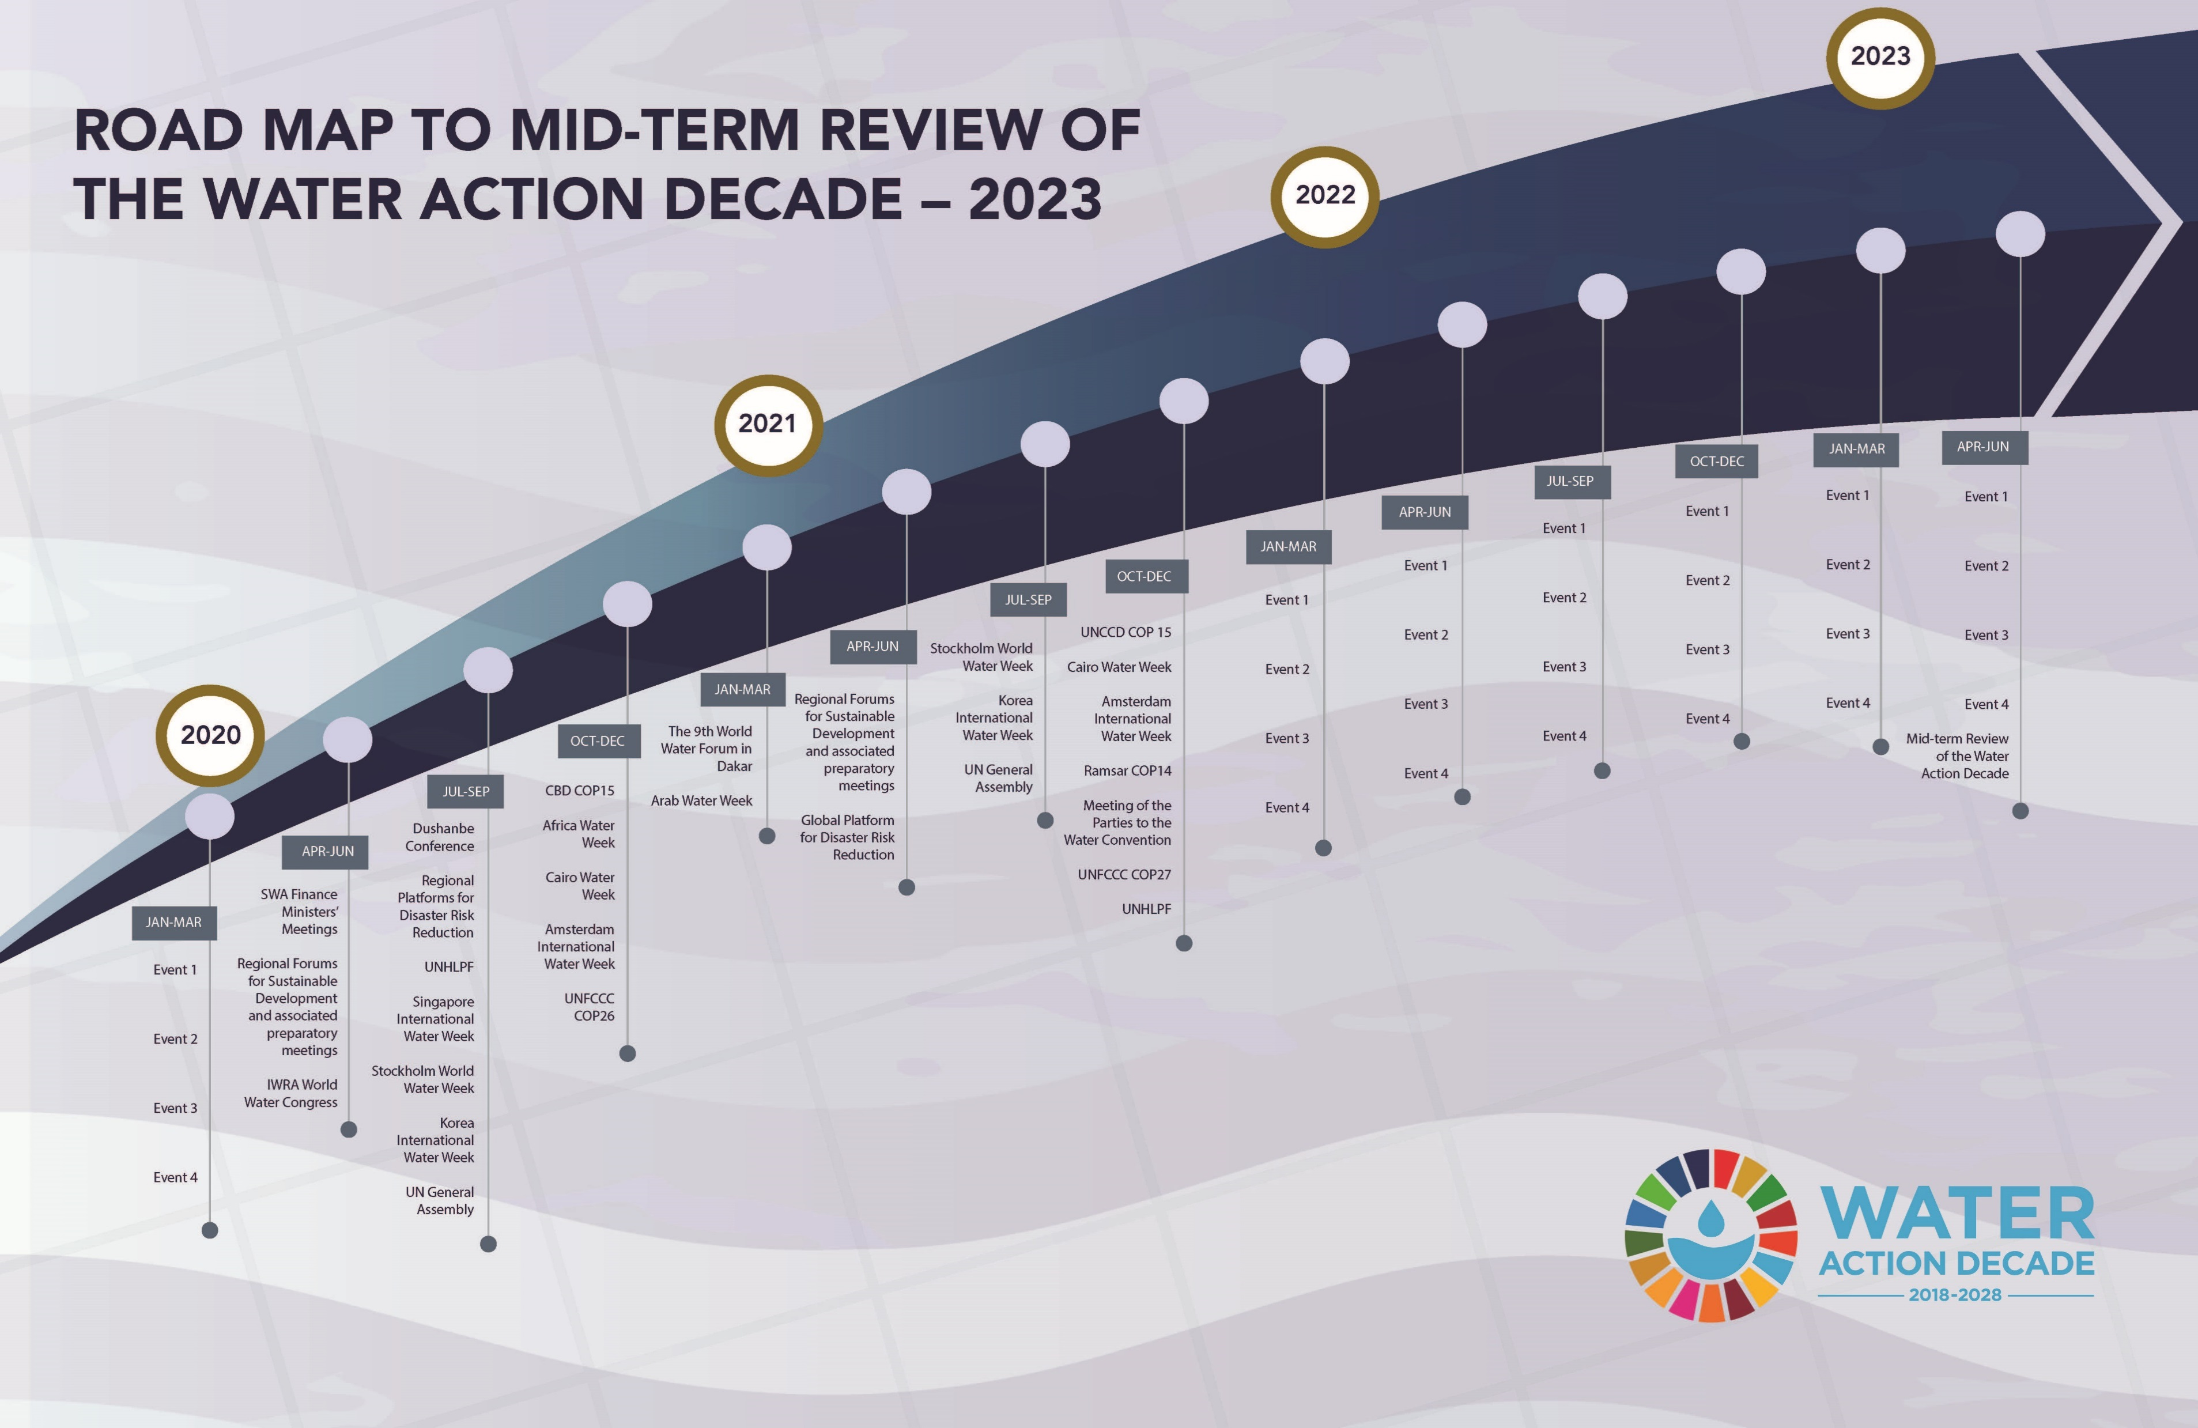
High-level Conference on the Midterm Comprehensive Review of Decade. New York; 22 -24 March 2023 – What have we achieved ?

Slide 6
THE WORLD IS NOT ON TRACK WITH SDGs
2019: Four years into “SDG era” and two years into Water Decade.
Specific SDGs are periodically reviewed. High-Level Political Forum (HLPF) reviewed progress with SDG6 in 2018. UN-Water SDG6 Synthesis Report.
UN SG annual Report 2019 – a similar concern with many SDGs
Countries are trying to accelerate and / or position themselves in the context of certain SDGs.

Slide 7

23 UNSOLVED PROBLEMS IN HYDROLOGY:
An example of a long-term program of action, or a lost opportunity ?
Initiative fits perfectly with the Water Action Decade
IAHS – active UN-Water partner
Summary of 2-years discussions published in HSJ in July 2019
“Problems” in the final set are formulated as “research questions”, not as development challenges
No explicit alignment with SDGs or implementation plans
Quo vadis?

Slide 8
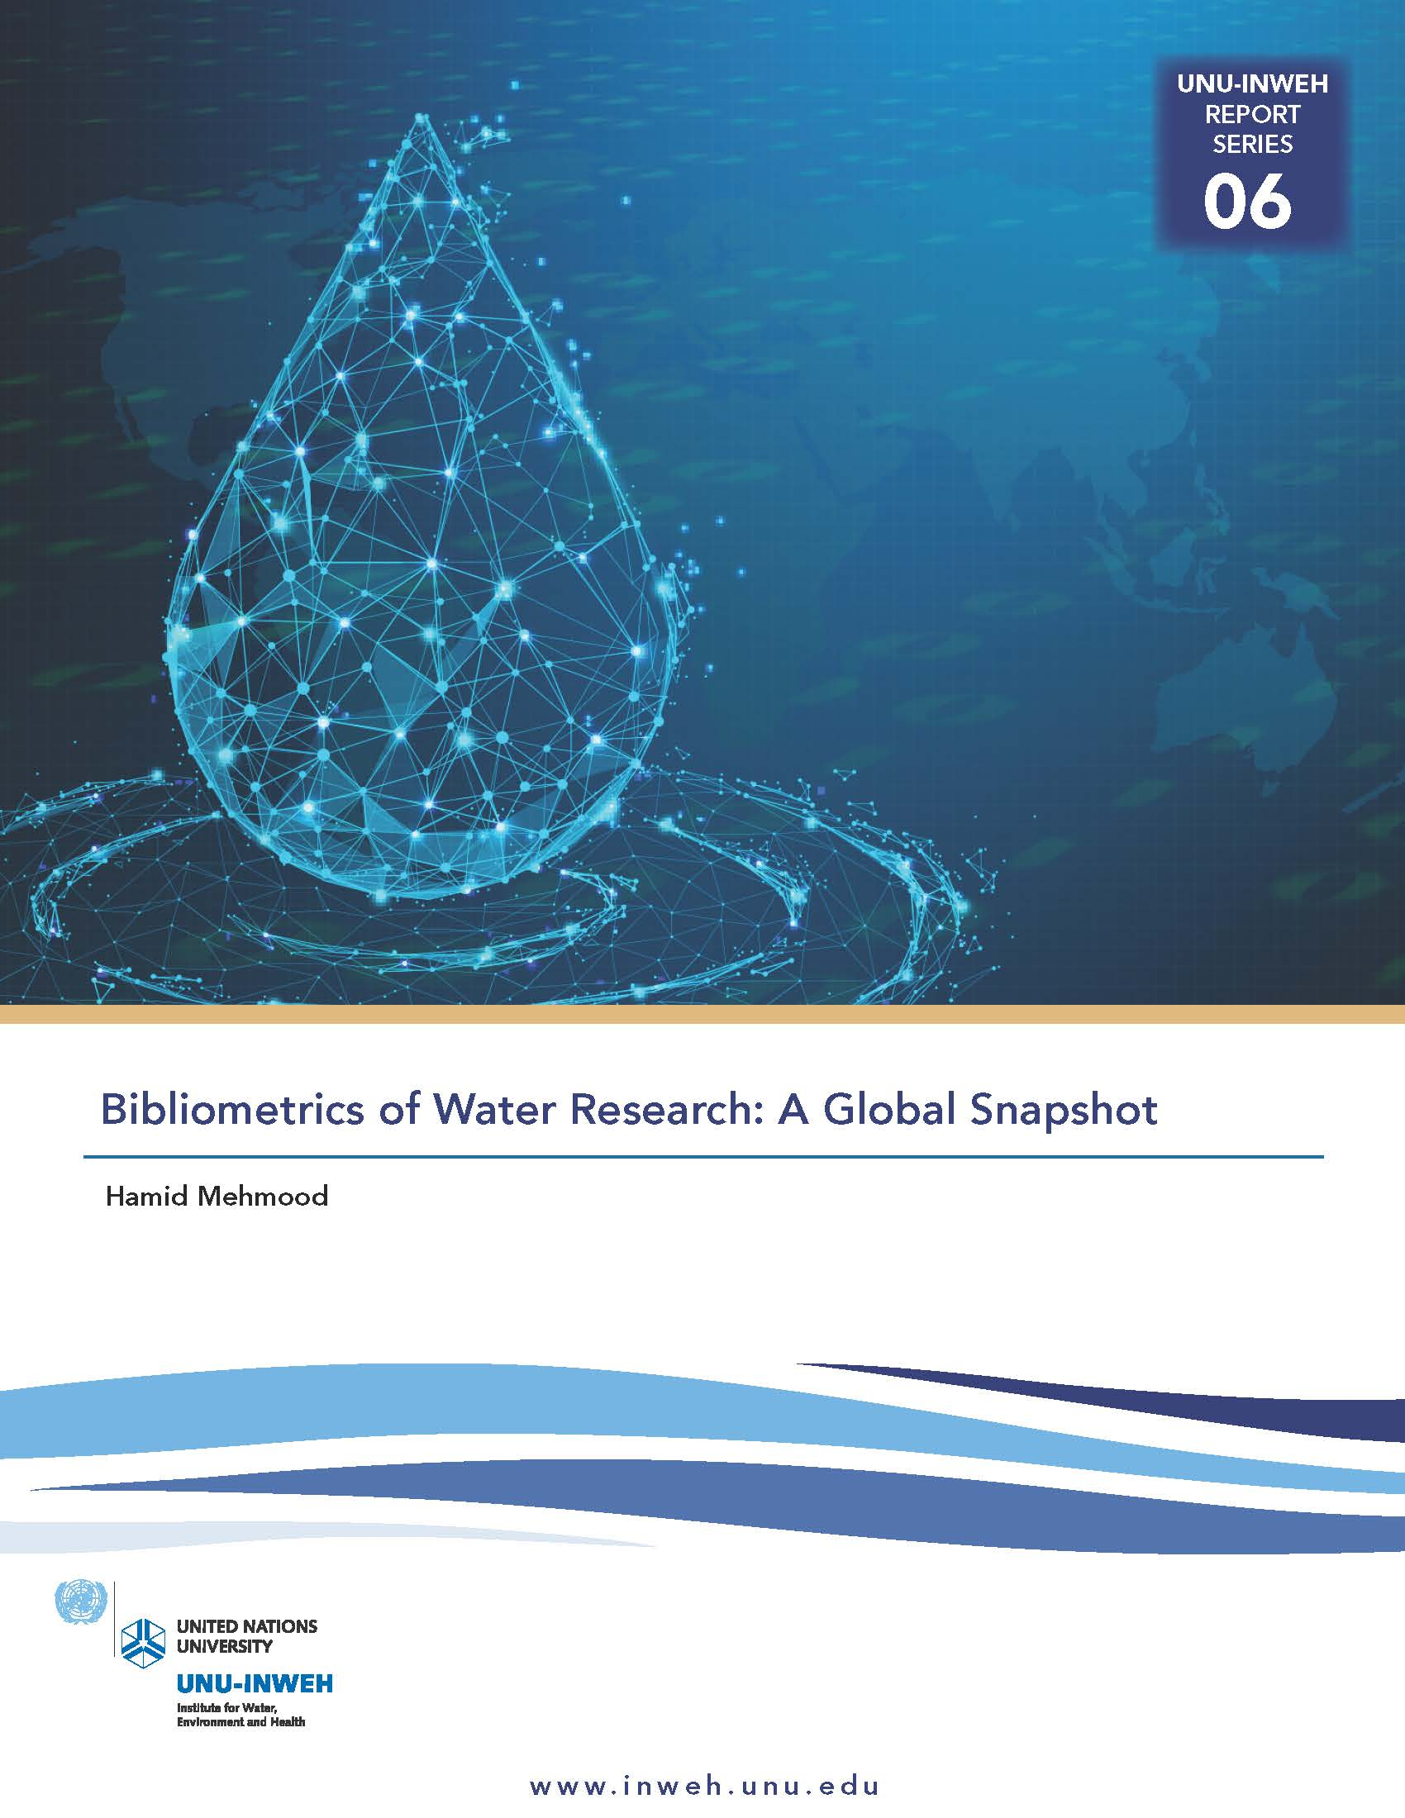

EXAMPLE CONTRIBUTIONS - CANADA
Federal Sustainable Development Strategy – supports water–related SDGs - nationally
Feminist International Assistance Policy –
  6 action areas, including Environment and Climate Action
  Canada is 13-th largest development aid provider for water sector of developing countries
Strong research capabilities and research impact
  6-th in the world by number of water-related journals published
  7-th most popular destination for foreign students to study “water”
  8-th in the world by the number of water-related publications and citations (Mehmood, 2019)

Slide 9
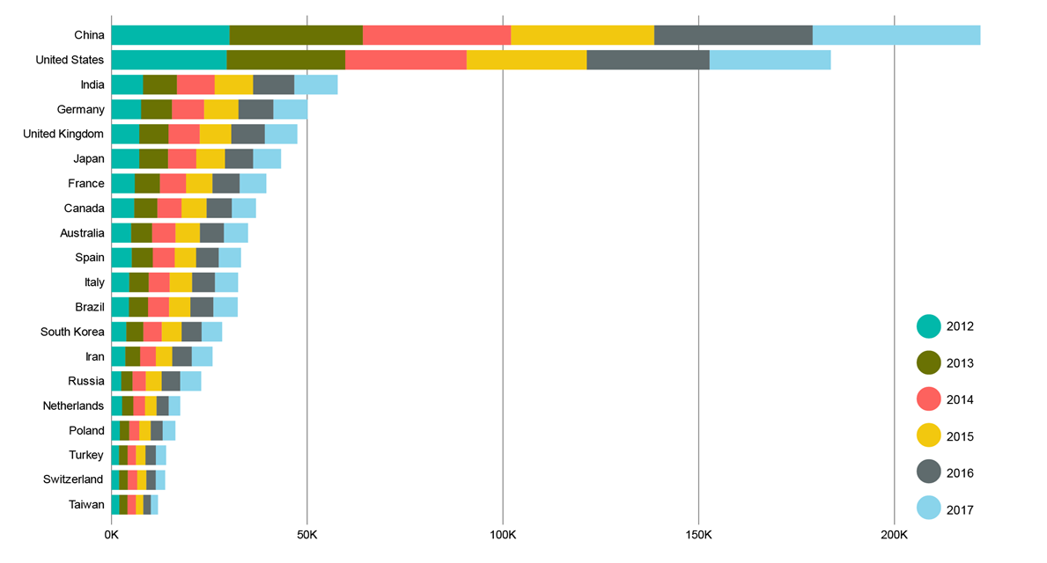
Top 20 countries by water-related publications during 2012-2017 (Mehmood, 2019)
EXAMPLE CONTRIBUTIONS - CANADA

Slide 10
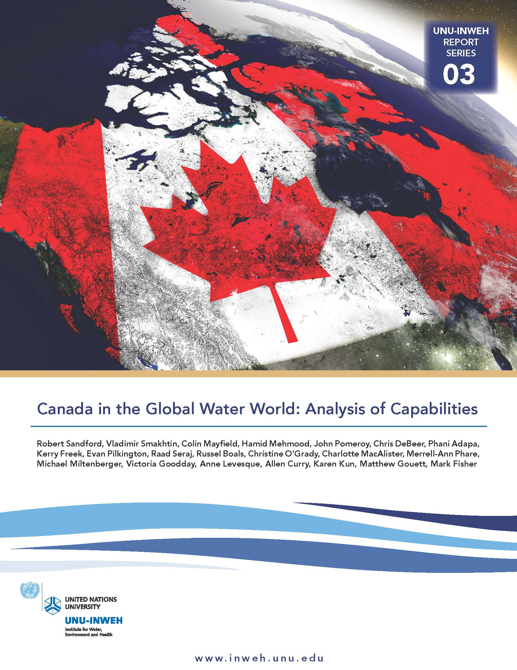
CANADA IN THE GLOBAL “WATER WORLD”
12 Organisations, 21 authors. Led by R. Sandford (UNU-INWEH)
Synthesis of the current status in terms of:
Water Education
Water Research
Overseas development support
Water governance and Institutions
Recommendations include, amongst others:
Developing national inventory of available professional capacity
Target specific developmental regional challenges to achieve quick wins with modest investments
Demonstrate how to resolve internal water problems to the world
Coordinate national contributions to global sustainability processes around GWF

Slide 11

OPPORTUNITIES FOR GWF
Demonstrate how to resolve nationally at least one chronic global water problem. Can GWF pick one?
Resolve at least one long-lasting national water problem within the time frame of the Decade. Is there a role for GWF?
Go beyond academic publications:
  Demand-driven planning; Co-development with future users / beneficiaries
  Output –> Outcome –> Impact
Establish concise connection, wherever possible, between individual GWF project outputs and SDG targets and indicators. Explain HOW a project contributes.
Build a “Canada Water” network around GWF – to speak internationally with one – Canadian – voice; at least for Water Research

Slide 12
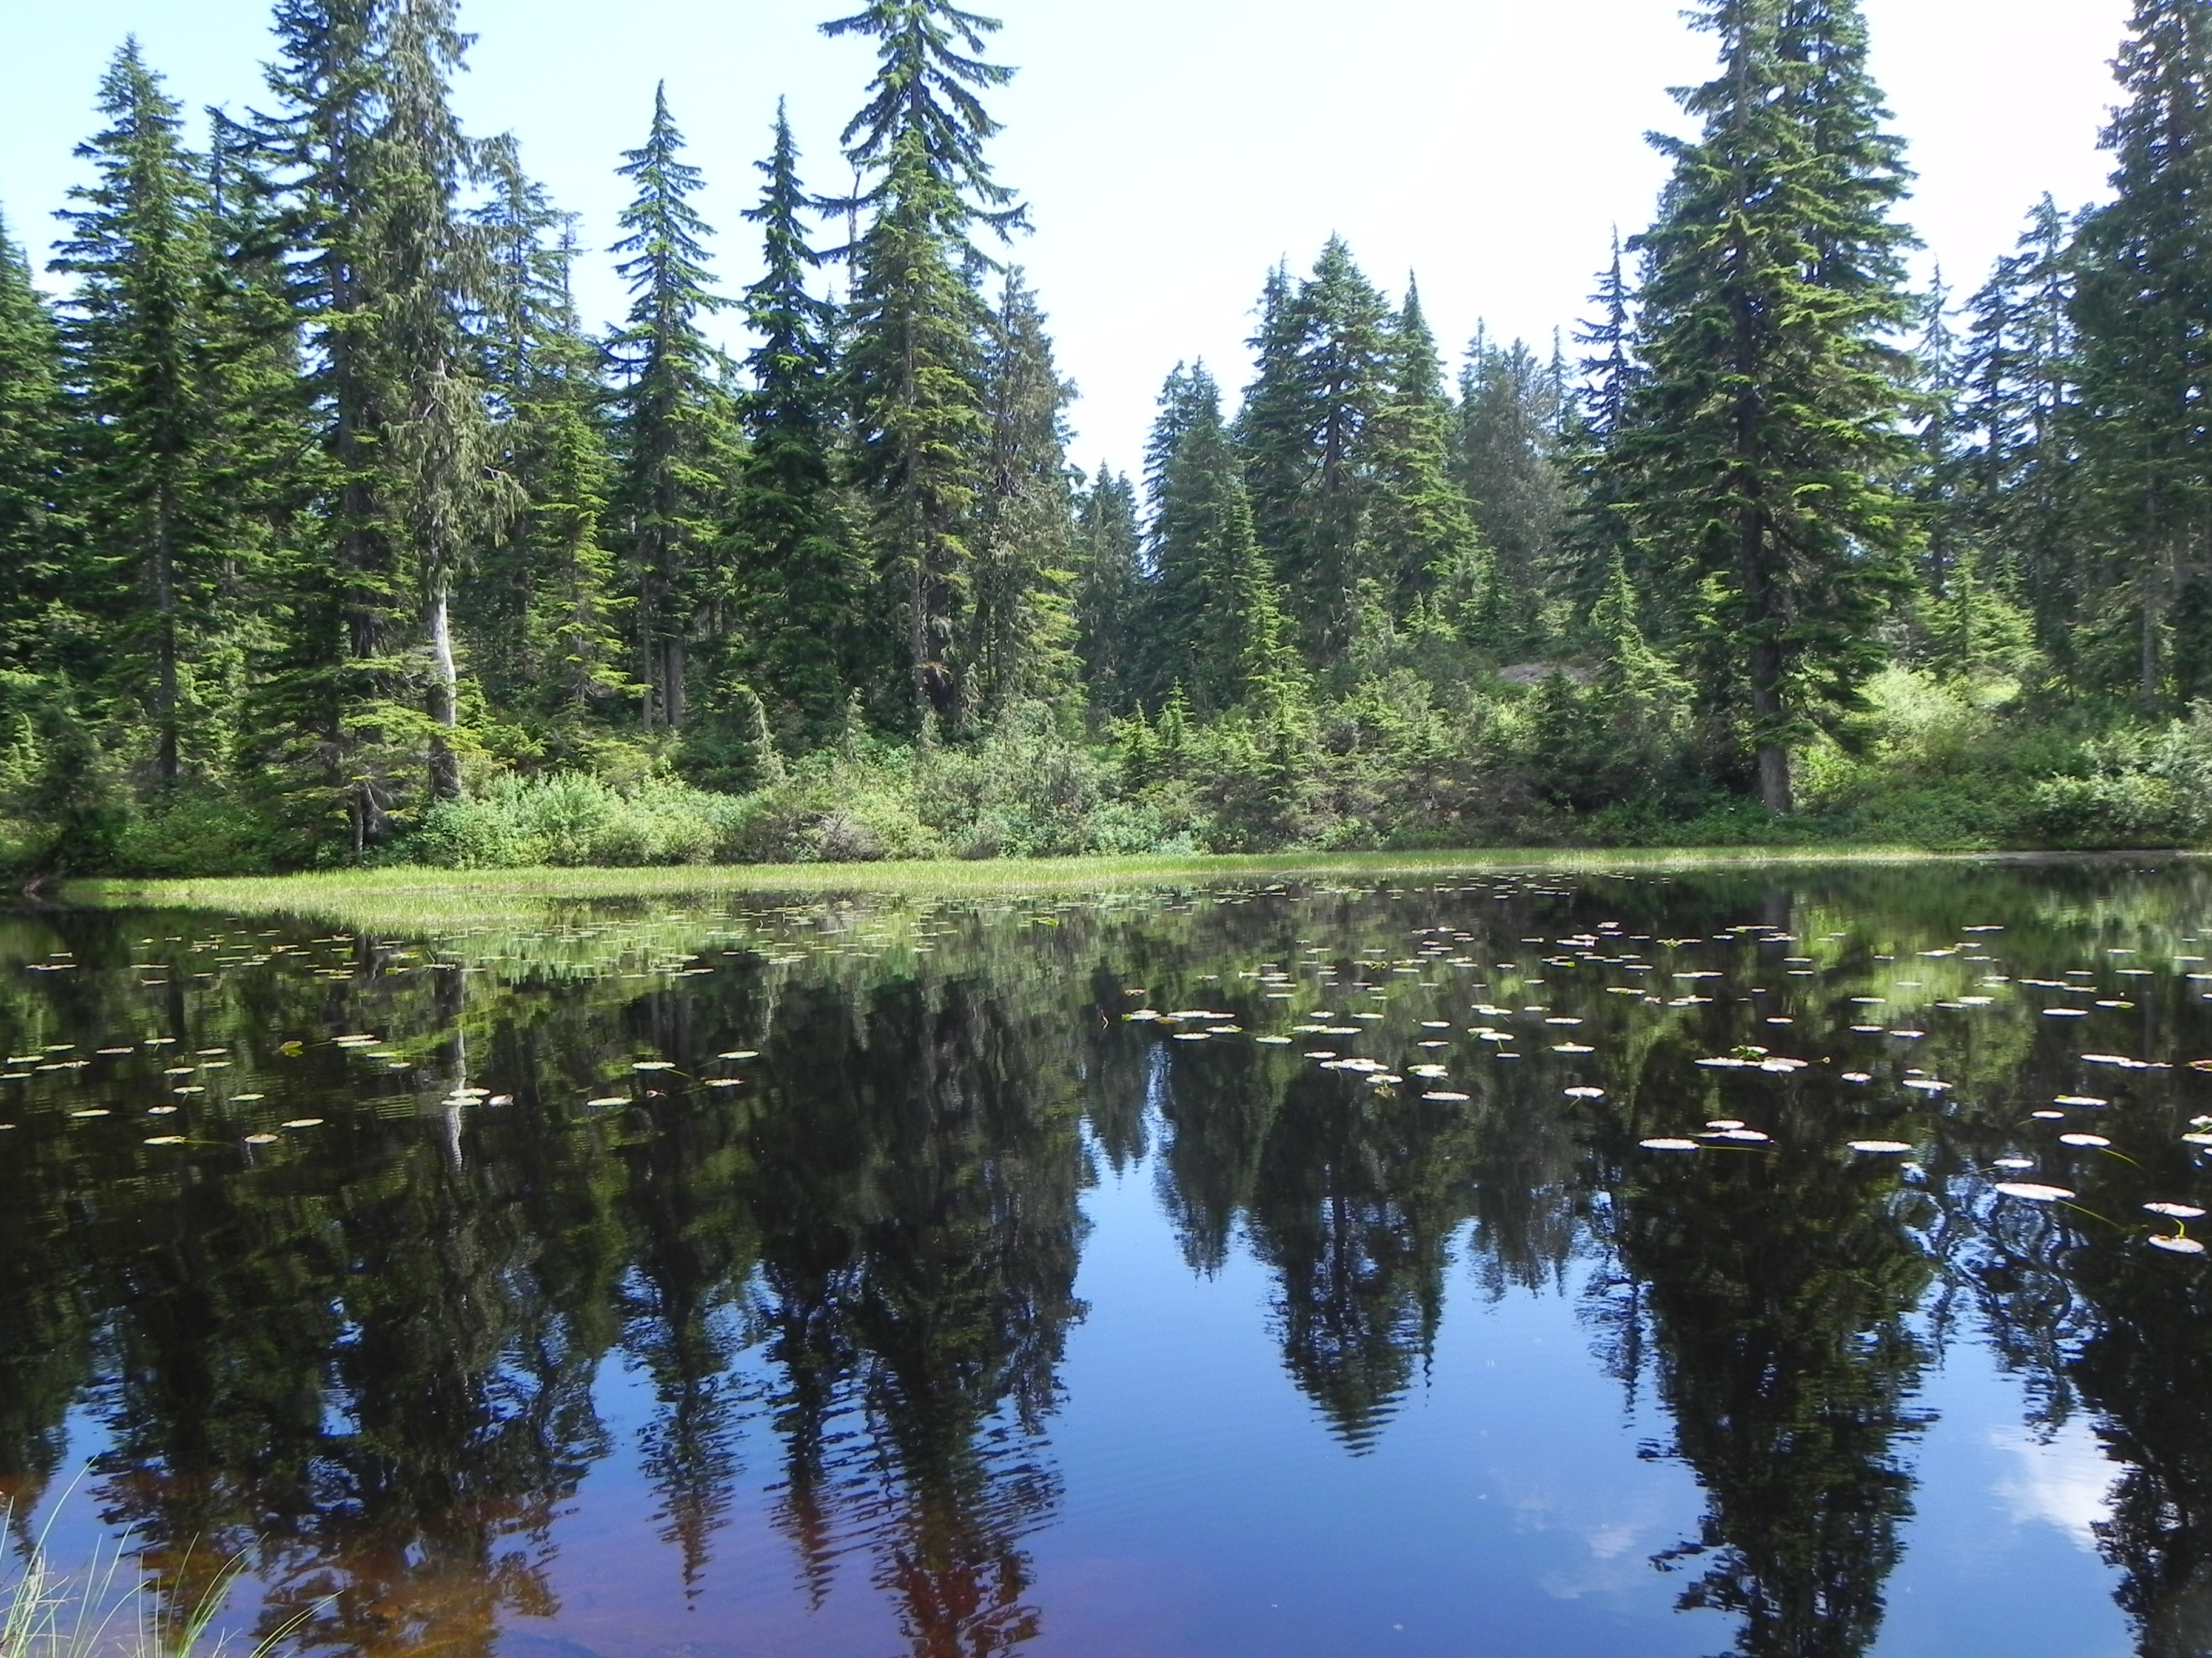
THANK YOU !

