Slide 1

Data Management Team
Advances
Global Water Futures Operations Meeting
November 19, 2019
Data Management Team
Bhaleka Persaud (UW), Gopal Saha (WLU),
Krysha Dukacz (MU), Laleh Moradi (UofS),
Michael Steeleworthy (WLU), Stephen O’Hearn (UofS)
John Pomeroy (UofS), Jimmy Lin (UW), Mike Waddington (MU)
Global Water Futures: Solutions to Water Threats in an Era of Global Change

Slide 2
Overview of Presentation
Data Management :
Objectives
Advances
GWF Data Policy update
Education and Awareness in data management
Metadata management
Data management tools
Archiving and preservation of GWF data
Next Steps
Data Management Team

Slide 3
Objectives: DM Team Responsibilities
Research Data Management
Planning
Storage
Description
Security
Data Governance
Best Practices
Formalize Data Management Roles
Data Stewardship
Protect data assets
Preserve data
Enrich data
Consultation
Education
Technology
Data Management Team

Slide 4
Objectives: FAIR Data & Metadata
Findable
Accessible
Meta(data) retrievable by DOI using standard protocol
Interoperable
(Meta)data:
Reusable
Meta(data) richly described
Protocol is free/open
references other (meta)data
Protocol can control access
Metadata are accessible
(Meta)data identifier (DOI*)
Metadata contains identifier
Data has rich Metadata
(Meta)data are part of a searchable resource
Use FAIR Vocabularies
Use formal, accessible and shared language
Clear data license
Detailed provenance
Meet domain standard
www.go-fair.org
Data Management Team
Notes:
F1. (meta)data are assigned a globally unique and persistent identifier
F2. data are described with rich metadata (defined by R1 below)
F3. metadata clearly and explicitly include the identifier of the data it describes
F4. (meta)data are registered or indexed in a searchable resource
A1. (meta)data are retrievable by their identifier using a standardized communications protocol
A1.1 the protocol is open, free, and universally implementable
A1.2 the protocol allows for an authentication and authorization procedure, where necessary
A2. metadata are accessible, even when the data are no longer available
I1. (meta)data use a formal, accessible, shared, and broadly applicable language for knowledge representation.
I2. (meta)data use vocabularies that follow FAIR principles
I3. (meta)data include qualified references to other (meta)data
R1. meta(data) are richly described with a plurality of accurate and relevant attributes
R1.1. (meta)data are released with a clear and accessible data usage license
R1.2. (meta)data are associated with detailed provenance
R1.3. (meta)data meet domain-relevant community standard
FAIR data, however, uses the term “Accessible” to mean accessible by appropriate people, at an appropriate time, in an appropriate way. This means that data can be FAIR when it is private, when it is accessible by a defined group of people, or when it is accessible by everyone (open data). It depends completely on the purpose of the data, where the data currently is in its lifecycle, and the end-usage of the data. For example, new experimental data may only be accessible by the generator and their group to start, then with consortia partners as the findings become refined, and finally with the public upon publication. Personally sensitive data may never be publicly accessible and usable. Commercially sensitive data may be held privately for stretches of time after collection and interpretation. Users are also free to use more restrictive licenses to govern how the data may be reused.
×
×Search
FAIR Principles
Implementation Networks
News
Events
Resources
About GO FAIR
FAIR Principles
Home › FAIR Principles
FAIR Principles
F1: (Meta) data are assigned globally unique and persistent identifiers
F2: Data are described with rich metadata
F3: Metadata clearly and explicitly include the identifier of the data they describe
F4: (Meta)data are registered or indexed in a searchable resource
A1: (Meta)data are retrievable by their identifier using a standardised communication protocol
A1.1: The protocol is open, free and universally implementable
A1.2: The protocol allows for an authentication and authorisation where necessary
A2: Metadata should be accessible even when the data is no longer available
I1: (Meta)data use a formal, accessible, shared, and broadly applicable language for knowledge representation
I2: (Meta)data use vocabularies that follow the FAIR principles
I3: (Meta)data include qualified references to other (meta)data
R1: (Meta)data are richly described with a plurality of accurate and relevant attributes
R1.1: (Meta)data are released with a clear and accessible data usage license
R1.2: (Meta)data are associated with detailed provenance
R1.3: (Meta)data meet domain-relevant community standards
FAIRification Process
In 2016, the ‘FAIR Guiding Principles for scientific data management and stewardship’ were published in Scientific Data. The authors intended to provide guidelines to improve the findability, accessibility, interoperability, and reuse of digital assets. The principles emphasise machine-actionability (i.e., the capacity of computational systems to find, access, interoperate, and reuse data with none or minimal human intervention) because humans increasingly rely on computational support to deal with data as a result of the increase in volume, complexity, and creation speed of data.
Findable
The first step in (re)using data is to find them. Metadata and data should be easy to find for both humans and computers. Machine-readable metadata are essential for automatic discovery of datasets and services, so this is an essential component of the FAIRification process.
F1. (Meta)data are assigned a globally unique and persistent identifier
F2. Data are described with rich metadata (defined by R1 below)
F3. Metadata clearly and explicitly include the identifier of the data they describe
F4. (Meta)data are registered or indexed in a searchable resource
Accessible
Once the user finds the required data, she/he needs to know how can they be accessed, possibly including authentication and authorisation.
A1. (Meta)data are retrievable by their identifier using a standardised communications protocol
A1.1 The protocol is open, free, and universally implementable
A1.2 The protocol allows for an authentication and authorisation procedure, where necessary
A2. Metadata are accessible, even when the data are no longer available
Interoperable
The data usually need to be integrated with other data. In addition, the data need to interoperate with applications or workflows for analysis, storage, and processing.
I1. (Meta)data use a formal, accessible, shared, and broadly applicable language for knowledge representation.
I2. (Meta)data use vocabularies that follow FAIR principles
I3. (Meta)data include qualified references to other (meta)data
Reusable
The ultimate goal of FAIR is to optimise the reuse of data. To achieve this, metadata and data should be well-described so that they can be replicated and/or combined in different settings.
R1. Meta(data) are richly described with a plurality of accurate and relevant attributes
R1.1. (Meta)data are released with a clear and accessible data usage license
R1.2. (Meta)data are associated with detailed provenance
R1.3. (Meta)data meet domain-relevant community standards
The principles refer to three types of entities: data (or any digital object), metadata (information about that digital object), and infrastructure. For instance, principle F4 defines that both metadata and data are registered or indexed in a searchable resource (the infrastructure component).
Except where otherwise noted, content on this website is licensed under a Creative Commons Attribution 4.0 License by GO FAIR
Contact
Imprint
Legal notice

Slide 5
Advances: Data Policy Amendment
Policy Changes
Embargo periods
Policy Clarifications
Definitions
Active-phase DM and Storage
Data Handling
Archiving/Discovery/Access
Roles of DM Team and Researchers within GWF
DM Service List, Appendix C
The new Data Policy outlines the role of the DM team in assisting researchers with DM
Handling sensitive datasets
Data Management Team

Slide 6
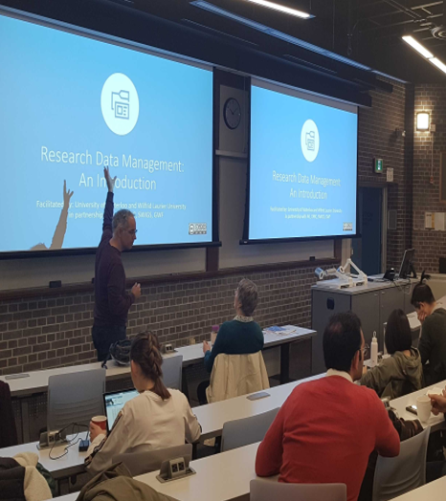
Advances: Professional Development
Workshops & Seminars
Individual Consultation
Posters and Documentation
Data Management Team
Notes:
Goal: Development of professional development materials & programming for DM​
Individual and joint workshops based on common principles:​
Storage and Transmission​
DM Planning, Collection​
Metadata control and sharing​
Posters produced for GWF ASMs and AGU 2019​
New: Coordinated PD Program​
Ongoing webinar series​
Factsheets​
Potential for online training modules​
Continuing:​
Team-based, HQP, and Ops outreach​
Integration into Canadian DM environment​
To date, the DM Team has given many workshops and presentations to GWF programs, research teams, and HQP. These sessions are usually based on common principles but located at the individual partner universities. Some in-person collaboration for workshops has occurred between Laurier, Waterloo, and McMaster given the geographic clustering of the universities, but there was still a gap to be filled in terms of broad-based coordinated outreach to all partners. ​
​
The DM team is now developing an online series of professional development and training sessions and tools. Our first was just last week, where a very good introduction to DM, Metadata and Data Policy was given to over 50 participants. The webinars will be run live and archived for future use. Our topics are a blend of topics the DM team wants to cover as we as concepts we are crowdsourcing from HQP. Such as DM planning, creating control files (aka readme files), version control, metadata and archiving, ethics, etc. Of particular note is these tools are not being developed in a vacuum. The DM Team has a strong connection to DM Partners such as Portage, Compute, and RDC, and our goals and material are often aligned with their work.​

Slide 7
Advances: Outreach Topics
Data Mgt plans
Archiving data
GWF Platforms
Data Cleaning
Data Policy in-Depth
GWF Metadata Tools
Data Management Team
Notes:
New DM Professional Development Series
Webinars, 1-page fact sheets, Workshops Webinar Series

Slide 8
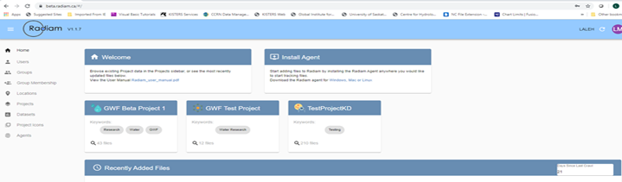
Advances: Metadata Management
Common metadata collection template
GWF Metadata Portal/Index/Catalogue
GeoNetwork now in Pilot
Harvests metadata for search, discovery, linking out
Radiam
Active-phase research data management, in development
CANARIE grant, Go-Live in spring 2020
GWFNet
Data Management Team
Notes:
New DM Professional Development Series
Webinars, 1-page fact sheets, Workshops Webinar Series

Slide 9
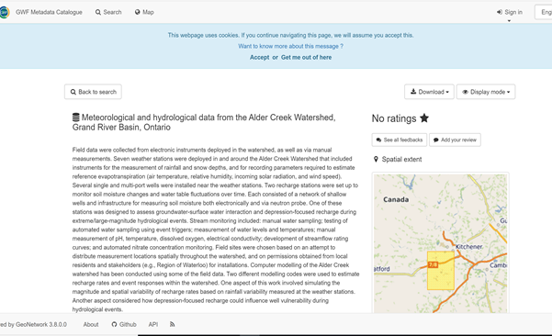
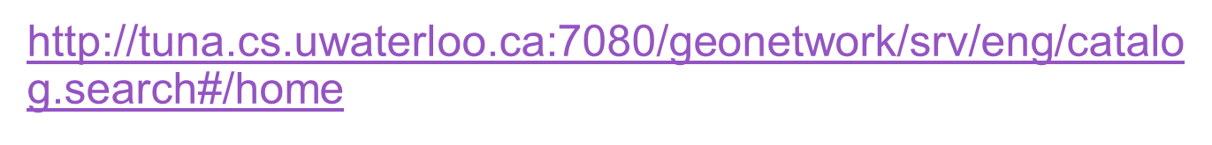
Advances: GWF Metadata Catalogue
    The GWF Metadata Catalogue (In Test):
    Built using GeoNetwork open source
    Employs the ISO 19115 metadata standard
    Allows text and spatial search
    Test instance: UW servers
    Development instance: Will likely use Compute Canada
Data Management Team

Slide 10
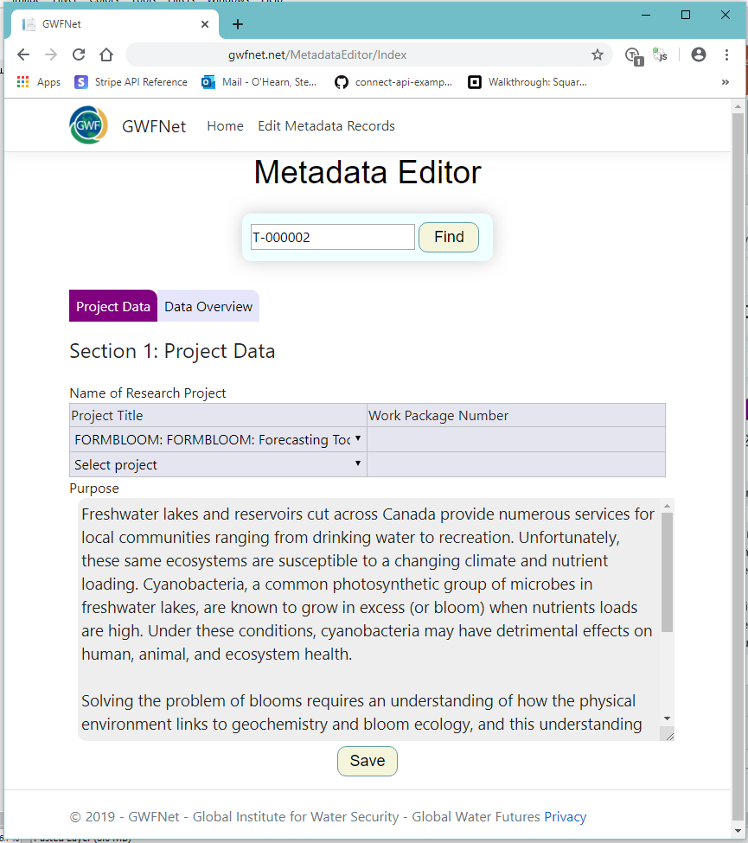
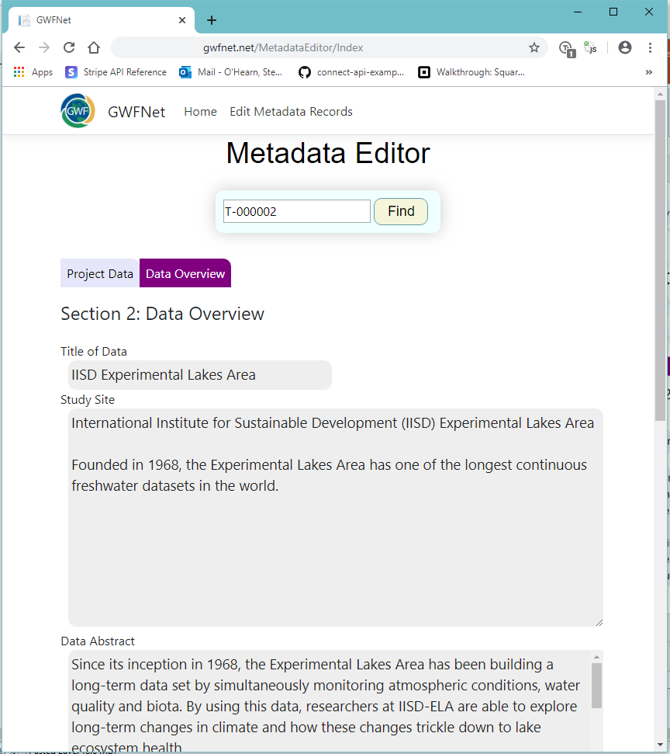
Advances: Metadata Schema & Standards
    Team aligned on DM Best Practices in the development of the GWF Template which is:
    Based on the ISO 19115 metadata standard already in used in many GWF-related research domains
    Interoperable with other standards (e.g., DDI, DataCite, DC) and data archives
    Expandable to many fields within and outside of GWF
Data Management Team

Slide 11
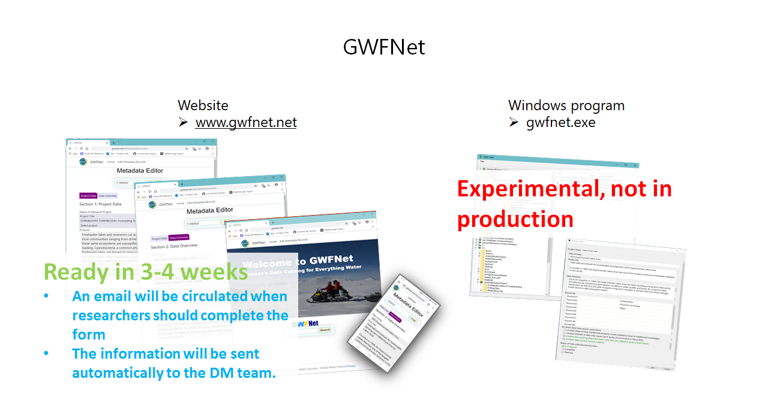
Advances: GWFNet
Data Management Team

Slide 12
Advances: Tools Supporting Data Management
WISKI
Cuizinart
Compute Canada (Graham Supercomputer)
DM websites
Data Management Team

Slide 13
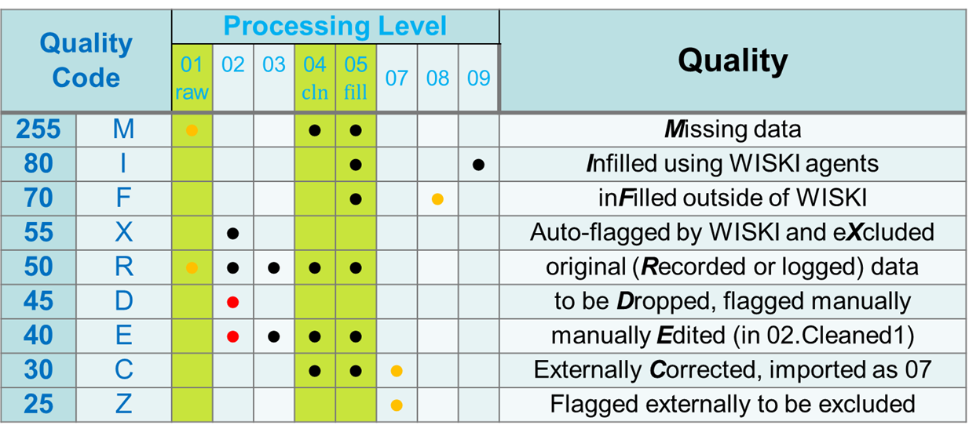
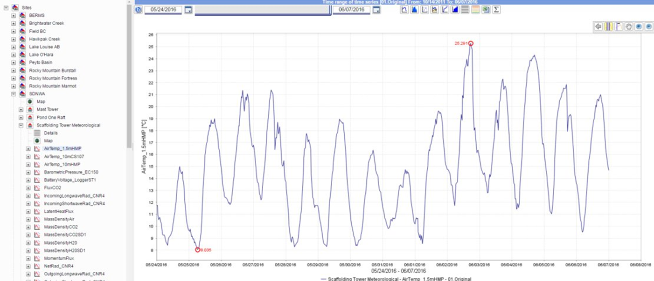
Advances: WISKI Advantages
Searchable database, customizable exports with R, Python, and MATLAB scripts
Visualization through Web Client
Preliminary cleaning of data
Tracks data quality with codes
If cleaning & filling externally, compare with original & assign codes
WISKI | Cuizinart | Compute Canada | DM websites
Data Management Team

Slide 14
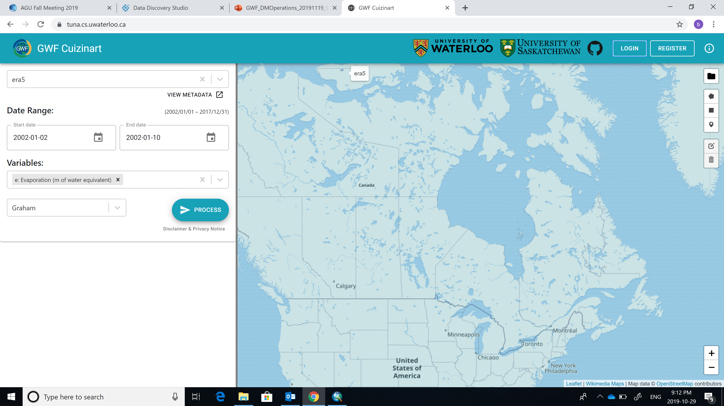
Advances: Cuizinart Subsetting Tool
Cloud-based platform
Interactive portal for researchers to "slice and dice" large NetCDF datasets
Easy-to-use interface to select:
Products
Variables of interest
Time period of interest
Geographical bounds ( via uploading your own shape file or select domain)
Receive download link of custom dataset
Webpage: http://www.cuizinart.io/
Email: gwf.cuizinart@uwaterloo.ca
WISKI | Cuizinart | Compute Canada | DM websites
Data Management Team

Slide 15
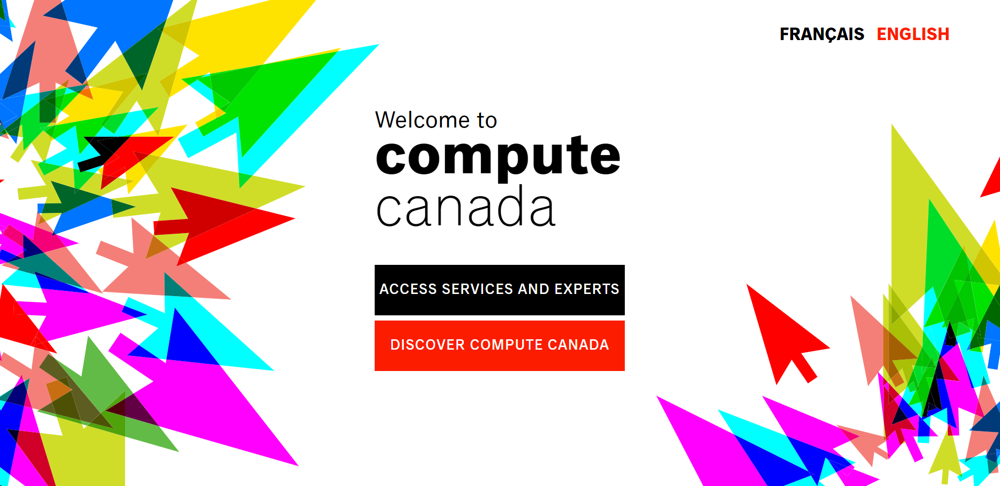
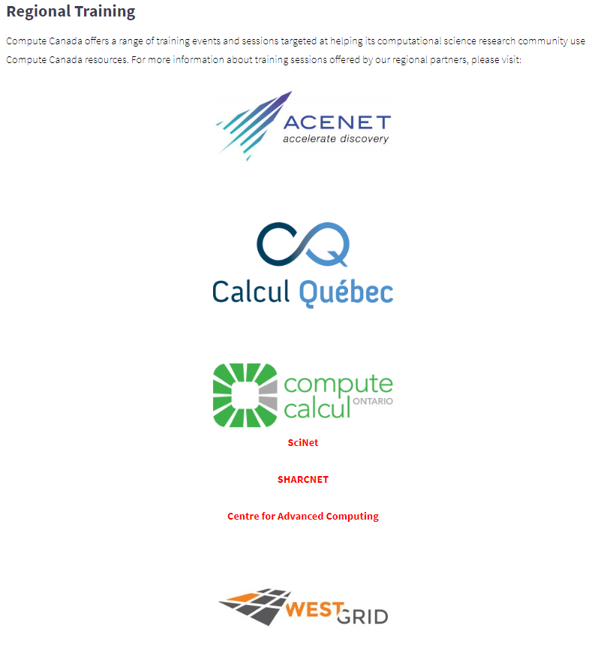
Advances: Compute Canada Accessibility
Research Platform and Portal (RPP) allocation for storage and computing purposes
Next round of RAC competition for 2020 to 2023
Using Globus to transfer data between two endpoints
6000 core year of computing and 2.5 PT of Storage is current capacity
Cloud Resources
WISKI | Cuizinart | Compute Canada | DM websites
Data Management Team

Slide 16
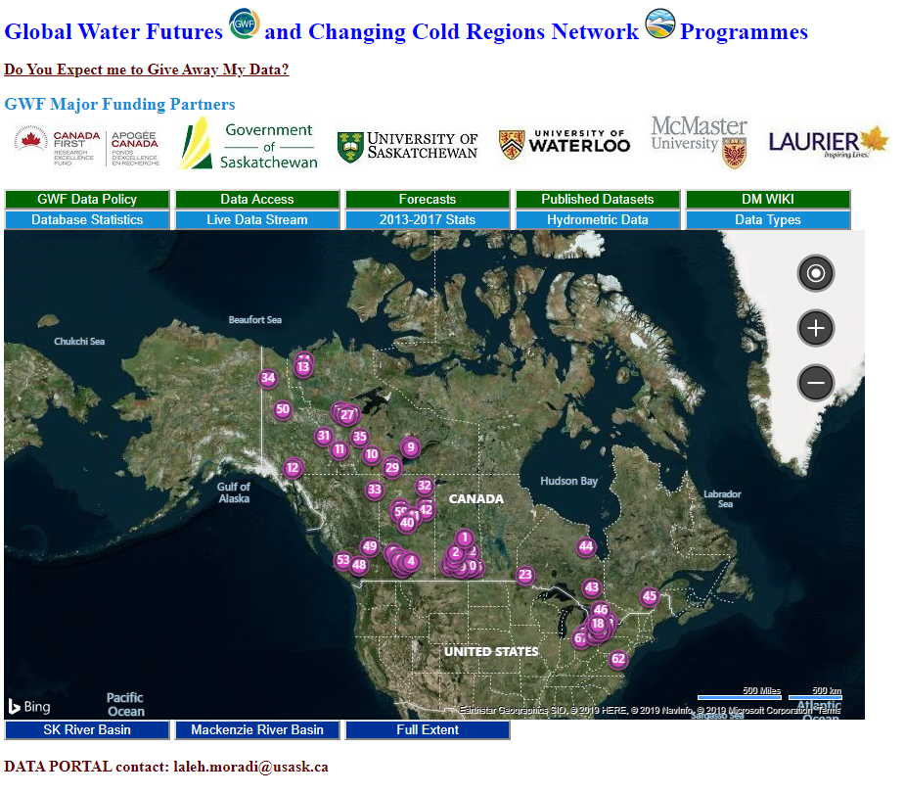
Advances: Data Portal (http://giws.usask.ca/meta)
WISKI | Cuizinart | Compute Canada | DM websites
Data Management Team

Slide 17
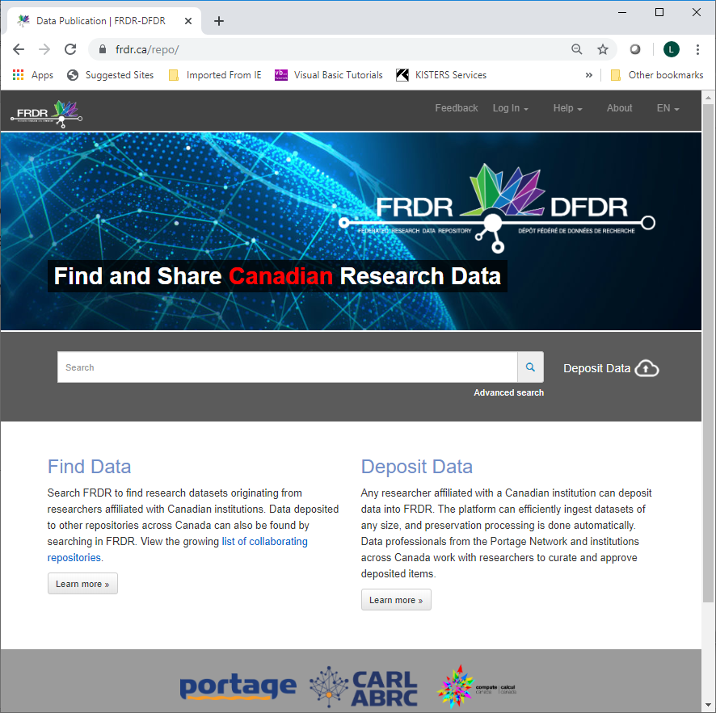
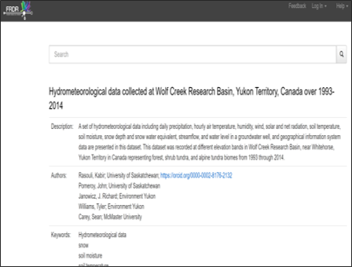
Advances: Archiving and Preservation
GWF Data Policy now lists several options for researchers to archive and catalogue their data in a variety of secure cloud based repositories
  e.g., FRDR, Dataverse, PDC, FLUXNET, etc.
Researchers are encouraged to work with the DM Team when archiving
  To ensure data meets GWF Policy & FAIR archiving practices
  To ensure data is adequately catalogued and is searchable
  DM team will help researchers register their data with the Federated Research Data Repository (www.frdr.ca) for DOI.
Data Management Team

Slide 18
Next Steps: DM Team-Researcher Collaboration
A metadata webform will be circulated to GWF HQPs PIs are encouraged to ensure their HQPs complete and submit the form
Ensure project team contributes to the Observatory Metadata Inventory through completion of forms distributed by the DM team
Make use of the data management resources and support available via GWF programme
Please let us know if projects HQP have specific DM training needs
Engaged your institution's data managers – we are here to help!
Data Management Team

Slide 19
Next Steps: DM Team
Build the GWF Observatory metadata inventory to catalogue all data being captured through GWF initiatives
Continue to build tools for metadata creation
Continue to support projects through updates to the data portal, improving WIKI resources and through education
Data Management Team

Slide 20
Thank You
Questions?
http://giws.usask.ca/reports/
http://giws.usask.ca/cfh/telemetry/
http://giws.usask.ca/telemetry/
http://giws.usask.ca/meta/
https://gwf.usask.ca/ Under Resources tab.
http://www.cuizinart.io/
http://tuna.cs.uwaterloo.ca:7080/geonetwork/srv/eng/catalog.search#/home
https://www.polardata.ca/
Global Water Futures: Solutions to Water Threats in an Era of Global Change
Notes:
Thank you for your attention. We look forward to hearing from you at the discussion sessions. There is time for questions.

